Slide 1
IT 334 Computer Networks Lab

Slide 2
List of Exercises / Experiments
INTERNETWORKING BASICS
1. Familiarization of Internetworking - Network Cables- Colour coding - Crimping. Internetworking Operating Systems- Configurations.
IP ROUTING
2. Implementing static routing.
3. Implementing dynamic routing using RIP.
4. Implementing dynamic routing using OSPF.
5. Implementing dynamic routing using EIGRP.

Slide 3
List of Exercises / Experiments
SWITCHING SERVICES --VIRTUAL LANS
6. Layer 2 Switching configuration -VLAN configuration.
7. VTP Configuration, VTP pruning.
8. Implement inter-VLAN routing.
SECURITY
9. Access Control List
a. Standard Access Lists. b. Extended Access Lists.
MANAGING A INTERNETWORK
10. Backup and restoring IOS.
11. Familiarization of network simulators.

Slide 4
Lab Experiments
Group-wise (5 members per group)
Hardware lab (Network Security Lab)
Group wise evaluation
Design - random group member (10)
Viva – random group member (10)
Continuous evaluation (5 + 5)
Simulation (Software Testing Lab)
Design (10)
Viva (10)
Continuous evaluation (5 + 5)

Slide 5
List of Exercises / Experiments
Class Project
i. Implementation of an organizations network with security using any routing protocols.
ii. Implementation of network using VLAN and configure inter-vlan communication

Slide 6
Group Leaders (Roll Numbers)
14 26 45 17
19 49 62 12 9
29 15 20 44
36 27 6 5
18

Slide 7
Class Project
Maximum 3 members per group
Problem statement submission -- 14/2/2019
Network Design – 14/3/2019
Project Submission -- 12/4/2019
Report Submission - 16/4/2019

Slide 8
network simulator

Slide 9
Project
Study of any network simulator
Any simple network simulation
E.g. NS3, Omnet

Slide 10
Network Simulator Project
Maximum 6 members per group
Problem statement submission -- 28/2/2019
Network Design – 28/3/2019
Project Submission -- 12/4/2019
Report Submission - 16/4/2019

Slide 11
Exams (100)
Two lab exams
Group (25)
Individual (25)
Continuous Evaluation (25)
Project
Class project (15)
Network Simulator (10)

Slide 12
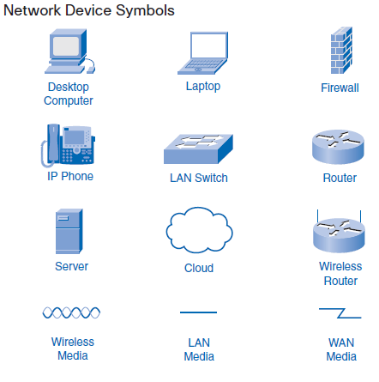

Slide 13
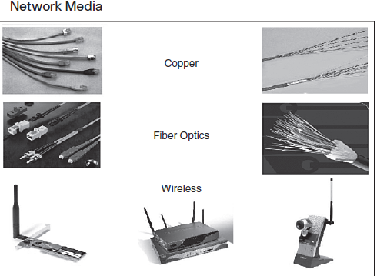

Slide 14
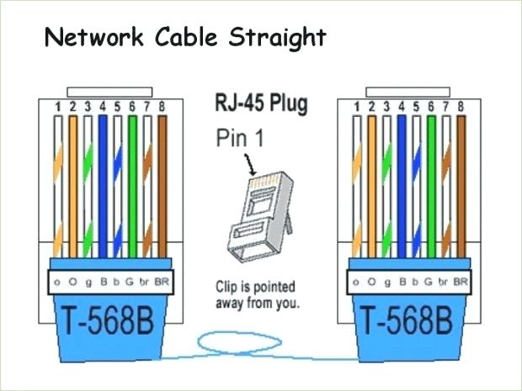

Slide 15
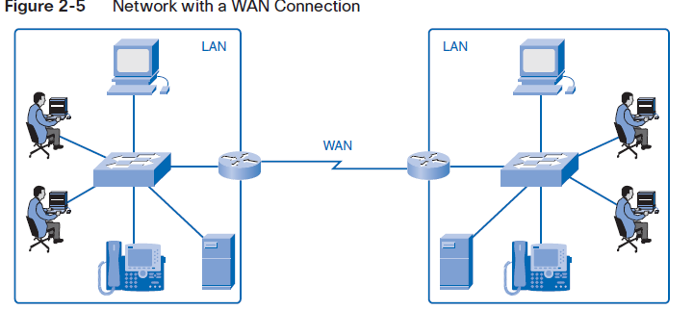

Slide 16
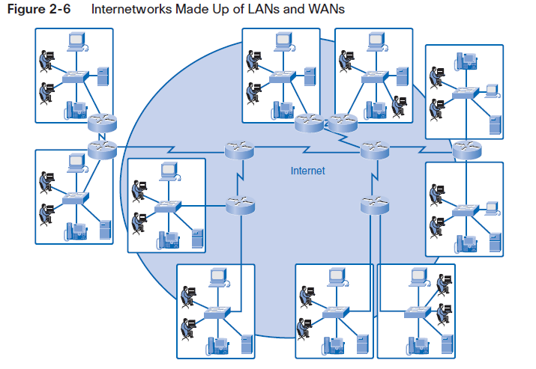

Slide 17
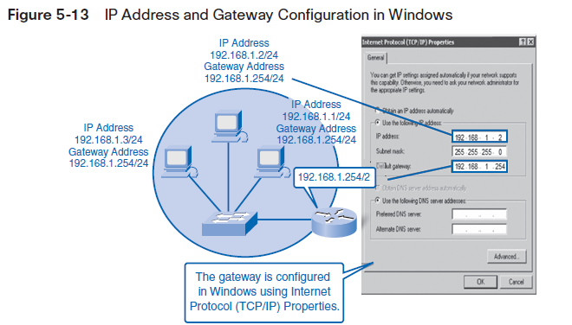

Slide 18
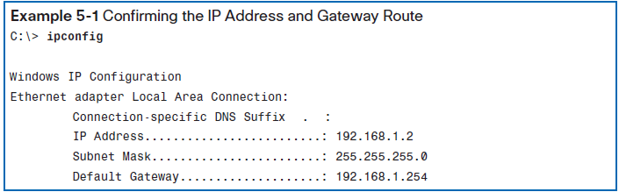

Slide 19
Hub
Physical Layer device
Muti-port repeater
Repeater receives digital signal, reamplifies or regenerates that signal, then forwards the signal out the other port without looking at any data
Host connected to each hub are in the same collision domain
Hub has same broadcast domain

Slide 20
Collision Domain
One device sends a frame out on a physical network segment forcing every other device on the same segment to pay attention to it.
If two devices on a single physical segment transmit simultaneously , it will cause a collision and requires these devices to retransmit.

Slide 21
Switch
Data link layer device
Each port of a switch is a single collision domain
More bandwidth
One broadcast domain

Slide 22
Broadcast Domain
Group of devices on a specific network segment that hear all the broadcasts sent out on that specific network segment

Slide 23
Ethernet Cabling
Straight through cable
Host to switch or hub
Router to switch or hub
Cross over cable
Switch to switch/ hub to hub/ host to host
router to router
Rolled cable
Console serial communication

Slide 24
SUBNETTING

Slide 25
Octets
The 32-bit IP address is broken up into 4 octets, which are arranged into a dotted-decimal notation scheme.
An octet is a set of 8 bits
Example of an IP version 4:
172.64.126.52

Slide 26
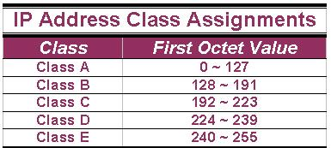
IP Address Classes (Cont.)
The 5 IP classes are split up based on the value in the 1st octet:

Slide 27
The 32 bits of the IP address are divided into Network & Host portions, with the octets assigned as a part of one or the other.
Network & Host Representation
By IP Address Class
Class
Octet1
Octet2
Octet3
Octet4
Class A
Network
Host
Host
Host
Class B
Network
Network
Host
Host
Class C
Network
Network
Network
Host

Slide 28
Each Network is assigned a network address & every device or interface (such as a router port) on the network is assigned a host address.

Slide 29
The all-1s and all-0s host addresses are invalid (Always)
Ex.
IP Address: 192.168.1.0
Subnet Mask: 255.255.255.0
OR
IP Address: 192.168.1.255
Subnet Mask: 255.255.255.0

Slide 30
Reason Behind the Rule
The all zeros host address is the same as the network ID
Ex. IP: 192.168.1.0
Subnet: 255.255.255.0
----------------------------------------
Network ID: 192.168.1.0
The all ones host address is reserved for the broadcast address

Slide 31
Class A Addresses
Class A IP addresses use the 1st 8 bits (1st Octet) to designate the Network address.
The 1st bit which is always a 0, is used to indicate the address as a Class A address & the remaining 7 bits are used to designate the Network.
The other 3 octets contain the Host address.

Slide 32
Class A Addresses (Cont.)
There are 128 Class A Network Addresses, but because addresses with all zeros aren’t used & address 127 is a special purpose address, 126 Class A Networks are available.

Slide 33
Class A Addresses (Cont.)
There are 16,777,214 Host addresses available in a Class A address.
Rather than remembering this number exactly, you can use the following formula to compute the number of hosts available in any of the class addresses, where “^{n}” represents the number of bits in the host portion:
(2^{n} – 2) = Number of available hosts

Slide 34
Class A Addresses (Cont.)
For a Class A network, there are:
2²⁴ – 2 or 16,777,214 hosts.
Half of all IP addresses are Class A addresses.
You can use the same formula to determine the number of Networks in an address class.
Eg., a Class A address uses 7 bits to designate the network, so (2⁷ – 2) = 126 or there can be 126 Class A Networks.

Slide 35
Class B IP Addresses
Class B addresses use the 1st 16 bits (two octets) for the Network address.
The last 2 octets are used for the Host address.
The 1st 2 bit, which are always 10, designate the address as a Class B address & 14 bits are used to designate the Network. This leaves 16 bits (two octets) to designate the Hosts.

Slide 36
Class B IP Addresses (Cont.)
So how many Class B Networks can there be?
Using our formula, (2¹⁴ – 2), there can be 16,382 Class B Networks & each Network can have (2¹⁶ – 2) Hosts, or 65,534 Hosts.

Slide 37
Class C IP Addresses
Class C addresses use the 1st 24 bits (three octets) for the Network address & only the last octet for Host addresses.the 1st 3 bits of all class C addresses are set to 110, leaving 21 bits for the Network address, which means there can be 2,097,150 (2²¹ – 2) Class C Networks, but only 254 (2⁸ – 2) Hosts per Network.

Slide 38
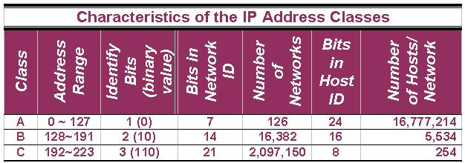
Class C IP Addresses (Cont.)

Slide 39
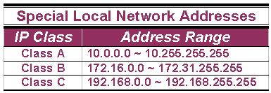
A list of these addresses for each IP address class:

Slide 40
Subnet Mask
An IP address has 2 parts:
The Network identification.
The Host identification.
Frequently, the Network & Host portions of the address need to be separately extracted.
In most cases, if you know the address class, it’s easy to separate the 2 portions.

Slide 41
Subnet Mask (Cont.)
The subnet masking process was developed to identify & extract the Network part of the address.
A subnet mask, which contains a binary bit pattern of ones & zeros, is applied to an address to determine whether the address is on the local Network.
If it is not, the process of routing it to an outside network begins.

Slide 42
Subnet Mask (Cont.)
The function of a subnet mask is to determine whether an IP address exists on the local network or whether it must be routed outside the local network.
It is applied to a message’s destination address to extract the network address.
If the extracted network address matches the local network ID, the destination is located on the local network.

Slide 43
Subnet Mask (Cont.)
However, if they don’t match, the message must be routed outside the local network.
The process used to apply the subnet mask involves Boolean Algebra to filter out non-matching bits to identify the network address.

Slide 44
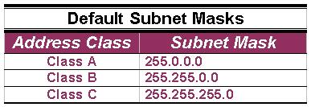
Default Standard Subnet Masks
There are default standard subnet masks for Class A, B and C addresses:

Slide 45
The subnet mask goes like this:
If a destination IP address is 206.175.162.21, we know that it is a Class C address & that its binary equivalent is: 11001110.10101111.10100010.00010101

Slide 46
We also know that the default standard Class C subnet mask is: 255.255.255.0 and that its binary equivalent is:
11111111.11111111.11111111.00000000

Slide 47
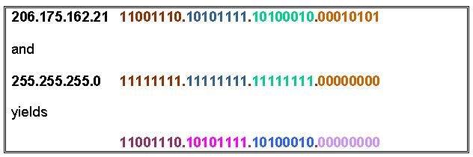
When these two binary numbers (the IP address & the subnet mask) are combined using Boolean Algebra, the Network ID of the destination network is the result:

Slide 48
Configuring an IP Address (Cont.)
The IP Address command is entered from the config-if mode because the action affects only that interface.
Both the IP address & the subnet mask are defined in the command.

Slide 49
Verifying an IP Address
IP addresses are verified using PING, & Telnet.
It is important that you know that PING is used to verify IP address connections to the Network Layer & that Telnet is used to verify network IP address connections to the Application Layer.

Slide 50
Verifying with Telnet
The reason you need to verify IP addresses is to ensure that the various parts of a network can properly communicate with the other parts.
Eg., if you can Telnet (Terminal Emulation Protocol) into a router from a remote location on the same network, you can verify that the interface & route are up and available.

Slide 51
Verifying with Telnet (Cont.)
Because Telnet operates on the OSI Model’s Application Layer, when it’s functioning, it’s safe to assume that all lower layers are also functioning.

Slide 52
Verifying with PING
The PING (Packet Internet Groper) command verifies OSI Layer 3 (Network Layer) connectivity.
It sends out ICMP (Internet Control Message Protocol) messages to verify both the logical addresses & the Physical connection.

Slide 53
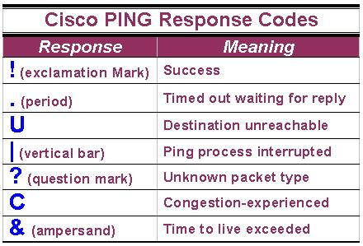
Verifying with PING (Cont.)
The PING command issued from a Cisco router responds with a number of single character responses.

Slide 54
Verifying with Traceroute
The Traceroute or Trace command is used to show the complete route from a source to a destination.
Trace sends out probe packets one at a time to each router or switch in the path between the source & the destination IP address entered.

Slide 55
Verifying with Traceroute (Cont.)
Traceroute displays the round-trip time for each packet sent to each upstream router.
Traceroute has really only 2 results:
Time exceeded or
Destination unreachable.
Trace is used to determine where a breakdown in a route may be occurring.

Slide 56
Verifying with Traceroute (Cont.)
Example on how Trace is used:
A network has 4 routers (A, B, C & D). A Trace command is issued on router A to trace the route from itself to router D.
A timing response comes back from router B, but the next message indicates that router C is unreachable. You can be fairly certain that the problem lies somewhere on the route between router B & router C.

Slide 57
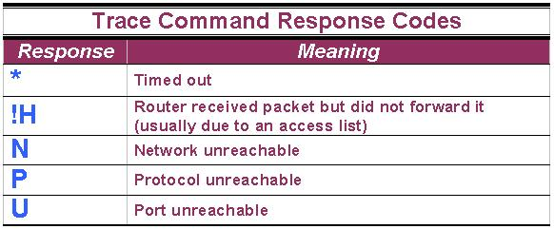
Verifying with Traceroute (Cont.)
Like PING, Trace has its own set of response codes:

Slide 58
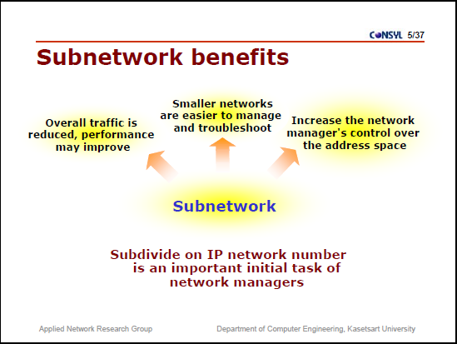

Slide 59
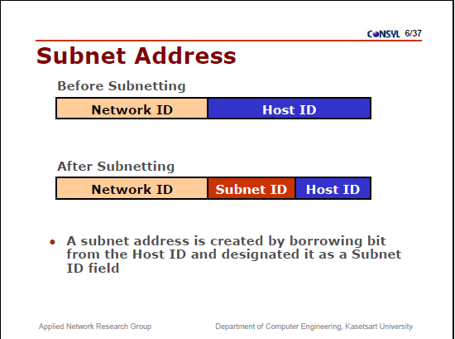

Slide 60
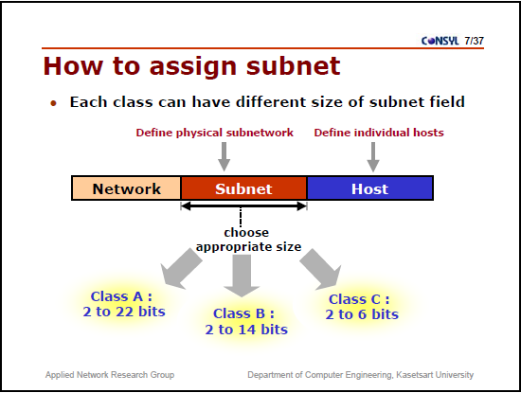

Slide 61
Using Subnetting to Segment a Network
Suppose we lease 219.123.113 /24
(1 network, 254 hosts using 8 host bits)
We need to borrow some of our host bits and use them for network bits.
IP 219.123.113.0000 0000
Mask 255.255.255.0000 0000

Slide 62
Ex. Use the /27 Mask
IP 219.123.113.0 (0000 0000)
Mask 255.255.255.224 (1110 0000)
What’s the block size? 32
Last Address
Computer Number
Block Size/ People Number
Last Address minus Block Size
0…31 | 32…63 | 64…95 | 96…127 | 128…159 | 160…191 | 192…223 | 224…255
Network ID for the 0 subnet
Network ID for the 1 subnet
Network ID for the 7 subnet

Slide 63
Why is it called the 0 subnet?
Ex. The /27 mask borrows 3 host bits and makes them network bits
.0 = 0000 0000
.224 = 1110 0000
Looking at the 3 borrowed bits:
 | Borrowed Bits Value | All Bits Value
0000 0000 | 0 | 0
0010 0000 | 1 | 32
0100 0000 | 2 | 64
0110 0000 | 3 | 96
1000 0000 | 4 | 128
1010 0000 | 5 | 160
1100 0000 | 6 | 192
1110 0000 | 7 | 224

Slide 64
Subnetting Exercise:
You’ve been hired to troubleshoot a problem network. The customer says that they are having problems with computers being able to connect to each other.
The network has computers with the following IPs:
201.54.13.1
201.54.13.6
201.54.13.21
201.54.13.31
201.54.13.32
201.54.13.63
201.54.13.65
All the computers are using the 255.255.255.224 mask
Which computers are able to communicate?

Slide 65
Sample Problem:
Select the correct base network ID for 203.121.45.27 /29
We could enumerate the /29 segments but that would take a while.
Instead, convert the IP to binary, but only the relevant octets.
27d -> binary = 0001 1011
Look at the cheatsheet to get the subnet mask for /29
255.255.255.248 -> 1111 1000
AND the IP and the mask
0001 1011
AND 1111 1000
---------------------------------
0001 1000b-> 24d
So, the base network ID is 203.121.45.24

Slide 66
Exercise
Select the correct base network ID for 203.121.45.31 /30
IP 203.121. 45 . 0001 1111
Mask 255.255.255. 1111 1100
-------------------------------------------------
AND 203.121. 45 . 0001 1100 = 28
203.121.45.28

Slide 67
Subnetting Exercise 2:
Write out the subnets for the 202.54.13.0 network, subnetted with the 255.255.255.240 mask.
What’s the network address of the 0 subnet?
What’s the first host address in the 0 subnet?
What’s the last host address in the 2 subnet?
What’s the broadcast address for the 3 subnet?

Slide 68
Let’s Look at the Cheat Sheet
Bits | Mask | Blocks | Nets | Hosts
0000 0000 | 0 | 256 | 1 | 254
1000 0000 | 128 | 128 | 2 | 126
1100 0000 | 192 | 64 | 2* | 62
1110 0000 | 224 | 32 | 6 | 30
1111 0000 | 240 | 16 | 14 | 14
1111 1000 | 248 | 8 | 30 | 6
1111 1100 | 252 | 4 | 62 | 2
1111 1110 | 254 | 2 | 126 | X
1111 1111 | 255 | 1 | 254 | X
So we could use a network with a subnet mask of 255.255.255.248

Slide 69
CIDR Notation
# of 1s in the mask
CIDR Notation | Bits | Mask | Blocks | Nets | Hosts
/24 | 0000 0000 | 0 | 256 | 1 | 254
/25 | 1000 0000 | 128 | 128 | 2 | 126
/26 | 1100 0000 | 192 | 64 | 2* | 62
/27 | 1110 0000 | 224 | 32 | 6 | 30
/28 | 1111 0000 | 240 | 16 | 14 | 14
/29 | 1111 1000 | 248 | 8 | 30 | 6
/30 | 1111 1100 | 252 | 4 | 62 | 2
/31 | 1111 1110 | 254 | 2 | 126 | X
/32 | 1111 1111 | 255 | 1 | 254 | X
A network with a 255.255.255.248 subnet mask is called a /29

Slide 70
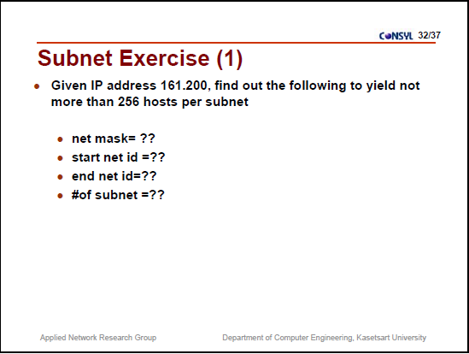

Slide 71
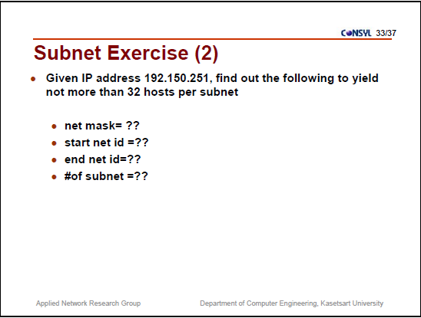

Slide 72
Network Address - One address is reserved to that of the network.
Broadcast Address – One address is reserved to address all hosts in that network or subnet.

Slide 73
Subnet Example
Network address 172.19.0.0 with /16 network mask
Network
Network
Host
Host
172
19
0
0
Using Subnets: subnet mask 255.255.255.0 or /24
Network
Network
Subnet
Host
Network Mask: 255.255.0.0 or /16
11111111
11111111
00000000
00000000
Subnet Mask: 255.255.255.0 or /24
11111111
11111111
11111111
00000000
Applying a mask which is larger than the default subnet mask, will divide your network into subnets.
Subnet mask used here is 255.255.255.0 or /24

Slide 74
Subnet Example
Network address 172.19.0.0 with /16 network mask
Using Subnets: subnet mask 255.255.255.0 or /24
Network
Network
Subnet
Host
172
19
0
Host
Subnets
172
19
1
Host
172
19
2
Host
255 Subnets
2⁸ - 1
172
19
3
Host
172
19
etc.
Host
172
19
254
Host
Cannot use last subnet as it contains broadcast address
172
19
255
Host

Slide 75
Subnet Example
Network address 172.19.0.0 with /16 network mask
Using Subnets: subnet mask 255.255.255.0 or /24
Network
Network
Subnet
Host
172
19
0
0
Subnets Addresses
172
19
1
0
172
19
2
0
255 Subnets
2⁸ - 1
172
19
3
0
172
19
etc.
0
172
19
254
0
Cannot use last subnet as it contains broadcast address
172
19
255
0

Slide 76
Subnet Example
Class B address 172.19.0.0 with /16 network mask
Using Subnets: subnet mask 255.255.255.0 or /24
Hosts Addresses
Network
Network
Subnet
Hosts
172
19
0
1
254
172
19
1
1
254
172
19
2
1
254
172
19
3
1
254
172
19
etc.
1
254
172
19
254
1
254
Each subnet has 254 hosts, 2⁸ – 2
172
19
255
Host

Slide 77
Subnet Example
Network address 172.19.0.0 with /16 network mask
Using Subnets: subnet mask 255.255.255.0 or /24
Network
Network
Subnet
Host
172
19
0
255
Broadcast Addresses
172
19
1
255
172
19
2
255
255 Subnets
2⁸ - 1
172
19
3
255
172
19
etc.
255
172
19
254
255
Cannot use last subnet as it contains broadcast address
172
19
255
255

Slide 78

Analogy
Dividing the barrel of apples into small barrels or baskets does not give us any more apples…
100 Apples

Slide 79
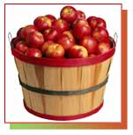
Analogy
10 barrels x 10 apples = 100 apples
10
10
10
100 Apples (10 * 10)
10
10
10
10
10
10
It is the same as taking a barrel of 100 apples and dividing it into 10 barrels of 10 apples each.
10

Slide 80
100 – 2 apples = 98 Usable Apples
Before subnetting:
In any network (or subnet) we can not use all the IP addresses for host addresses.
We lose two addresses for every network or subnet.
Network Address - One address is reserved to that of the network.
Broadcast Address – One address is reserved to address all hosts in that network or subnet.
98 Apples (100 – 2)

Slide 81
10 barrels x 8 apples = 80 apples
8
8
8
(less 2)
(less 2)
(less 2)
80 Apples 10 * (10 - 2)
8
8
8
(less 2)
(less 2)
(less 2)
8
8
8
(less 2)
(less 2)
(less 2)
In subnetting we will see that we continue to lose two apples per subnet, one for the address and one for the broadcast.
8

Slide 82
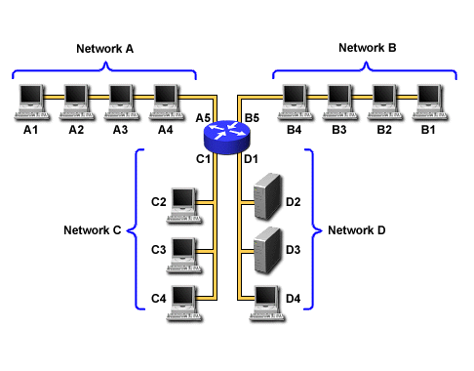
Subnet Example
Network address 172.19.0.0 with /16 network mask
Using Subnets: subnet mask 255.255.255.0 or /24
172.19.0.0/24
172.19.10.0/24
172.19.5.0/24
172.19.25.0/24

Slide 83
Important things to remember about Subnetting
You can only subnet the host portion, you do not have control of the network portion.
Subnetting does not give you more hosts, it only allows you to divide your larger network into smaller networks.
When subnetting, you will actually lose host adresses:
For each subnet you lose the address of that subnet
For each subnet you lose the broadcast address of that subnet
You “may” lose the first and last last subnets
Why would you want to subnet?
Divide larger network into smaller networks
Limit layer 2 and layer 3 broadcasts to their subnet.
Better management of traffic.

Slide 84
Subnetting – Example
Host IP Address: 138.101.114.250
Network Mask: 255.255.0.0 (or /16)
Subnet Mask: 255.255.255.192 (or /26)
Given the following Host IP Address, Network Mask and Subnet mask find the following information:
Major Network Information
Major Network Address
Major Network Broadcast Address
Range of Hosts if not subnetted
Subnet Information
Subnet Address
Range of Host Addresses (first host and last host)
Broadcast Address
Other Subnet Information
Total number of subnets
Number of hosts per subnet

Slide 85
Major Network Information
Host IP Address: 138.101.114.250
Network Mask: 255.255.0.0
Subnet Mask: 255.255.255.192
Major Network Address: 138.101.0.0
Major Network Broadcast Address: 138.101.255.255
Range of Hosts if not Subnetted: 138.101.0.1 to 138.101.255.254

Slide 86
Step 1: Convert to Binary
128 64 32 16 8 4 2 1
Step 1:
Translate Host IP Address and Subnet Mask into binary notation

Slide 87
Step 2: Find the Subnet Address
Step 2:
Determine the Network (or Subnet) where this Host address lives:
1. Draw a line under the mask
2. Perform a bit-wise AND operation on the IP Address and the Subnet Mask
Note: 1 AND 1 results in a 1, 0 AND anything results in a 0
3. Express the result in Dotted Decimal Notation
4. The result is the Subnet Address of this Subnet or “Wire” which is 138.101.114.192

Slide 88
Step 2: Find the Subnet Address
Step 2:
Determine the Network (or Subnet) where this Host address lives:
Quick method:
Find the last (right-most) 1 bit in the subnet mask.
Copy all of the bits in the IP address to the Network Address
Add 0’s for the rest of the bits in the Network Address

Slide 89
Step 3: Subnet Range / Host Range
Step 3:
Determine which bits in the address contain Network (subnet) information and which contain Host information:
Use the Network Mask: 255.255.0.0 and divide (Great Divide) the from the rest of the address.
Use Subnet Mask: 255.255.255.192 and divide (Small Divide) the subnet from the hosts between the last “1” and the first “0” in the subnet mask.

Slide 90
Step 4: First Host / Last Host
Host Portion
Subnet Address: all 0’s
First Host: all 0’s and a 1
Last Host: all 1’s and a 0
Broadcast: all 1’s

Slide 91
Step 5: Total Number of Subnets
Total number of subnets
Number of subnet bits 10
2¹⁰ = 1,024
1,024 total subnets
Subtract one “if” all-zeros subnet cannot be used
Subtract one “if” all-ones subnet cannot be used
ip subnet zero (allows subnets zero and last)

Slide 92
Step 6: Total Number of Hosts per Subnet
Total number of hosts per subnet
Number of host bits 6
2⁶ = 64
64 host per subnets
Subtract one for the subnet address
Subtract one for the broadcast address
62 hosts per subnet

Slide 93
IOS
CISCO Internetwork Operating System (IOS)
Kernel of CISCO Routers
Auxiliary Port
Allows to configure modem commands
Connect to a remote router which is down (out-of-band)
Connect using telnet in-band

Slide 94
Commands
User exec mode
View statistics
Router >
Priviledged exec mode
View and change configuration
Router > enable
Router #
Global Configuration mode
Make changes to running configuration
Router # configure terminal
OR
Router # config t

Slide 95
Commands
Router ǂ disable
Router>
Router>logout //exit console
Routerǂ ?
List of all commands available from that prompt
Spacebar another whole page
Enter one command at a time
Routerǂ c?
All commands start with c

Slide 96
Commands
Router # sh history
Shows last 20 commands entered
Router # sh run
Running configuration of router
Router # sh ip int
Router # sh ip int brief
Router(config-if) # no shut
Router ports are disabled by default
Switch ports are enabled by default
Router # sh ip route

Slide 97
Static Routing
A company is granted a block of IP address 130.0.0.0. The company needs 6 subnets. Implement static routing between the first and 3rd

Slide 98
Network IP: 130.10.0.0
Default Mask : 255.255.0.0
Subnet Mask: 255.255.224.0
Subnet Range
130.10.0.0 – 130..10.31.255
130.10.32.0– 130.10.63.255
130.10.64.0 –130.10.95.255
130.10.96.0 –130.10.127.255
130.10.128.0 – 130.10.159.255
130.10.160.0 –130.10.191.255

Slide 99
R1 > enable
R1 # config terminal
R1(config) # int g0/0
R1(config-if) # ip address 130.10.0.1 255.255.224.0
R1(config-if) # no shut
R1(config-if) # ^z
R1 # config t
R1(config) #int s0/0/0
R1(config-if) # ip address 130.10.32.1 255.255.224.0
R1(config-if) # clock rate 64000
R1(config-if) # no shut
R1(config-if) #^z
R1(config) # ip route 130.10.64.0 255.255.224.0 130.10.32.2

Slide 100
Dynamic Routing Using RIP
An organization is granted 192.168.20.0. They need 14 subnets. Design the subnet and implement dynamic routing between the fourth and seventh subnet

Slide 101
Network IP: 192.168.20.0
Default Mask : 255.255.255.0
Subnet Mask: 255.255.255.240
Subnet Range
192.168.20.0 – 192.168.20.15
192.168.20.16– 192.168.20.31
192.168.20.32 –192.168.20.47
192.168.20.48 –192.168.20.63
192.168.20.64 – 192.168.20.79
192.168.20.80 –192.168.20.95
192.168.20.96 -- 192.168.20.111

Slide 102
R1 > enable
R1 # config t
R1(config) # int g0/1
R1(config-if) # ip address 192.168.20.49 255.255.255.240
R1(config-if) # no shut
R1(config-if) # ^z
R1 # config t
R1(config) #int s0/0/1
R1(config-if) # ip address 192.168.20.1 255.255.255.240
R1(config-if) # clock rate 64000
R1(config-if) # no shut
R1(config-if) #^z
R1(config) # router rip
R1(config- router) # network 192.168.20.48
R1(config-router ) # network 192.168.20.0

Slide 103
R1 > enable
R1 # config t
R1(config) # int g0/1
R1(config-if) # ip address 192.168.20.49 255.255.255.240
R1(config-if) # no shut
R1(config-if) # ^z
R1 # config t
R1(config) #int s0/0/1
R1(config-if) # ip address 192.168.20.1 255.255.255.240
R1(config-if) # clock rate 64000
R1(config-if) # no shut
R1(config-if) #^z
R1(config) # router eigrp 10
R1(config- router) # network 192.168.20.48
R1(config-router ) # network 192.168.20.0

Slide 104
R1 > enable
R1 # config t
R1(config) # int g0/1
R1(config-if) # ip address 192.168.20.49 255.255.255.240
R1(config-if) # no shut
R1(config-if) # ^z
R1 # config t
R1(config) #int s0/0/1
R1(config-if) # ip address 192.168.20.1 255.255.255.240
R1(config-if) # clock rate 64000
R1(config-if) # no shut
R1(config-if) #^z
R1(config) # router ospf 10
R1(config- router) # network 192.168.20.48 0.0.0.15 area 0
R1(config-router ) # network 192.168.20.00.0.0.15 area 0

Slide 105
Variable length subnetting

