Slide 1
JAVASCRIPT
Module III

Slide 2
JavaScript
JavaScript- scripting language - used to enhance the functionality and appearance of web pages.
JavaScript is a scripting language (a scripting language is a lightweight programming language)
A JavaScript is usually embedded directly into HTML pages
JavaScript is an interpreted language (means that scripts execute without preliminary compilation)
JavaScript is the most popular scripting language on the internet, and works in all major browsers, such as Internet Explorer, Mozilla, Firefox, Netscape, Opera.

Slide 3
How to Put a JavaScript Into an HTML Page?
helloworld.html

Slide 4
<script> tag to indicate to the browser that the text which follows is part of a script.
The type attribute specifies the MIME type of the script as well as the scripting language used in the script.
Each code statement has to end with a semicolon (;).
When an HTML document is loaded into a web browser, it becomes a document object.
Document object, which represents the HTML document the browser is currently displaying.
An object resides in the computer’s memory and contains information used by the script.

Slide 5
document.write()-Writes HTML expressions or JavaScript code to a document
document.writeln()-Same as write(), but adds a newline character after each statement

Slide 6
Embedding JavaScript Code
JavaScript code is typically placed in a separate file, then included in the HTML document that uses the script.
Code more reusable
JavaScript files have the file extension .js.
To use an external script, put the name of the script file in the src (source) attribute of a <script> tag
Eg: <script src="myScript.js"></script>

Slide 7
Modifying the Script
Displaying a Line of Colored Text
modify.html
script.js

Slide 8
Displaying Text in an Alert Dialog
Displaying Text in an Alert Dialog
To display information in windows called dialogs (or dialog boxes) that “pop up” on the screen to grab the user’s attention.
JavaScript allows easily to display a dialog box containing a message.
The script uses the browser’s window object to display an alert dialog.
The argument to the window object’s alert method is the string to display.
Eg: window.alert( "Welcome”);

Slide 9
Obtaining User Input with prompt Dialogs
A prompt box is often used if you want the user to input a value before entering a page.
When a prompt box pops up, the user will have to click either "OK" or "Cancel" to proceed after entering an input value.
If the user clicks "OK“, the box returns the input value. If the user clicks "Cancel“, the box returns null.

Slide 10
Declarations, Keywords and Variables
Keywords are words that have special meaning in JavaScript.
A variable is a location in the computer’s memory where a value can be stored for use by a script.
All variables have a name and value, and should be declared with a var statement before they’re used in a script.

Slide 11
Identifiers
The name of a variable can be any valid identifier.
An identifier is a series of characters consisting of letters, digits, underscores ( _ ) and dollar signs ($) that does not begin with a digit and is not a reserved JavaScript keyword.
JavaScript is case sensitive—uppercase and lowercase letters are considered to be different characters.

Slide 12
Comment
A single-line comment that begins with the characters // states the purpose of the variable in the script.
A // comment can begin at any position in a line of JavaScript code and continues until the end of the line.
Multi-line comments begin with the delimiter /* and end with the delimiter */

Slide 13
If the user either types a non-integer value or clicks the Cancel button, a logic error will occur and the result in NaN(not a number)
Function parseInt converts its string argument to an integer.
Datatype
JavaScript does not require variables to have a declared type before they can be used in a script
A variable in JavaScript can contain a value of any data type, and in many situations JavaScript automatically converts between values of different types for you.
Loosely typed language

Slide 14
JavaScript Operators
Arithmetic Operators
Operator | Description | Example | Result
+ | Addition | x=2 | 4
 |  | y=2
 |  | x+y
- | Subtraction | x=5 | 3
 |  | y=2
 |  | x-y
* | Multiplication | x=5 | 20
 |  | y=4
 |  | x*y
/ | Division | 15/5 | 3
 |  | 5/2 | 2,5
% | Modulus (division remainder) | 5%2 | 1
 |  | 10%8 | 2
 |  | 10%2 | 0
++ | Increment | x=5 | x=6
 |  | x++
-- | Decrement | x=5 | x=4
 |  | x--

Slide 15
JavaScript Operators – 2
Assignment Operators
Operator | Example | Is The Same As
= | x=y | x=y
+= | x+=y | x=x+y
-= | x-=y | x=x-y
*= | x*=y | x=x*y
/= | x/=y | x=x/y
%= | x%=y | x=x%y

Slide 16
JavaScript Operators - 3
Comparison Operators
Operator | Description | Example
== | is equal to | 5==8 returns false
=== | is equal to (checks for both value and type) | x=5
 |  | y="5"
 |  | x==y returns true
 |  | x===y returns false
!= | is not equal | 5!=8 returns true
> | is greater than | 5>8 returns false
< | is less than | 5<8 returns true
>= | is greater than or equal to | 5>=8 returns false
<= | is less than or equal to | 5<=8 returns true

Slide 17
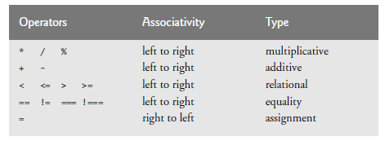
Operator precedence

Slide 18
Control statement
JavaScript has only eight control statements:
Sequence
Three types of selection (if, else, switch)
Four types of repetition(while, do…while, for, for…in)

Slide 19
Selection statement
A selection statement is used to choose among alternative courses of action in a script.
If statment
Eg: if ( studentGrade >= 60 )
document.writeln( "<p>Passed</p>" );

Slide 20
Selection statement
If…else statement
if ( studentGrade >= 60 )
document.writeln( "<p>Passed</p>" );
else
document.writeln( "<p>Failed</p>" );
Conditional Operator (?:)
Eg: document.writeln( studentGrade >= 60 ? "Passed" : "Failed" );

Slide 21
Selection statement
Nested if...else Statements
Nested if…else statements test for multiple cases by placing if…else statements inside if…else statements.
Eg: if ( studentGrade >= 90 )
document.writeln( "A" );
else
if ( studentGrade >= 80 )
document.writeln( "B" );
else
if ( studentGrade >= 70 )
document.writeln( "C" );
else
document.writeln( "F" );

Slide 22
Selection statement
Dangling-else Problem
The JavaScript interpreter always associates an else with the previous if, unless told to do otherwise by the placement of braces ({}).
if ( x > 5 )
if ( y > 5 )
document.writeln( "<p>x and y are > 5</p>" );
else
document.writeln( "<p>x is <= 5</p>" );
Above code illustrates the dangling-else problem
Above code interpreted as follows :
if ( x > 5 )
if ( y > 5 )
document.writeln( "<p>x and y are > 5</p>" );
else
document.writeln( "<p>x is <= 5</p>" );

Slide 23
To force the first nested if statement to execute as it was intended originally
if ( x > 5 )
{
if ( y > 5 )
document.writeln( "<p>x and y are > 5</p>" );
}
else
document.writeln( "<p>x is <= 5</p>" );

Slide 24
Repetition statement
While
A repetition structure (also known as a loop) allows you to specify that a script is to repeat an action while some condition remains true.
Eg: var product = 2;
while ( product <= 1000 )
product = 2 * product;

Slide 25
for Repetition Statement
Syntax
for ( initialization; loopContinuationTest; increment )
statements
initialization expression names the loop’s control variable and provides its initial value
loopContinuationTest is the expression that tests the loop-continuation condition
increment is an expression that increments the control variable

Slide 26
Question
Consider the following problem statement:
A person invests $1000.00 in a savings account yielding 5 percent interest. Assuming that all the interest is left on deposit, calculate and print the amount of money in the account at the end of each year for 10 years. Use the following formula to determine the amounts:
a = p (1 + r) n

Slide 27
switch Multiple-Selection Statement
An algorithm will contain a series of decisions in which a variable or expression is tested separately for each of the values it may assume, and different actions are taken for each value.
JavaScript provides the switch multiple-selection statement to handle such decision making.

Slide 28
do…while Repetition Statement
The do…while repetition statement is similar to the while statement.
In the while statement, the loop-continuation test occurs at the beginning of the loop, before the body of the loop executes.
The do…while statement tests the loop-continuation condition after the loop body executes—therefore, the loop body always executes at least once.

Slide 29
break and continue Statements
JavaScript provides the statements break and continue to alter the flow of control.
The break statement, when executed in a while, for, do…while or switch statement, causes immediate exit from the statement.
The continue statement, when executed in a while, for or do…while statement, skips the remaining statements in the body of the statement and proceeds with the next iteration of the loop.
In while and do…while statements, the loop-continuation test evaluates immediately after the continue statement executes.
In for statements, the increment expression executes, then the loop-continuation test evaluates.
Improper placement of continue before the increment in a while may result in an infinite loop.

Slide 30
<html>
<head>
<meta charset = "utf-8">
<title>Using the continue Statement in a for Statement</title>
<script>
for ( var count = 1; count <= 10; ++count )
{
if ( count == 5 )
continue;
document.writeln( count + " " );
} //end for
document.writeln( "<p>Used continue to skip printing 5</p>" );
</script>
</head><body></body>
</html>

Slide 31
Javascript function
The best way to develop and maintain a large program is to construct it from small, simple pieces, or modules. This technique is called divide and conquer.

Slide 32
Program Modules in JavaScript
Scripts that write in JavaScript typically contain of one or more pieces called functions.
The prepackaged functions that belong to JavaScript objects (such as Math.pow) are called methods.
programmer-defined functions-Functions to define tasks that may be used at many points in a script.

Slide 33
Program Modules in JavaScript
A function is invoked (that is, made to perform its designated task) by a function call.
The function call specifies the function name and provides information (as arguments) that the called function needs to perform its task.

Slide 34
Program Modules in JavaScript
Function calls
Name
Left parenthesis
Arguments separated by commas
Constants, variables or expressions
Right parenthesis
Examples:
total += parseFloat( inputValue );
total += parseFloat( s1 + s2 );

Slide 35
Function definition
Format of a function definition
function function-name( parameter-list ) { declarations and statements }
Function name any valid identifier
Parameter list names of variables that will receive arguments
Must have same number as function call
May be empty
Declarations and statements
Function body (“block” of code)

Slide 36
JavaScript function
<html>
<head>
<title>Eg for function</title>
<script>
document.write("<h1> square of number upto 10</h1>");
var i,y;
for (i=1;i<10;i++)
document.writeln("<p>the square of \t" + i +" is "+ sq(i)+"</p>");
function sq( y ) //
{
return y*y;
}
</script> </head> </html>
Function call
Function definition

Slide 37
Javascript function
//find largest of three numbers
<html>
<head>
<title>maximum of three number</title>
<script>
var num1,num2,num3,a,b,c, max;
num1=window.prompt("enter first number","0");
num2=window.prompt("enter second number","0");
num3=window.prompt("enter third number","0");
num1=parseInt(num1);
b=parseInt(num2);
c=parseInt(num3);
max=highest(num1,b,c);
document.writeln("the maximum value is“ +max+ "\n");

Slide 38
Javascript function
//function definition
function highest(x,y,z)
{
return Math.max(x,Math.max(y,z));
}
</script>
</head>
</html>
All variables declared with the keyword var in fucntion definition are local variable.

Slide 39
Random Number Generation
Random-number generation introduces element of chance
Math.random
var randomValue = Math.random();
Floating point value between 0 and 1
Adjust range by scaling and shifting
Math.floor
Always round down
Math.floor( 1 + Math.random() * 6 )

Slide 40
Scope rules
Scope of an identifier for a variable or function is the portion of the program in which the identifier can be referenced.
Global variables or script-level variables that are declared in the head element are accessible in any part of a script and are said to have global scope.
Identifiers declared inside a function have function (or local) scope and can be used only in that function.
If a local variable in a function has the same name as a global variable, the global variable is “hidden” from the body of the function.

Slide 41
JS global functions
isfinite()-determine whether the number is finite or not.
isNan()-Takes a numeric argument and returns true if the value of the argument is not a number; otherwise, it returns false.
parseInt()-convert string to int
parseFloat()-convert string to float

Slide 42
Recursion
A recursive function is a function that calls itself, either directly, or indirectly through another function.

Slide 43
Form validation
<html>
<head>
<script>
function validateform(){
var name=document.myform.name.value;
var password=document.myform.password.value;
if (name==null || name==""){
alert("Name can't be blank");
return false;
}else if(password.length<6){
alert("Password must be at least 6 characters long.");
return false;
}
}
</script> </head>
<body>
<form name="myform" method="post" action=“hello.html" onsubmit="return validateform()" >
Name: <input type="text" name="name"><br/>
Password: <input type="password" name="password"><br/>
<input type="submit" value="register">
</form> </body></html>

Slide 44
JAVASCRIPT ARRAYS

Slide 45
JS Arrays
Arrays are data structures consisting of related data items.
JS arrays are dynamic
Size of an array in JavaScript can be changed (increased) AFTER it is created
Each element referenced by a number
Start at “zeroth element”: 10 element array has elements: 0,1,2 ,..,8,9
Subscript or index

Slide 46
Declaring and Allocating Arrays
In javascript, arrays are implemented in the form of array object.
New operator is used to create an array
Allocates memory for objects
Dynamic memory allocation operator var c; ← array declaration c = new Array( 12 ); ← memory allocation

Slide 47
Array initialization
Using an Initializer List
var n = [ 10, 20, 30, 40, 50 ];
var n = new Array( );
var n = [ 10, 20, , 40, 50 ];
For...in statment
Eg: for (var element in n)
The for…in statement skips any undefined elements in the array.

Slide 48
<html>
<body>
<h2>JavaScript Arrays</h2>
<p id="demo"></p>
<script>
var cars = ["Saab", "Volvo", "BMW"];
document.getElementById("demo").innerHTML = cars;
</script>
</body>
</html>

Slide 49
<html>
<head>
<meta charset = "utf-8">
<title>Sum Array Elements</title>
<script>
var theArray = [ 1, 2, 3, 4, 5, 6, 7, 8, 9, 10 ];
var total1 = 0, total2 = 0;
var length = theArray.length;
for ( var i = 0; i < length; ++i )
document.writeln("<p>"+theArray[i]+"</p>");
for ( var j in theArray )
document.writeln("<p>"+theArray[j]+"</p>");
</script>
</head>
</html>

Slide 50
Passing Arrays to Functions
To pass an array argument to a function, specify the array’s name (a reference to the array) without brackets.
Array declaration:
Eg:var hourlyTemperatures = new Array( 24 );
Function call
modifyArray( hourlyTemperatures );
For a function to receive an array through a function call, the function’s parameter list must specify a parameter that will refer to the array in the body of the function.
JavaScript does not provide a special syntax for this purpose—it simply requires that the identifier for the array be specified in the parameter list.
the function header for function modifyArray might be written as
Eg: function modifyArray( b )

Slide 51
JS Array methods
The key property of the ‘Array’ object is ‘length’, i.e the number of elements in an array
Two of the key ‘Array’ methods are:
reverse( )
sort( )
Two search methods
indexOf- searches for the first occurrence of specific key value
lastIndexOf -searches for the last occurrence of specific key value

Slide 52
Sorting Arrays with Array Method sort
Sorting data (putting data in a particular order, such as ascending or descending) is one of the most important computing functions.
The Array object in JavaScript has a built-in method sort for sorting arrays.
By default, Array method sort (with no arguments) uses string comparisons to determine the sorting order of the array elements.
The strings are compared by the ASCII values of their characters.

Slide 53
a negative value if the first argument is less than the second argument
Zero if the arguments are equal, or
a positive value if the first argument is greater than the second argument.

Slide 54
Searching Arrays with Array Method indexOf
When working with data stored in arrays, it’s often necessary to determine whether an array contains a value that matches a certain key value.
The process of locating a particular element value in an array is called searching.
The Array object in JavaScript has built-in methods indexOf and lastIndexOf for searching arrays.
Method indexOf searches for the first occurrence of the specified key value
Method lastIndexOf searches for the last occurrence of the specified key value.
If the key value is found in the array, each method returns the index of that value; otherwise, -1 is returned.

Slide 55
Math object
The Math object’s methods enable you to conveniently perform many common mathematical calculations
An object’s methods are called by writing the name of the object followed by a dot (.) and the name of the method.
In parentheses following the method name are arguments to the method.
Eg: var result = Math.sqrt( 900 );

Slide 56
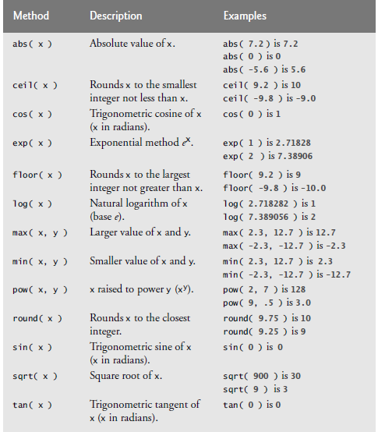

Slide 57
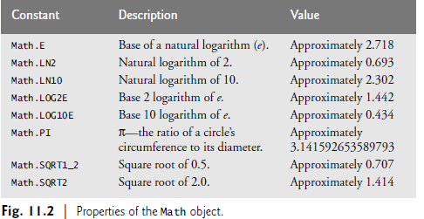

Slide 58
String Object
A string is a series of characters treated as a single unit.
A string may include letters, digits and various special characters, such as +, -, *, /, and $.
JavaScript supports the set of characters called Unicode®, which represents a large portion of the world’s languages.
A string is an object of type String.
String literals or string constants are written as a sequence of characters in double or single quotation marks, as follows:
Eg: "John Q. Doe" (a name)
'9999 Main Street' (a street address)

Slide 59
String Object …
A String may be assigned to a variable in a declaration.
Eg: var color = "blue";
Strings can be compared via the relational and equality operators
The comparisons are based on the Unicode values of the corresponding characters.
For example, the expression "h" < "H" evaluates to false because lowercase letters have higher Unicode values.

Slide 60
Methods of the String Object
The String object encapsulates the attributes and behaviors of a string of characters.
It provides many methods (behaviors) that accomplish useful tasks such as
selecting characters from a string
combining strings (called concatenation),
obtaining substrings (portions) of a string,
searching for substrings within a string,
tokenizing strings (i.e., splitting strings into individual words)
converting strings to all uppercase or lowercase letters

Slide 61
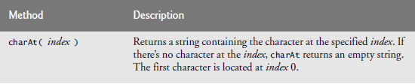
Methods of the String Object

Slide 62
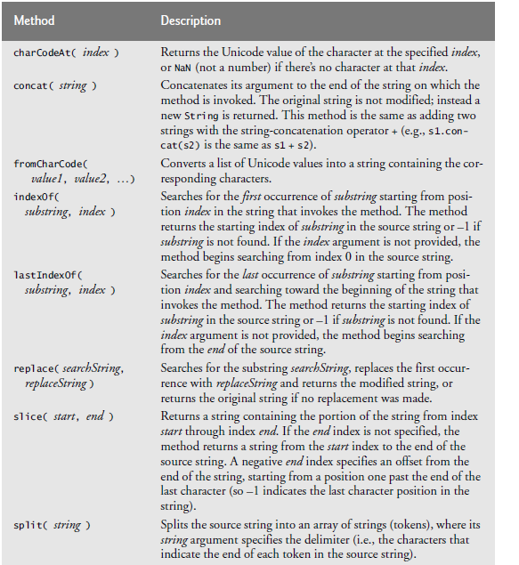

Slide 63
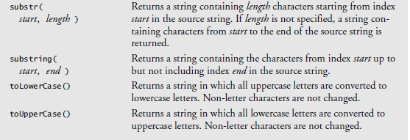

Slide 64
Character-Processing Methods
charAt—returns the character at a specific position
charCodeAt—returns the Unicode value of the character at a specific position
fromCharCode—returns a string created from a series of Unicode values
toLowerCase—returns the lowercase version of a string
toUpperCase—returns the uppercase version of a string

Slide 65
Searching Methods
indexOf
lastIndexOf

Slide 66
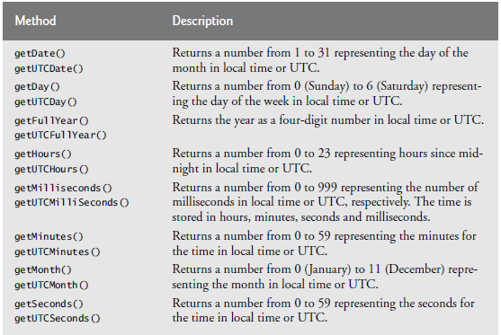
Date Object
JavaScript’s Date object provides methods for date and time manipulations.

Slide 67
document Object
The document object, which we’ve used extensively, is provided by the browser and allows JavaScript code to manipulate the current document in the browser.
The document object has several properties and methods, such as method document.getElementByID, which has been used in many examples.

Slide 68
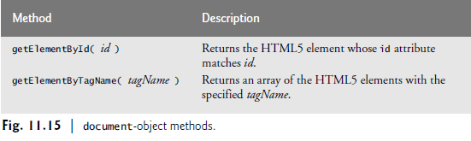

Slide 69
This method is one of the most common methods in the HTML DOM, and is used almost every time you want to manipulate, or get info from, an element on your document.
Returns null if no elements with the specified ID exists.
An ID should be unique within a page. However, if more than one element with the specified ID exists, the getElementById() method returns the first element in the source code

Slide 70
The getElementsByTagName() method returns a collection of an elements's child elements with the specified tag name, as a NodeList object.
The NodeList object represents a collection of nodes. The nodes can be accessed by index numbers. The index starts at 0.
The innerHTML property sets or returns the HTML content (inner HTML) of an element.

