Slide 1
Module IV
Document Object Model (DOM)

Slide 2
What is DOM?
The Document Object Model (DOM) is a cross-platform and language-independent application programming interface that treats an HTML, XHTML, or XML document as a tree structure wherein each node is an object representing a part of the document.

Slide 3
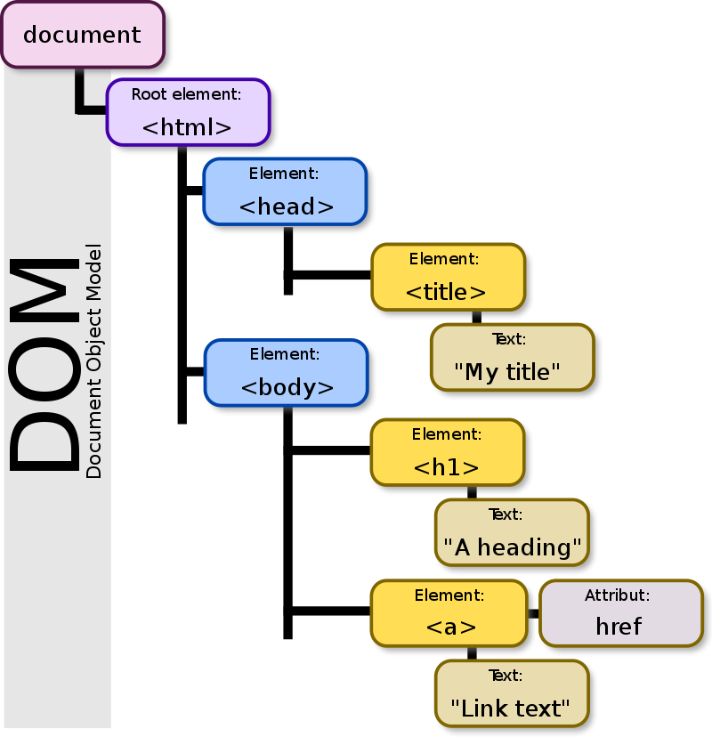

Slide 4
DOM
The DOM represents a document with a logical tree.
Each branch of the tree ends in a node, and each node contains objects.
DOM methods allow programmatic access to the tree; with them one can change the structure, style or content of a document.
Nodes can have event handlers attached to them. Once an event is triggered, the event handlers get executed.

Slide 5
What is the HTML DOM?
The HTML DOM is a standard object model and programming interface for HTML. It defines:
The HTML elements as objects
The properties of all HTML elements
The methods to access all HTML elements
The events for all HTML elements
In other words: The HTML DOM is a standard for how to get, change, add, or delete HTML elements.

Slide 6
HTML DOM
The DOM gives you scripting access to all the elements on a web page
Inside the browser, the whole web page—paragraphs, forms, tables, etc.—is represented in an object hierarchy
Using JavaScript, we can dynamically create, modify and remove elements in the page.

Slide 7
HTML DOM methods are actions you can perform (on HTML Elements).
HTML DOM properties are values (of HTML Elements) that you can set or change.
The HTML DOM can be accessed with JavaScript (and with other programming languages).
In the DOM, all HTML elements are defined as objects.
The programming interface is the properties and methods of each object.
A property is a value that you can get or set (like changing the content of an HTML element).
A method is an action you can do (like add or deleting an HTML element).

Slide 8
Eg:
<html> <body> <p id="demo"></p> <script> document.getElementById("demo").innerHTML = "Hello World!"; </script> </body> </html>
In the example above, getElementById is a method, while innerHTML is a property.
getElementById -The most common way to access an HTML element is to use the id of the element.
innerHTML Property - The easiest way to get the content of an element is by using the innerHTML property.
The innerHTML property is useful for getting or replacing the content of HTML elements.

Slide 9
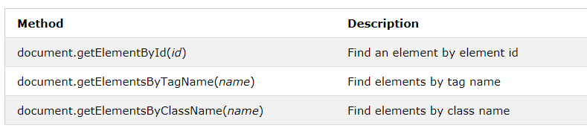
JavaScript HTML DOM Document
The document object represents your web page.
If you want to access any element in an HTML page, you always start with accessing the document object.
Finding HTML Elements

Slide 10
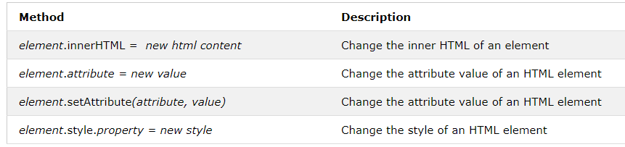
Changing HTML Elements

Slide 11
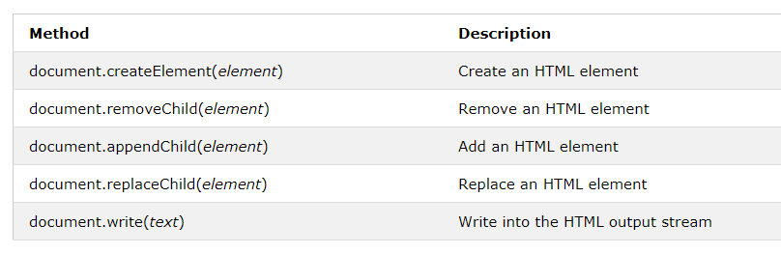
Adding and Deleting Elements

Slide 12
Finding HTML Elements
Often, with JavaScript, you want to manipulate HTML elements.
To do so, you have to find the elements first. There are a couple of ways to do this:
Finding HTML elements by id
Finding HTML elements by tag name
Finding HTML elements by class name
Finding HTML elements by CSS selectors
Finding HTML elements by HTML object collections

Slide 13
Finding HTML Element by Id
<!DOCTYPE html>
<html>
<body>
<p id="intro">Hello World!</p>
<p>This example demonstrates the <b>getElementById</b> method!</p>
<p id="demo"></p>
<script>
var myElement = document.getElementById("intro");
document.getElementById("demo").innerHTML =
"The text from the intro paragraph is " + myElement.innerHTML;
</script>
</body>
</html>

Slide 14
Finding HTML Elements by Tag Name
<!DOCTYPE html>
<html>
<body>
<p>Hello World!</p>
<p>The DOM is very useful.</p>
<p>This example demonstrates the <b>getElementsByTagName</b> method</p>
<p id="demo"></p>
<script>
var x = document.getElementsByTagName("p");
document.getElementById("demo").innerHTML =
'The first paragraph (index 0) is: ' + x[0].innerHTML;
</script>
</body>
</html>

Slide 15
Finding HTML Elements by class Name
<!DOCTYPE html>
<html>
<body>
<p>Hello World!</p>
<p class="intro">The DOM is very useful.</p>
<p class="intro">This example demonstrates the <b>getElementsByClassName</b> method.</p>
<p id="demo"></p>
<script>
var x = document.getElementsByClassName("intro");
document.getElementById("demo").innerHTML =
'The first paragraph (index 0) with class="intro": ' + x[0].innerHTML;
</script>
</body>
</html>

Slide 16
Changing HTML Content
The easiest way to modify the content of an HTML element is by using the innerHTML property.
To change the content of an HTML element, use this syntax:
document.getElementById(id).innerHTML = new HTML
Eg:
<!DOCTYPE html>
<html>
<body>
<h1 id="id01">Old Heading</h1>
<script>
var element = document.getElementById("id01");
element.innerHTML = "New Heading";
</script>
<p>JavaScript changed "Old Heading" to "New Heading".</p>
</body>
</html>

Slide 17
Changing the Value of an Attribute
To change the value of an HTML attribute, use :
document.getElementById(id).attribute = new value
<!DOCTYPE html> <html> <body> <img id="myImage" src="smiley.gif"> <script> document.getElementById("myImage").src = "landscape.jpg"; </script> </body> </html>

Slide 18
Changing HTML Style
To change the style of an HTML element, use:
document.getElementById(id).style.property = new style
<html> <body> <p id="p2">Hello World!</p> <script> document.getElementById("p2").style.color = "blue";
document.getElementById("p2").style.fontFamily = "Arial"; </script> <p>The paragraph above was changed by a script.</p> </body> </html>

Slide 19
Traversing and Modifying a DOM Tree
The DOM enables you to programmatically access a document’s elements, allowing you to modify its contents dynamically using JavaScript.
Here we discuss, some of the DOM-node properties and methods for traversing the DOM tree, modifying nodes and creating or deleting content dynamically

Slide 20
Traversing and Modifying a DOM Tree …
document.getElementById
Node.insertBefore
Node.appendChild
Node.replaceChild
Node.removeChild

Slide 21
Traversing and Modifying a DOM Tree …
The setAttribute() method adds the specified attribute to an element, and gives it the specified value.
Syntax:
element.setAttribute(attributename, attributevalue);
Eg:
currentNode.setAttribute( "class", "highlighted" );

Slide 22
Traversing and Modifying a DOM Tree …
The getAttribute() method returns the value of the attribute with the specified name of an element.
Syntax:
element.getAttribute(attributename)

Slide 23
Modeling a Document: DOM Nodes and Trees
Document’s getElementById method is the simplest way to access a specific element in a page
The method returns objects called DOM nodes.
All the nodes in a document make up the page’s DOM tree, which describes the relationships among elements

Slide 24
Modeling a Document: DOM Nodes and Trees
Nodes are related to each other through child-parent relationships.
An HTML5 element inside another element is said to be its child—the containing element is known as the parent.
A node can have multiple children but only one parent.
Nodes with the same parent node are referred to as siblings.

Slide 25
Viewing a Document’s DOM
Press ctrl+shift+i in chrome
Get the elements tab of the development environment
The html node at the top of the tree is called the root node, because it has no parent.
Below the html node, the head node is indented to signify that the head node is a child of the html node.

Slide 26
DOM Collections
The Document Object Model contains several collections, which are groups of related objects on a page.
DOM collections are accessed as properties of DOM objects such as the document object or a DOM node.
The document object has properties containing the
• images collection
• links collection
• forms collection
• anchors collection
These collections contain all the elements of the corresponding type on the page.

Slide 27
DOM Collections …
images collection- The images collection returns a collection of all <img> elements in the document.
links collection- The links collection returns a collection of all links in the document.
forms collection- The forms collection returns a collection of all <form> elements in the document.
anchors collection- The anchors collection returns a collection of all <a> elements in the document that have a name attribute.

Slide 28
Link collection
Syntax:
document.links
Properties
Length-Returns the number of <a> and/or <area> elements in the collection.

Slide 29
Image collection
Syntax:
document.images

Slide 30
Collections …
Collections allow easy access to all elements of a single type in a page.
This is useful for gathering elements into one place and for applying changes to those elements across an entire page

Slide 31
Dynamic Styles
An element’s style can be changed dynamically.
Often such a change is made in response to user events.
Style changes can create mouse-hover effects, interactive menus and animations.

Slide 32
Dynamic Styles …
The document object’s body property refers to the body element.
Use the setAttribute method to set the style attribute with the user-specified color for the background-color CSS property.
If you have predefined CSS style classes defined for your document, you can also use the setAttribute method to set the class attribute.

Slide 33
Using a Timer and Dynamic Styles to Create Animated Effects
The window object’s setInterval and clearInterval methods, combining them with dynamic styles to create animated effects.
setInterval
The setInterval() method calls a function or evaluates an expression at specified intervals (in milliseconds).
The setInterval() method will continue calling the function until clearInterval() is called, or the window is closed.
The setInterval method returns a unique identifier to keep track of that particular interval timer.
The ID value returned by setInterval() is used as the parameter for the clearInterval() method.
Syntax:
setInterval(function, milliseconds, param1,param2, ...)

Slide 34
Using a Timer and Dynamic Styles to Create Animated Effects
clearInterval
The clearInterval() method clears a timer set with the setInterval() method.
The ID value returned by setInterval() is used as the parameter for the clearInterval() method
Syntax:
clearInterval(id_of_setinterval)
id_of_setinterval-(Required) The ID of the timer returned by the setInterval() method

Slide 35
JavaScript Event Handling
JavaScript events, which allow scripts to respond to user interactions and modify the page accordingly.
Events allow scripts to respond to a user who is moving the mouse, entering form data, pressing keys and much more.
Events and event handling help make web applications more dynamic and interactive.

Slide 36
JavaScript Event Handling
HTML events are "things" that happen to HTML elements.
When JavaScript is used in HTML pages, JavaScript can "react" on these events.
An HTML event can be something the browser does, or something a user does.
Here are some examples of HTML events:
An HTML web page has finished loading
An HTML input field was changed
An HTML button was clicked
HTML allows event handler attributes, with JavaScript code, to be added to HTML elements.
Syntax: <element event='some JavaScript'>
Eg: <button onclick="displayDate()">

Slide 37
Common HTML events
Onchange-An HTML element has been changed.
Onclick-The user clicks an HTML element
Onmouseover-The user moves the mouse over an HTML element
Onmouseout-The user moves the mouse away from an HTML element.
Onkeydown-The user pushes a keyboard key
Onload-The browser has finished loading the page

Slide 38
load Event
This event fires when the window finishes loading successfully
every DOM element has a load event, but it’s most commonly used on the window object.

Slide 39
Event mousemove and the event Object
mousemove event, which occurs whenever the user moves the mouse over the web page
event object contains information about the event that occurred.

Slide 40
Rollovers with mouseover and mouseout
When the mouse cursor moves into an element, a mouseover event occurs for that element.
When the cursor leaves the element, a mouseout event occurs.

Slide 41
Form Processing with focus and blur
The focus and blur events can be useful when dealing with form elements that allow user input.
The focus event fires when an element gains the focus
blur fires when an element loses the focus

Slide 42
Submit and reset
Two more events for processing forms are submit and reset.
These events fire when a form is submitted or reset

Slide 43
Event Bubbling
Event bubbling is the process by which events fired on child elements “bubble” up to their parent elements.
when an event is fired on an element, it’s first delivered to the element’s event handler (if any), then to the parent element’s event handler (if any).
This might result in event handling that was not intended.
If you intend to handle an event in a child element alone, you should cancel the bubbling of the event in the child element’s event-handling code by using the cancelBubble property of the event object

