Slide 1
MODULE -6

Slide 2
Content
Introduction
HTTP Transactions
Multitier Application Architecture
Client-Side Scripting versus ServerSide Scripting
Accessing Web Servers

Slide 3
Introduction
Web server—that responds to client requests (typically from a web browser) by providing resources such as XHTML documents.
For example, when users enter a Uniform Resource Locator (URL) address, such as www.deitel.com, into a web browser, they’re requesting a specific document from a web server.
The web server maps the URL to a resource on the server (or to a file on the server’s network) and returns the requested resource to the client.
During this interaction, the web server and the client communicate using the platform-independent Hypertext Transfer Protocol (HTTP), a protocol for transferring requests and files over the Internet or a local intranet.

Slide 4
HTTP Transactions
URIs and URLs
Parts of a URL
Making a Request and Receiving a Response
HTTP Headers
HTTP get and post Requests

Slide 5
Multitier Application Architecture
Web-based applications are often multitier applications (sometimes referred to as n-tier applications) that divide functionality into separate tiers (i.e., logical groupings of functionality).
Although tiers can be located on the same computer, the tiers of web-based applications often reside on separate computers.

Slide 6
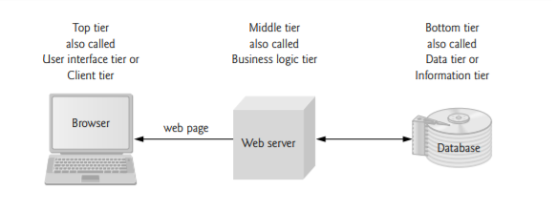
Multitier Application Architecture
Fig: Three-tier architecture.

Slide 7
Bottom tier
The bottom tier (also called the data tier or the information tier) maintains the application’s data.
This tier typically stores data in a relational database management system (RDBMS).

Slide 8
Middle tier
The middle tier implements business logic, controller logic and presentation logic to control interactions between the application’s clients and its data.
The middle tier acts as an intermediary between data in the information tier and the application’s clients.
The middle-tier controller logic processes client requests (such as requests to view a product catalog) and retrieves data from the database.
The middle-tier presentation logic then processes data from the information tier and presents the content to the client.
Web applications typically present data to clients as HTML documents.

Slide 9
Middle tier
Business logic in the middle tier enforces business rules and ensures that data is reliable before the application updates a database or presents data to users.
Business rules dictate how clients access data and how applications process data.
For example, a business rule in the middle tier of a retail store’s web-based application might ensure that all product quantities remain positive.
A client request to set a negative quantity in the bottom tier’s product information database would be rejected by the middle tier’s business logic.

Slide 10
Top tier
The top tier, or client tier, is the application’s user interface, which gathers input and displays output.
Users interact directly with the application through the user interface, which is typically a web browser or a mobile device.
In response to user actions (e.g., clicking a hyperlink), the client tier interacts with the middle tier to make requests and to retrieve data from the information tier.
The client tier then displays the data retrieved for the user.

Slide 11
Accessing Web Servers
To request documents from web servers, users must know the hostnames on which the web server software resides.
Users can request documents from local web servers (i.e., ones residing on users’ machines) or remote web servers (i.e., ones residing on different machines).
Local web servers can be accessed through your computer’s name or through the name localhost—a hostname that references the local machine and normally translates to the IP address 127.0.0.1 (known as the loopback address)

Slide 12
Accessing Web Servers
To display the machine name in Windows, Mac OS X or Linux, run the hostname command in a command prompt or terminal window.
A remote web server referenced by a fully qualified hostname or an IP address can also serve documents.
In the URL
http ://www.deitel.com/books/downloads.html, the middle portion, www.deitel.com, is the server’s fully qualified hostname.

Slide 13
PHP
PHP, or PHP: Hypertext Preprocessor, has become the most popular server-side scripting language for creating dynamic web pages.
PHP - created by Rasmus Lerdorf
PHP is an open-source technology that’s supported by a large community of users and developers.
PHP is platform independent—implementations exist for all major UNIX, Linux, Mac and Windows operating systems.
PHP also supports many databases, including MySQL.

Slide 14
Simple PHP Program
PHP code is embedded directly into text-based documents, such as HTML, though these script segments are interpreted by the server before being delivered to the client.
PHP script file names end with .php.

Slide 15
PHP code is inserted between the delimiters and can be placed anywhere in HTML markup.
All variables are preceded by a $ and are created the first time they’re encountered by the PHP interpreter.
PHP statements terminate with a semicolon (;)

Slide 16
A single-line comment, which begins with two slashes (//).
Multiline comments begin with delimiter /* on the first line of the comment and end with delimiter */ at the end of the last line of the comment.
When a variable is encountered inside a double quoted ("") string, PHP interpolates the variable.
In other words, PHP inserts the variable’s value where the variable name appears in the string.

Slide 17
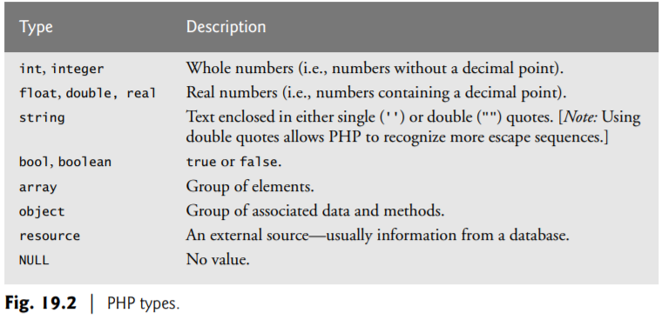
PHP variables are loosely typed—they can contain different types of data (e.g., integers, doubles or strings) at different times.

Slide 18
Converting Between Data Types
Converting between different data types may be necessary when performing arithmetic operations with variables.
Type conversions can be performed using function settype.

Slide 19
Functions gettype and settype
Variables are typed based on the values assigned to them.
For example, variable $testString becomes a string when assigned the value "3.5 seconds".
function gettype, which returns the current type of its argument.
Function settype to modify the type of each variable.
Function settype takes two arguments—the variable whose type is to be changed and the variable’s new type.

Slide 20
Calling function settype can result in loss of data.
For example, doubles are truncated when they’re converted to integers.
When converting from a string to a number, PHP uses the value of the number that appears at the beginning of the string.
If no number appears at the beginning, the string evaluates to 0.
For eg: the string "3.5 seconds" is converted to a double, storing 3.5 in variable $testString.

Slide 21
Casting
Another option for conversion between types is casting (or type casting).
Unlike settype, casting does not change a variable’s content—it creates a temporary copy of a variable’s value in memory.
Casting is useful when a different type is required in a specific operation but you would like to retain the variable’s original value and type.
The concatenation operator (.) combines multiple strings in the same print statement

Slide 22
Arithmetic Operators
PHP provides several arithmetic operators.
function define to create a named constant.
Function define takes two arguments—the name and value of the constant.
An optional third argument accepts a bool value that specifies whether the constant is case insensitive—constants are case sensitive by default.

Slide 23
Uninitialized variables have undefined values that evaluate differently, depending on the context.
For example, when an undefined value is used in a numeric context, it evaluates to 0. (e.g., $num in line 51)
In contrast, when an undefined value is interpreted in a string context (e.g., $nothing in line 48), it evaluates to the string “”.
When you run a PHP script that uses an undefined variable, the PHP interpreter outputs warning messages in the web page.
Strings are converted to integers or doubles when they’re used in arithmetic operations.
In line 57, a copy of the value of variable str, "3 dollars", is converted to the integer 3 for use in the calculation.
The type and value of variable $str are left unchanged.

Slide 24
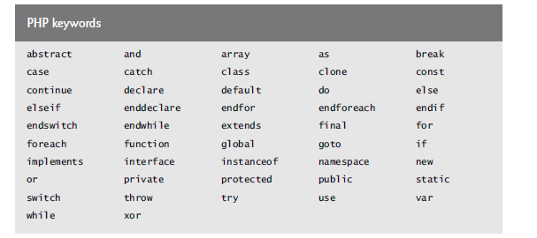
Keywords

Slide 25
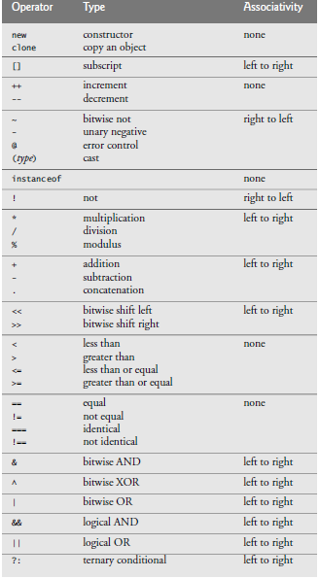
precedence

Slide 26
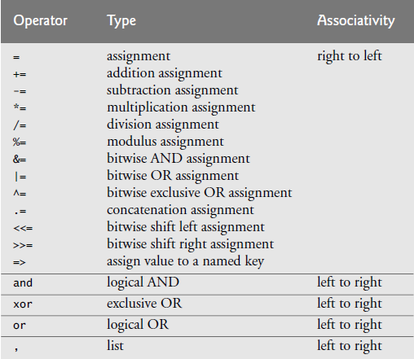

Slide 27
Initializing and Manipulating Arrays
PHP provides the capability to store data in arrays.
Arrays are divided into elements that behave as individual variables.
Array names, like other variables, begin with the $ symbol.
Individual array elements are accessed by following the array’s variable name with an index enclosed in square brackets ([]).
If a value is assigned to an array element of an array that does not exist, then the array is created (line 18).

Slide 28
Create an Array in PHP
In PHP, the array() function is used to create an array
In PHP, there are three types of arrays:
Indexed arrays - Arrays with a numeric index
Associative arrays - Arrays with named keys
Multidimensional arrays - Arrays containing one or more arrays

Slide 29
PHP Indexed Arrays
There are two ways to create indexed arrays:
1. The index can be assigned automatically (index always starts at 0), like this:
$cars = array("Volvo", "BMW", "Toyota");
2. the index can be assigned manually:
$cars[0] = "Volvo"; $cars[1] = "BMW"; $cars[2] = "Toyota";
The count() function is used to return the length (the number of elements) of an array.
Eg: count($cars);

Slide 30
PHP Associative Arrays
Associative arrays are arrays that use named keys that you assign to them.
There are two ways to create an associative array:
$age = array("Peter"=>"35", "Ben"=>"37", "Joe"=>"43");
or
$age['Peter'] = "35"; $age['Ben'] = "37"; $age['Joe'] = "43";

Slide 31
In addition to integer indices, arrays can have float or nonnumeric indices (lines 38-40).
An array with noninteger indices is called an associative array.
For example, indices Amy, Bob and Carol are assigned the values 21, 18 and 23 respectively.

Slide 32
PHP provides functions for iterating through the elements of an array (line 44).
Each array has a built-in internal pointer, which points to the array element currently being referenced.
Function reset sets the internal pointer to the first array element.
Function key returns the index of the element currently referenced by the internal pointer, and function next moves the internal pointer to the next element and returns the element.
When this occurs, function key cannot return an index, $element is set to false and the for statement terminates.

Slide 33
The array $fourth is also associative. To override the automatic numeric indexing performed by function array, we can use operator =>
The value to the left of the operator is the array index and the value to the right is the element’s value.

Slide 34
The foreach control statement (lines 60–61) is specifically designed for iterating through arrays, especially associative arrays, because it does not assume that the array has consecutive integer indices that start at 0.
The foreach statement starts with the array to iterate through, followed by the keyword as, followed by two variables—
first is assigned the index of the element
second is assigned the value of that index.

Slide 35
String Comparisons
Many string-processing tasks can be accomplished by using the equality and comparison operators.
function strcmp -to compare two strings
The function returns -1 if the first string alphabetically precedes the second string,
0 if the strings are equal
1 if the first string alphabetically follows the second.

Slide 36
String Processing with Regular Expressions
PHP can process text easily and efficiently, enabling straightforward searching, substitution, extraction and concatenation of strings.
Text manipulation is usually done with regular expressions—a series of characters that serve as pattern-matching templates (or search criteria) in strings, text files and databases.
Function preg_match uses regular expressions to search a string for a specified pattern using Perl-compatible regular expressions (PCRE).

Slide 37
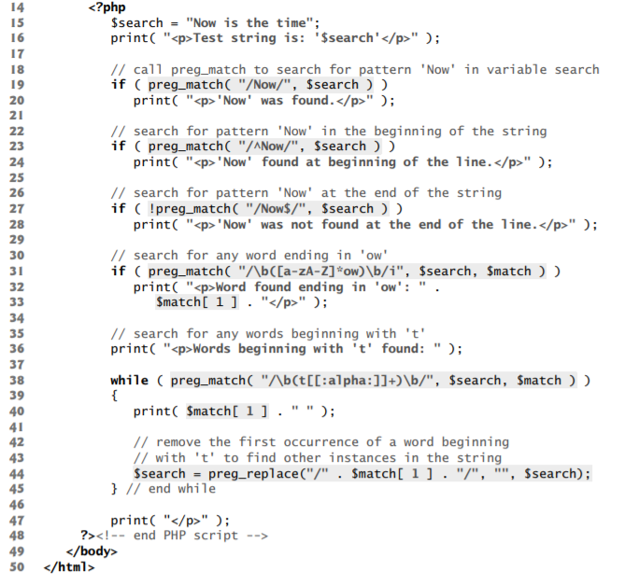

Slide 38
1. Searching for Expressions
Function preg_match to search for the literal characters "Now" inside variable $search(line 19).
If the pattern is found, preg_match returns the length of the matched string— which evaluates to true in a boolean context.
Function preg_match takes two arguments—a regular-expression pattern to search for and the string to search.
The regular expression must be enclosed in delimiters—typically a forward slash (/) is placed at the beginning and end of the regular-expression pattern.
By default, preg_match performs a case-sensitive pattern matches.
To perform case insensitive pattern matches you simply place the letter i after the regular-expression pattern’s closing delimiter, as in "/\b([a-zA-Z]*ow)\b/i" (line 31).

Slide 39
2. Representing Patterns
In addition to literal characters, regular expressions can include meta characters, such as ^, $ and ., that specify patterns.
The caret (^) meta character matches the beginning of a string (line 23).
The dollar sign ($) matches the end of a string (line 27).
The period (.) meta character matches any single character except newlines, but can be made to match newlines with the “s” modifier.

Slide 40
Representing Patterns
Line 31, which contains a bracket expression, searches (from left to right) for the first word ending with the letters ow.
Bracket expressions are lists of characters enclosed in square brackets ([]) that match any single character from the list.
Ranges can be specified by supplying the beginning and the end of the range separated by a dash (-).
For instance, the bracket expression [a-z] matches any lowercase letter and [A-Z] matches any uppercase letter.

Slide 41
Representing Patterns
In this example, we combine the two to create an expression that matches any letter.
The \b before and after the parentheses indicates the beginning and end of a word, respectively—in other words, we’re attempting to match whole words.
The expression [a-zA-Z]*ow inside the parentheses (line 31) represents any word ending in ow.
The quantifier * matches the preceding pattern zero or more times.
Thus, [a-zA-Z]*ow matches any number of letters followed by the literal characters ow.
Quantifiers are used in regular expressions to denote how often a particular character or set of characters can appear in a match.

Slide 42
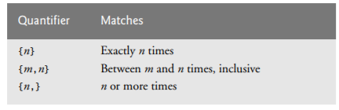
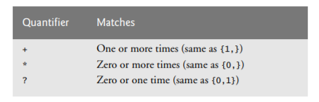

Slide 43
3. Finding Matches
The optional third argument to function preg_match is an array that stores matches to the regular expression.
When the expression is broken down into parenthetical sub-expressions, preg_match stores the first encountered instance of each expression in this array, starting from the leftmost parenthesis.
The first element (i.e., index 0) stores the string matched for the entire pattern.
The match to the first parenthetical pattern is stored in the second array element, the second in the third array element and so on.
If the parenthetical pattern is not encountered, the value of the array element remains uninitialized.
Because the statement in line 31 is the first parenthetical pattern, Now is stored in variable $match[1] (and, because it’s the only parenthetical statement in this case, it’s also stored in $match[0]).

Slide 44
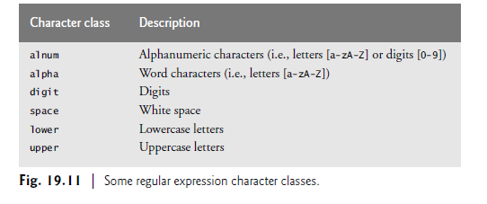
4. Character Classes
The pattern in line 38, /\b(t[[:alpha:]]+)\b/i, matches any word beginning with the character t followed by one or more letters.
The pattern uses the character class [[:alpha:]] to recognize any letter—this is equivalent to the [a-zA-Z].

Slide 45
Character Classes
Character classes are enclosed by the delimiters [: and :].
When this expression is placed in another set of brackets, such as [[:alpha:]] in line 38, it’s a regular expression matching a single character that’s a member of the class.
A bracketed expression containing two or more adjacent character classes in the class delimiters represents those character sets combined.
For example, the expression [[:upper:][:lower:]]* represents all strings of uppercase and lowercase letters in any order, while [[:upper:]][[:lower:]]* matches strings with a single uppercase letter followed by any number of lowercase characters.
The expression ([[:upper:]][[:lower:]])* represents all strings that alternate between uppercase and lowercase characters (starting with uppercase and ending with lowercase).

Slide 46
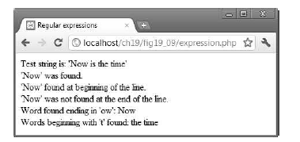

Slide 47
Form Processing and Business Logic
Superglobal Arrays
Knowledge of a client’s execution environment is useful to system administrators who want to access client-specific information such as the
client’s web browser
the server name or
the data sent to the server by the client.
One way to obtain this data is by using a superglobal array.
Superglobal arrays are associative arrays predefined by PHP that hold variables acquired from user input, the environment or the web server, and are accessible in any variable scope.

Slide 48
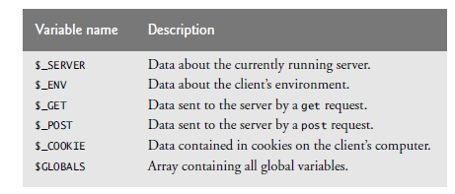

Slide 49
Using PHP to Process HTML5 Forms
Forms enable web pages to collect data from users and send it to a web server for processing.
Such capabilities allow users to purchase products, request information, send and receive web-based e-mail, create profiles in online networking services and take advantage of various other online services.

Slide 50
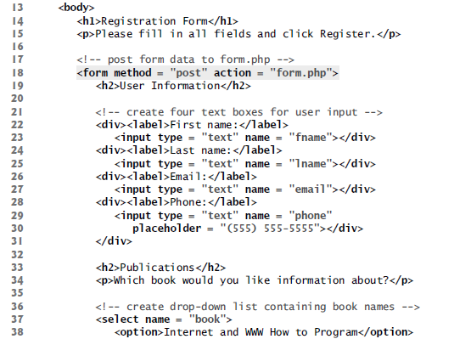

Slide 51
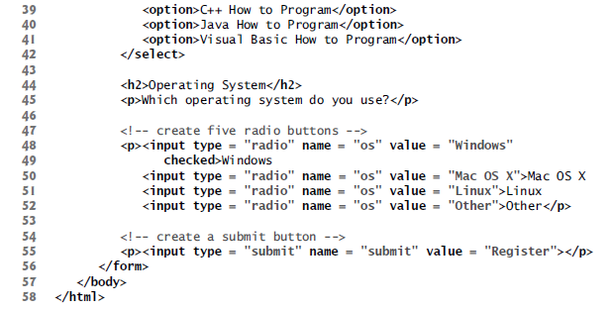

Slide 52
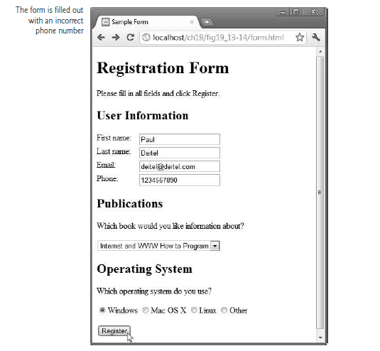

Slide 53
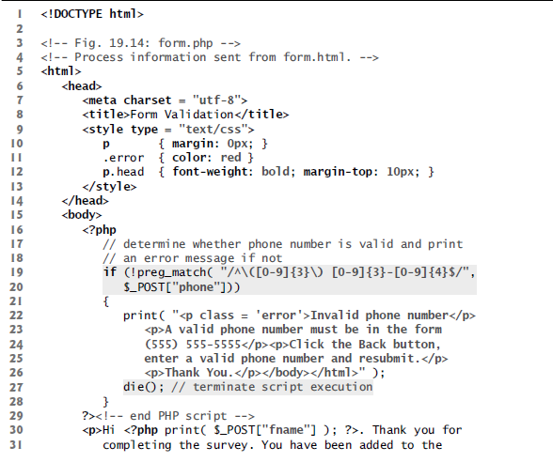

Slide 54
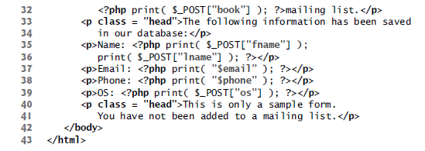

Slide 55
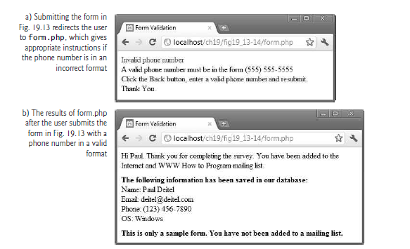

Slide 56
The form’s action attribute (line 18) indicates that when the user clicks the Register button, the form data will be posted to form.php (Fig. 19.14) for processing.
Using method = "post" appends form data to the browser request that contains the protocol (i.e.HTTP) and the URL of the requested resource (specified by the action attribute).
When Register is clicked, each field’s name and value are sent to the web server.
Script form.php accesses the value for each field through the superglobal array $_POST, which contains key/value pairs corresponding to name–value pairs for variables submitted through the form

Slide 57
Lines 19–20 determine whether the phone number entered by the user is valid.
The validation in this example requires the phone number to begin with an opening parenthesis, followed by an area code, a closing parenthesis, a space, an exchange, a hyphen and a line number
validation can be used to ensure that credit card numbers contain the proper number of digits before the numbers are encrypted and sent to a merchant.
This script implements the business logic, or business rules, of our application.

Slide 58
the expression \( matches the opening parenthesis of the phone number.
We want to match the literal character (, so we escape its normal meaning by preceding it with the backslash character (\).
This parenthesis in the expression must be followed by three digits ([0-9]{3}), a closing parenthesis, three more digits, a literal hyphen and four additional digits.
The use of ^ and $ symbols to ensure that no extra characters appear at either end of the string.

Slide 59
If the regular expression is matched, the phone number has a valid format, and an HTML5 document is sent to the client that thanks the user for completing the form.
Function die (line 27) terminates script execution.
This function is called if the user did not enter a correct telephone number, since we do not want to continue executing the rest of the script.
The function’s optional argument is a string or an integer.
If it’s a string, it’s printed as the script exits. If it’s an integer, it’s used as a return status code

Slide 60
Reading from a Database
Steps:
Open a connection to a MySQL Server
Select and open the database to be queried
Querying the database(specifying the query string and the database to query).
Close the connection

Slide 61
Reading from a Database Php-mysql
mysql_connect — Open a connection to a MySQL Server
Three arguments—
server’s hostname
a username
a password.
The host name localhost is your computer.
The username and password specified here were created during installation.
Function mysql_connect returns a database handle—a representation of PHP’s connection to the database

Slide 62
Open a connection
$link = mysql_connect('localhost', 'mysql_user', 'mysql_password'); (deprecated)
If the connection to MySQL fails, the function returns false.
Eg:
<?php $link = mysqli_connect('localhost', 'mysql_user', 'mysql_password'); if (!$link) { die('Could not connect: ' . mysqli_error()); } echo 'Connected successfully'; mysqli_close($link); ?>

Slide 63
Select and Open a Database
mysqli_select_db(link_identifier, database_name)
to select and open the database to be queried
The function returns true on success or false on failure.
Parameters: database_name, link_identifier
database_name
The name of the database that is to be selected.
link_identifier
The MySQL connection.

Slide 64
Eg
<?php $link = mysqli_connect('localhost', 'mysql_user', 'mysql_password'); if (!$link) { die('Not connected : ' . mysqli_error()); } // make foo the current db $db_selected = mysqli_select_db($link , ‘foo'); if (!$db_selected) { die ('Can\'t use foo : ' . mysqli_error()); } ?>

Slide 65
Querying the Database
mysqli_query(link_identifier, Query)
specifying the query string and the database to query.
If the query fails, the function returns false.
For SELECT, SHOW, DESCRIBE, EXPLAIN and other statements returning resultset, mysqli_query() returns a resource on success, or FALSE on error.
For other type of SQL statements, INSERT, UPDATE, DELETE, DROP, etc, mysql_query() returns TRUE on success or FALSE on error.
Parameters: Query, link_identifier
Query-An SQL query
link_identifier- The MySQL connection.

Slide 66
Close the connection
mysqli_close
to close the connection to the database.
argument - link_identifier
The MySQL connection. If the link identifier is not specified, the last link opened by mysqli_connect() is assumed.
If no connection is found or established, an E_WARNING level error is generated.
Returns TRUE on success or FALSE on failure.
mysqli_error
returns any error strings from the database

Slide 67
Fetch row from the result
mysql_fetch_row (Result,)
function to return an array containing the values for each column in the current row of the query result
Parameters: Result
Result
The result resource that is being evaluated.
This result comes from a call to mysqli_query().

Slide 68
Returns an array of strings that corresponds to the fetched row, or FALSE if there are no more rows.
while ($row = mysql_fetch_array($result)) { printf("ID: %s Name: %s", $row[0], $row[1]); }

Slide 69
Getting the number of rows of result
mysqli_num_rows(Result)
Get number of rows in result
Parameter-Result
Result
The result resource that is being evaluated. This result comes from a call to mysqli_query().
Returns the number of rows in a result set on success or FALSE on failure.

Slide 70
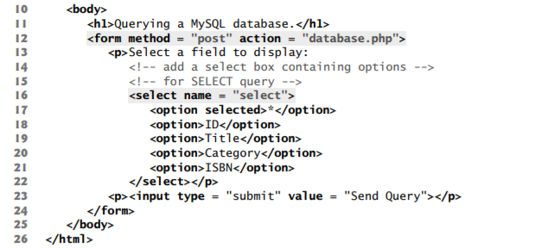

Slide 71
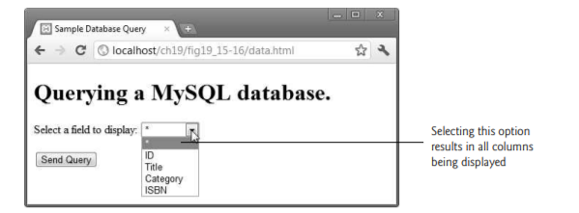

Slide 72
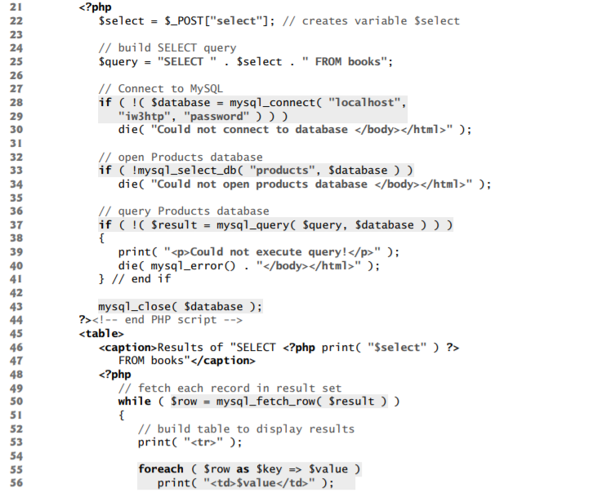
database.php

Slide 73
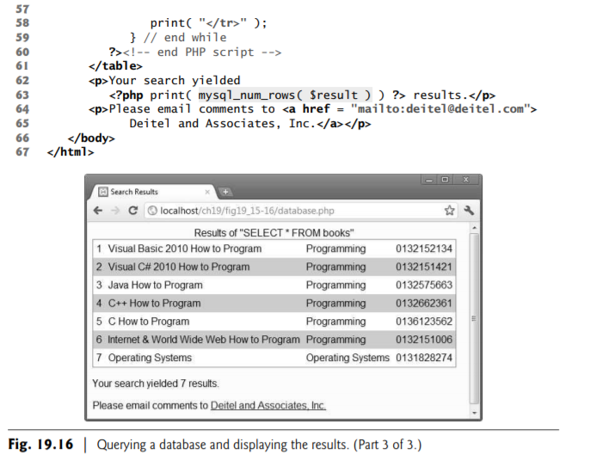

Slide 74
Using Cookies
A cookie is a piece of information that’s stored by a server in a text file on a client’s computer to maintain information about the client during and between browsing sessions.
A website can store a cookie on a client’s computer to record user preferences and other information that the website can retrieve during the client’s subsequent visits.
Websites also can use cookies to track information about client activity.
Analysis of information collected via cookies can reveal the popularity of websites or products.

Slide 75
Cookies
Websites store cookies on users’ hard drives, which raises issues regarding security and privacy.
Websites should not store critical information, such as credit card numbers or passwords, in cookies, because cookies are typically stored in text files that any program can read.
Several cookie features address security and privacy concerns.
A server can access only the cookies that it has placed on the client.
For example, a web application running on www.deitel.com cannot access cookies that the website www.pearson.com has placed on the client’s computer.

Slide 76
Cookie also has an expiration date, after which the web browser deletes it.
Users who are concerned about the privacy and security implications of cookies can disable cookies in their browsers.
A cookie is created with the setcookie() function.
Syntax:
setcookie(name, value, expire, path, domain, secure, httponly);
only the name parameter is required.
All other parameters are optional.

Slide 77
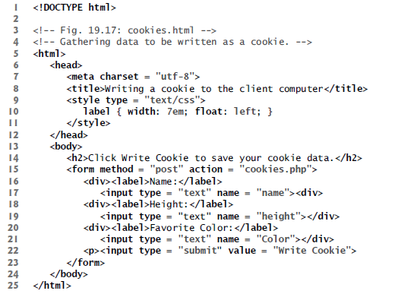

Slide 78
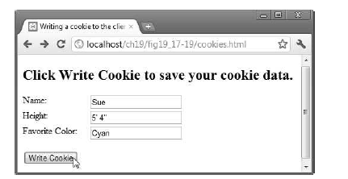

Slide 79
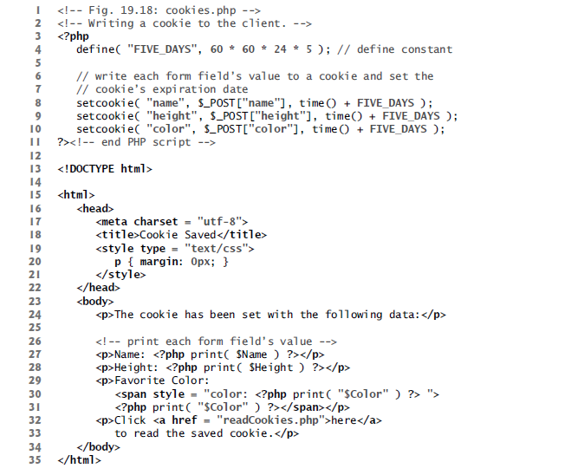
Writing Cookies

Slide 80
function setcookie (lines 8–10) to set the cookies to the values posted from cookies.html.
The cookies defined in function setcookie are sent to the client at the same time as the information in the HTTP header;
therefore, setcookie needs to be called before any other output.
Function setcookie takes the name of the cookie to be set as the first argument, followed by the value to be stored in the cookie.
The optional third argument indicates the expiration date of the cookie.

Slide 81
session cookie
If no expiration date is specified, the cookie lasts only until the end of the current session—that is, when the user closes the browser.
persistent cookie
Cookies with an expiration date

Slide 82
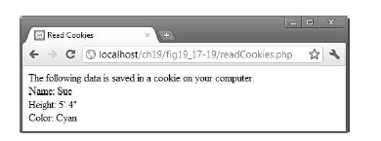
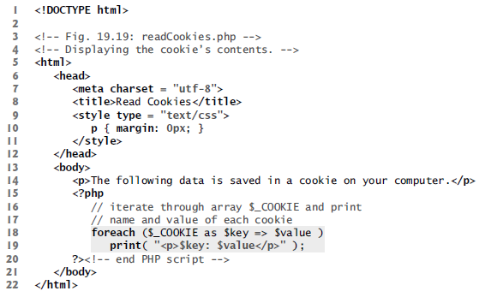
Reading an Existing Cookie

Slide 83
Reading an Existing Cookie
PHP creates the superglobal array $_COOKIE, which contains all the cookie values indexed by their names, similar to the values stored in array $_POST when an HTML5 form is posted.
Lines 18–19 iterate through the $_COOKIE array using a foreach statement, printing out the name and value of each cookie in a paragraph.
The foreach statement takes the name of the array ($_COOKIE) and iterates through each index value of the array ($key).
In this case, the index values are the names of the cookies.

