Slide 1
Programmable timer -8254

Slide 2
When processor has to perform time based activities, there are two methods to maintain timing operations.
First method using delay subroutine
Second method using external timer.
In the first method processor time is wasted by simply decrementing a register.
In the second method, the processor time can be used efficiently, because processor can perform other tasks in between timer interrupt.
One of programmable external timer device developed by INTEL is 8254.

Slide 3
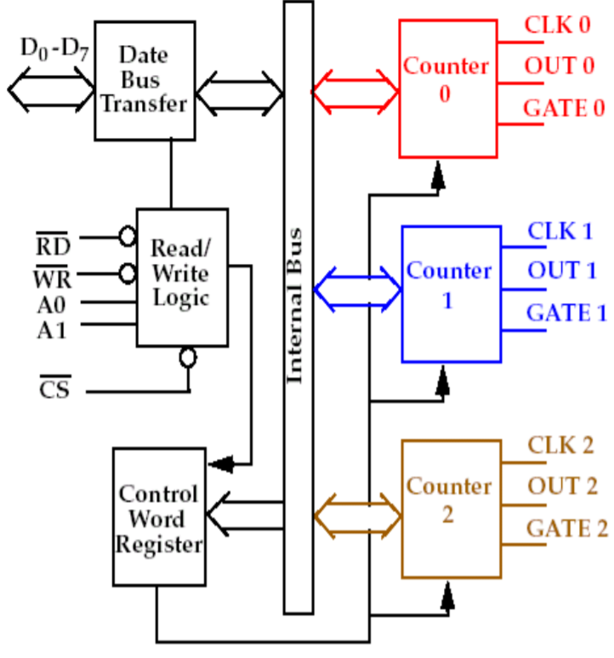
8254 internal architecture

Slide 4
8254 has 3 independent counters.
In each counter a count value is stored can be loaded and the count value can be decremented by applying a clock signal.
At the end of each count, each counter will generate an output which can be used as interrupt to processor to initiate the time based activity.

Slide 5
3 independent 16 bit counter, which can be programmed to work in any one of the possible six modes.
Eqch counter has a clock input, gate input and counter output.
To operate a counter, a count value has to be loaded in count register, gate should be tied high and a clock signal should be applied through clock input.
The counter counts by decrementing the count value by one in each cycle of clock signal and generate an output depending on the mode of operation.

Slide 6
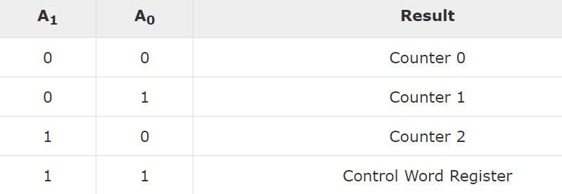
8254 has eight data lines which can be used for communication with processor.
The control words and count values are written into 8254 registers through data bus buffer.
There are 4 port address needed for a single 8254, given by A0, A1, and CS.

Slide 7
Mode of operation
1. Mode 0 (Interrupt On Terminal Count )
2. Mode 1 (Programmable Monoshot )
3. Mode 2 (Rate Generator )
4. Mode 3 (Square Wave Generator )
5. Mode 4 (Software Triggered Strobe )
6. Mode 5 (Hardware Triggered Strobe )

Slide 8
Control word format

