Slide 1
Module 2

Slide 2
Addressing modes of 8086
Every instruction has to operate on data.
The method of specifying the data to be operated by the instruction is called addressing.
12 addressing modes in 8086.

Slide 3
Addressing modes of 8086
Register addressing
Immediate addressing
Direct addressing
Register indirect addressing
Based addressing
Indexed addressing
Based indexed addressing
String addressing
Direct I/O port addressing
Indirect I/O port addressing
Relative addressing
Implied addressing

Slide 4
Register addressing
The instruction will specify the name of the register which holds the data to be operated by the instruction.
Eg1: MOV CL,DH
The content of 8 bit register DH is moved to another 8 bit register CL.
Eg 2: MOV BX,CX

Slide 5
Immediate addressing
In this addressing 8-bit or 16 bit data is specified as part of the instruction.
Eg 1: MOV DL,08H
The 8-bit data given in the register is moved to DL register.
Eg 2:MOV AX,0A9FH

Slide 6
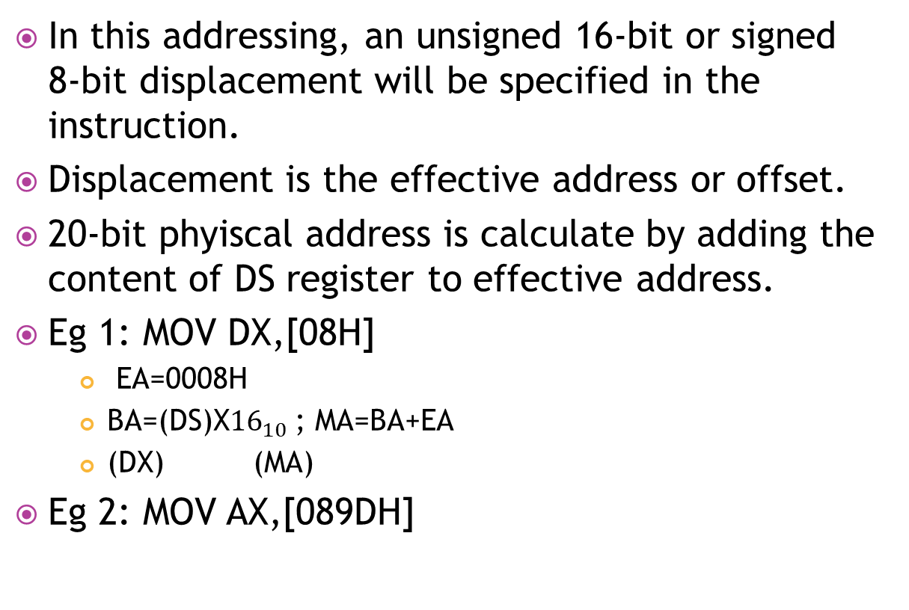
Direct addressing

Slide 7
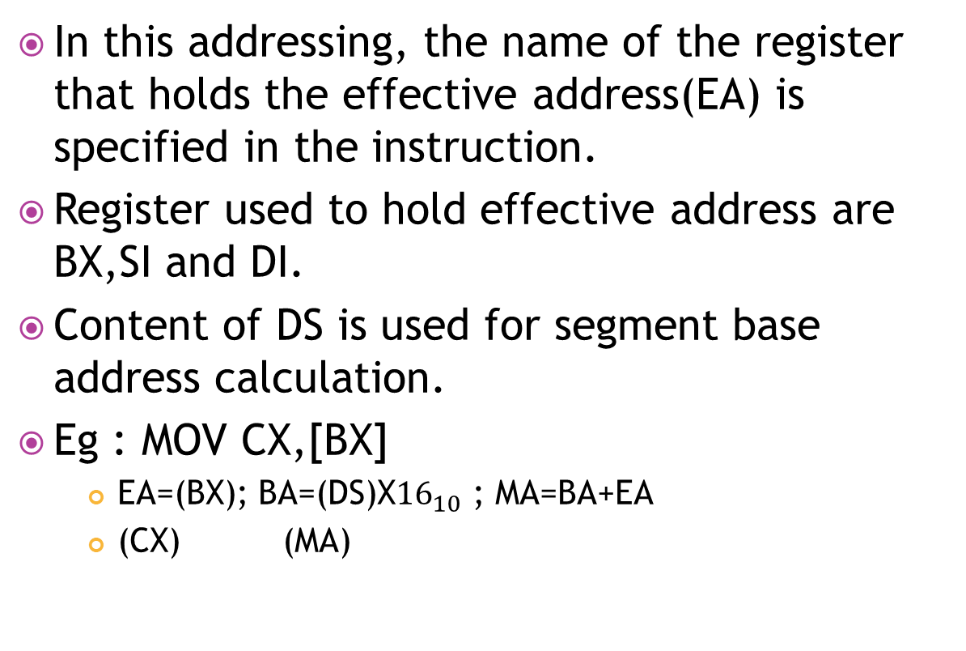
Register indirect addressing

Slide 8
Based addressing
In this addressing, BX or BP register is used to hold a base value for effective address and a signed 8-bit or unsigned 16-bit displacement will be specified in the instruction.
Effective address is calculated by adding displacement to base value in BP or BX.
Eg : MOV AX, [BX+08H]

Slide 9
Indexed addressing
In this addressing, SI or DI register is used to hold an index value for memory data and a signed 8-bit or unsigned 16-bit displacement will be specified in the instruction.
Eg: MOV CX,[SI+0A2H]

Slide 10
Based indexed addressing
In this addressing, the EA is given by sum of base value, index value and an 8-bit or 16-bit displacement specified in the instruction.
Base value- BX or BP register
Index value-SI or DI register
Eg: MOV DX,[BX+SI+0AH]

Slide 11
String addressing
In this addressing, the effective address of source data is stored in SI register and the EA of destination data is stored in DI register.
Segment register used for calculating base address for source address is DS.
Segment register used for calculating base address for destination address is ES.
This addressing mode support auto increment/decrement of index register SI and DI depending on direction flag.

Slide 12
If DF =1, then the content of index registers are decremented to point to next byte/word of the string after execution of a string instruction.
If DF =0, then the content of index registers are incremented to point to previous byte/word of the string after execution of a string instruction.
Eg: MOVS BYTE
This instruction move a byte of string from one memory location to another memory instruction.

Slide 13
DiRECT I/O port addressing
It is used to access data from standard I/O mapped devices or ports.
An 8-bit port address is directly specified in the instruction.
Eg: IN AL,[09H]

Slide 14
INDiRECT I/O port addressing
Used to access data from standard I?O mapped devices or ports.
The instruction will specify the name of the register which holds the port address.
In 8086, the 16-bit port address is stored in DX register.
Eg: OUT [DX],AX
The content of AX is moved to port whose address is specified by DX register.

Slide 15
Relative addressing
The effective address of a program instruction is specified to IP by an 8-bit signed displacement.
Eg: JZ OAH

Slide 16
IMPLIED addressing
The instruction itself will specify the data to be operated by the instruction.
Eg: CLR-clear carry

