Slide 1
MPC –module 1

Slide 2
Microprocessor
Microprocessor is a computer Central Processing Unit (CPU) on a single chip.
It contains millions of transistors connected by wires.
The microprocessor is multipurpose, clock driven, register based, digital-integrated circuit that accepts binary data as input, processes it according to instructions stored in its memory, and provides results as output.
A microprocessor is a general-purpose system.
Eg: 8085,8086

Slide 3
Block diagram of a microprocessor
ALU
Register Section
Address bus
Data bus
Control and timing section
Control bus

Slide 4
8086 microprocessor
It is a 16 bit microprocessor.
It has a 16 bit data bus.
It has a 20 bit address bus,
so it can directly access 2^20 or 1,048,576 (1M) locations.
The 8086 microprocessor can generate 16 bit I/O address; hence it can access 2^16 or 65536 ports.
It can read data from or write data to memory or ports either 16 bits or 8 bits at a time.

Slide 5
8086 microprocessor
The 8086 microprocessor operate in two modes
Minimum mode
Maximum mode
When only one CPU is used in the system, the 8086 microprocessor operates in the minimum mode.
In multiprocessor system, 8086 microprocessor operates in the maximum mode.

Slide 6
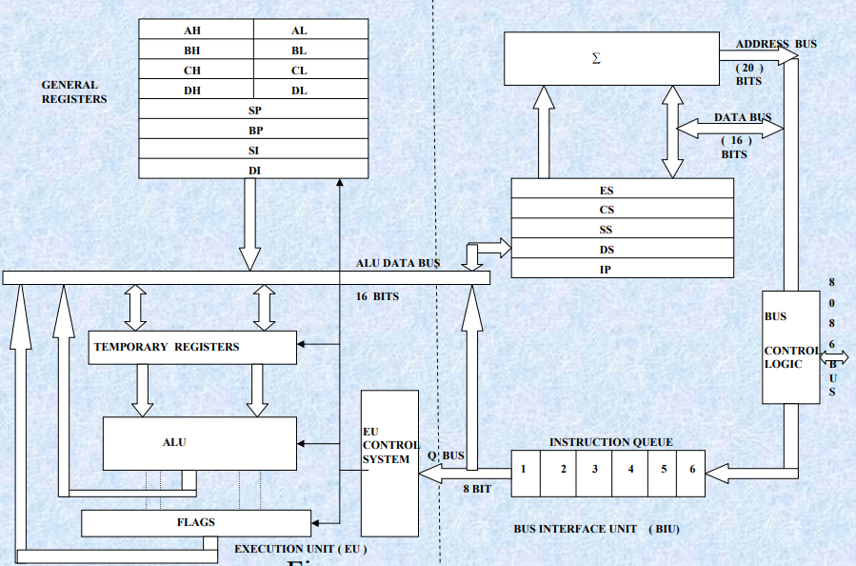
Architecture - 8086 microprocessor

Slide 7
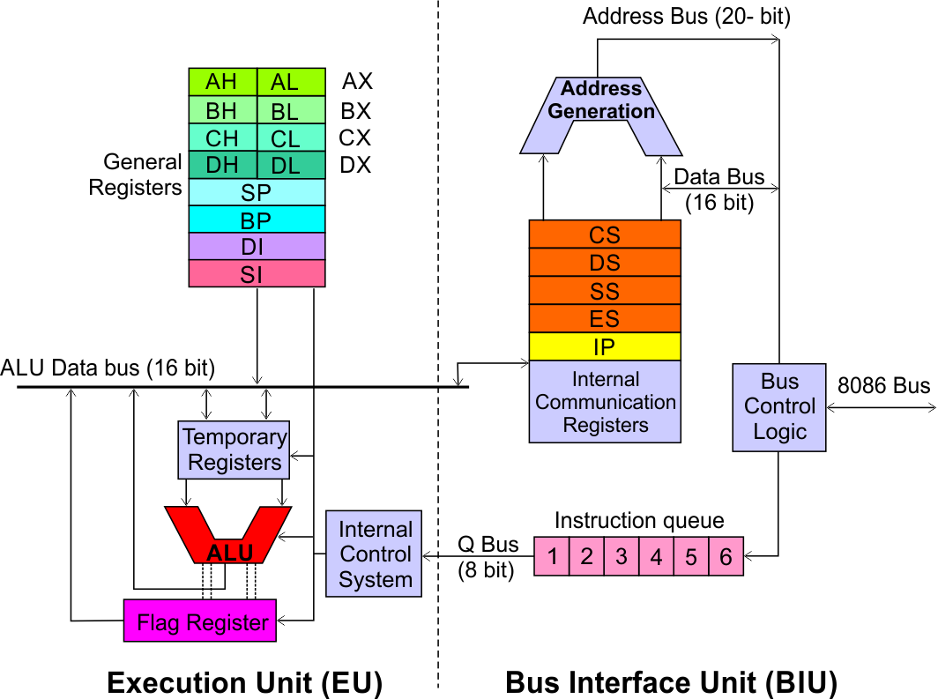

Slide 8
Two functional units
Bus Interface Unit (BIU)
Execution Unit (EU)
BIU fetches instructions, reads data from memory and I/O ports, writes data to memory and I/ O ports.
This unit is responsible for establishing communication with external devices and peripherals including memory via the bus.
EU executes instructions that have already been fetched by the BIU.
These two units can work simultaneously to increase system throughput.
The throughput is a measure of number of instructions executed per unit time.

Slide 9
Bus Interface Unit
Instruction Queue
Segment registers
Instruction Pointers
Address summer
Bus Control Logic

Slide 10
Execution unit
Control Circuit
Instruction Decoder
Arithmetic Logic Unit (ALU)
Flag Registers
General purpose registers
Pointers and Index Registers

Slide 11
Registers
It consist of :
General purpose registers
Special purpose registers
General purpose registers :
It can be used as 8 bit or 16 bit.
Used for holding data, variables, intermediate results etc..
Special purpose registers
Used as segment registers, pointers, index registers

Slide 12
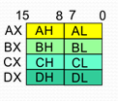
General data registers

Slide 13
General data registers
AX,BX,CX and DX are the general purpose 16-bit registers.
AX is used as 16 bit accumulator.
AL can be used as an 8-bit accumulator for 8-bit operations.
BX is used as an offset storage for forming physical addresses in case of certain addressing modes.
CX register is used as a default counter.
DX register is used as an implicit operand or destination in case of a few instruction.

Slide 14
Segment registers
8086 addresses are segmented memory.
The complete 1 megabyte memory is divided into 16 logical segments.
Each segments contains 64 Kbytes of memory.
Four segment registers:
code segment register(CS)
Data segment register(DS)
Extra segment register(ES)
Stack segment register(SS)

Slide 15
8086 Microprocessor
Bus Interface Unit (BIU)
Dedicated Adder to generate 20 bit address
Four 16-bit segment registers
Code Segment (CS)
Data Segment (DS)
Stack Segment (SS)
Extra Segment (ES)
Segment Registers >>

Slide 16
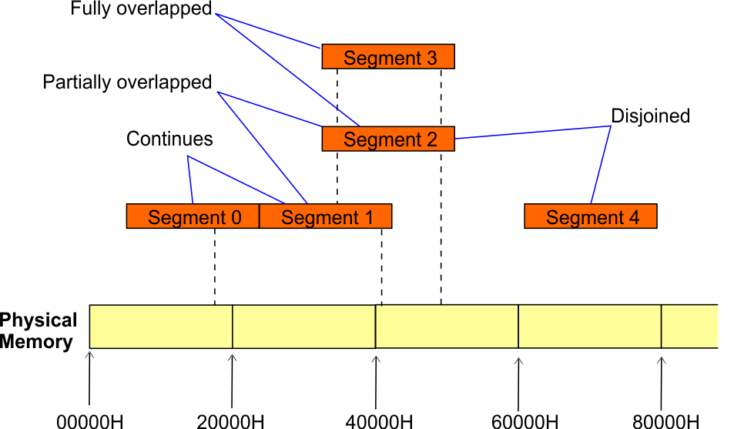
8086 Microprocessor
Bus Interface Unit (BIU)
Segment
Registers
8086’s 1-megabyte memory is divided into segments of up to 64K bytes each.
The 8086 can directly address four segments (256 K bytes within the 1 M byte of memory) at a particular time.
Programs obtain access to code and data in the segments by changing the segment register content to point to the desired segments.

Slide 17
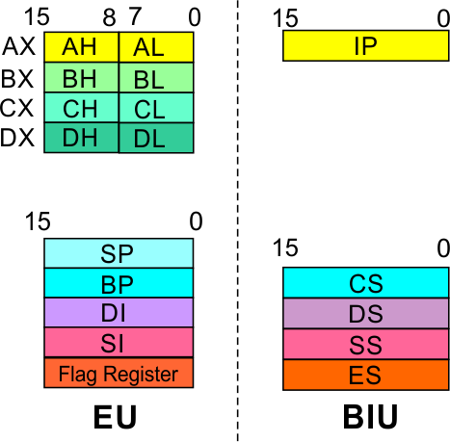
8086 Microprocessor
Bus Interface Unit (BIU)
Code Segment Register
16-bit
Used for addressing a memory location in the code segment of the memory.
CS contains the base or start of the current code segment; IP contains the distance or offset from this address to the next instruction byte to be fetched.
BIU computes the 20-bit physical address by logically shifting the contents of CS 4-bits to the left and then adding the 16-bit contents of IP
Segment
Registers
Data Segment Register
16-bit
Points to the current data segment; operands for most instructions are fetched from this segment.
The 16-bit contents of the Source Index (SI) or Destination Index (DI) or a 16-bit displacement are used as offset for computing the 20-bit physical address.

Slide 18
8086 Microprocessor
Bus Interface Unit (BIU)
Segment
Registers
Stack Segment Register
16-bit
Points to the current stack.
It is used for addressing stack segment of memory.
Extra Segment Register
16-bit
Points to the extra segment in which data
(in excess of 64K pointed to by the DS) is stored.
String instructions use the ES and DI to determine the 20-bit physical address for the destination.

Slide 19
Pointer and index register

Slide 20
Pointer and index register
Pointer contains offset within the particular segments.
The pointers IP,BP and SP usually contains offsets within the code and stack segment.
Index registers are used as general purpose registers as well as for offset storage in case of indexed, base indexed and relative indexed addressing modes.
SI register is used to store the offset of source data in data segment
DI register used to store the offset of destination data in data or extra segment.

Slide 21
Physical address calculation
Calculated from segment address and offset
The segment register contains 16-bit segment base address, related to different segment.
Any of the pointers and index registers or BX may contains the offset of the location to be addressed.

Slide 22
8086 Microprocessor
Bus Interface Unit (BIU)
Segment
Registers
Instruction Pointer
16-bit
Always points to the next instruction to be executed within the currently executing code segment.
Its content is automatically incremented as the execution of the next instruction takes place.

Slide 23
8086 Microprocessor
Bus Interface Unit (BIU)
Instruction queue
A group of First-In-First-Out (FIFO) in which up to 6 bytes of instruction code are pre fetched from the memory ahead of time.
This is done in order to speed up the execution by overlapping instruction fetch with execution.
Fetching the next instruction while the current instruction executes is called pipelining.

Slide 24
Instruction queue
While the fetched instruction is executed internally, the external bus is used to fetch the machine code of the next instruction and arrange it in a queue known as predecoded instruction byte queue.
It is 6 byte long, FIFO structure.
The instruction from the queue are taken for decoding sequentially.
Once a byte is decode, the queue is rearranged by pushing it out and the queue status is checked for the possibility of the next opcode fetch cycle.
While the opcode is fetched by the BIU, the EU executes the previously decoded instruction concurrently.
The BIU along with the EU, thus form a pipeline.
i.e Fetching the next instruction while the current instruction executes is called pipelining.

Slide 25
8086 Microprocessor
Execution Unit (EU)
EU decodes and executes instructions.
A decoder in the EU control system translates instructions.
16-bit ALU for performing arithmetic and logic operation
Four general purpose registers(AX, BX, CX, DX);
Pointer registers (Stack Pointer, Base Pointer);
and
Index registers (Source Index, Destination Index) each of 16-bits
Some of the 16 bit registers can be used as two 8 bit registers as :
AX can be used as AH and AL
BX can be used as BH and BL
CX can be used as CH and CL
DX can be used as DH and DL

Slide 26
8086 Microprocessor
Execution Unit (EU)
EU
Registers
Accumulator Register (AX)
Consists of two 8-bit registers AL and AH, which can be combined together and used as a 16-bit register AX.
AL in this case contains the low order byte of the word, and AH contains the high-order byte.
The I/O instructions use the AX or AL for inputting / outputting 16 or 8 bit data to or from an I/O port.
Multiplication and Division instructions also use the AX or AL.

Slide 27
8086 Microprocessor
Execution Unit (EU)
EU
Registers
Base Register (BX)
Consists of two 8-bit registers BL and BH, which can be combined together and used as a 16-bit register BX.
BL in this case contains the low-order byte of the word, and BH contains the high-order byte.
This is the only general purpose register whose contents can be used for addressing the 8086 memory.

Slide 28
8086 Microprocessor
Execution Unit (EU)
EU
Registers
Counter Register (CX)
Consists of two 8-bit registers CL and CH, which can be combined together and used as a 16-bit register CX.
When combined, CL register contains the low order byte of the word, and CH contains the high-order byte.
Instructions such as SHIFT, ROTATE and LOOP use the contents of CX as a counter.

Slide 29
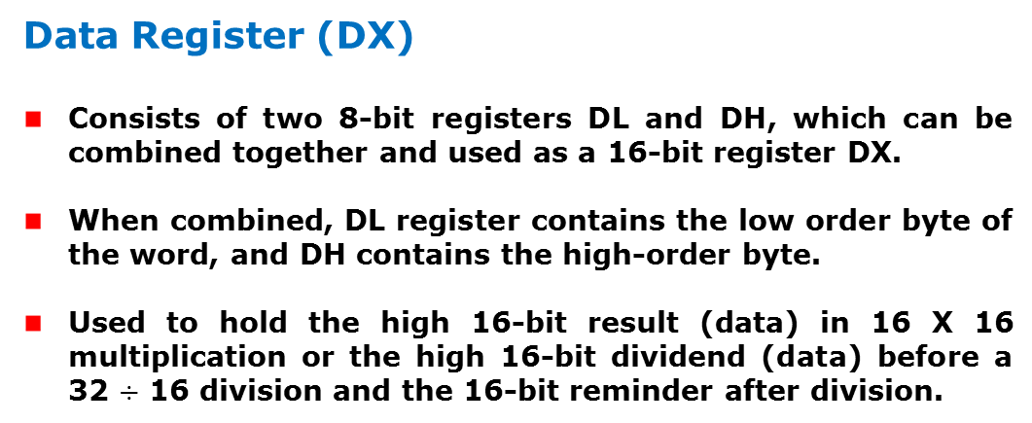
8086 Microprocessor
Execution Unit (EU)
EU
Registers
Data Register (DX)
Consists of two 8-bit registers DL and DH, which can be combined together and used as a 16-bit register DX.
When combined, DL register contains the low order byte of the word, and DH contains the high-order byte.
Used to hold the high 16-bit result (data) in 16 X 16 multiplication or the high 16-bit dividend (data) before a 32 $÷$ 16 division and the 16-bit reminder after division.

Slide 30
8086 Microprocessor
Execution Unit (EU)
EU
Registers
Stack Pointer (SP) and Base Pointer (BP)
SP and BP are used to access data in the stack segment.
SP is used as an offset from the current SS during execution of instructions that involve the stack segment in the external memory.
SP contents are automatically updated (incremented/ decremented) due to execution of a POP or PUSH instruction.
BP contains an offset address in the current SS, which is used by instructions utilizing the based addressing mode.

Slide 31
8086 Microprocessor
Execution Unit (EU)
EU
Registers
Source Index (SI) and Destination Index (DI)
Used in indexed addressing.
Instructions that process data strings use the SI and DI registers together with DS and ES respectively in order to distinguish between the source and destination addresses.

Slide 32
8086 Microprocessor
Execution Unit (EU)
EU
Registers
Source Index (SI) and Destination Index (DI)
Used in indexed addressing.
Instructions that process data strings use the SI and DI registers together with DS and ES respectively in order to distinguish between the source and destination addresses.

Slide 33
Flag registers
It has a 16 bit flag register.
Divided into two parts
Condition codes or status flag
Control flag register
Control flag registers-
direction flag
interrupt flag
trap flag

Slide 34
8086 Microprocessor
Execution Unit (EU)
Auxiliary Carry Flag
This is set, if there is a carry from the lowest nibble, i.e, bit three during addition, or borrow for the lowest nibble, i.e, bit three, during subtraction.
Carry Flag
This flag is set, when there is a carry out of MSB in case of addition or a borrow in case of subtraction.
Flag Register
Sign Flag
This flag is set, when the result of any computation is negative
Zero Flag
This flag is set, if the result of the computation or comparison performed by an instruction is zero
Parity Flag
This flag is set to 1, if the lower byte of the result contains even number of 1’s ; for odd number of 1’s set to zero.
15 | 14 | 13 | 12 | 11 | 10 | 9 | 8 | 7 | 6 | 5 | 4 | 3 | 2 | 1 | 0
 |  |  |  | OF | DF | IF | TF | SF | ZF |  | AF |  | PF |  | CF
Over flow Flag
This flag is set, if an overflow occurs, i.e, if the result of a signed operation is large enough to accommodate in a destination register. The result is of more than 7-bits in size in case of 8-bit signed operation and more than 15-bits in size in case of 16-bit sign operations, then the overflow will be set.
Trap Flag
If this flag is set, the processor enters the single step execution mode by generating internal interrupts after the execution of each instruction
Direction Flag
This is used by string manipulation instructions. If this flag bit is ‘0’, the string is processed beginning from the lowest address to the highest address, i.e., auto incrementing mode. Otherwise, the string is processed from the highest address towards the lowest address, i.e., auto decrementing mode.
Interrupt Flag
Causes the 8086 to recognize external mask interrupts; clearing IF disables these interrupts.

Slide 35
Flag registers

Slide 36
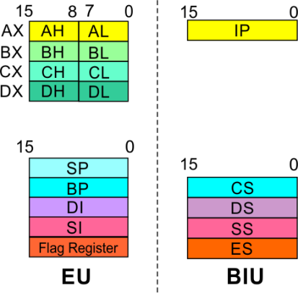
8086 Microprocessor
Architecture
8086 registers categorized into 4 groups
15 | 14 | 13 | 12 | 11 | 10 | 9 | 8 | 7 | 6 | 5 | 4 | 3 | 2 | 1 | 0
 |  |  |  | OF | DF | IF | TF | SF | ZF |  | AF |  | PF |  | CF
Sl.No. | Type | Register width | Name of register
1 | General purpose register | 16 bit | AX, BX, CX, DX
 |  | 8 bit | AL, AH, BL, BH, CL, CH, DL, DH
2 | Pointer register | 16 bit | SP, BP
3 | Index register | 16 bit | SI, DI
4 | Instruction Pointer | 16 bit | IP
5 | Segment register | 16 bit | CS, DS, SS, ES
6 | Flag (PSW) | 16 bit | Flag register

Slide 37
8086 Microprocessor
Architecture
Registers and Special Functions
Register | Name of the Register | Special Function
AX | 16-bit Accumulator | Stores the 16-bit results of arithmetic and logic operations
AL | 8-bit Accumulator | Stores the 8-bit results of arithmetic and logic operations
BX | Base register | Used to hold base value in base addressing mode to access memory data
CX | Count Register | Used to hold the count value in SHIFT, ROTATE and LOOP instructions
DX | Data Register | Used to hold data for multiplication and division operations
SP | Stack Pointer | Used to hold the offset address of top stack memory
BP | Base Pointer | Used to hold the base value in base addressing using SS register to access data from stack memory
SI | Source Index | Used to hold index value of source operand (data) for string instructions
DI | Data Index | Used to hold the index value of destination operand (data) for string operations

Slide 38
Memory Segmentation
8086 addresses are segmented memory.
The complete 1 megabyte memory is divided into 16 logical segments.
Each segments contains 64 Kbytes of memory.
The 16 bit content of the segment register actually points to the starting location of a particular segment.
To address a specific memory location within the segment, we need an offset address.
The offset address is also 16-bit long so that the maximum offset value can be FFFFH.

Slide 39
Memory Segmentation
The address of the segment may be assigned as 0000H to F000H.
The offset value range from 0000H to FFFFH so that the physical addresses range from 00000H to FFFFFH.
The above case is for non-overlapping segments.
The area of memory from the start of the second segment to the possible end of the first segment is called an overlapped segment area.

Slide 40
Advantage of segmented memory
Allow the memory capacity to be 1 Mbytes although the actual addresses to be handled are of 16-bit size.
Allows the placing of code, date and stack portions of the same program in different parts of memory, for data and code protection.
Permits a program or its data to be put into different areas of memory each time the program is executed. (relocation)

Slide 41
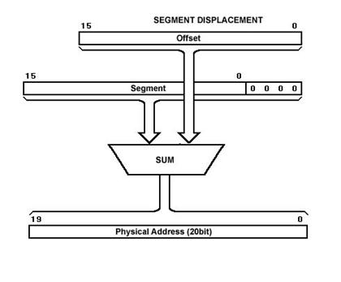
Physical memory address generation

Slide 42
Physical address eg:
Assume the value of Data Segment Register (DS) is 2222H and the offset value is 0016H.
ie: Data at any location has a logical address specified as:2222H: 0016H
To convert this 16-bit address into 20-bit, the BIU appends 0H to the LSB (by multiplying with 16) of the address.
After appending, the starting address of the Data Segment becomes 22220H.
Therefore the physical address:22220H + 0016H : 22236 H

Slide 43
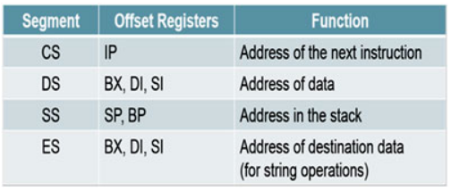
The default offset values to the corresponding memory segments

Slide 44
8086-signal description
The Microprocessor 8086 is a 16-bit CPU available in different clock rates and packaged in a 40 pin DIP or plastic package.
The 8086 operates in single processor or multiprocessor configuration to achieve high performance.
The pins serve a particular function in minimum mode (single processor mode) and other function in maximum mode configuration (multiprocessor mode).

Slide 45
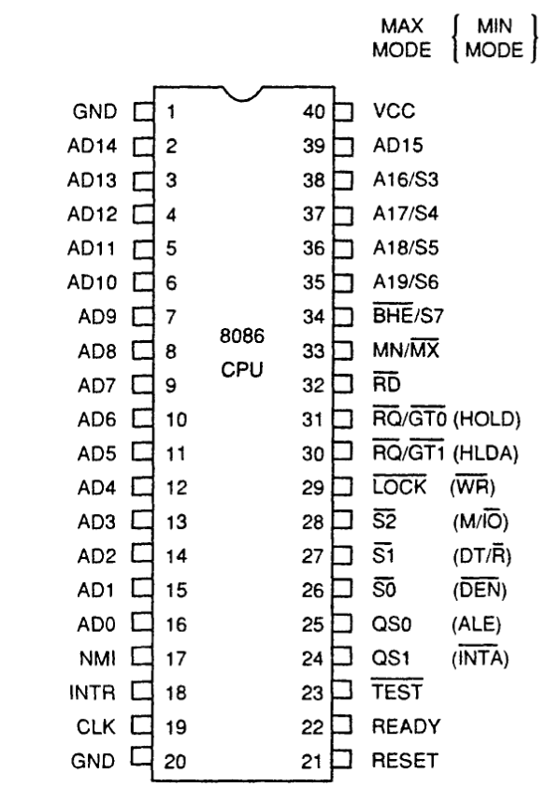
INTEL 8086 - Pin Diagram

Slide 46
8086-signal
The 8086 signals can be categorized in three groups.
The signal having common functions in minimum as well as maximum mode.
The signals which have special functions for minimum mode .
The signals having special functions for maximum mode.

Slide 47
INTEL 8086 - Pin Details
Power Supply
5V ± 10%
Ground
Reset
Registers, seg regs, flags
CS: FFFFH, IP: 0000H
If high for minimum 4 clks
Clock
Duty cycle: 33%

Slide 48
INTEL 8086 - Pin Details
Address/Data Bus:
Contains address bits A₁₅-A₀ when ALE is 1 & data bits D₁₅ – D₀ when ALE is 0.
Address Latch Enable:
When high, multiplexed address/data bus contains address information.

Slide 49
INTEL 8086 - Pin Details
INTERRUPT
Non - maskable interrupt
Interrupt acknowledge
Interrupt request

Slide 50
INTEL 8086 - Pin Details
Direct Memory Access
Hold
Hold acknowledge

Slide 51
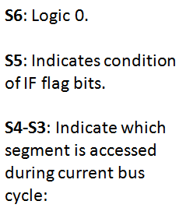
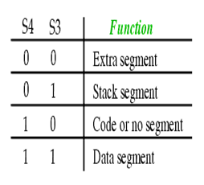
INTEL 8086 - Pin Details
Address/Status Bus
Address bits A₁₉ – A₁₆ & Status bits S₆ – S₃

Slide 52
INTEL 8086 - Pin Details
BHE#, A₀:
0,0: Whole word (16-bits)
0,1: High byte to/from odd address
1,0: Low byte to/from even address
1,1: No selection
Bus High Enable/S7
Enables most significant data bits D₁₅ – D₈ during read or write operation.
S₇: Always 1.

Slide 53
INTEL 8086 - Pin Details
Min/Max mode
Minimum Mode: +5V
Maximum Mode: 0V
Minimum Mode Pins
Maximum Mode Pins

Slide 54
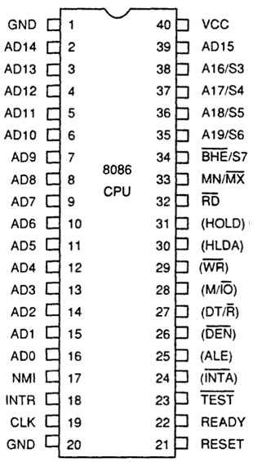
Minimum Mode- Pin Details
Read Signal
Write Signal
Memory or I/0
Data Transmit/Receive
Data Bus Enable

Slide 55
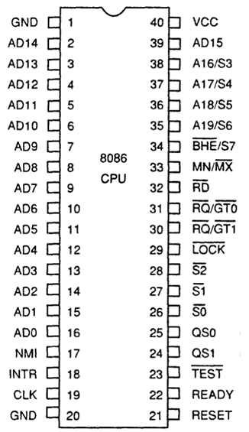
Maximum Mode - Pin Details
S2 S1 S0
000: INTA
001: read I/O port
010: write I/O port
011: halt
100: code access
101: read memory
110: write memory
111: none -passive
Status Signal
Inputs to 8288 bus controller to generate bus timing and control signals.

Slide 56
Maximum Mode - Pin Details
Lock Output
Used to lock peripherals off the system
Activated by using the LOCK: prefix on any instruction
DMA Request/Grant
Lock Output

Slide 57
Maximum Mode - Pin Details
QS1 QS0
00: Queue is idle
01: First byte of opcode
10: Queue is empty
11: Subsequent byte of opcode
Queue Status
Used by numeric coprocessor (8087)

