Slide 1
8279 KEYBOARD AND DISPLAY INTERFACING

Slide 2
8279 programmable keyboard/display controller is designed by Intel that interfaces a keyboard with the CPU.
The keyboard interface first scans the keyboard and identifies if any key has been pressed.
It then sends their relative response of the pressed key to the CPU and vice-a-versa.
It also transmit the received data from the CPU to the display device.

Slide 3
The Keyboard can be interfaced in two modes:
Interrupt mode
polled mode
Interrupt mode:
The processor is requested service only if any key is pressed, otherwise the CPU will continue with its main task.
Polled mode:
The CPU periodically reads an internal flag of 8279 to check whether any key is pressed or not with key pressure.

Slide 4
8279 working
The keyboard consists of maximum 64 keys, which are interfaced with the CPU by using the key-codes.
These key-codes are de-bounced and stored in an 8-byte FIFORAM, which can be accessed by the CPU.
If more than 8 characters are entered in the FIFO, then it means more than eight keys are pressed at a time.
This is when the overrun status is set.
If a FIFO contains a valid key entry, then the CPU is interrupted in an interrupt mode else the CPU checks the status in polling to read the entry.
Once the CPU reads a key entry, then FIFO is updated, and the key entry is pushed out of the FIFO to generate space for new entries.

Slide 5
Architecture and Signal Descriptions of 8279
The keyboard display controller chip 8279 provides:
A set of four scan lines and eight return lines for interfacing keyboards
A set of eight output lines for interfacing display

Slide 6
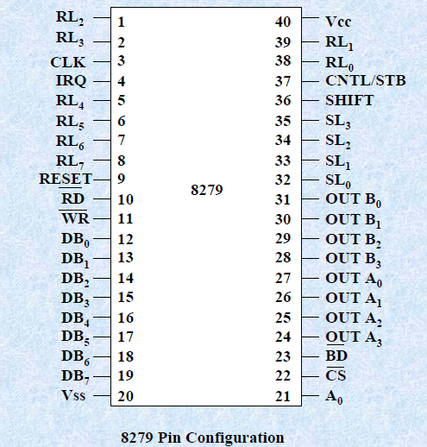
PIN DIAGRAM OF 8279

Slide 7
DB0-DB7 :
These are bidirectional data bus lines.
The data and command words to and from the CPU are transferred on these lines.
CLK :
This is a clock input used to generate internal timing required by 8279.
RESET :
This pin is used to reset 8279. A high on this line reset 8279. After resetting 8279, its in sixteen 8-bit display, left entry encoded scan, 2-key lock out mode. The clock prescaler is set to 31.

Slide 8
CS : Chip Select –
A low on this line enables 8279 for normal read or write operations.
Other wise, this pin should remain high.
A0 :
A high on this line indicates the transfer of a command or status information.
A low on this line indicates the transfer of data.
This is used to select one of the internal registers of 8279.
RD, WR ( Input/Output ) READ/WRITE –
These input pins enable the data buffers to receive or send data over the data bus.

Slide 9
IRQ :
This interrupt output lines goes high when there is a data in the FIFO sensor RAM.
The interrupt lines goes low with each FIFO RAM read operation but if the FIFO RAM further contains any key-code entry to be read by the CPU, this pin again goes high to generate an interrupt to the CPU.
Vss, Vcc :
These are the ground and power supply lines for the circuit.
SL0-SL3-Scan Lines :
These lines are used to scan the key board matrix and display digits.
These lines can be programmed as encoded or decoded, using the mode control register

Slide 10
RL0 - RL7 - Return Lines :
These are the input lines which are connected to one terminal of keys, while the other terminal of the keys are connected to the decoded scan lines.
These are normally high, but pulled low when a key is pressed.
SHIFT :
The status of the shift input lines is stored along with each key code in FIFO, in scanned keyboard mode.
It is pulled up internally to keep it high, till it is pulled low with a key closure.
BD – Blank Display :
This output pin is used to blank the display during digit switching or by a blanking closure.

Slide 11
OUT A0 – OUT A3 and OUT B0 – OUT B3 –
These are the output ports for two 16*4 or 16*8 internal display refresh registers.
The data from these lines is synchronized with the scan lines to scan the display and keyboard.
The two 4-bit ports may also as one 8-bit port.
CNTL/STB- CONTROL/STROBED I/P Mode :
In keyboard mode, this lines is used as a control input and stored in FIFO on a key closure.
The line is a strobed lines that enters the data into FIFO RAM, in strobed input mode.
It has an interrupt pull up. The lines is pulled down with a key closer.

Slide 12
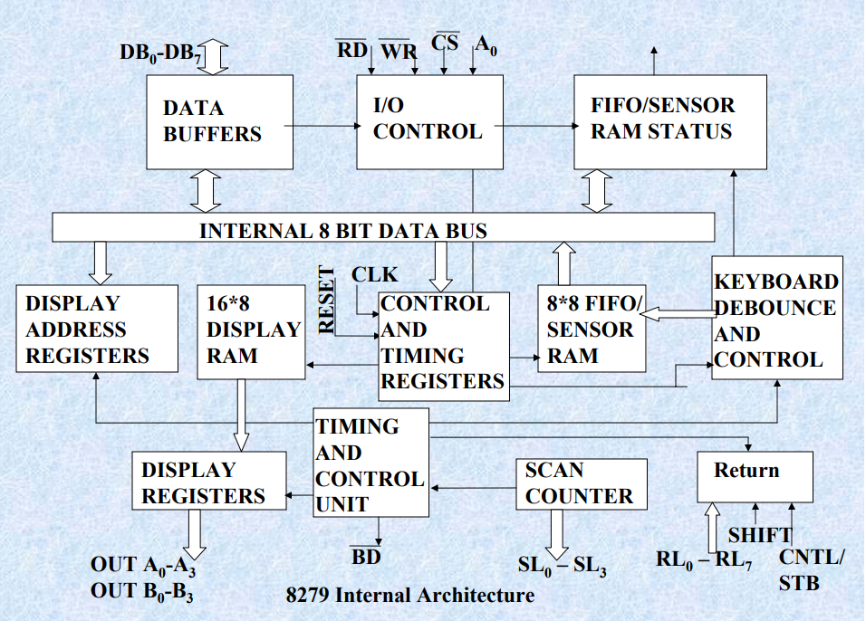
8279 internal architecture

Slide 13
It consists 4 main section.
CPU interface and control section.
Scan section
Keyboard Section
Display section.
CPU INTERFACE AND CONTROL SECTION:
It consists of
Data buffers
I/O control
Control and timing registers.
Timing and control logic.

Slide 14
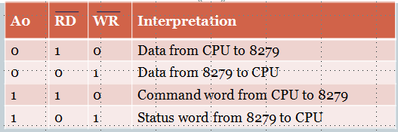
I/O Control and Data Buffers :
The I/O control section controls the flow of data to/from the 8279.
The data buffers interface the external bus of the system with internal bus of 8279.
The I/O section is enabled only if CS is low. The pins A0, RD and WR select the command, status or data read/write operations carried out by the CPU with 8279.

Slide 15
Control and Timing Register and Timing Control :
These registers store the keyboard and display modes and other operating conditions programmed by CPU.
The registers are written with A0=1 and WR=0.
The Timing and control unit controls the basic timings for the operation of the circuit.
Scan counter divide down the operating frequency of 8279 to derive scan keyboard and scan display frequencies.

Slide 16
Scan section
It has two modes,
Encoded mode
Decoded mode.
ENCODED MODE:
It provide binary count from 0000 to 1111 by four scan lines(SC3-SC0)by active high inputs.
It is externally decoded to provide 16 scan lines

Slide 17
Display use all 16 lines to interface 16 digit 7 segment display.
But keyboard use only 8 scan lines out of 16 lines.
DECODED MODE:
In this mode ,the internal decoder decodes the least 2 significant bits.
It is provide four possible combination from (SC0-SC3) such as 1110 ,1101 ,1011 and 0111.
This four active low outputs line is used to directly to interface 4 –digit 7-segment display ,8*4 matrix keyboard

Slide 18
Scan Counter
The scan counter has two modes to scan the key matrix and refresh the display.
In the encoded mode, the counter provides binary count that is to be externally decoded to provide the scan lines for keyboard and display (Four externally decoded scan lines may drive upto 16 displays).
In the decode scan mode, the counter internally decodes the least significant 2 bits and provides a decoded 1 out of 4 scan on SL 0-SL 3( Four internally decoded scan lines may drive upto 4 displays).
The keyboard and display both are in the same mode at a time

Slide 19
Keyboard section
This is consist of,
Return buffers.
Keyboard debounce control.
FIFO / sensor RAM.
FIFO / sensor RAM status.

Slide 20
Return Buffers and Keyboard Debounce and Control
This section for a key closure row wise.
If a key closer is detected, the keyboard debounce unit debounces the key entry (i.e. wait for 10 ms).
After the debounce period, if the key continues to be detected.
The code of key is directly transferred to the sensor RAM along with SHIFT and CONTROL key status

Slide 21
FIFO/Sensor RAM and Status Logic
This unit acts as 8-byte first-in-first-out (FIFO) RAM where the key code of every pressed key is entered into the RAM as per their sequence.
The status logic generates an interrupt request after each FIFO read operation till the FIFO gets empty.
In the scanned sensor matrix mode, this unit acts as sensor RAM where its each row is loaded with the status of their corresponding row of sensors into the matrix.
When the sensor changes its state, the IRQ line changes to high and interrupts the CPU.

Slide 22
Display section
It consists of,
Display RAM.
Display Address registers.
Display registers.

Slide 23
DISPLAY RAM:
It is a 16*8 RAM.
Which stores 16 digits display codes.
It can be accessed by CPU directly.
In Decoded mode,8279 uses only first four location of Display RAM.
In Encoded mode,8279 uses only first eight location of Display RAM.
And all 16 location for 16 digits display.

Slide 24
DISPLAY ADDRESS REGISTERS:
Used to hold address of the byte currently write or read by the CPU and scan count value.
In auto increment mode, address in the register is automatically incremented for each write or read.
DISPLAY REGISTERS:
It is a Two 4-bit registers such as , A and B.
They hold the bit patterns of character to be displayed.
The content of display registers A and B can B blanked and inhibited individually.

Slide 25
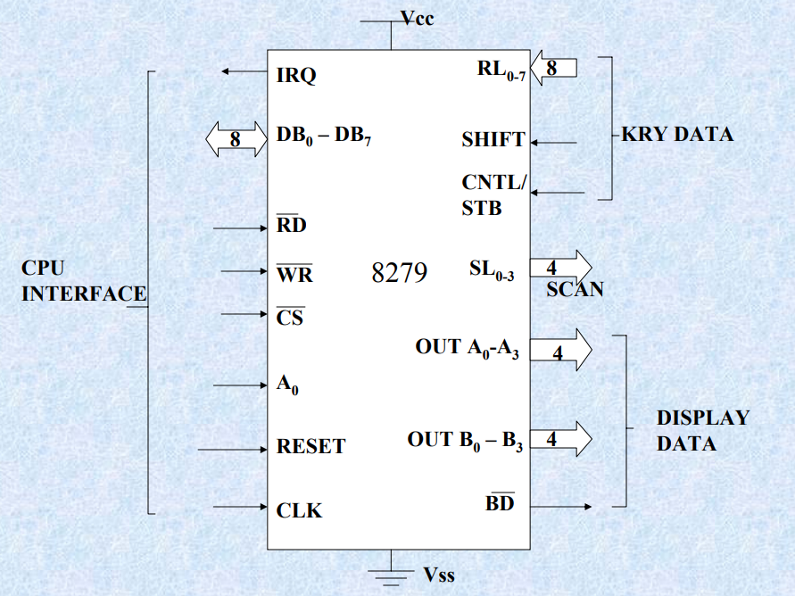

Slide 27
Modes of Operation of 8279
The modes of operation of 8279 are as follows :
Input (Keyboard) modes.
Output (Display) modes.
Input ( Keyboard ) Modes :
Scanned Keyboard Mode
Scanned Sensor Matrix
Strobed input
Output (Display) Modes
Display Scan
Display Entry

Slide 28
Scanned Keyboard Mode :
This mode allows a key matrix to be interfaced using either encoded or decoded scans.
In encoded scan, an 8*8 keyboard or in decoded scan, a 4*8 keyboard can be interfaced.
The code of key pressed with SHIFT and CONTROL status is stored into the FIFO RAM.

Slide 29
Scanned Sensor Matrix :
In this mode, a sensor array an be interfaced with 8279 using either encoded or decoded scans.
With encoded scan 8*8 sensor matrix or with decoded scan 4*8 sensor matrix can be interfaced.
The sensor codes are stored in the CPU addressable sensor RAM.
Strobed input:
In this mode, if the control lines goes low, the data on return lines, is stored in the FIFO byte by byte.

Slide 30
Display Scan :
In this mode 8279 provides 8 or 16 character multiplexed displays those can be organized as dual 4- bit or single 8-bit display units.
Display Entry : ( right entry or left entry mode )
8279allows options for data entry on the displays.
The display data is entered for display either from the right side or from the left side.

Slide 31
Scanned Keyboard mode with 2 Key Lockout :
In this mode of operation, when a key is pressed, a debounce logic comes into operation.
During the next two scans, other keys are checked for closure and if no other key is pressed the first pressed key is identified.
The key code of the identified key is entered into the FIFO with SHIFT and CNTL status, provided the FIFO is not full, i.e. it has at least one byte free.
If the FIFO does not have any free byte, naturally the key data will not be entered and the error flag is set.

Slide 32
If FIFO has at least one byte free, the above code is entered into it and the 8279 generates an interrupt on IRQ line to the CPU to inform about the previous key closures.
If another key is found closed during the first key, the keycode is entered in FIFO.
If the first pressed key is released before the others, the first will be ignored.
A key code is entered to FIFO only once for each valid depression, independent of other keys pressed along with it, or released before it.

Slide 33
If two keys are pressed within a debounce cycle (simultaneously ), no key is recognized till one of them remains closed and the other is released.
The last key, that remains depressed is considered as single valid key depression

Slide 34
Scanned Keyboard with N-Key Rollover
In this mode, each key depression is treated independently.
When a key is pressed, the debounce circuit waits for 2 keyboards scans and then checks whether the key is still depressed.
If it is still depressed, the code is entered in FIFO RAM.

Slide 35
Any number of keys can be pressed simultaneously and recognized in the order, the keyboard scan recorded them.
All the codes of such keys are entered into FIFO.
In this mode, the first pressed key need not be released before the second is pressed.
All the keys are sensed in the order of their depression, rather in the order the keyboard scan senses them, and independent of the order of their release.

Slide 36
Scanned Keyboard Special Error Mode
This mode is valid only under the N-Key rollover mode.
This mode is programmed using end interrupt / error mode set command.
If during a single debounce period ( two keyboard scans ) two keys are found pressed , this is considered a simultaneous depression and an error flag is set.
This flag, if set, prevents further writing in FIFO but allows the generation of further interrupts to the CPU for FIFO read. The error flag can be read by reading the FIFO status word.
The error Flag is set by sending normal clear command with CF = 1.

Slide 37
Sensor Matrix Mode
In the sensor matrix mode, the debounce logic is inhibited.
The 8-byte FIFO RAM now acts as 8 * 8 bit memory matrix.
The status of the sensor switch matrix is fed directly to sensor RAM matrix.
Thus the sensor RAM bits contains the row wise and column wise status of the sensors in the sensor matrix.
The IRQ line goes high, if any change in sensor value is detected at the end of a sensor matrix scan or the sensor RAM has a previous entry to be read by the CPU.
The IRQ line is reset by the first data read operation, if AI = 0, otherwise, by issuing the end interrupt command. AI is a bit in read sensor RAM word.

Slide 38
Display Modes
Left Entry Mode :
In the left entry mode, the data is entered from left side of the display unit.
Address 0 of the display RAM contains the leftmost display characters and address 15 of the RAM contains the right most display characters.
Right Entry Mode :
In this right entry mode, the first entry to be displayed is entered on the rightmost display.
The next entry is also placed in the right most display but after the previous display is shifted left by one display position.
The leftmost characters is shifted out of that display at the seventeenth entry and is lost, i.e. it is pushed out of the display RAM

Slide 39
ENCODED SCAN:
In this scan, scan lines (SL2-SL0) are decoded externally to provide 8 scan lines.
Additionally it provides 8 return lines.
So the size of matrix keyboard is 8*8 (i.e Scan * Return)=64.
When the key is pressed , it is stored the status of return lines , Scan lines ,SHIFT and CNTL/STB keys into FIFO RAM.
The Scanned keyboard structure is,
B7 | B6 | B5 | B4 | B3 | B2 | B1 | B0
CNTL | SHIFT | SCAN |  |  | RETURN

Slide 40
Example:
Find the key code for given condition below:
CNTL/STB SHIFT keys are open.
The pressed keys are to scan lines 2 and return lines 4.
SOLUTION:
B7 | B6 | B5 | B4 | B3 | B2 | B1 | B0
1 | 1 | 0 | 1 | 0 | 1 | 0 | 0

