Slide 1
MODULE 5

Slide 2
Microcontroller
A microcontroller (MCU) is a small computer on a single integrated circuit consisting of a relatively simple central processing unit (CPU) combined with peripheral devices such as memories, I/O devices, and timers.

Slide 3
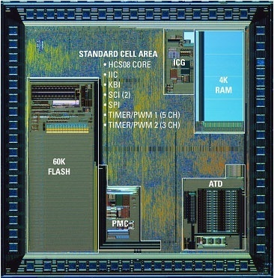
Die shot of a microcontroller

Slide 4
Why do we need to learn Microprocessors/controllers?
The microprocessor is the core of computer systems.
Nowadays many communication, digital entertainment, portable devices, are controlled by them.
A designer should know what types of components he needs, ways to reduce production costs and product reliable.

Slide 5
The necessary tools for a microprocessor/controller
CPU: Central Processing Unit
I/O: Input /Output
Bus: Address bus & Data bus
Memory: RAM & ROM
Timer
Interrupt
Serial Port
Parallel Port

Slide 6
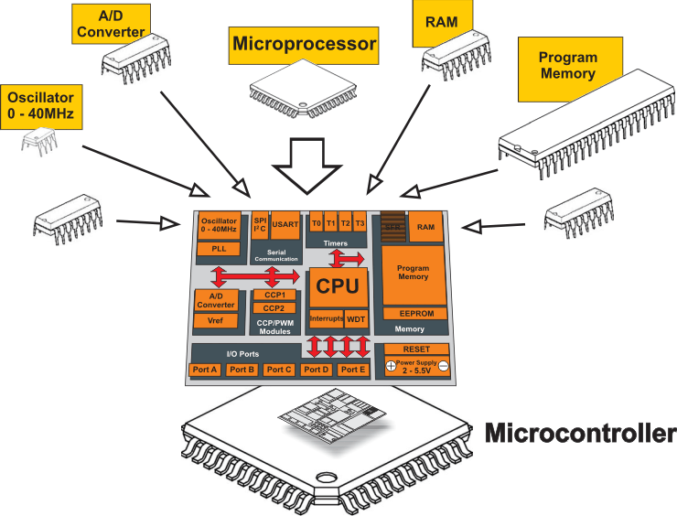
Microcontroller VS Microprocessor

Slide 7
Microprocessors:
General-purpose microprocessor
CPU for Computers
No RAM, ROM, I/O on CPU chip itself
Example：Intel’s x86, Motorola’s 680x0
Many chips on mother’s board
Data Bus
CPU
General-Purpose Micro-processor
I/O Port
Serial COM Port
RAM
ROM
Timer
Address Bus
General-Purpose Microprocessor System
Notes:
Intel’s x86: 8086,8088,80386,80486, Pentium
Motorola’s 680x0: 68000, 68010, 68020,68030,6040

Slide 8
Microcontroller :
A smaller computer
On-chip RAM, ROM, I/O ports...
Example：Motorola’s 6811, Intel’s 8051, Zilog’s Z8 and PIC 16X
CPU
RAM
ROM
A single chip
Serial COM Port
I/O Port
Timer
Microcontroller

Slide 9
Microprocessor vs. Microcontroller
Microprocessor
CPU is stand-alone, RAM, ROM, I/O, timer are separate
Designer can decide on the amount of ROM, RAM and I/O ports.
expensive
general-purpose
Microcontroller
CPU, RAM, ROM, I/O and timer are all on a single chip.
Fix amount of on-chip ROM, RAM, I/O ports
for applications in which cost, power and space are critical
single-purpose
Notes:
versatility 多用途的: any number of applications for PC

Slide 10
Disadvantages of microprocessor
The overall system cost is high
A large sized PCB is required for assembling all the components
Overall product design requires more time
Physical size of the product is big

Slide 11
Advantages of Microcontroller based System
As the peripherals are integrated into a single chip, the overall system cost is very less.
The product is of small size compared to micro processor based system.
The system design now requires very little efforts.
As the peripherals are integrated with a microprocessor the system is more reliable.
Though microcontroller may have on chip ROM,RAM and I/O ports, addition ROM, RAM I/O ports may be interfaced externally if required.
On chip ROM provide a software security

Slide 12
S.No | Microprocessor | Microcontroller
1 | A microprocessor is a general purpose device which is called a CPU | A microcontroller is a dedicated chip which is also called single chip computer.
2 | A microprocessor do not contain onchip I/OPorts, Timers, Memories etc.. | A microcontroller includes RAM, ROM, serial and parallel interface, timers, interrupt circuitry (in addition to CPU) in a single chip.
3 | Microprocessors are most commonly used as the CPU in microcomputer systems | Microcontrollers are used in small, minimum component designs performing control-oriented applications.
4 | Microprocessor instructions are mainly nibble or byte addressable | Microcontroller instructions are both bit addressable as well as byte addressable.
5 | Microprocessor instruction sets are mainly intended for catering to large volumes of data. | Microcontrollers have instruction sets catering to the control of inputs and outputs.
6 | Microprocessor based system design is complex and expensive | Microcontroller based system design is rather simple and cost effective
7 | The Instruction set of microprocessor is complex with large number of instructions. | The instruction set of a Microcontroller is very simple with less number of instructions. For, ex: PIC microcontrollers have only 35 instructions.
8 | A microprocessor has zero status flag | A microcontroller has no zero flag.

Slide 13
Embedded System
Embedded system means the processor is embedded into that application.
An embedded product uses a microprocessor or microcontroller to do one task only.
In an embedded system, there is only one application software that is typically burned into ROM.
Example：printer, keyboard, video game player
A printer is an example of embedded system since the processor inside it performs one task only.
Notes:
processor 整合到整個系統中, 你只看到此系統的外觀, 應用, 感覺不到有 processor 在其中.
Embedded system 通常只有一項應用, 而 PC 有許多 applications (game, accounting, fax, mail...)
A printer is an example of embedded system since the processor inside it performs one task only.

Slide 14
Three criteria in Choosing a Microcontroller
Meeting the computing needs of the task efficiently and cost effectively
speed, the amount of ROM and RAM, the number of I/O ports and timers, size, packaging, power consumption
easy to upgrade
cost per unit
Availability of software development tools
assemblers, debuggers, C compilers, emulator, simulator, technical support
Wide availability and reliable sources of the microcontrollers.

Slide 15
TYPES OF MICROCONTROLLERS
Microcontrollers can be classified on the basis of internal bus width, architecture, memory and instruction set

Slide 16
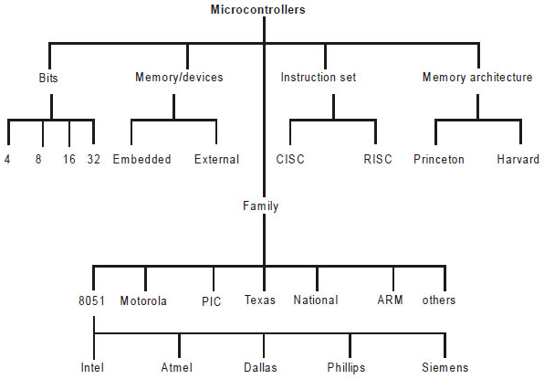
Types of Microcontrollers

Slide 17
CLASSIFICATION BASED ON NO OF BITS
4-bit
8-bit
16-bit
32-bit

Slide 18
Classification According to Memory Devices
The memory devices are divided into two types, they are
Embedded memory microcontroller
External memory microcontroller
Embedded memory microcontroller:
When an embedded system has a microcontroller unit that has all the functional blocks available on a chip is called an embedded microcontroller.
For example, 8051 having program & data memory, I/O ports, serial communication, counters and timers and interrupts on the chip is an embedded microcontroller.
External Memory Microcontroller:
When an embedded system has a microcontroller unit that has not all the functional blocks available on a chip is called an external memory microcontroller.
For example, 8031 has no program memory on the chip is an external memory microcontroller.

Slide 19
TYPES OF MICROCONTROLLER
Types based on vendor or provider
AVR
PIC
Motorolla etc
Hitachi

Slide 20
TYPES OF MICROCONTROLLER
Types based on architecture
1. Harvard architecture
2. Von Neuman architecture

Slide 21
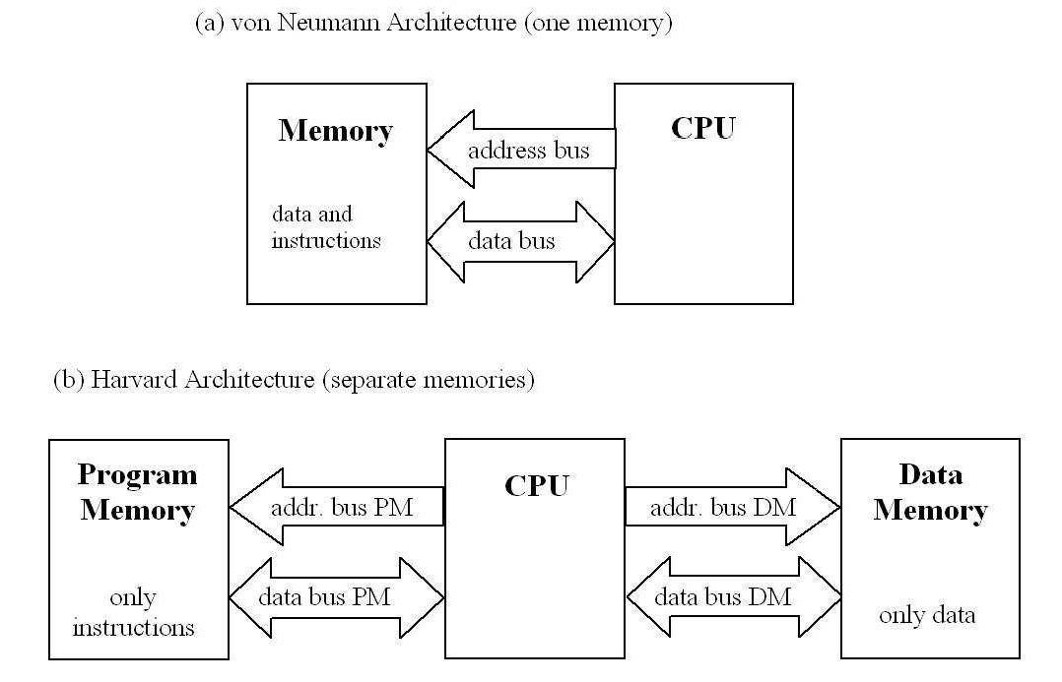
von Neumann / Harvard Arch.

Slide 22
Classification According to Instruction Set
RISC
CISC

Slide 23
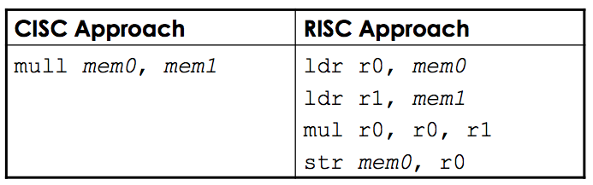
CISC vs. RISC
RISC – Reduced Instruction Set Computers
CISC – Complex Instruction Set Computers
Different architectures for doing the same operations
Suppose you wanted to multiply two numbers in memory locations mem0 & mem1 and store the results back in mem0
Same result but the complexity of operations and the number of steps used in the two cases differ

Slide 24
CISC vs. RISC (1)
CISC | RISC
Example – Intel x86 chips | Examples – SPARC, PowerPC, ARM
Large number of instructions | Few instructions, typically less than 100
Variable-length instructions, instructions can range from 1-15 bytes | Fixed-length instructions, all instructions have the same number of bytes
Some instructions can have long execution times | No instruction with a long execution times execution time

Slide 25
CISC vs. RISC (2)
CISC | RISC
Arithmetic and logical operations can be applied to memory and register operands | Arithmetic and logical operations only use register operands • Memory contents have to be loaded into registers first • Referred to as load/store architecture
Stack-intensive procedure linkage • Stack is used for procedure arguments and return values | Register-intensive procedure linkage • Registers used for procedure arguments and return values

Slide 26
Difference between 8051 and AVR Controllers:
8051s are 8-bit controllers based on CISC architecture, AVRs are 8-bit controllers based on RISC architecture
8051 consumes more power than AVR microcontroller
In 8051, we can program easily than the AVR microcontroller
The speed of AVR is more than the 8051 microcontroller

Slide 27
Comparison some of the 8051 Family Members
 | ROM | RAM | Timer
8051 | 4k | 128 | 2
8031 | - | 128 | 2
8751 | 4k eprom | 128 | 2
8052 | 8krom | 256 | 3
8032 | - | 256 | 3
8752 | 8k eprom | 256 | 3

Slide 28
Applications
Home
Appliances, intercom, telephones, security systems, garage door openers, answering machines, fax machines, TVs, cable TV tuner, VCR, camcorder, remote controls, video games, cellular phones, musical instruments, sewing machines, lighting control, paging, camera, pinball machines, toys, exercise equipment.
Office
Telephones, security systems, fax machines, microwave, copier, laser printer, color printer, paging.
Auto
Navigation system, engine control, air bag, ABS, instrumentation, security system, transmission control, entertainment, climate control, cellular phone, keyless entry.

Slide 29
Definition of Embedded Systems
Embedded system: is a system whose principal function is not computational, but which is controlled by a computer embedded within it.

Slide 30
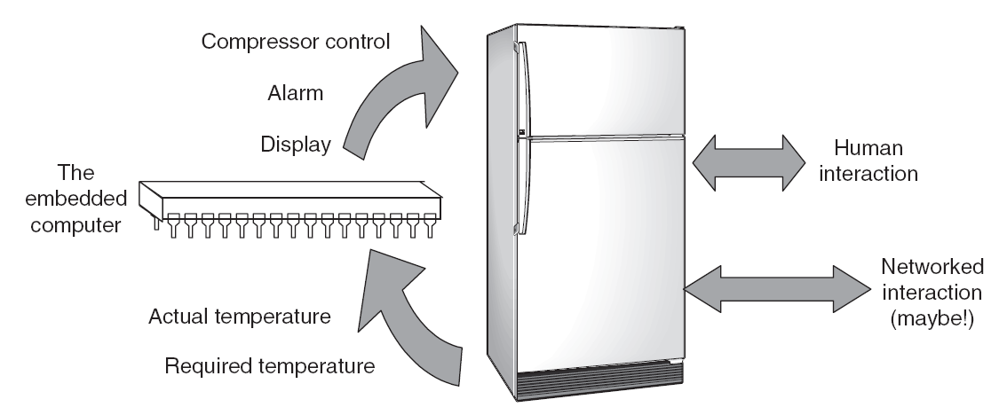
Examples: Refrigerator

Slide 31
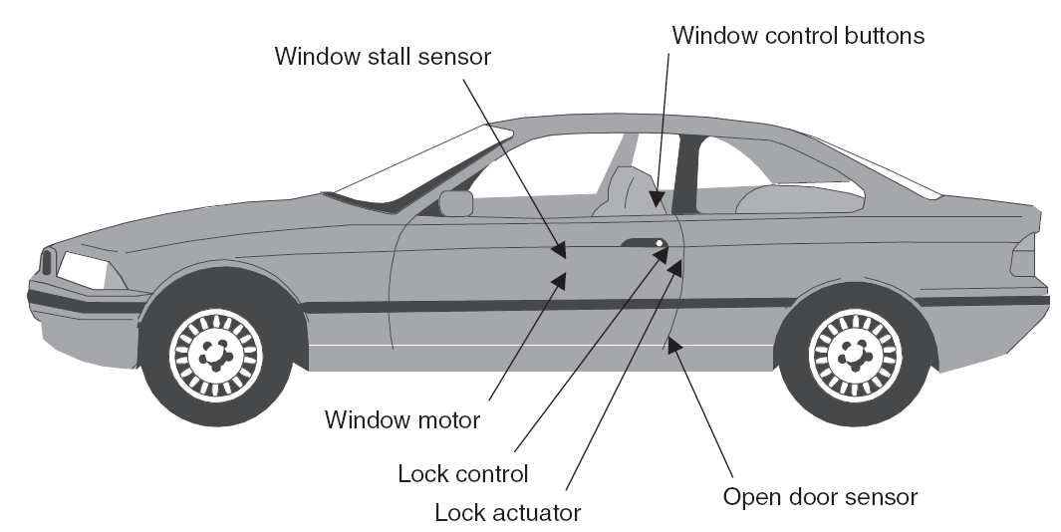
Examples: Car Door

Slide 32
Working with microcontroller
Working with microcontroller can be divided into three steps:-
programming the microcontroller
Connect to the external network
Burning it inside the IC.
1
2
3

Slide 33
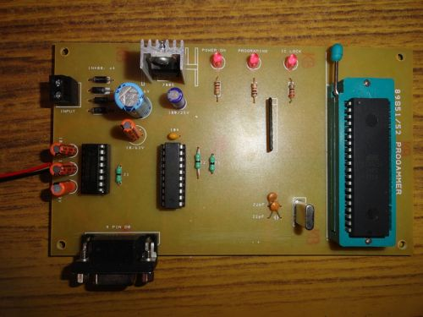

Burning the program in a Microcontroller
A microcontroller programming software
Programmer tool

Slide 34
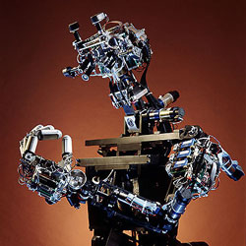
Microcontroller – part and parcel of AI

Slide 35
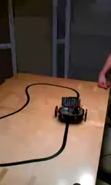
Part and parcel of robotic projects

Slide 36
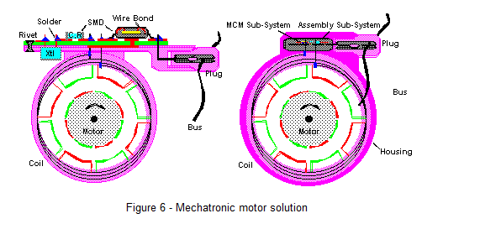
Uses in automobile engine control system
Notes:
http://www.mcjournal.com/articles/arc105/arc105.htm

Slide 37
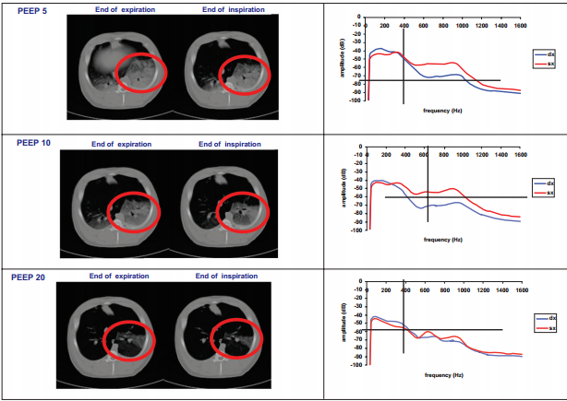
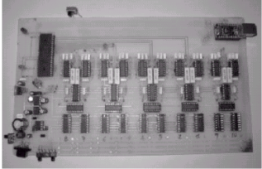
Microcontrollers in medical devices

Slide 38
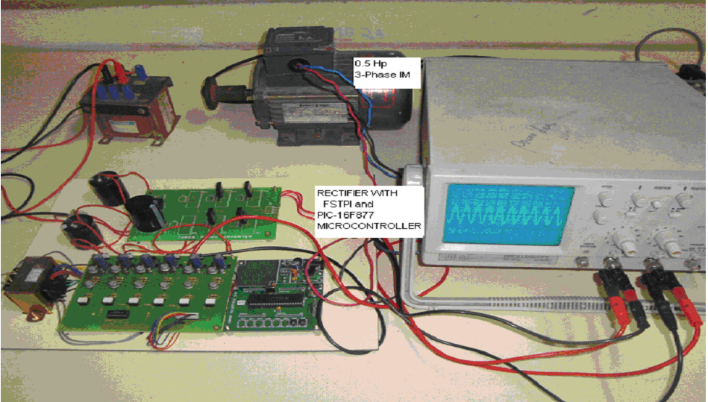
Microcontrollers in power systrem

