Slide 1
Process models

Slide 2
Incremental process models
Incremental process models provide limited functionality early in the software's lifecycle.
This functionality is then expanded on in later releases. We will examine two such processes.

Slide 3
1. Incremental development software model
Incremental approaches attempt to maintain some of the advantages of the pure waterfall model, but attempt to allow for greater change management and overall flexibility in the software process.
Software development occurs in small increments, allowing this model to handle change far better than the waterfall method.

Slide 4
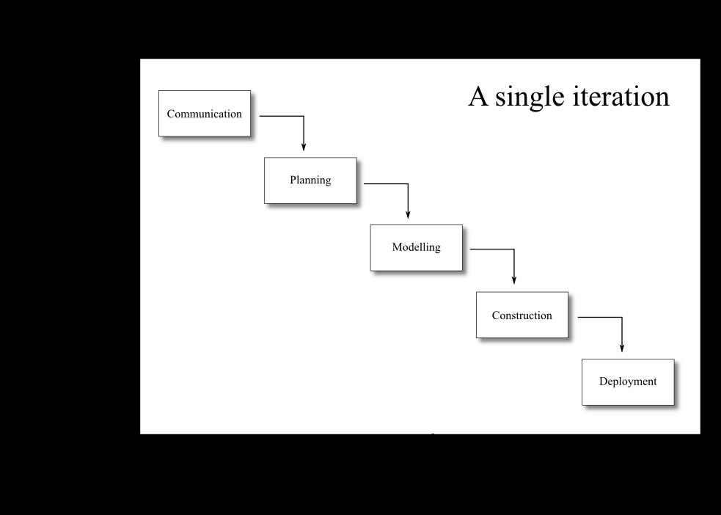

Slide 5
The incremental model allows the developers to quickly release a version of the software with limited functionality, and then at each development iteration to add additional, incremental functionality.
The development in each iteration occurs in a linear method, as with the waterfall model.
Ideally, the most important functions are implemented first and successive stages add new functionality in order of priority.
By doing this, the full development task is broken down into smaller, more manageable portions,
allowing implementation problems to be highlighted before the full system is completed.

Slide 6
Incremental delivery is this process of releasing the product to the client at the end of each iteration.
This allows the client to use regular, updated versions of the software, giving them the capability to judge the progress of the software development.

Slide 7
An incremental development approach has the following advantages:
The process is more responsive to changing user requirements than a waterfall approach — later subsystems can be re-specified. Also a modular approach can mean maintenance changes are simpler and less expensive.
There is an opportunity for incremental delivery to users, so the users can benefit from parts of the system development without having to wait for the entire life cycle to run its course.
Incremental delivery means that users have a portion of the software to examine in order to see how well the software meets their needs, and whether the software requirements have to be modified.

Slide 8
Complete project failure is less likely, since users will have some working sub-systems even if time and money run out before the complete system is delivered.
The project can begin with fewer workers, as only a subset of the final product is being worked on.
The risk associated with the development of the software can be better managed.
The time taken to develop previous iterations can be used as an estimate for the time needed to develop the remaining iterations, and hence improve project planning.

Slide 9
There are some costs, and dangers associated with an incremental development approach though:
This development model relies on close interaction with the users — if they are not easily available or slow in evaluating each iteration, the whole process can slow down.
The reliance on user involvement can exacerbate the already difficult task of estimating the amount of time and budget required.
High user involvement means that resources are drawn away from the customer's normal operation during system development.

Slide 10
2. Rapid Application Development (RAD) process model
Rapid Application Development is an incremental process model that has a focus on short development cycles (hence the term "rapid").
This speed is obtained by using off-the-shelf components, and a component-based design and implementation approach.

Slide 11
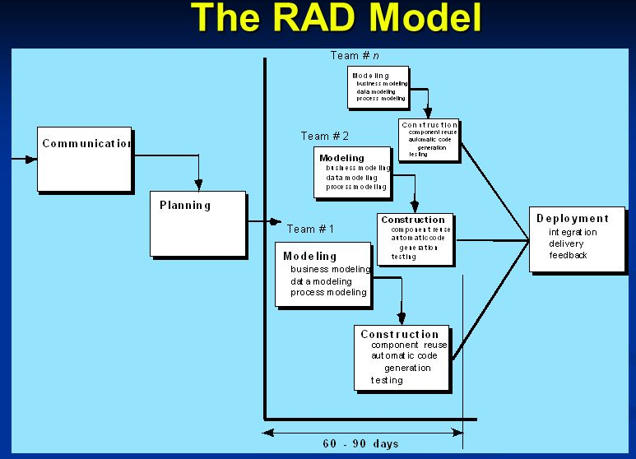

Slide 12
It has the following advantages:
Development cycles are rapid, typically between 60 to 90 days.
It has the following disadvantages:
For large projects, RAD may require a large number of people to split the project into a sufficient number of teams.
The developers and the customers must be committed to the necessary activities in order for the process to succeed.
The project must be suitably modularized in order for RAD to be successful.
RAD may not be appropriate where high-performance is necessary.
RAD may also not be appropriate when technical risks are high.

Slide 13
Evolutionary process models
Product requirements may change with time, even while the software is under development.
Worse, the initial specifications may not be detailed, and tight deadlines may result in a need to have software quickly ready.
All of this points to a product that evolves over time, and evolutionary process models are designed to satisfy the engineering requirements of these products.
Evolutionary process models are, as we shall see, iterative; they allow for the software engineer to deliver a product, and then iteratively move towards a final product as the understanding of the product improves.
One disadvantage to keep in mind is that it can be difficult to plan the number of iterations, and hence the length of the project, in advance.

Slide 14
1. Prototyping life cycle model
A prototype system is a smaller version of part(s) of the final system that gives the user a sense of the finished system's functionality.
It has some of the core features of the final system and, where features and functions are omitted, it pretends to behave like the final system.
Prototypes are typically developed quickly, may lack unnecessary features, may be buggy, and have poor usability.
However, prototypes can fill an important role in understanding software which does not have clear requirements.

Slide 15
Where the system to be developed is a truly new system, there may be no clear requirements defining the software's behavior.
By building a prototype, both the developers and users have some real, visible working system model on which to focus their ideas.
An analysis of this prototype forms the basis for the requirements specification, and perhaps even some of the design.
If there is still uncertainty of the new system and questions still remain, further prototypes can be developed (or an existing prototype extended).
In this way, prototyping allows developers and customers to better understand incomplete and fuzzy software requirements.

Slide 16
Once the developers and users have a clear idea of the software's requirements, the project can move into an another development life-cycle, and the prototypes are thrown away.
This is important, since as we previously mentioned, the prototypes are generated quickly and are not designed to be robust or complete.
To prototype quickly and effectively, fourth generation languages (4GLs), graphical user-interface (GUI) tools (like those that come with Visual Studio, QT and GTK), and off-the-shelf components are commonly used.
The quality of the prototype is only of concern where it would hinder the prototype‘s use in understanding the final software being developed.
If the prototype is usable enough to meet the objectives put forward for its development, the prototype has been successful.

Slide 17
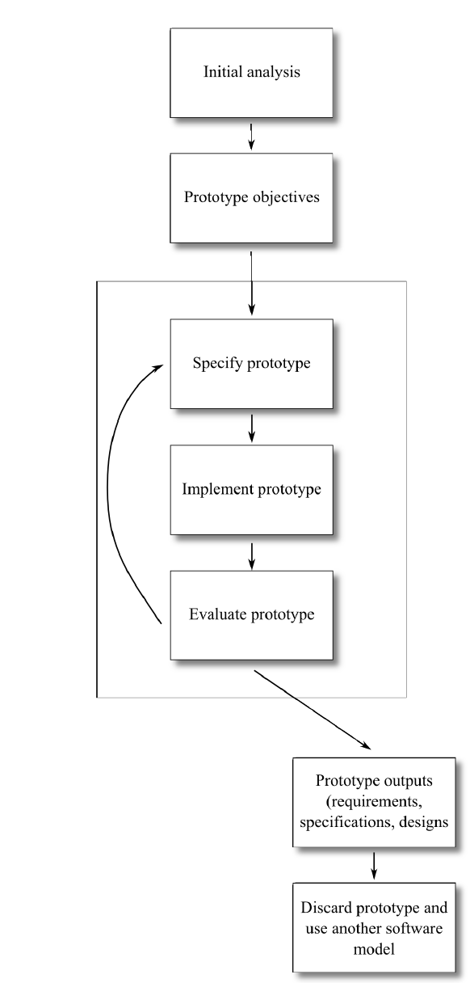

Slide 18
As can be seen, after some initial analysis a set of objectives is developed for the prototype.
These objectives may differ between projects — perhaps detailed requirements need to be elicited, perhaps alternative user interactions are to be evaluated and so on.
Each version of the prototype should be specified so that the software can be correctly designed and implemented — a prototype that does not fully test the objectives is a waste of resources, and may be misleading.
Once a prototype has been completed it should be evaluated against its objectives.
The evaluation decides whether the prototype should be extended, a new prototype developed, or — if the specified objectives are met — if the project can move on to develop the software using another process model.

Slide 19
Advantages of prototyping include:
Users get an early idea of the final system features.
The prototype provides an opportunity to identify problems early and to change the requirements appropriately.
The prototype is a model that all users and customers should be able to understand and provide feedback on, thus the prototype can be an important tool to improve communication between users and developers.
It may be possible to use aspects of the prototype specification and design in the final system specification and design, thus some of the prototype development resources can be recouped.
Disadvantages:
A major problem with developing “disposable” prototypes is that the customer may believe it to be the final product.
Customers may not understand the need to re-engineer the software and restart development, and may ask that the prototype be “cleaned up” and released to them.

Slide 20
2. Boehm's spiral model
The spiral model was published by Barry Boehm in 1986. It provides an iterative, evolutionary approach to software development combined with the step-by-step aspects of the waterfall process model and the requirements analysis abilities of prototyping.
It is intended for development of large, complicated software projects.
This process model provides for the rapid development of progressively more complete versions of the software.
Each iteration of the evolutionary development will have a release, which may merely be a paper model of the software, a prototype, or an early iteration of the software.

Slide 21
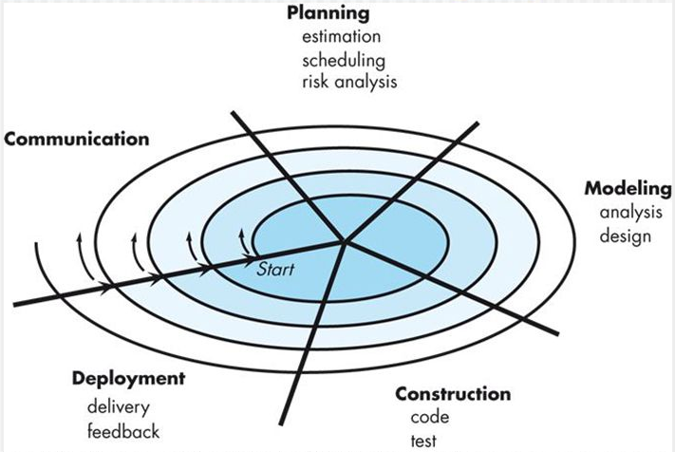

Slide 22
Each iteration of the spiral model contains all of the activities from the generic process framework outlined above: communication, planning, modelling, construction and deployment.
One can consider an iteration to be an arc in a spiral: each arc contains the same breakdown of how the development is approached, but each arc will focus on something new.
Each iteration also requires a certain amount of risk assessment, in order to lay out the plans and determine how the project should proceed.
Risk assessment will adjust the expected number of iterations, and also affect what milestones are expected.
The development of prototypes (as with the prototyping life cycle model) is an ideal way to mitigate the risks involved with poorly understood or vague software requirements.

Slide 23
The advantages of this model are:
The spiral model considers the entire software life-cycle.
Because of its iterative approach, it is adaptable, and appropriate for large-scale projects.
However, the model does have disadvantages:
It requires expertise at assessing and managing risk.
It may be difficult to convince customers that such an evolutionary approach is necessary.

Slide 24
Component-based development
In this process model, software is developed by integrating pre-developed software components and packages.
This may be commercial off-the-shelf components, or they may be components previously developed by the software engineers themselves.
Each component needs to present a well-defined interface to allow for easy integration.

Slide 25
The component-based model proceeds through the following steps:
Determine what components are available and evaluate them for their suitability.
Consider how the component will be integrated with the software.
Design the software architecture so that the components may be easily employed.
Integrate the components into the architecture.
Test the software to ensure that all of the components are functioning appropriately together.

Slide 26
This approach may lead to a strong culture of component reuse. It has been shown that this model also leads to a 70% reduction in development time, an 84% reduction in project cost, and increased developer productivity.
This model is similar to RAD. Note that RAD differs in that it is focused on rapid development, rather than specifically on component reuse.

Slide 27
The unified process
This unified process is also known as the Rational Unified Process (RUP), after the Rational Corporation who helped in the model's development.
The Rational Corporation also develops CASE tools to support the use of the model.
The unified process is a unification of the various early object-oriented analysis and design models proposed in the 80s and 90s.
It is an attempt to combine the best features of these various models which initially resulted in the unified modelling language (UML).
The UML has become the standard diagrammatic language for modelling object-oriented software.

Slide 28
While the UML provides a modelling framework for developing object-oriented software, it does not provide any process model.
This led to the development of the unified process, which is a process model for developing object-oriented software, and uses the UML as its modelling language.
The unified process is an incremental software process that is architecture driven, focuses on mitigating risk, and drives development through using use cases.
Being architecture-driven, early iterations focus on building the portions of the software that will define the software's overall architecture.
Focusing on risk, early iterations also focus on developing the high-risk portions of the software.

Slide 29
Software development iterations moves through five phases: inception, elaboration, construction, transition and production.
These phases cannot be directly mapped on to the generic process framework activities: rather, each iteration contains some of the framework activities.
The inception phase is concerned with project feasibility: what should the software do, in broad terms rather than specifics, and what are the high risk areas? Should the development go ahead? Inception is usually a short phase, often having no more than one iteration. Little development usually occurs during the inception phase, but the software requirements are discovered using use cases (communication), and a small subset of these requirements (those with high risk, and which focus on the software architecture) are fleshed out (to provide more information about communication and planning).

Slide 30
Programming begins during the iterations of the Elaboration phase. Each iteration develops the requirements fleshed out in the previous iterations (modelling and construction), and chooses more requirements to flesh out (communication and planning) for development in the next iteration. The elaboration phase completes once all of the requirements have been fleshed out. However, this does not mean that communication and planning activities stop and do not occur in later phases: there is always constant communication with the customer and an understanding that requirements may change.
Much of the construction activity occurs in the iterations of the construction phase. While the iterations of the elaboration phase each had at least one meeting in which some use cases are fleshed-out and selected for development in the next iteration, all the use cases have already been fleshed out when the construction phase begins.

Slide 31
The transition phase contains the initial portions of the deployment activity: the software is given to the customer for evaluation (called beta testing, which we will discuss in ???). The customer‘s feedback will cause the software to be modified as required, and thus the transition phase includes some communication and construction activities.
The production phase includes the final portion of the deployment activity: the software is now being used by the customer, and is monitored and supported by the software engineer.
The transition phase employs a technique called beta testing. Beta testing occurs when the software is given to the user to allow them to use the software and uncover any defects and deficiencies. There should be a formal communications framework for the customer to report their findings to the developers, and for the developers to assess these reports and to determine how to proceed.

Slide 32
Agile process models
Many of the process models we have just discussed have a perceived weakness: a lack of acknowledgement in the importance of managing change in the software life-cycle, and an overemphasis on the process, tools, and documentation associated with them.
Agile process models were developed as a way to avoid these weaknesses.
The Manifesto for Agile Software Development states that the core values of agile process models are:
Individuals and interactions over process and tools.
Working software over comprehensive documentation.
Customer collaboration over contract negotiation.
Responding to change over following a plan.

Slide 33
The motivation for this manifesto is that it is difficult to predict how software systems, the teams that develop them, and the context in which the software is used, evolve.
The market conditions in which the customer wished to use the software could change, and the customer's needs will evolve to meet these new conditions, changing the software requirements.
We may not even be able to decide on the requirements when the development work commences.
Software engineers and their development methods must be agile enough to respond to all of these changes.
The customer is important in agile development. There must be effective communication between the customer and the developers in order to properly understand what it is that the customer needs.
The customer usually also works closely with the development team, allowing the developers to more fully understand their requirements, and allowing the customer to more fully understand the state of the software.

Slide 34
Apart from stressing closer communication between customer and developer, agile models also stress better communication between the members of the team creating the software.
The most efficient form of communication is considered to be face-to-face communication, rather than documentation.
While agile development is strongly driven by the customer, it also recognizes that any plans laid out to meet their requirements may change.
This generally means that agile process models use an incremental / evolutionary approach to development, delivering multiple increments of the software to the customer.
This allows the customer to have working software, to evaluate the software, and to ultimately allow the developers to more effectively respond to the customer's requirements.

Slide 35
The features of agile process models
The key features of an agile process model can be summarized as follows:
The software itself is the important measure of the team's progress, rather than documentation.
The development team has autonomy to determine how to structure itself, handle the development work, and apply the process model.
Adaptability to change comes in large part through delivering software incrementally.
Adaptability also comes from frequent delivery, so that customers can more easily examine the software and provide feedback.
The process is tolerant: it is adapted to the development team's needs.
Software is important, documentation less so: this means that design and construction are often heavily interleaved.

Slide 36
Extreme programming
The most widely used agile process model is extreme programming.
Extreme programming is an object-oriented development approach and provides four framework activities:
planning, design, coding and testing.

Slide 37
Software Architecture
Software architecture encompasses the structures of large software systems.
The architectural views of a system is abstract, distilling away details of implementation, algorithm, and data representation and concentrating on the behavior and interaction of “black box” elements.
A software architecture is developed as the first step toward designing a system that has a collection of desired properties.
The software architecture of a program or computing system is the structure or structures of the system, which comprise software components, the externally visible properties of these components, and the relationships among them.

Slide 38
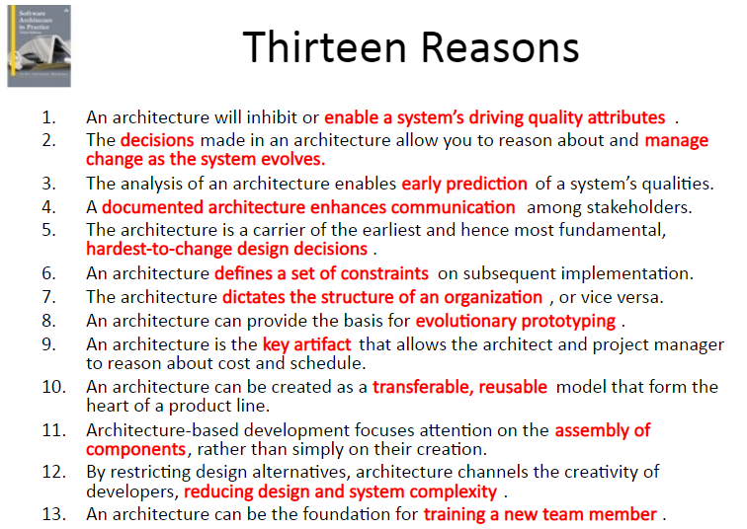

Slide 39
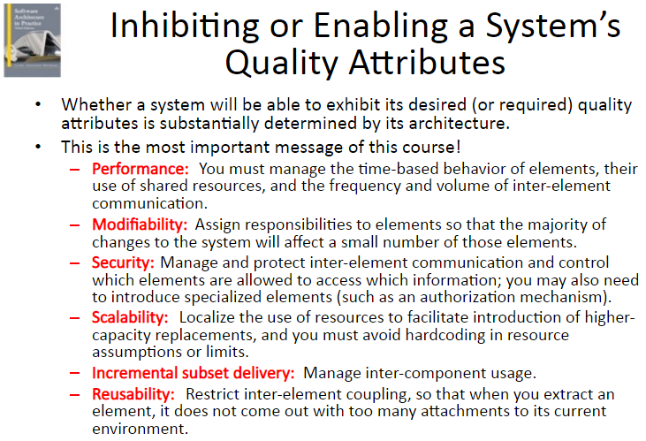

Slide 40
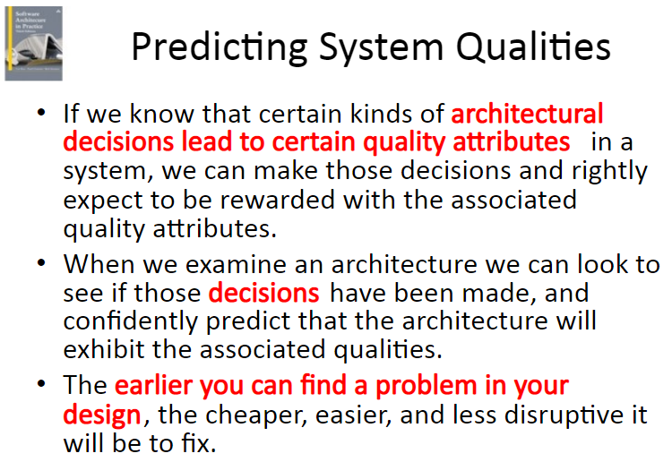

Slide 41
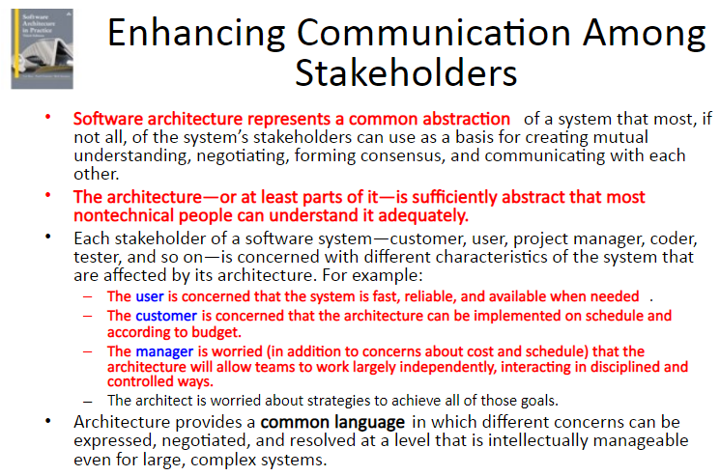

Slide 42
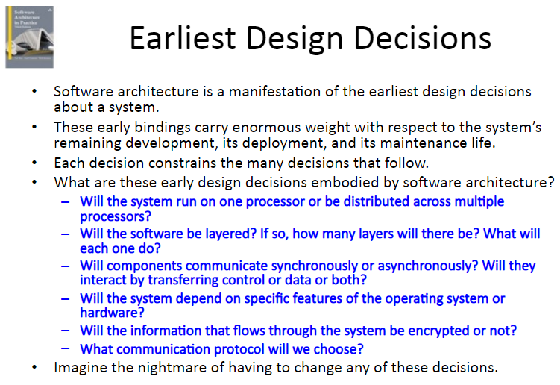

Slide 43
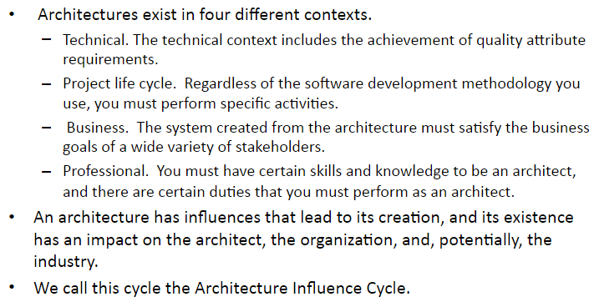

Slide 44
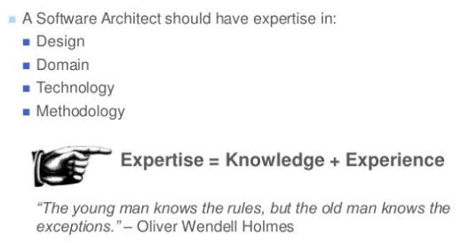
Role of software architect

Slide 45
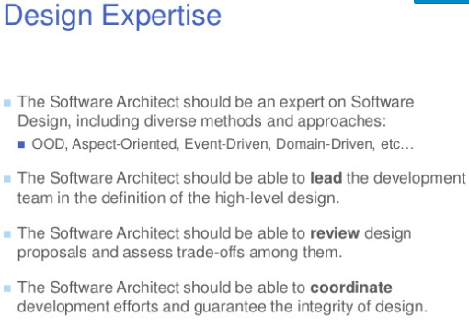

Slide 46
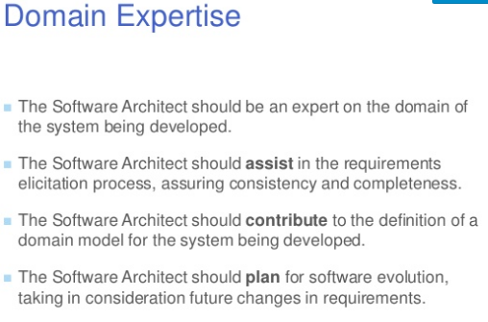

Slide 47
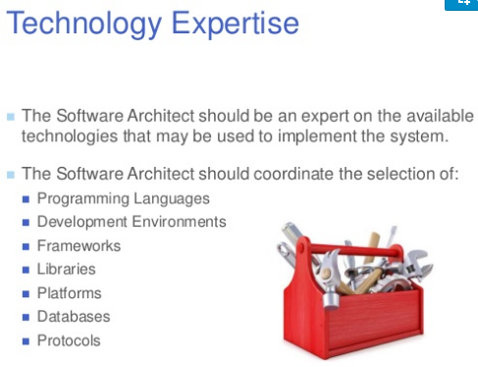

Slide 48
