Slide 1
Software design principles
Module II

Slide 2
Correctness and Robustness
Key Concept : Correctness
Goal: That each artifact satisfies designated
requirements, and that together they satisfy
all of the application’s requirements.
Approaches to correctness
Informal approaches
Formal approaches

Slide 3
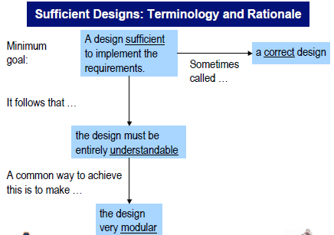

Slide 4
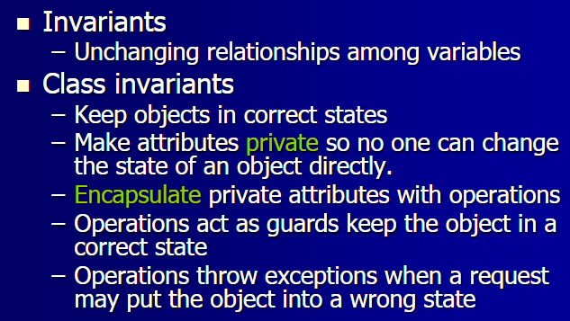
Formal approaches to correctness

Slide 5
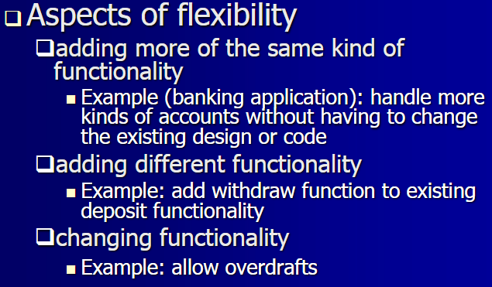
Flexibility

Slide 6
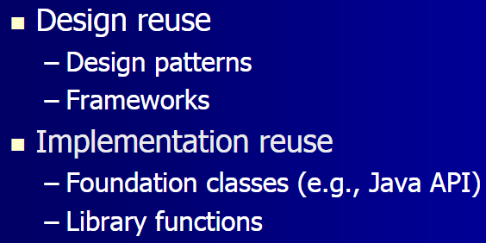
Reusability

Slide 7
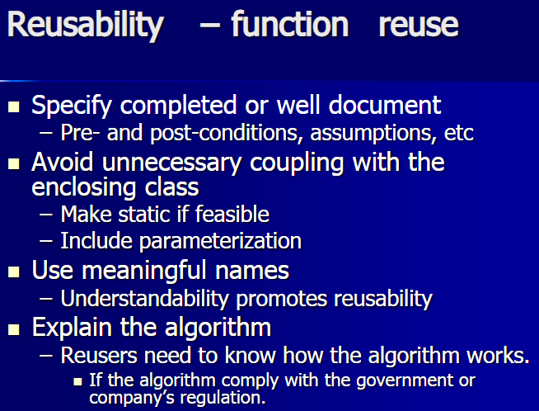

Slide 8
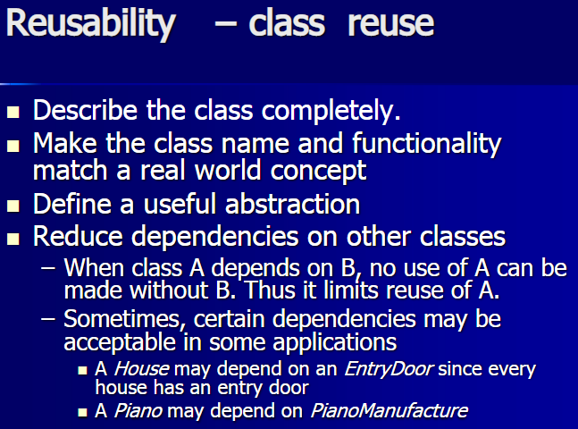

Slide 9
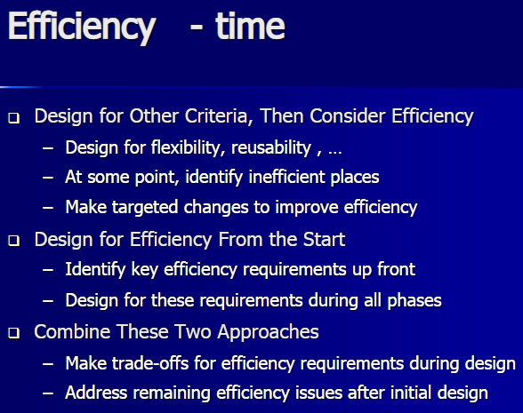

Slide 10
