Slide 1
Interaction Diagram Notation

Slide 2
Decomposition Tools
Different styles of software development are often characterized by a strong reliance on a particular modeling tool during the design phase.
Relational Database designers tend to depend heavily on Entity Relationship Diagrams.
Functional/Procedural designers may use a tool like Function Decomposition Diagrams.
eXtreme Programming designers often use Class Responsibility Collaboration Cards.

Slide 3
Object-Oriented Decomposition
The modeling genre of choice for most object-oriented designers is the Unified Modeling Language.
The most important activity in object-oriented design is assigning responsibility to objects.
The preferred tool to assist object-oriented designers in assigning responsibility to objects are the two UML interaction diagrams.

Slide 4
Introduction
Why do objects exist?
To perform an activity to help fulfill a system’s purpose
Interaction Diagrams are used to model system dynamics
How do objects change state?
How do objects interact (message passing)?

Slide 5
Collaboration & Sequence Diagrams
An Interaction Diagram is a generalization of two specialized UML diagram types
Collaboration Diagrams: Illustrate object interactions organized around the objects and their links to each other
Sequence Diagrams: Illustrate object interactions arranged in time sequence

Slide 6
Collaboration & Sequence Diagrams (2)
Both diagram types are semantically equivalent, however, they may not show the same information
Collaboration Diagrams emphasize the structural organization of objects, while Sequence Diagrams emphasize the time ordering of messages
Collaboration Diagrams explicitly show object linkages, while links are implied in Sequence Diagrams

Slide 7
Interaction Diagrams Are Valuable
Interaction Diagrams provide a thoughtful, cohesive, common starting point for inspiration during programming
Patterns, principles, and idioms can be applied to improve the quality of the Interaction Diagrams

Slide 8
Common Interaction Diagram Notation

Slide 9
Collaboration Diagrams
Objects are connected with numbered (sequenced) arrows along links to depict information flow
Arrows are drawn from the interaction source
The object pointed to by the arrow is referred to as the target
Arrows are numbered to depict their usage order within the scenario
Arrows are labeled with the passed message

Slide 10
Example Collaboration Diagram

Slide 11
Example Collaboration Diagram: makePayment

Slide 12
Basic Collaboration Diagram Notation
Link - connection path between two objects (an instance of an association)
Message - represented with a message expression on an arrowed line between objects
Sequence Number - represents the order in which the flows are used

Slide 13
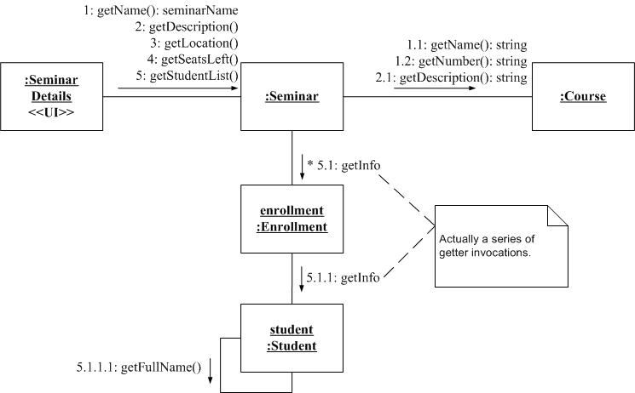
Communication Diagram from AgileModeling.com

Slide 14
Sequence Diagrams
Correspond to one scenario within a Use Case
Model a single operation within a System over time
Identify the objects involved with each scenario
Identify the passed messages and actions that occur during a scenario
Identify the required response of each action

Slide 15
Example Sequence Diagram

Slide 16
Example Sequence Diagram: make Payment

Slide 17
Basic Sequence Diagram Notation
Links - Sequence Diagrams do not show links
Message - represented with a message expression on an arrowed line between objects

Slide 18
Basic Sequence Diagram Notation (2)
Object Lifeline - the vertical dashed line underneath an object
Objects do not have a lifeline until they are created
The end of an object’s life is marked with an “X” at the end of the lifeline
Passage of time is from top to bottom of diagram

Slide 19
Basic Sequence Diagram Notation (3)
Activation - the period of time an object is handling a message (box along lifeline)
Activation boxes can be overlaid to depict an object invoking another method on itself

Slide 20
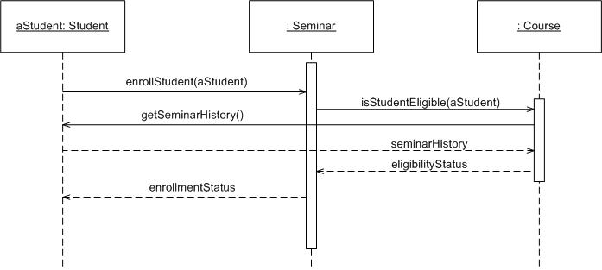
Sequence Diagram from AgileModeling.com

Slide 21
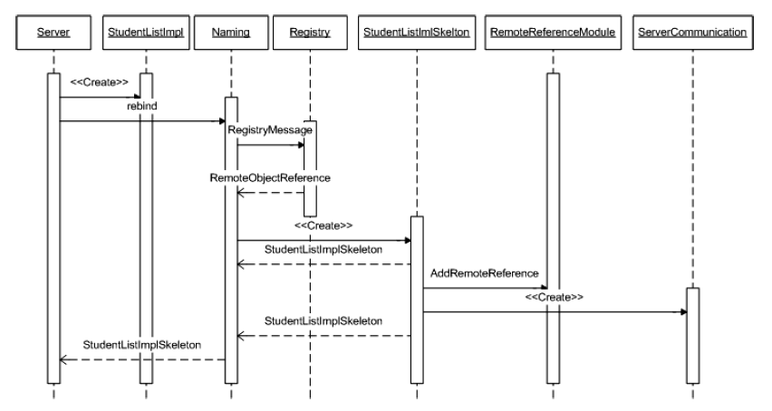
Sequence Diagram for Java Remote Method Invocation http://nathanbalon.net/projects/cis578/cis578_middleware_report.pdf

Slide 22
Interaction Diagram Strengths
Communication Diagram
Space Economical - flexibility to add new objects in two dimensions
Better to illustrate complex branching, iteration, and concurrent behavior
Sequence Diagram
Clearly shows sequence or time ordering of messages
Simple notation

Slide 23
Interaction Diagram Weaknesses
Communication Diagram
Difficult to see sequence of messages
More complex notation
Sequence Diagram
Forced to extend to the right when adding new objects; consumes horizontal space

Slide 24
Conclusions
Beginners in UML often emphasize Class Diagrams. Interaction Diagrams usually deserve more attention.
There is no rule about which diagram to use. Both are often used to emphasize the flexibility in choice and to reinforce the logic of the operation. Some tools can convert one to the other automatically.

