Slide 1
CSCI 330 The UNIX System
Awk

Slide 2
What is awk?
created by: Aho, Weinberger, and Kernighan
scripting language used for manipulating data and generating reports
versions of awk
awk, nawk, mawk, pgawk, …
GNU awk: gawk

Slide 3
What can you do with awk?
awk operation:
scans a file line by line
splits each input line into fields
compares input line/fields to pattern
performs action(s) on matched lines
Useful for:
transform data files
produce formatted reports
Programming constructs:
format output lines
arithmetic and string operations
conditionals and loops

Slide 4
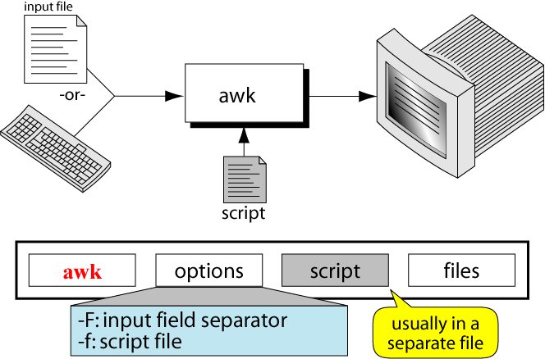
The Command: awk

Slide 5
Basic awk Syntax
awk [options] ‘script’ file(s)
awk [options] –f scriptfile file(s)
Options:
-F to change input field separator
-f to name script file

Slide 6
Basic awk Program
consists of patterns & actions:
pattern {action}
if pattern is missing, action is applied to all lines
if action is missing, the matched line is printed
must have either pattern or action
Example:
awk '/for/' testfile
prints all lines containing string “for” in testfile

Slide 7
Basic Terminology: input file
A field is a unit of data in a line
Each field is separated from the other fields by the field separator
default field separator is whitespace
A record is the collection of fields in a line
A data file is made up of records

Slide 8
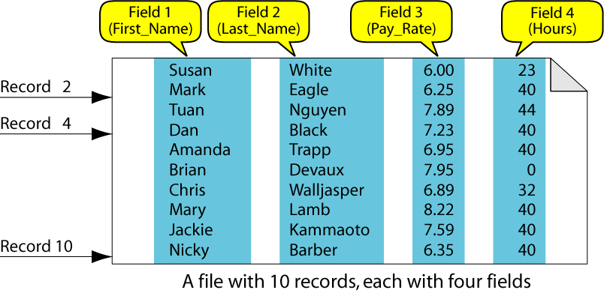
Example Input File

Slide 9
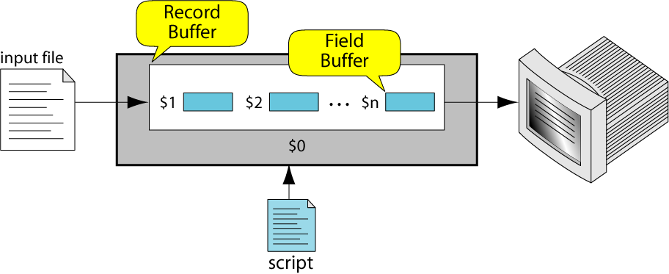
Buffers
awk supports two types of buffers:
record and field
field buffer:
one for each fields in the current record.
names: $1, $2, …
record buffer :
$0 holds the entire record

Slide 10
Some System Variables
FS Field separator (default=whitespace)
RS Record separator (default=\n)
NF Number of fields in current record
NR Number of the current record
OFS Output field separator (default=space)
ORS Output record separator (default=\n)
FILENAME Current filename

Slide 11
Example: Records and Fields
% cat emps
Tom Jones 4424 5/12/66 543354
Mary Adams 5346 11/4/63 28765
Sally Chang 1654 7/22/54 650000
Billy Black 1683 9/23/44 336500
% awk '{print NR, $0}' emps
1 Tom Jones 4424 5/12/66 543354
2 Mary Adams 5346 11/4/63 28765
3 Sally Chang 1654 7/22/54 650000
4 Billy Black 1683 9/23/44 336500

Slide 12
Example: Space as Field Separator
% cat emps
Tom Jones 4424 5/12/66 543354
Mary Adams 5346 11/4/63 28765
Sally Chang 1654 7/22/54 650000
Billy Black 1683 9/23/44 336500
% awk '{print NR, $1, $2, $5}' emps
1 Tom Jones 543354
2 Mary Adams 28765
3 Sally Chang 650000
4 Billy Black 336500

Slide 13
Example: Colon as Field Separator
% cat em2
Tom Jones:4424:5/12/66:543354
Mary Adams:5346:11/4/63:28765
Sally Chang:1654:7/22/54:650000
Billy Black:1683:9/23/44:336500
% awk -F: '/Jones/{print $1, $2}' em2
Tom Jones 4424

Slide 14
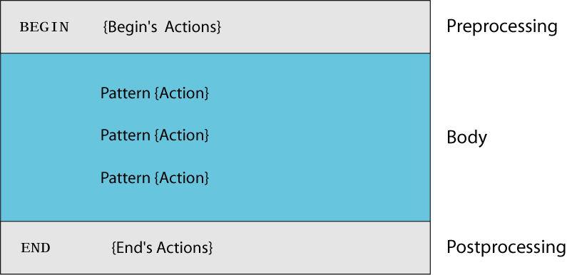
awk Scripts
awk scripts are divided into three major parts:
comment lines start with #

Slide 15
awk Scripts
BEGIN: pre-processing
performs processing that must be completed before the file processing starts (i.e., before awk starts reading records from the input file)
useful for initialization tasks such as to initialize variables and to create report headings

Slide 16
awk Scripts
BODY: Processing
contains main processing logic to be applied to input records
like a loop that processes input data one record at a time:
if a file contains 100 records, the body will be executed 100 times, one for each record

Slide 17
awk Scripts
END: post-processing
contains logic to be executed after all input data have been processed
logic such as printing report grand total should be performed in this part of the script

Slide 18
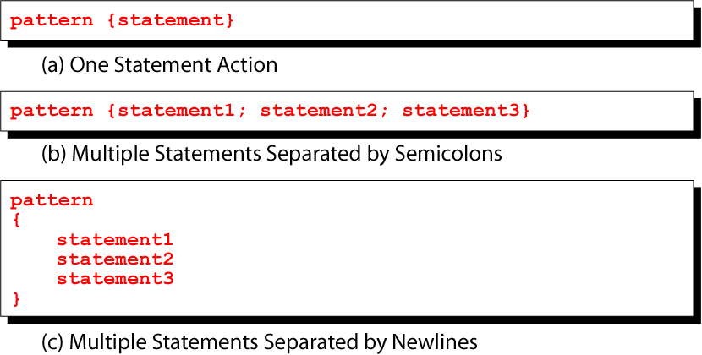
Pattern / Action Syntax

Slide 19
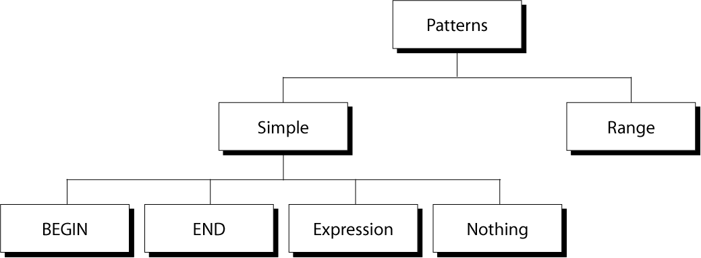
Categories of Patterns

Slide 20
Expression Pattern types
match
entire input record
regular expression enclosed by ‘/’s
explicit pattern-matching expressions
~ (match), !~ (not match)
expression operators
arithmetic
relational
logical

Slide 21
Example: match input record
% cat employees2
Tom Jones:4424:5/12/66:543354
Mary Adams:5346:11/4/63:28765
Sally Chang:1654:7/22/54:650000
Billy Black:1683:9/23/44:336500
% awk –F: '/00$/' employees2
Sally Chang:1654:7/22/54:650000
Billy Black:1683:9/23/44:336500

Slide 22
Example: explicit match
% cat datafile
northwest NW Charles Main 3.0 .98 3 34
western WE Sharon Gray 5.3 .97 5 23
southwest SW Lewis Dalsass 2.7 .8 2 18
southern SO Suan Chin 5.1 .95 4 15
southeast SE Patricia Hemenway 4.0 .7 4 17
eastern EA TB Savage 4.4 .84 5 20
northeast NE AM Main 5.1 .94 3 13
north NO Margot Weber 4.5 .89 5 9
central CT Ann Stephens 5.7 .94 5 13
% awk '$5 ~ /\.[7-9]+/' datafile
southwest SW Lewis Dalsass 2.7 .8 2 18
central CT Ann Stephens 5.7 .94 5 13

Slide 23
Examples: matching with REs
% awk '$2 !~ /E/{print $1, $2}' datafile
northwest NW
southwest SW
southern SO
north NO
central CT
% awk '/^[ns]/{print $1}' datafile
northwest
southwest
southern
southeast
northeast
north

Slide 24
Arithmetic Operators
Operator Meaning Example
+ Add x + y
- Subtract x – y
* Multiply x * y
/ Divide x / y
% Modulus x % y
^ Exponential x ^ y
Example:
% awk '$3 * $4 > 500 {print $0}' file

Slide 25
Relational Operators
Operator Meaning Example
< Less than x < y
< = Less than or equal x < = y
== Equal to x == y
!= Not equal to x != y
> Greater than x > y
> = Greater than or equal to x > = y
~ Matched by reg exp x ~ /y/
!~ Not matched by req exp x !~ /y/

Slide 26
Logical Operators
Operator Meaning Example
&& Logical AND a && b
|| Logical OR a || b
! NOT ! a
Examples:
% awk '($2 > 5) && ($2 <= 15)
{print $0}' file
% awk '$3 == 100 || $4 > 50' file

Slide 27
Range Patterns
Matches ranges of consecutive input lines
Syntax:
pattern1 , pattern2 {action}
pattern can be any simple pattern
pattern1 turns action on
pattern2 turns action off

Slide 28
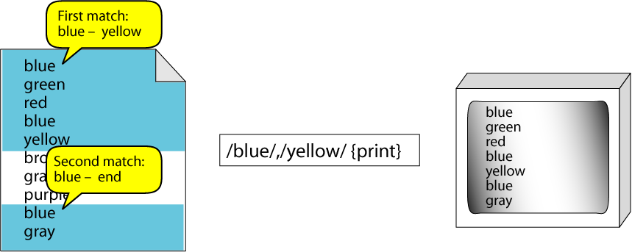
Range Pattern Example

Slide 29
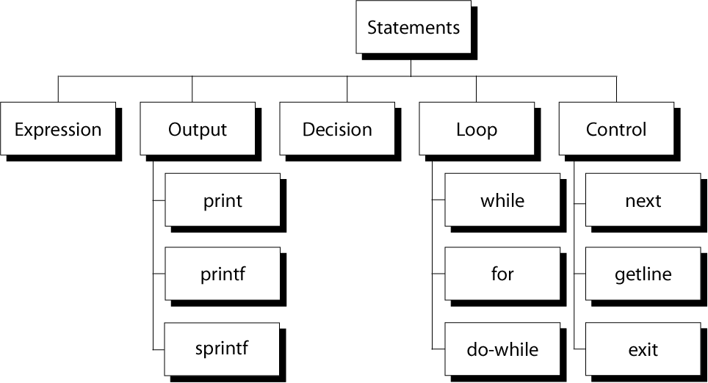
awk Actions

Slide 30
awk expressions
Expression is evaluated and returns value
consists of any combination of numeric and string constants, variables, operators, functions, and regular expressions
Can involve variables
As part of expression evaluation
As target of assignment

Slide 31
awk variables
A user can define any number of variables within an awk script
The variables can be numbers, strings, or arrays
Variable names start with a letter, followed by letters, digits, and underscore
Variables come into existence the first time they are referenced; therefore, they do not need to be declared before use
All variables are initially created as strings and initialized to a null string “”

Slide 32
awk Variables
Format:
variable = expression
Examples:
% awk '$1 ~ /Tom/
{wage = $3 * $4; print wage}'
filename
% awk '$4 == "CA"
{$4 = "California"; print $0}'
filename

Slide 33
awk assignment operators
= assign result of right-hand-side expression to
left-hand-side variable
++ Add 1 to variable
-- Subtract 1 from variable
+= Assign result of addition
-= Assign result of subtraction
*= Assign result of multiplication
/= Assign result of division
%= Assign result of modulo
^= Assign result of exponentiation

Slide 34
Awk example
File: grades
john 85 92 78 94 88
andrea 89 90 75 90 86
jasper 84 88 80 92 84
awk script: average
# average five grades
{ total = $2 + $3 + $4 + $5 + $6
avg = total / 5
print $1, avg }
Run as:
awk –f average grades

Slide 35
Output Statements
print
print easy and simple output
printf
print formatted (similar to C printf)
sprintf
format string (similar to C sprintf)

Slide 36
Function: print
Writes to standard output
Output is terminated by ORS
default ORS is newline
If called with no parameter, it will print $0
Printed parameters are separated by OFS,
default OFS is blank
Print control characters are allowed:
\n \f \a \t \\ …

Slide 37
print example
% awk '{print}' grades
john 85 92 78 94 88
andrea 89 90 75 90 86
% awk '{print $0}' grades
john 85 92 78 94 88
andrea 89 90 75 90 86
% awk '{print($0)}' grades
john 85 92 78 94 88
andrea 89 90 75 90 86

Slide 38
print Example
% awk '{print $1, $2}' grades
john 85
andrea 89
% awk '{print $1 "," $2}' grades
john,85
andrea,89

Slide 39
print Example
% awk '{OFS="-";print $1 , $2}' grades
john-85
andrea-89
% awk '{OFS="-";print $1 "," $2}' grades
john,85
andrea,89

Slide 40
Redirecting print output
Print output goes to standard output
unless redirected via:
> “file”
>> “file”
| “command”
will open file or command only once
subsequent redirections append to already open stream

Slide 41
print Example
% awk '{print $1 , $2 > "file"}' grades
% cat file
john 85
andrea 89
jasper 84

Slide 42
print Example
% awk '{print $1,$2 | "sort"}' grades
andrea 89
jasper 84
john 85
% awk '{print $1,$2 | "sort –k 2"}' grades
jasper 84
john 85
andrea 89

Slide 43
print Example
% date
Wed Nov 19 14:40:07 CST 2008
% date |
awk '{print "Month: " $2 "\nYear: ", $6}'
Month: Nov
Year: 2008
CSCI 330 - The UNIX System
43
Notes:
The AWK/NAWK Utility
Copyright Department of Computer Science, Northern Illinois University, 2004
43

Slide 44
printf: Formatting output
Syntax:
printf(format-string, var1, var2, …)
works like C printf
each format specifier in “format-string” requires argument of matching type

Slide 45
Format specifiers
%d, %i decimal integer
%c single character
%s string of characters
%f floating point number
%o octal number
%x hexadecimal number
%e scientific floating point notation
%% the letter “%”

Slide 46
Format specifier examples
Given: x = ‘A’, y = 15, z = 2.3, and $1 = Bob Smith
Printf Format Specifier | What it Does
%c | printf("The character is %c \n", x) output: The character is A
%d | printf("The boy is %d years old \n", y) output: The boy is 15 years old
%s | printf("My name is %s \n", $1) output: My name is Bob Smith
%f | printf("z is %5.3f \n", z) output: z is 2.300

Slide 47
Format specifier modifiers
between “%” and letter
%10s
%7d
%10.4f
%-20s
meaning:
width of field, field is printed right justified
precision: number of digits after decimal point
“-” will left justify

Slide 48
sprintf: Formatting text
Syntax:
sprintf(format-string, var1, var2, …)
Works like printf, but does not produce output
Instead it returns formatted string
Example:
{
text = sprintf("1: %d – 2: %d", $1, $2)
print text
}

Slide 49
awk builtin functions
tolower(string)
returns a copy of string, with each upper-case character converted to lower-case. Nonalphabetic characters are left unchanged.
Example: tolower("MiXeD cAsE 123")
returns "mixed case 123"
toupper(string)
returns a copy of string, with each lower-case character converted to upper-case.

Slide 50
awk Example: list of products
103:sway bar:49.99
101:propeller:104.99
104:fishing line:0.99
113:premium fish bait:1.00
106:cup holder:2.49
107:cooler:14.89
112:boat cover:120.00
109:transom:199.00
110:pulley:9.88
105:mirror:4.99
108:wheel:49.99
111:lock:31.00
102:trailer hitch:97.95

Slide 51
awk Example: output
Marine Parts R Us
Main catalog
Part-id name price
======================================
101 propeller 104.99
102 trailer hitch 97.95
103 sway bar 49.99
104 fishing line 0.99
105 mirror 4.99
106 cup holder 2.49
107 cooler 14.89
108 wheel 49.99
109 transom 199.00
110 pulley 9.88
111 lock 31.00
112 boat cover 120.00
113 premium fish bait 1.00
======================================
Catalog has 13 parts

Slide 52
awk Example: complete
BEGIN {
FS= ":"
print "Marine Parts R Us"
print "Main catalog"
print "Part-id\tname\t\t\t price"
print "======================================"
}
{
printf("%3d\t%-20s\t%6.2f\n", $1, $2, $3)
count++
}
END {
print "======================================"
print "Catalog has " count " parts"
}
is output sorted ?

Slide 53
awk Array
awk allows one-dimensional arrays
to store strings or numbers
index can be number or string
array need not be declared
its size
its elements
array elements are created when first used
initialized to 0 or “”

Slide 54
Arrays in awk
Syntax:
arrayName[index] = value
Examples:
list[1] = "one"
list[2] = "three"
list["other"] = "oh my !"

Slide 55
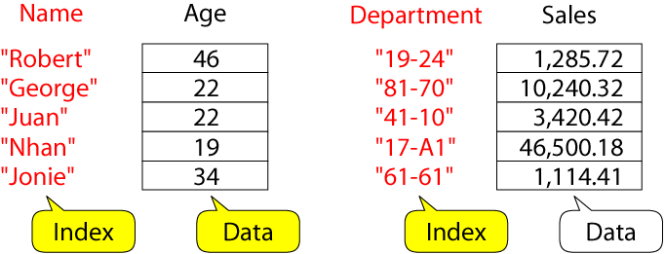
Illustration: Associative Arrays
awk arrays can use string as index

Slide 56
Awk builtin split function
split(string, array, fieldsep)
divides string into pieces separated by fieldsep, and stores the pieces in array
if the fieldsep is omitted, the value of FS is used.
Example:
split("auto-da-fe", a, "-")
sets the contents of the array a as follows:
a[1] = "auto"
a[2] = "da"
a[3] = "fe"

Slide 57
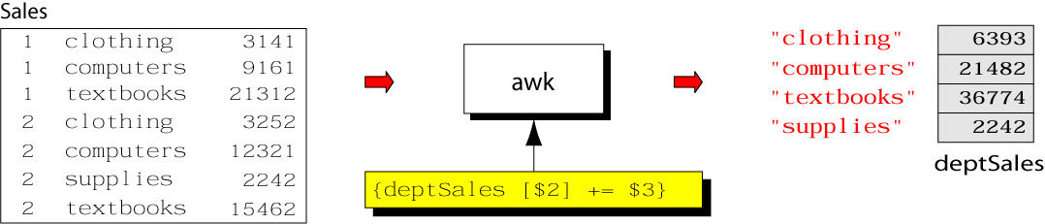
Example: process sales data
input file:
output:
summary of category sales

Slide 58
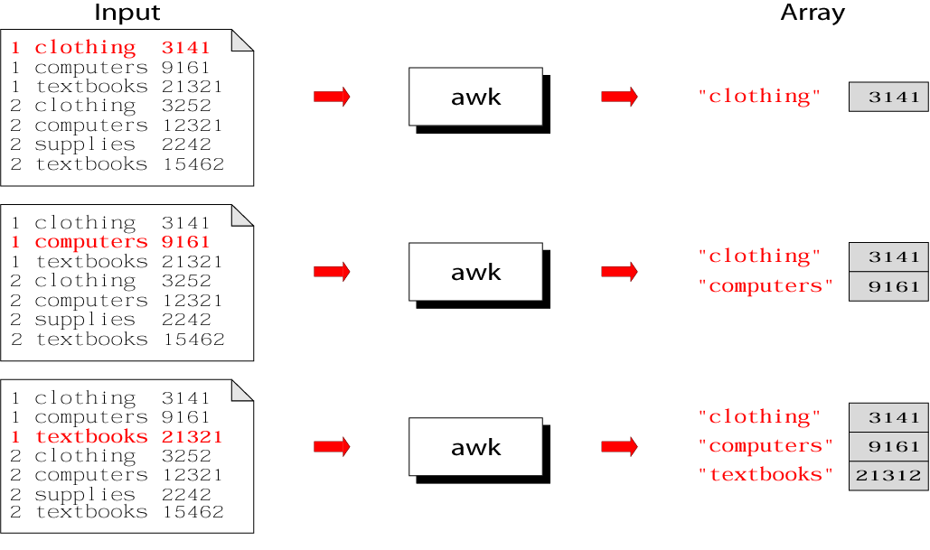
Illustration: process each input line

Slide 59
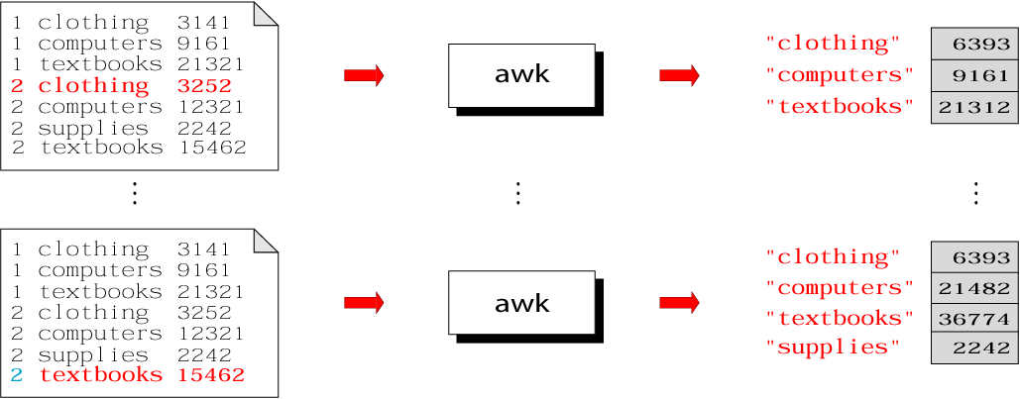
Illustration: process each input line

Slide 60
Summary: awk program

Slide 61
Example: complete program
% cat sales.awk
{
deptSales[$2] += $3
}
END {
for (x in deptSales)
print x, deptSales[x]
}
% awk –f sales.awk sales

Slide 62
Delete Array Entry
The delete function can be used to delete an element from an array.
Format:
delete array_name [index]
Example:
delete deptSales["supplies"]

Slide 63
Awk control structures
Conditional
if-else
Repetition
for
with counter
with array index
while
do-while
also: break, continue

Slide 64
if Statement
Syntax:
if (conditional expression)
statement-1
else
statement-2
Example:
if ( NR < 3 )
print $2
else
print $3

Slide 65
for Loop
Syntax:
for (initialization; limit-test; update)
statement
Example:
for (i = 1; i <= NR; i++)
{
total += $i
count++
}

Slide 66
for Loop for arrays
Syntax:
for (var in array)
statement
Example:
for (x in deptSales)
{
print x, deptSales[x]
}

Slide 67
while Loop
Syntax:
while (logical expression)
statement
Example:
i = 1
while (i <= NF)
{
print i, $i
i++
}

Slide 68
do-while Loop
Syntax:
do
statement
while (condition)
statement is executed at least once, even if condition is false at the beginning
Example:
i = 1
do {
print $0
i++
} while (i <= 10)

Slide 69
loop control statements
break
exits loop
continue
skips rest of current iteration, continues with next iteration

Slide 70
loop control example
for (x = 0; x < 20; x++) {
if ( array[x] > 100) continue
printf "%d ", x
if ( array[x] < 0 ) break
}

Slide 71
Example: sensor data
1 Temperature
2 Rainfall
3 Snowfall
4 Windspeed
5 Winddirection
also: sensor readings
Plan: print average readings in descending order

Slide 72
Example: sensor readings
2008-10-01/1/68
2008-10-02/2/6
2007-10-03/3/4
2008-10-04/4/25
2008-10-05/5/120
2008-10-01/1/89
2007-10-01/4/35
2008-11-01/5/360
2008-10-01/1/45
2007-12-01/1/61
2008-10-10/1/32

Slide 73
Example: print sensor data
BEGIN {
printf("id\tSensor\n")
printf("----------------------\n")
}
{
printf("%d\t%s\n", $1, $2)
}

Slide 74
Example: print sensor readings
BEGIN {
FS="/"
printf(" Date\t\tValue\n“
printf("---------------------\n")
}
{
printf("%s %7.2f\n", $1, $3)
}

Slide 75
Example: print sensor summary
BEGIN {
FS="/"
}
{
sum[$2] += $3;
count[$2]++;
}
END {
for (i in sum) {
printf("%d %7.2f\n",i,sum[i]/count[i])
}
}

Slide 76
Example: Remaining tasks
awk –f sense.awk sensors readings
Sensor Average
-----------------------
Winddirection 240.00
Temperature 59.00
Windspeed 30.00
Rainfall 6.00
Snowfall 4.00
2 input files
sorted
sensor names

Slide 77
Example: print sensor averages
Remaining tasks:
recognize nature of input data
use: number of fields in record
substitute sensor id with sensor name
use: associative array
sort readings
use: sort –gr –k 2

Slide 78
Example: sense.awk
NF > 1 {
name[$1] = $2
}
NF < 2 {
split($0,fields,"/")
sum[fields[2]] += fields[3];
count[fields[2]]++;
}
END {
for (i in sum) {
printf("%15s %7.2f\n", name[i], sum[i]/count[i]) | "sort -gr -k 2"
}
}

Slide 79
Example: print sensor averages
Remaining tasks:
Sort
use: sort -gr
Substitute sensor id with sensor name
1. use:
join -j 1 sensor-data sensor-averages
2. within awk
CSCI 330 - The UNIX System
79

Slide 80
Example: solution 1 (1/3)
#! /bin/bash
trap '/bin/rm /tmp/report-*-$$; exit' 1 2 3
cat << HERE > /tmp/report-awk-1-$$
BEGIN {FS="/"}
{
sum[\$2] += \$3;
count[\$2]++;
}
END {
for (i in sum) {
printf("%d %7.2f\n", i, sum[i]/count[i])
}
}
HERE
CSCI 330 - The UNIX System
80

Slide 81
Example: solution 1 (2/3)
cat << HERE > /tmp/report-awk-2-$$
BEGIN {
printf(" Sensor Average\n")
printf("-----------------------\n")
}
{
printf("%15s %7.2f\n", \$2, \$3)
}
HERE
CSCI 330 - The UNIX System
81

Slide 82
Example: solution 1 (3/3)
awk -f /tmp/report-awk-1-$$
sensor-readings |
sort > /tmp/report-r-$$
join –j 1 sensor-data /tmp/report-r-$$ > /tmp/report-t-$$
sort -gr -k 3 /tmp/report-t-$$ |
awk -f /tmp/report-awk-2-$$
/bin/rm /tmp/report-*-$$
CSCI 330 - The UNIX System
82

Slide 83
Example: output
Sensor Average
-----------------------
Winddirection 240.00
Temperature 59.00
Windspeed 30.00
Rainfall 6.00
Snowfall 4.00
CSCI 330 - The UNIX System
83

Slide 84
Example: solution 2 (1/2)
#! /bin/bash
trap '/bin/rm /tmp/report-*$$; exit' 1 2 3
cat << HERE > /tmp/report-awk-3-$$
NF > 1 {
name[\$1] = \$2
}
NF < 2 {
split(\$0,fields,"/")
sum[fields[2]] += fields[3];
count[fields[2]]++;
}
CSCI 330 - The UNIX System
84

Slide 85
Example: solution 2 (2/2)
END {
for (i in sum) {
printf("%15s %7.2f\n", name[i], sum[i]/count[i])
}
}
HERE
echo " Sensor Average"
echo "-----------------------"
awk -f /tmp/report-awk-3-$$ sensor-data sensor-readings | sort -gr -k 2
/bin/rm /tmp/report-*$$
CSCI 330 - The UNIX System
85

