Slide 1
Fraudulent Claim Detection
A Machine Learning Approach to Detect Insurance Fraud

Slide 2
Problem Statement
Insurance fraud results in massive financial losses each year.
The objective of this project is to build a model that can detect fraudulent insurance claims based on various customer and claim attributes.

Slide 3
Dataset Overview
- ~1000 insurance claim records
- 40 columns
- Target Variable: 'fraud_reported'
- Mix of categorical, numerical, and date fields

Slide 4
Data Preprocessing
- Removed redundant columns (_c39)
- Converted date fields
- Encoded categorical variables
- Scaled numerical features
- Handled class imbalance using resampling

Slide 5
Train-Validation Split
Training Set: 800 samples
Validation Set: 200 samples
Class Balance
Training: 75.25% not fraud, 24.75% fraud
Validation: 75.5% not fraud, 24.5% fraud
The class distribution is preserved using stratified splitting.

Slide 6
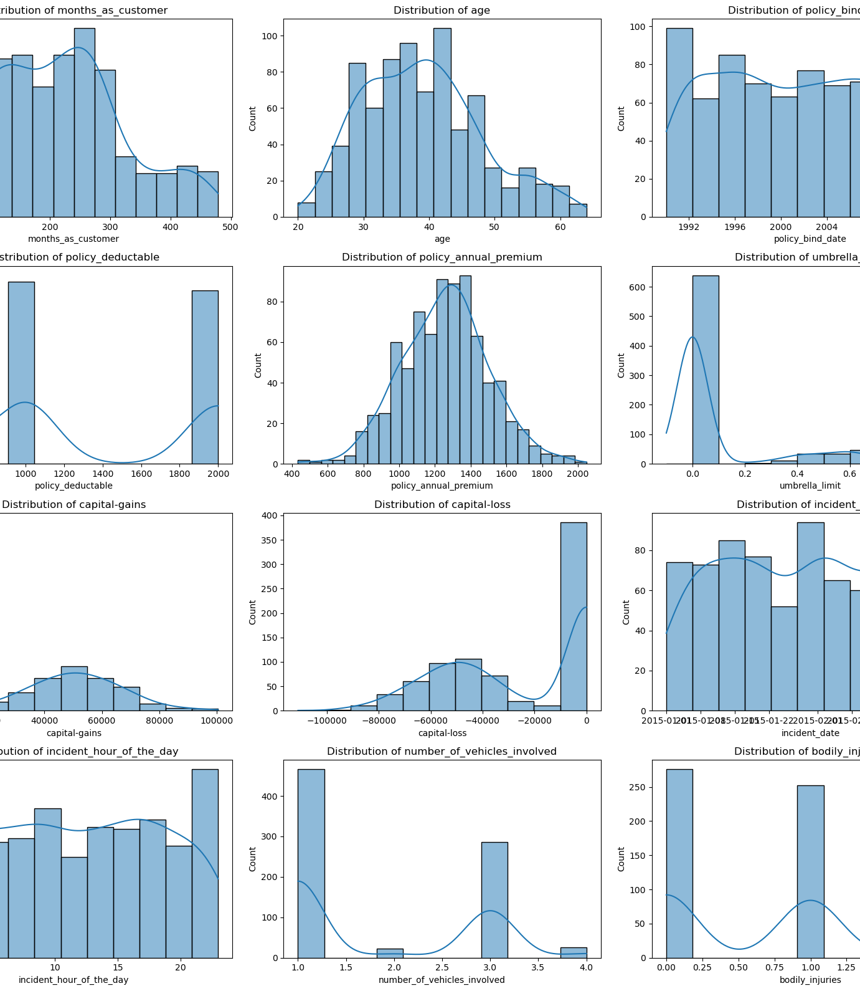
Exploratory Data Analysis (EDA) on Training Data

Slide 7
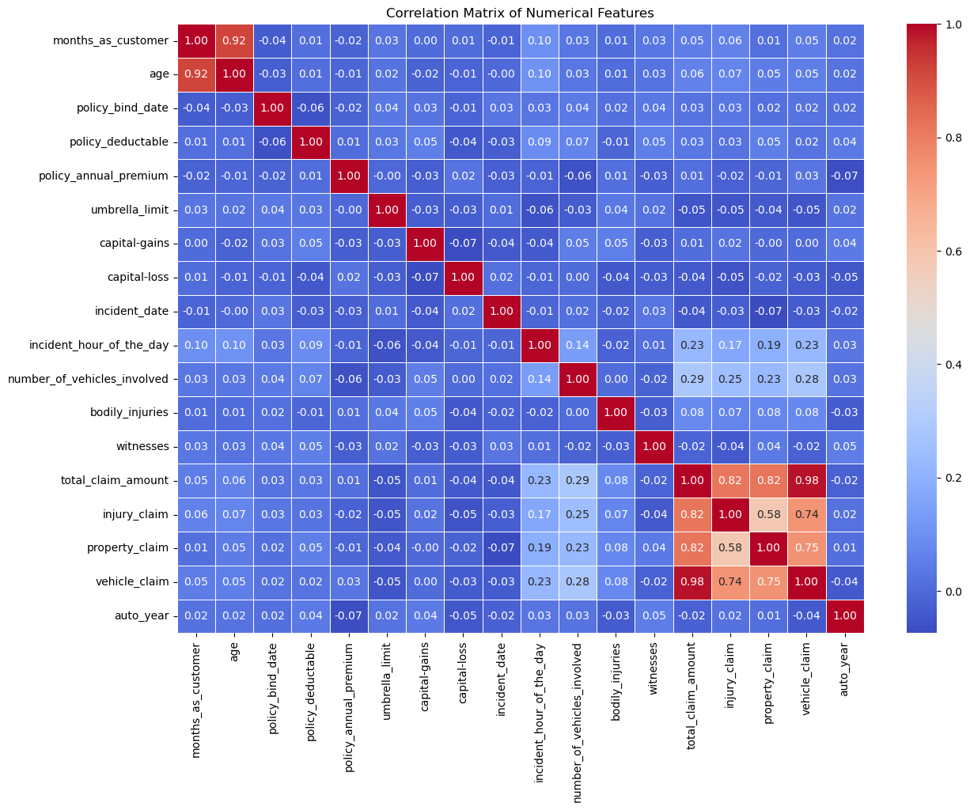
Correlation Analysis

Slide 8
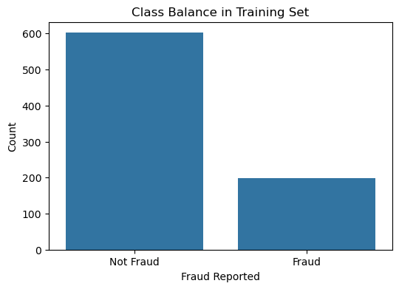
Class Balance Check

Slide 9
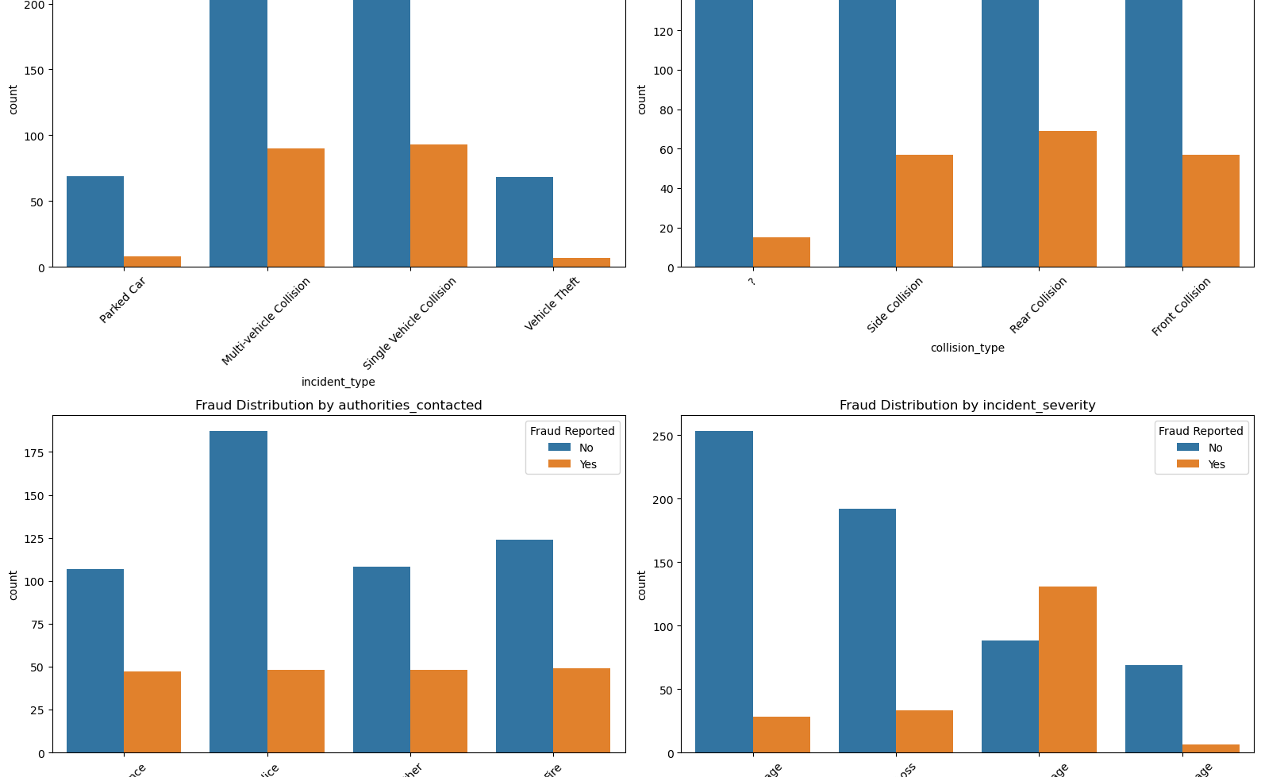
Bivariate Analysis

Slide 10
Bivariate Analysis Insights
Incident Type: “Single Vehicle Collision” has a visibly higher fraud rate than other types.
Collision Type: Some missing categories, but “Rear Collision” seems more associated with non-fraud.
Authorities Contacted: Fraud is more prevalent when no authorities were contacted.
Incident Severity: “Total Loss” has a disproportionately higher fraud rate.

Slide 11
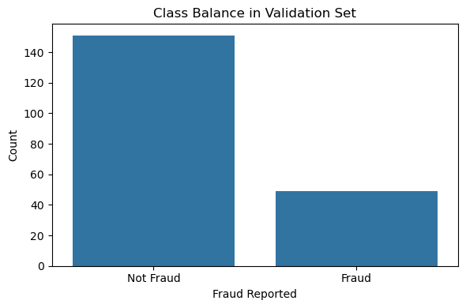
EDA on Validation Data (Optional)
Class balance in the validation set mirrors the training set:
~75% Not Fraud
~25% Fraud
This confirms that our stratified split preserved the class distribution.

Slide 12
Feature Engineering
Key Steps Performed:
Class imbalance fixed using upsampling (now 50/50 fraud vs not fraud).
Date features were broken into year and month.
Categorical features were one-hot encoded.
Numerical features were standardized using StandardScaler.
Final feature space includes 161 columns after encoding and transformations.

Slide 13
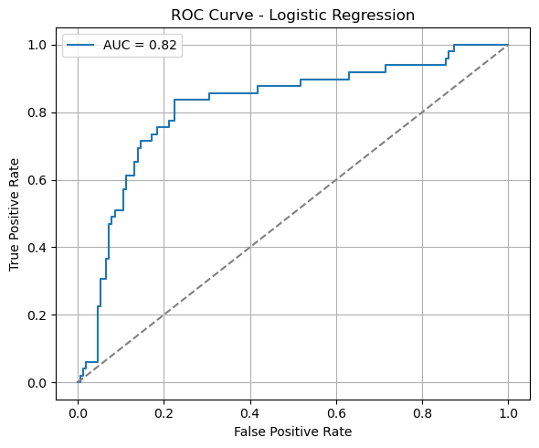
Model Building

Slide 14
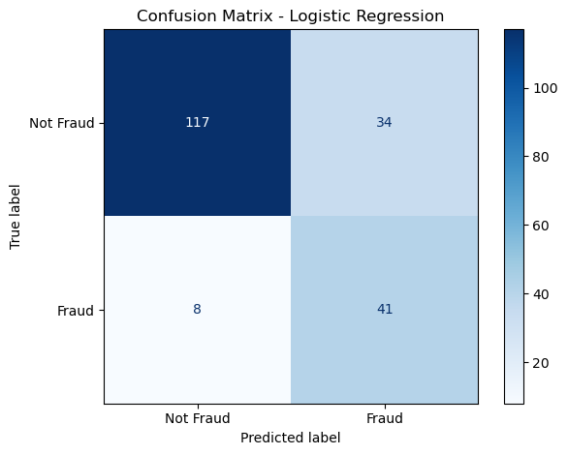
Logistic Regression Model
Logistic Regression Results (at threshold = 0.25)
Metric Not Fraud (0) Fraud (1)
Precision 0.94 0.55
Recall 0.85 0.84
F1-score 0.85 0.66
Overall Accuracy: 79%
The model does well in detecting fraud (Recall = 0.84), though precision for fraud is moderate.

Slide 15
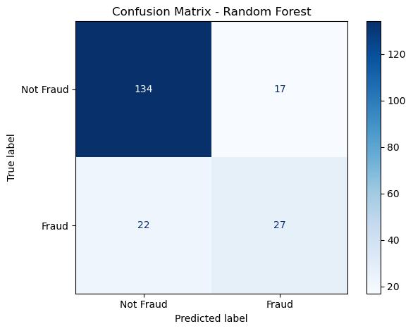
Train a standard Random Forest
Random Forest Model – Evaluation Summary ROC AUC Score:
AUC = 0.84, which indicates strong overall model performance.
Metric Not Fraud (0) Fraud (1)
Precision 0.86 0.61
Recall 0.89 0.55
F1-score 0.87 0.58
Accuracy: 80.5%
Key Observations:
Excellent recall for Not Fraud
Moderate fraud detection (precision = 0.62, recall = 0.55)

Slide 16
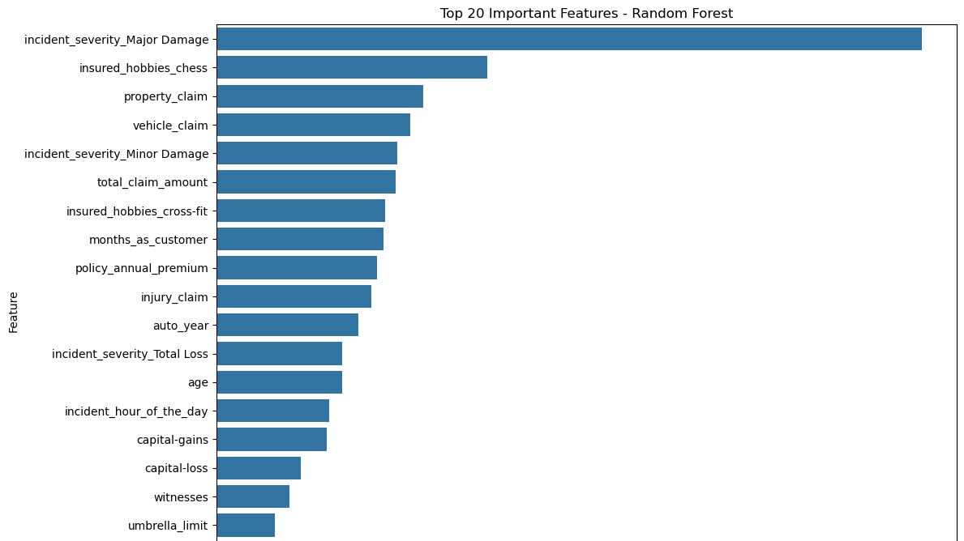
Random Forest model
Top 20 Most Important Features (Random Forest)
The most impactful predictors for fraud detection include:
total_claim_amount
vehicle_claim
incident_hour_of_the_day
injury_claim
Encoded variables like:
incident_severity_Major Damage
authorities_contacted_None
collision_type_Side Collision
These features contribute most to the model's decision-making process, especially in identifying fraud patterns.

Slide 17
Model Evaluation
Logistic Regression (Threshold = 0.25)
Metric Not Fraud (0) Fraud (1)
Precision 0.94 0.55
Recall 0.85 0.84
F1-Score 0.85 0.66
Overall Accuracy: 79%
Insight: Logistic Regression performs well in identifying frauds (high recall = 0.84), although the precision for fraud detection is moderate.

Slide 18
Random Forest Model
ROC AUC Score: 0.84
Metric Not Fraud (0) Fraud (1)
Precision 0.86 0.61
Recall 0.89 0.55
F1-Score 0.87 0.58
Overall Accuracy: 80.5%
Insight:
Strong generalization ability as seen from a high AUC score.
Performs very well on non-fraud cases.
Moderate performance on fraud cases, but better balanced than logistic regression in terms of precision.

Slide 19
Conclusion
The models built (Logistic Regression and Random Forest) are effective at identifying fraudulent claims, with the Random Forest showing better overall performance and slightly higher accuracy.
However, both models show a trade-off between precision and recall for fraud detection:
High recall ensures most frauds are caught.
Moderate precision indicates some false positives.
Random Forest is the recommended model for deployment due to its robustness and superior evaluation metrics.
Further improvements can be made using:
Advanced ensemble methods (e.g., XGBoost, LightGBM).
Feature selection and dimensionality reduction.
Cost-sensitive learning to penalize misclassification of fraud cases.

