Slide 1
Objectives
Explain the core principles of Representational Similarity Analysis (RSA) Understand how RSA quantifies similarity between neural, behavioral, or model representations.
Identify domains where RSA is applied Explore how RSA is used in neuroscience, cognitive science, and AI research.
Describe how RSA is applied to brain data Learn how RSA operates on neuroimaging data (e.g., fMRI, EEG) and supports hypothesis testing about representational structure.
Compare RSA to other alignment and representational techniques
Distinguish multivariate from univariate analysis approaches in neuroscience Recognize advantage of RSA over “classical” univariate techniques.

Slide 2
Kriegeskorte 2008 - RSA
Representational similarity analysis – connecting the branches of systems neuroscience
Notes:
Kriegeskorte, N., Mur, M., & Bandettini, P. A. (2008). Representational similarity analysis – connecting the branches of systems neuroscience. Frontiers in Systems Neuroscience, 2:4. https://doi.org/10.3389/neuro.06.004.2008

Slide 3
Simple Premise
RSA links human behavior or brain activity to computational models by comparing how similar different stimuli are, across modalities.
First-order similarity:
A single similarity (or dissimilarity) matrix captures the pattern of responses to different stimuli.▸ For example, a matrix of dissimilarities between brain activation patterns, or between model embeddings.
Second-order similarity (RSA):
RSA compares two such similarity matrices — e.g., one from brain data and one from a model —to quantify how similar their representational structures are.

Slide 4
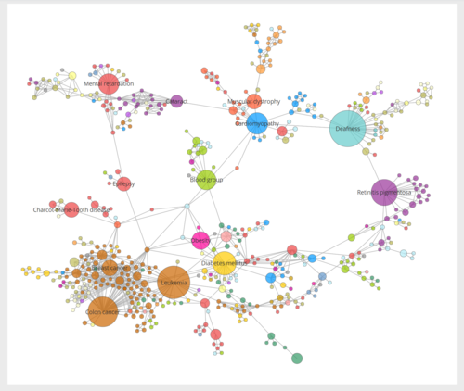
Main Features of RSA
Modality-independent: works across diverse data types — from brain activity (fMRI, EEG) to behavioral responses or artificial neural networks.
Compares representational structures across any domain. Aligns biological data and computational models.
Similarity-based framework: Instead of relying on raw activity levels, RSA uses pairwise distances or dissimilarities between stimulus responses as its representational format.

Slide 5
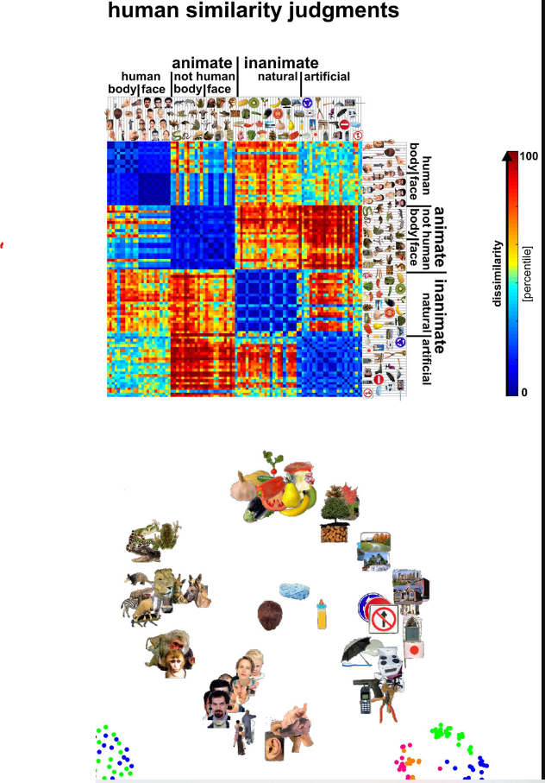
Constructing a Single Similarity Matrix: Behavior

Slide 6
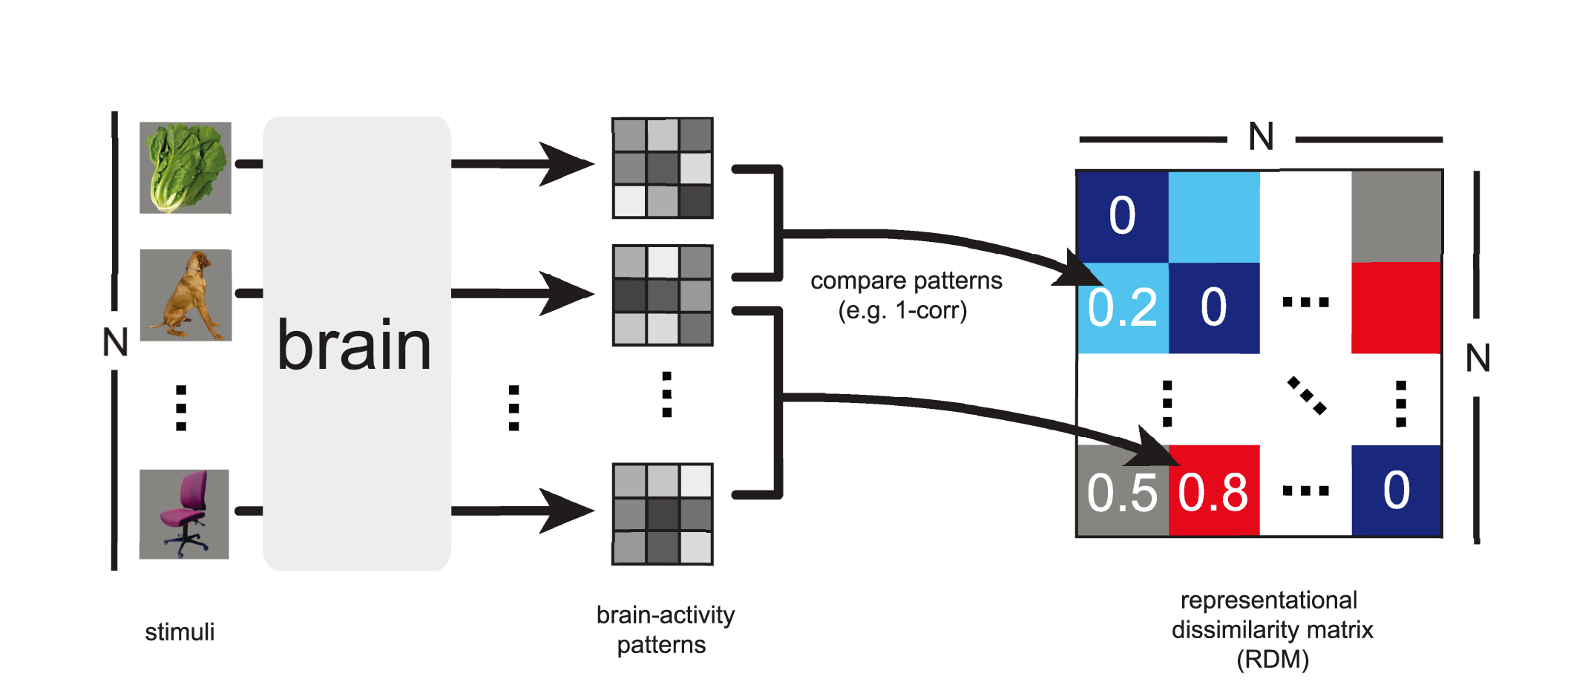
Constructing a Single Similarity Matrix: Brain
Representational Dissimilarity Matrix (RDM)

Slide 7
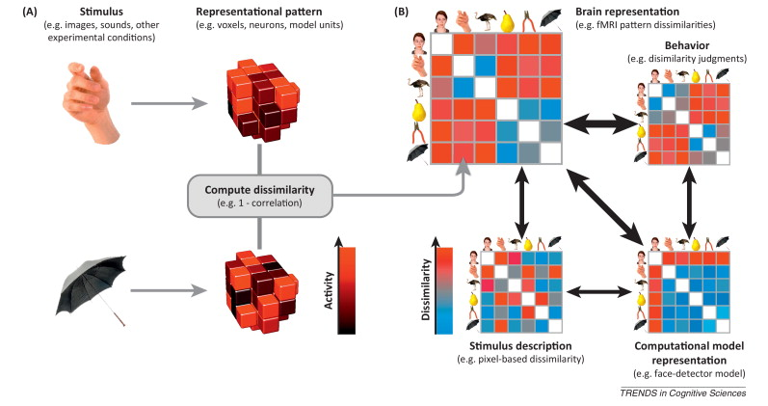
Comparing Similarity Matrices
Example of 2 stimuli and brain response

Slide 8
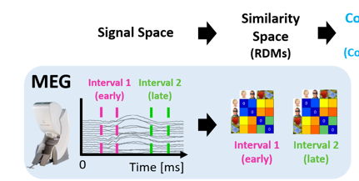
Applicable to Sensor x Time Representations

Slide 9
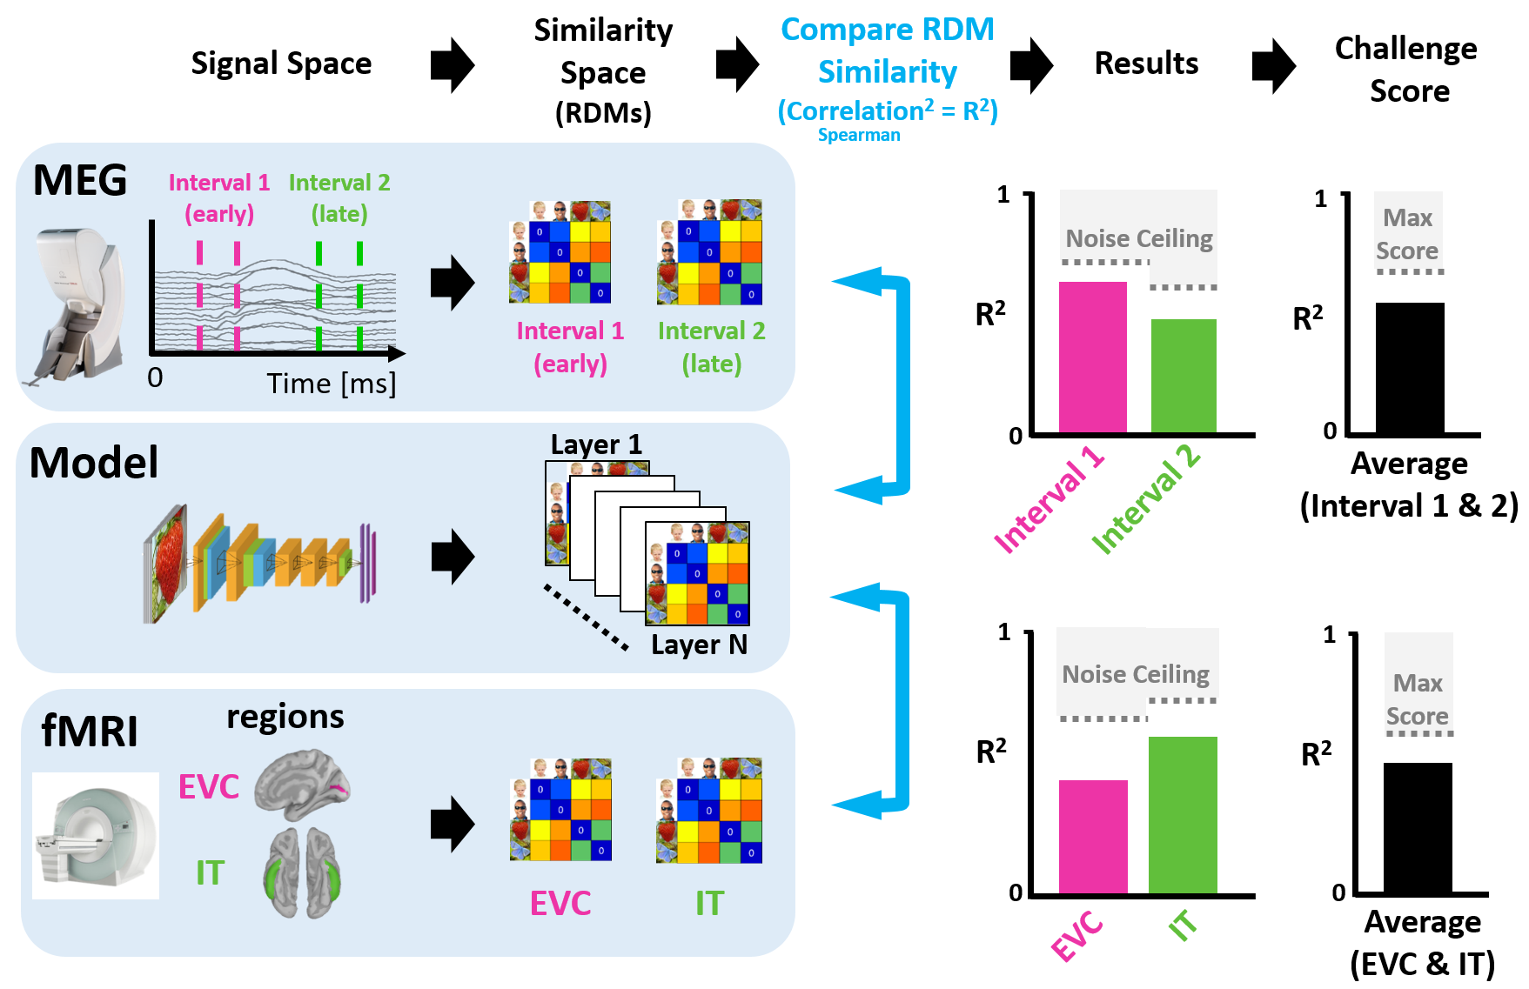
Comparing similarity matrices
Extrastriate and Inferior temporal fit with DNN

Slide 10
Clarification Points
The noise ceiling -- the maximum expected correlation with the data, given its intrinsic variability (i.e., measurement noise).
Estimated by computing the correlation between two independent measurements of the same neural responses (e.g., across different runs or participants), for the same stimuli.
Reflects upper bound on how well any model (e.g., a DNN) could match the data
A model’s ability to predict brain data (X → Y) should not exceed the consistency of Y with itself.

Slide 11
What Types of Representations Can RSA Evaluate?
Compare brain regions (no model needed)
Identify regions with similar representational structures
Understand functional organization without requiring model predictions
Does V1 represent shapes more like V2 or more like IT?
Relate brain activity to behavior
Compare neural dissimilarity matrices to behavioral similarity judgments
Reveal whether and where brain representations align with subjective perception
Are participants' judgments reflected in their neural representations?
Compare representations across individuals or species
Assess whether two brains represent stimuli in similar ways
Useful for studying shared coding principles across participants, populations, or species

Slide 12
RSA and Loss of Dimensions
When using human similarity judgments, we construct an RDM directly from reported pairwise similarities.
When using neurobiological data, we start from a matrix of shape: S × V, where
S = stimuli or trials
V = voxels, electrodes, sensors, or brain regions
When using computational models, we start from: S × F, where
S = objects
F = feature dimensions (e.g., units in a layer; can even be F = 1)
To relate brain data to models, both matrices (S × V and S × F) are converted to RDMs (Representational Dissimilarity Matrices).
Multiple very different S × F matrices can produce identical RDMs.
This means RSA evaluates representational geometry, not the specific feature dimensions used to construct it.
RSA is blind to how many or which features generated the pattern — only the pairwise structure matters.

Slide 13
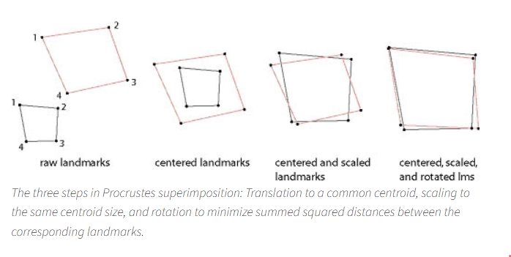
Dimensional Alignment Methods
When two domains (e.g., brain data and a model) are represented as observation × feature matrices, and their features are assumed to reflect the same underlying dimensions, we can evaluate alignment before reducing to RDMs.
Unlike RSA, the following techniques assess the strength and structure of shared dimensions. All are supervised methods.
Procrustes Analysis ▸ Aligns the geometry of two feature spaces by applying rotation and scaling transformations. ▸ Measures how well the shapes of the representations match.
Principal Component Regression (PCR) ▸ Projects both datasets into low-dimensional subspaces (via PCA), then performs regression. ▸ Tests whether the principal dimensions of one domain predict those of the other.
Partial Least Squares (PLS) Correlation ▸ Finds latent components that maximize covariance between the two datasets.
Canonical Correlation Analysis (CCA) ▸ Identifies pairs of linear combinations (canonical variables) that are maximally correlated across datasets. ▸ Explores whether and how dimensions in one space relate to those in another.
Notes:
Procrustes rotation> https://www.virtual-anthropology.com/virtual-anthropology/compare/geometric-morphometrics/procrustes-superimposition/

Slide 14
Biological Context
Univariate vs multivariate approaches

Slide 15
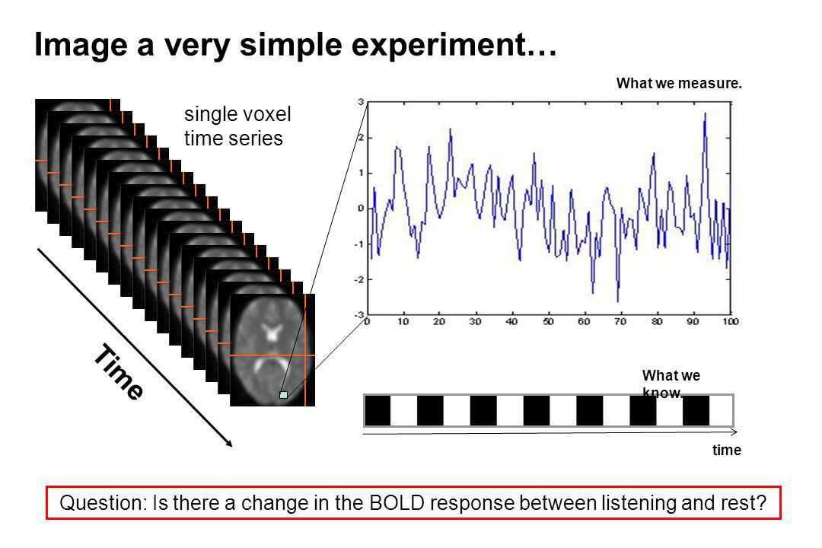
Univariate

Slide 16
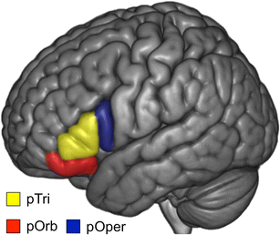



Case Study: Narrative Comprehension and IFG Representations
Goal: Investigate how brain regions encode different dimensions of a narrative:
Spatial (where)
Temporal (when)
Action-related (what)
Design: Participants listened to the same narrative, but focused on different aspects (space, time, or action).
Each sub-region of the Inferior Frontal Gyrus (IFG) treated as a separate analysis unit (like a “voxel”).
Univariate Analysis (not shown):
pOper (posterior opercular): higher mean activation for some conditions.
Pars Triangularis: no significant differences across conditions.
Multivariate Analysis
Considered full patterns of activation across voxels within each IFG sub-region.
Computed similarity across task conditions using multivariate pattern similarity (RSA-like logic).
Found distinct representational patterns even where univariate effects were absent.
Conclusion: Multivariate approaches can detect meaningful task-related representations even when mean activity (univariate) shows no effect.
Cooper et al., 2011
Multivariate pair-wise similarity of 3 conditions in two IFG sub-regions

Slide 17
Multivariate vs. univariate values

Slide 18

Decoding From Brain Data

Slide 19
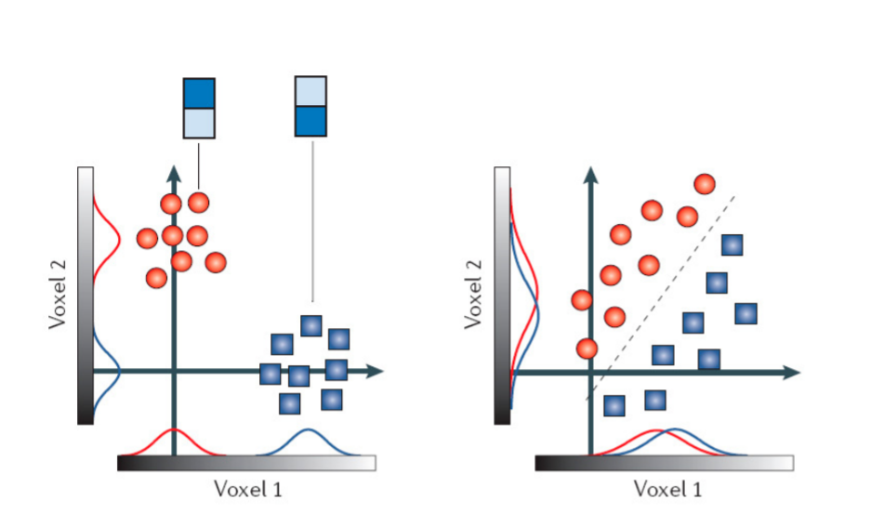
Multivariate Decoding Finds Representational Structure
Two conditions (blue/red) are presented, each generating a distribution of brain activity across trials.
Each trial is shown as a circle or square in a 2D voxel space.
Case 1: Univariate Differences Detected
Each condition produces different mean activity in both Voxel1 and Voxel2.
A univariate analysis detects significant differences.
→ The region is correctly identified as discriminative.
Case 2: No Univariate Differences
Both conditions show similar mean activation in Voxel1 and Voxel2.
Univariate analysis finds no effect, and: would conclude the region is non-discriminative
But...The joint distribution across Voxel1 and Voxel2 differs by condition.
This means the region does encode condition-related information — but only when the pattern across voxels is considered.
Case 1
Case 2
http://imaging.mrc-cbu.cam.ac.uk/imaging/Introduction_to_fMRI_2010?action=AttachFile&do=get&target=Intro_fMRI_2010_03_MVPA.pdf
Notes:
FIX notes.

Slide 20
Machine Learning Workflows
Data Structure:
Select a set of N voxels from a single brain region.
Each stimulus trial is represented as an N-dimensional activity pattern (i.e., one row in the data matrix).
For each participant:
Rows = stimulus trials
Columns = voxel responses (features)
Classification Goal: Classify which condition (e.g., stimulus class) was presented, based on the voxel activity pattern.
Machine Learning Workflow
Split data: Use ~80% of the trials for training, and ~20% for testing (e.g., cross-validation).
Train classifier (e.g., SVM, logistic regression):
Learn to map multi-voxel activity patterns to condition labels.
Test performance: Evaluate accuracy on held-out trials to assess generalization.

Slide 21
Summary: RSA as a Multivariate Tool for Comparing Representations
What RSA Does
Uses multivariate activity patterns (e.g., voxel responses, model features) to compute a representational dissimilarity matrix (RDM) for each domain.
Compares RDMs to assess how similar two systems are in terms of representational geometry.
What RSA Ignores
RSA is blind to feature-level alignment: It does not care about the number or identity of dimensions. Different underlying feature spaces can produce identical RDMs.
It captures second-order similarity (structure of similarities between stimuli), but not feature correspondence.
RSA in Context
Belongs to a broader family of multivariate analysis methods in neuroscience and AI: Focus on patterns across features, not individual feature activity.
Complements techniques like:
MVPA / Decoding
CCA, PLS, Procrustes
Encoding models

