Slide 1

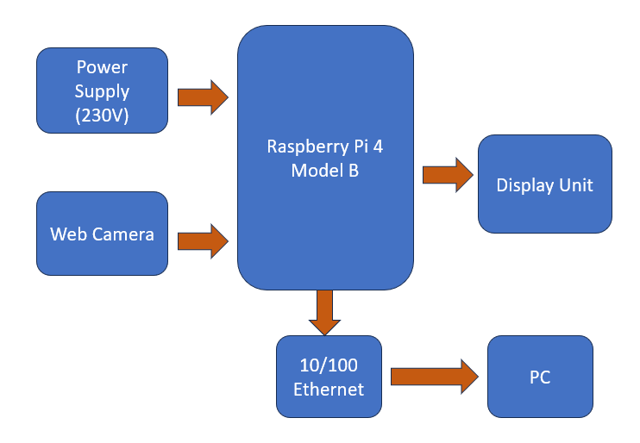
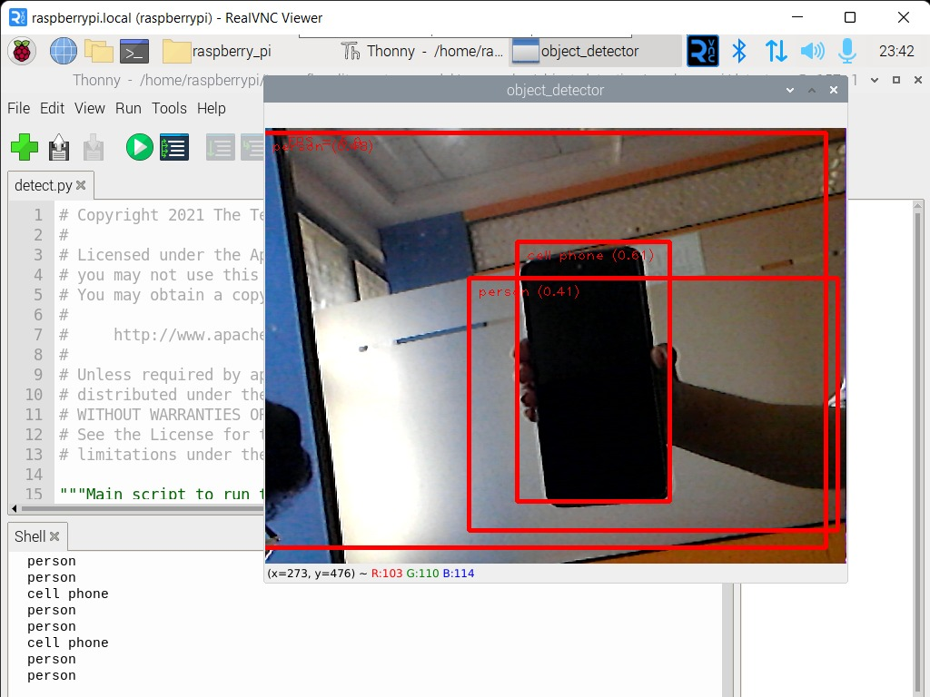
Raspberry Pi-Based Object Detection with Speech and Text Output
Batch No:B16 SRNs:02FE21BEC080,02FE21BEC083,02FE21BEC100,02FE21BEC105
Student Names: Sakshi B , Samruddhi V S, Srushti P, Ujwala V T
Guide: Prof. S. M.Hungund
Problem statement
Methodology
Results
Current object detection systems are often costly, lack portability, and rely on cloud processing, causing delays and limited accessibility. This project aims to develop a cost-effective, real-time, portable solution that instantly detects and identifies objects, providing feedback through speech and text.
Objectives
Minimize hardware and software costs to make object detection accessible to a broader audience.
Enable instantaneous object detection and feedback without noticeable delays.
Implement speech and text output for object identification to cater to various user preferences and needs, including those with visual impairments.
The system captures data via sensors, processes it in real-time using an optimized detection engine on edge devices, and provides feedback through text or voice. A deployment toolkit ensures portability and scalability
Detected objects are classified and relayed via the Output Module using text or voice feedback, including spatial information for better user understanding.
Successfully detected and classified objects (e.g., "person" and "cell phone") in the input image with bounding boxes.
Identifies multiple objects (e.g., "person" and "cell phone") simultaneously within the same frame.
Provides clear visual feedback with labeled bounding boxes for ease of interpretation.
Contributions
Literature survey
Conclusions
Conducting literature surveys on object detection and voice assistant technologies.
Exploring alternative machine learning architectures or techniques to improve performance.
Design of a flexible system that can be updated to recognize additional objects or integrate new features.
Development of a low-cost object detection system suitable for widespread use.
Z. Ozkan, E. Bayhan, M. Namdar and A. Basgumus, "Object Detection and Recognition of Unmanned Aerial Vehicles Using Raspberry Pi Platform," 2021 5th International Symposium on Multidisciplinary Studies and Innovative Technologies (ISMSIT), Ankara, Turkey, 2021, pp. 467-472, doi: 10.1109/ISMSIT52890.2021.9604698.
V. Kamath and R. A., "Performance Analysis of the Pretrained EfficientDet for Real-time Object Detection on Raspberry Pi," 2021 International Conference on Circuits, Controls and Communications (CCUBE), Bangalore, India, 2021, pp. 1-6, doi: 10.1109/CCUBE53681.2021.9702741
In conclusion, the "Raspberry Pi-Based Real-Time Object Detection with Speech and Text Output" project offers a cost-effective and portable solution for efficient object detection and identification. By prioritizing public safety and accessibility, it has the potential to enhance automation and assistive technology in everyday applications.
Senior Design Project (20EECW201)
2024-25

