Slide 1

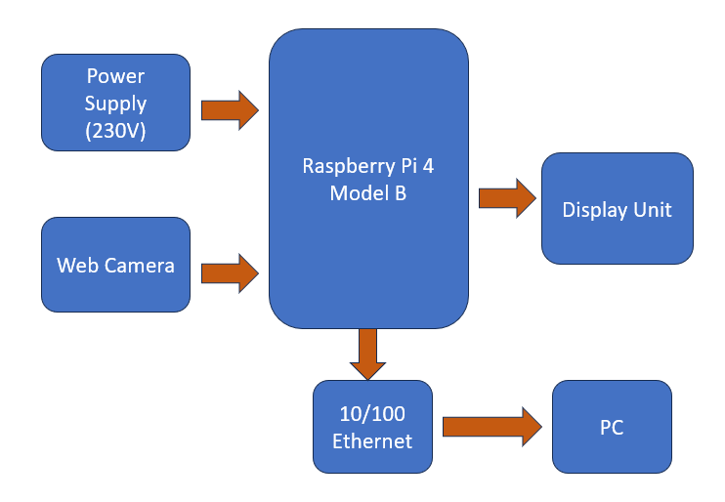
Raspberry Pi-Based Object Detection with Speech and Text Output
Batch No: 16 Division: B SRNs: 02FE21BEC080, 02FE21BEC083, 02FE21BEC100, 02FE21BEC105
Student Names: Sakshi B, Samruddhi S, Srushti P & Ujwala V S Guide: Prof. S.M.Hungund
Context: Object detection is essential in many fields, but current solutions are often too resource-intensive, costly, or inflexible for low-power devices. There is a need for a real-time, affordable, and adaptable system that can be easily deployed on edge devices across various environments.
Problem Statement: Current object detection systems are often costly, lack portability, and rely on cloud processing, causing delays and limited accessibility. This project aims to develop a cost-effective, real-time, portable solution that instantly detects and identifies objects, providing feedback through speech and text.
Deliverables :
Lightweight Object Detection.
Portable Hardware Prototype.
Deployment Toolkit.
Drivable
Training / Pre-Requisites
Understanding the working of raspberry pi.
Timeline
Starter Reference Material
Z. Ozkan, E. Bayhan, M. Namdar and A. Basgumus, "Object Detection and Recognition of Unmanned Aerial Vehicles Using Raspberry Pi Platform," 2021 5th International Symposium on Multidisciplinary Studies and Innovative Technologies (ISMSIT), Ankara, Turkey, 2021, pp. 467-472, doi: 10.1109/ISMSIT52890.2021.9604698.
V. Kamath and R. A., "Performance Analysis of the Pretrained EfficientDet for Real-time Object Detection on Raspberry Pi," 2021 International Conference on Circuits, Controls and Communications (CCUBE), Bangalore, India, 2021, pp. 1-6, doi: 10.1109/CCUBE53681.2021.9702741.
Kick Off < 1st Month >
Milestone 1 < 2nd Month >
Milestone 2 < 3rd & 4th Month
Hands on learning with pre-trained Semantic segmentation architecture (Available Dataset). Dataset Preparation (Capture and annotation) : Road scenario.
Contribution at Architecture level .
Training and Initial Testing.
.
Integrating, testing and validation.
Documentation and applying for contests .

