Slide 1


Department of Electronics and Communication Engineering
Lightweight blockchain enabled patient monitoring system
SL.NO. | NAME | USN | ROLL NO.
01 | Sakshi Bagewadi | 02FE21BEC060 | 08
02 | Samruddhi V S | 02FE21BEC064
03 | Srushti P | 02FE21BEC100 | 24
04 | Ujwala V T | 02FE21BEC105 | 27
Under the guidance of : Prof. Shwetha Madiwalar.
Dept. of ECE

Slide 2
SI. NO | INDEX
01. | Need Statement
02. | Problem Statement
03. | Introduction
04. | Literature Survey
05. | Block Diagram
05. | Flow chart
06. | Input and output
07. | Optimization
08. | Result
09. | References

Slide 3
Need Statement
There is a need for a low-cost, efficient system that can detect and identify objects in real-time, providing immediate feedback through speech and text. This project aims to create a portable solution for real-time object detection and identification with instant output.

Slide 4
Problem Statement
Current object detection systems are often costly, lack portability, and rely on cloud processing, causing delays and limited accessibility. This project aims to develop a cost-effective, real-time, portable solution that instantly detects and identifies objects, providing feedback through speech and text.

Slide 5
Introduction
The advancement of artificial intelligence and machine learning has enabled the development of powerful object detection systems capable of identifying and recognizing objects in real-time.
This project leverages the capabilities of Raspberry Pi and pretrained YOLOv5/YOLOv8 models to create an efficient, low-cost object detection system.
The integration of text-to-speech technology allows the system to audibly announce detected objects.
Thee detected objects are displayed on a screen, providing a visual representation of the analysis.
Equipped with a PiCam for real-time image capture, the system is designed to detect objects in its environment and provide both text-based and speech-based.

Slide 6
Literature Review
Sl No. | Paper Title | Objective | Methods/Techniques/Algorithm used | Limitations /Disadvantages/Remarks
1 | Scalable Object Detection using Deep Neural Network | Detects objects in images without requiring prior knowledge of their specific classes. It is efficient and scalable to handle a large number of object classes. | The core of the proposed model is a DCNN, which is trained to predict a set of bounding boxes and their corresponding confidence scores. | The model is limited to predicting a fixed number of bounding boxes, which might not be sufficient for images with a large number of objects.
2 | Object Detection Using Machine Learning for Visually Impaired People | A system that can accurately detect various objects in both indoor and outdoor environments. Ensure that the object detection process is efficient and can recognize multiple objects in a timely manner. | Utilize machine learning algorithms and computer vision techniques to analyze visual data and identify objects. | The system might struggle in low-light or challenging lighting conditions, affecting the accuracy of object detection.
3 | Object Detection and Human Identification using Raspberry Pi | Develop a system to aid blind and visually impaired individuals in navigating their surroundings. | Stereoscopic Sonar Algorithm to process ultrasonic sensor data and create a 3D representation of the environment | The accuracy of obstacle detection might be affected by factors like environmental noise, object reflectivity.

Slide 7
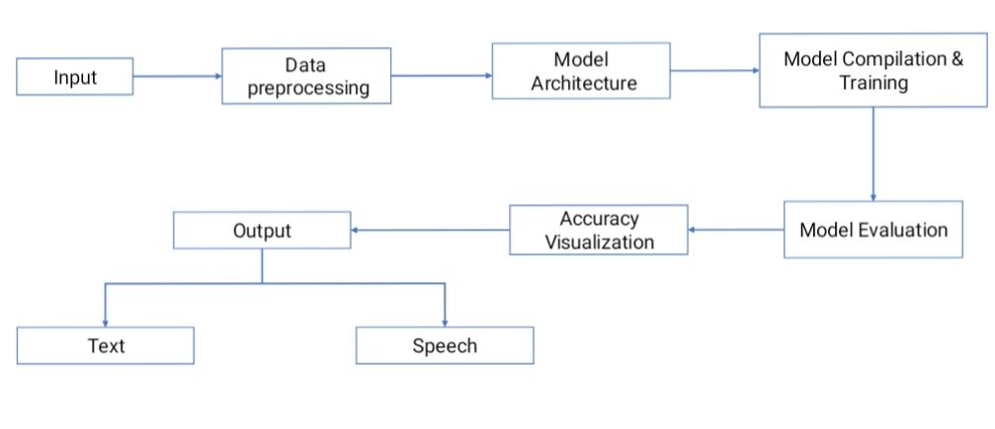
Block Diagram

Slide 8
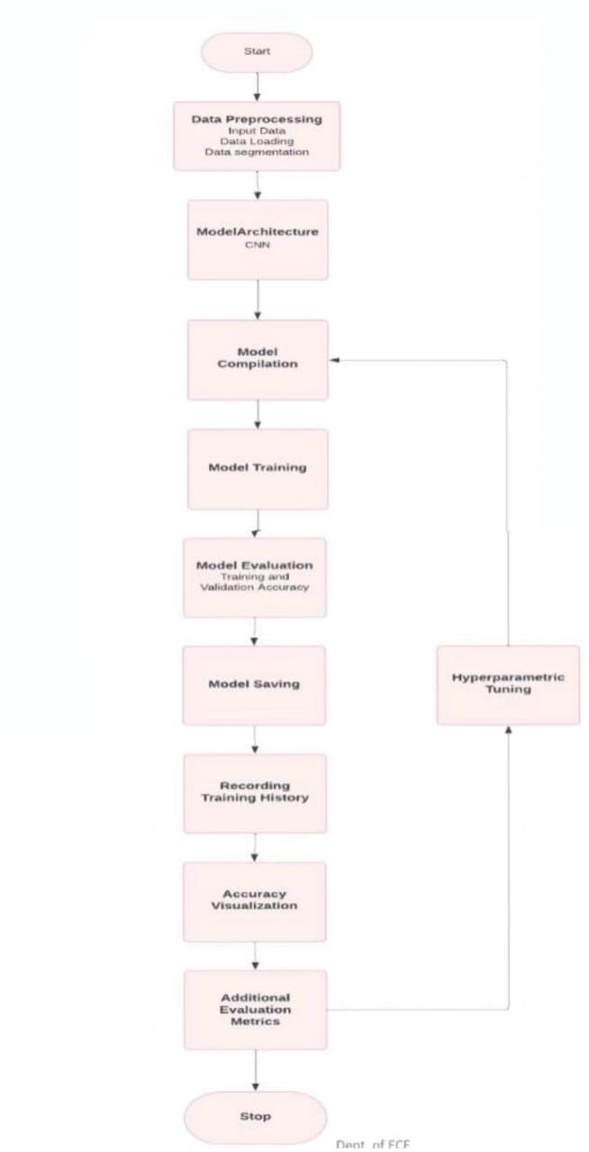
Flow chart

Slide 9
Input and Output
Dataset
We extract the input from the kaggle like fruit detection, Animal detection.
INPUTS
OUTPUT
Classify the tumors as
Adenocarcinoma
Covid19
Large cell carcinoma
Normal
Squamous cell carcinoma

Slide 10
Optimization:
10

Slide 11
Post optimization
With Adam, we got smoother and more stable loss curves during training.
Faster initial improvements in accuracy, especially on deeper layers.
It makes training more robust.
The accuracy of model increased to 98%.
11

Slide 12
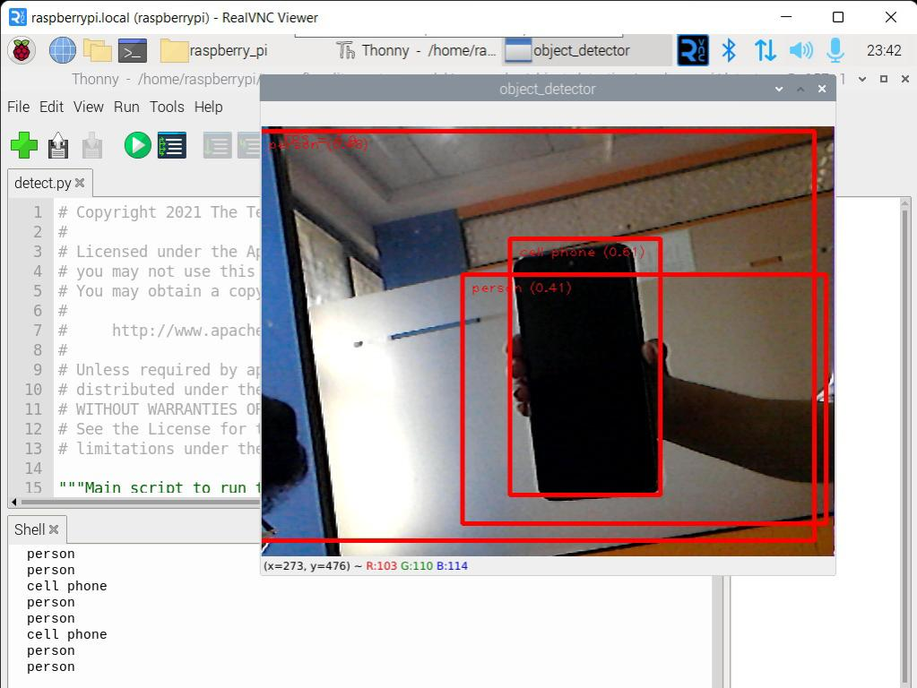
Result
12

Slide 13
Future scope:
Custom Object Detection:Train the system on custom datasets to identify specific objects relevant to visually impaired users (like public signs, personal items, or vehicles), making the system more context-aware and user-friendly.
Mproved Feedback Systems:Enhance feedback options with vibration alerts, haptic feedback, and customized voice commands to make it more accessible for visually impaired users. Real-time guidance (like directional cues) can be added to assist users in locating objects.
Commercialization and Affordability: Efforts could be made to commercialize the system as an affordable assistive device for visually impaired people. Partnerships with nonprofits or government agencies could facilitate large-scale distribution to underserved populations.
Dept. of ECE

Slide 14
References:
Erhan, D., Szegedy, C., Toshev, A. And Anguelov, D., 2014. Scalable object detection using deep neural networks. In Proceedings of the IEEE conference on computer vision and pattern recognition (pp. 2147-2154).
Mandhala, V.N., Bhattacharyya, D., Vamsi, B. And Thirupathi Rao, N., 2020. Object detection using machine learning for visually impaired people. International Journal of Current Research and Review, 12(20), pp.157-167.
Lakshmi, K., 2016. Design and Implementation of Text to Speech conversion using Raspberry pi. Dimensions, 85, p.x56mm.
Hayashi, T. and Watanabe, S., 2020. Discretalk: Text-to-speech as a machine translation problem. arXiv preprint arXiv:2005.05525.
Dept. of ECE

