Slide 1
🐵💻 Meet Python with Robo & Monkey!
A Fun 2-Hour Coding Adventure

Slide 2
What Is a Language?
• A language is how we talk to each other.
• English, Hindi, Spanish… even 🐵 monkey sounds!

Slide 3
What Is a Programming Language?
• A programming language helps us talk to computers.
• Python is one such language.
• Robo Monkey follows instructions to help Monkey!

Slide 4
Real vs Programming Languages
Real Language vs Programming Language
Talk to people vs Talk to computers
English, Hindi vs Python, Scratch
"Hello!" vs print("Hello!")

Slide 5
Meet Python 🐍
• Created by Guido van Rossum
• Easy, friendly, and fun!
• Used by beginners and pros alike!

Slide 6
What Is an Interpreter?
• Python uses a special helper called an interpreter.
• It reads and runs our code line by line.
• Like Robo Monkey reading instructions for Monkey!

Slide 7
Let’s Talk in Python!
Example: print("Hello, world!")
• Robo Monkey says: Hello, world!
• Python prints what we tell it to.

Slide 8
Unicode Characters Are Cool!
print("🐵🤖💡🚀")
print("I ❤️ Python!")
• Use emojis and symbols in Python!

Slide 9
Story Time – Unicode Adventure
print("🐵 met 🤖 in the 🌴 jungle.")
print("They found a 🗝️ to open a 🔐 chest!")
print("Inside was a 🧠 made of 💻 parts!")
print("They high-fived and said: 🎉🎉🎉")

Slide 10
Let’s Write Our Own Story!
• Pick your favorite emojis or unicode characters.
• Write 2-line Python print() stories.
• Share them aloud with the group!

Slide 11
Summary
• Language vs Programming Language
• Python helps Robo Monkey follow instructions
• Print words, emojis, and stories!
• Python interpreter runs the code

Slide 12
What’s Next?
• Keep learning Python!
• Make games, stories, and fun apps.
• Python is your new superpower! 🦸‍♂️🐍

Slide 13
Setup IDE locally
https://www.youtube.com/watch?v=s6X_BVfncOw
https://code.visualstudio.com/download
https://www.python.org/downloads/
Notes:
https://thegraphcourses.org/courses/python-dev/topics/intro-to-vs-code/

Slide 14
Try Python Online!
• No need to install anything!
Use online editors like:
- https://replit.com
- https://trinket.io
- https://www.programiz.com/python-programming/online-compiler/
• Just type your code and click RUN!
Example:
print("🐍 Python is fun!")

Slide 15
🍌 What is a List?
• A list is like a bunch of bananas in a row!
• Monkey finds many bananas:
bananas = ['big banana', 'small banana', 'ripe banana']
• He can pick one using its position: bananas[0]

Slide 16
🌴 What is a Set?
• A set is a collection with no duplicates.
• Monkey keeps only unique fruits:
fruits = {'banana', 'apple', 'banana'}
• Python will keep only one banana!

Slide 17
🗺️ What is a Dictionary?
• A dictionary is like a treasure map!
• Monkey maps fruits to their colors:
fruit_colors = {'banana': 'yellow', 'apple': 'red'}
• Now he can find any fruit’s color easily!

Slide 18
📖 Monkey’s Banana Adventure
• Monkey 🐵 went to the jungle 🌴
• He picked up bananas 🍌 and stored them in a list
• He found many fruits, but kept only unique ones using a set
• Then he made a map 🗺️ of all fruits and their colors using a dictionary
• He printed his findings using Python!
Notes:
# 🐵 Monkey & 🤖 Robo in the Jungle Adventure
# Monkey finds his first banana
banana = "Golden Banana 🍌"
print(f"Monkey found a {banana}!")
# He collects a bunch of bananas
banana_basket = ["Small Banana", "Big Banana", "Spotted Banana"]
print(f"Basket of bananas: {banana_basket}")
# They enter a mysterious jungle with strange fruits (some are duplicates!)
jungle_fruits = ["banana", "apple", "banana", "dragonfruit", "apple"]
unique_fruits = set(jungle_fruits)
print(f"Unique fruits found: {unique_fruits}")
# Robo suggests mapping fruit colors
fruit_colors = {
"banana": "yellow",
"apple": "red",
"dragonfruit": "pink"
}
# Monkey tries to find the color of a mango (plot twist!)
if "mango" in fruit_colors:
print(f"Mango is {fruit_colors['mango']}")
else:
print("Wait... where's the mango? 🤔")
# They find a fruit with a hidden message inside!
mystery_fruit = {
"name": "Time Fruit",
"color": "blue",
"message": "You’ve unlocked the power of Python! 🧠✨"
}
print(f"Mystery Fruit: {mystery_fruit['name']} - {mystery_fruit['color']}")
print(f"Secret Message: {mystery_fruit['message']}")
# Ending twist - The fruit turns Robo into Robo-Monkey!
robo_mode = True
if robo_mode:
print("🤖🔁 Robo has transformed into Robo-Monkey 3000! Now he codes in Python faster than light! 🚀")

Slide 19
Title: 🍌 Creating 3 Bananas in a List
bananas = ['banana', 'banana', 'banana']
print(bananas) # Output: ['banana', 'banana', 'banana’]
Lists keep all items, even duplicates!
Monkey loves having lots of bananas 🍌🍌🍌
NOTES
Code

Slide 20
🍌 Adding Bananas to a Set
banana_set = {'banana', 'banana', 'banana'}
print(banana_set) # Output: {'banana’}
notes
No matter how many bananas Monkey adds, there is only one banana in the set!
CODE
Sets keep only unique items!

Slide 21
Fun game
CODE # Simple Animal-Fruit Guessing Game 🍌🍊🍉 animal_fruit = { "monkey": "banana", "squirrel": "orange", "elephant": "watermelon" } print("Welcome to the Simple Animal-Fruit Guessing Game!") for animal in animal_fruit: guess = input(f"What fruit does the {animal} like? ").strip().lower() if guess == animal_fruit[animal]: print(f"Correct! The {animal} loves {guess}s.\n") else: print(f"Oops! The {animal} does not like {guess}s. The correct answer is {animal_fruit[animal]}.\n") print("Thanks for playing!")
Notes:
# Simple Animal-Fruit Guessing Game 🍌🍊🍉
animal_fruit = {
"monkey": "banana",
"squirrel": "orange",
"elephant": "watermelon"
}
print("Welcome to the Simple Animal-Fruit Guessing Game!")
for animal in animal_fruit:
guess = input(f"What fruit does the {animal} like? ").strip().lower()
if guess == animal_fruit[animal]:
print(f"Correct! The {animal} loves {guess}s.\n")
else:
print(f"Oops! The {animal} does not like {guess}s. The correct answer is {animal_fruit[animal]}.\n")
print("Thanks for playing!")

Slide 22
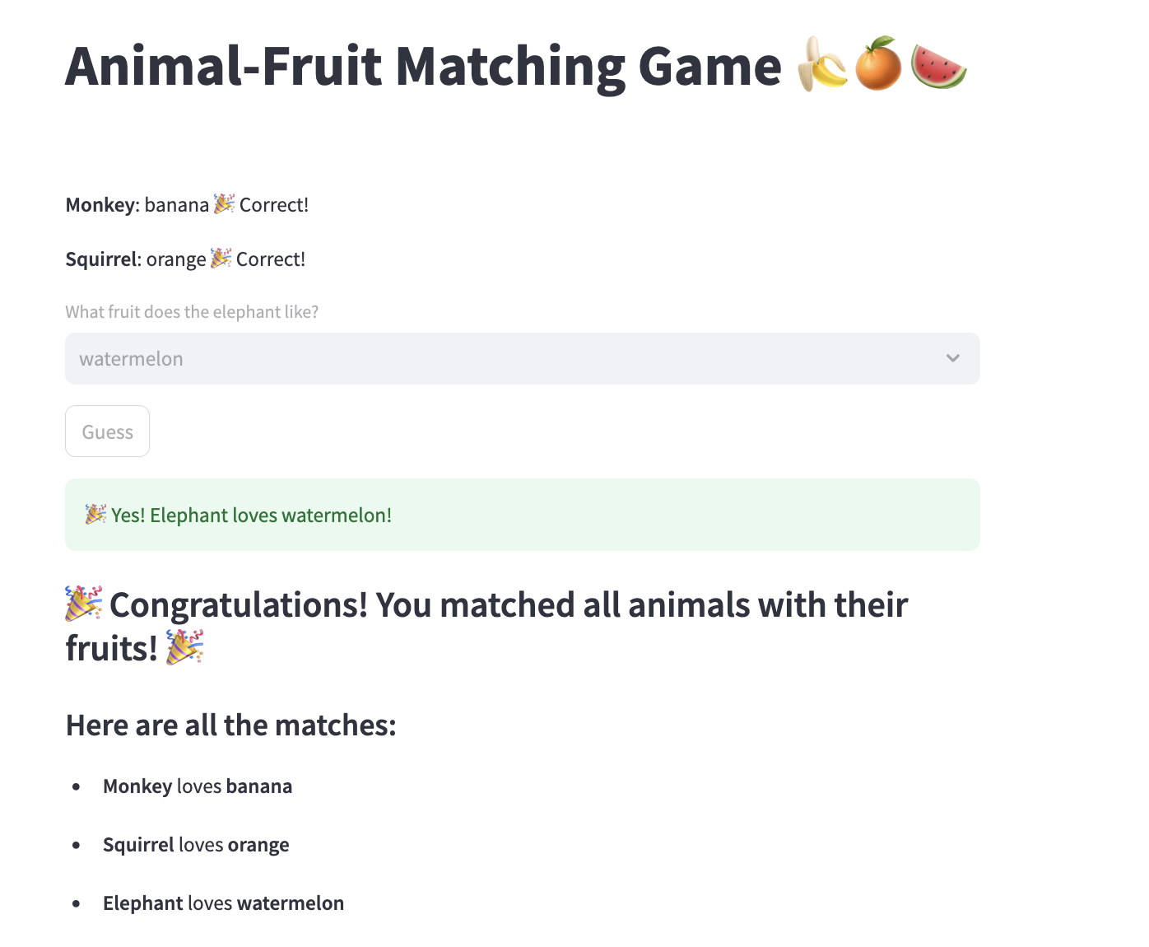
streamlit run steamlit.py
Notes:
import streamlit as st
st.title("Animal-Fruit Matching Game 🍌🍊🍉")
animal_fruit = {
"monkey": "banana",
"squirrel": "orange",
"elephant": "watermelon"
}
fruits = ["banana", "orange", "watermelon"]
# Store guesses in session state
if "guessed" not in st.session_state:
st.session_state.guessed = {}
def check_guess(animal, guess):
if guess == animal_fruit[animal]:
st.session_state.guessed[animal] = True
return True
return False
for animal in animal_fruit:
if animal in st.session_state.guessed:
st.markdown(f"**{animal.capitalize()}**: {animal_fruit[animal]} 🎉 Correct!")
else:
guess = st.selectbox(f"What fruit does the {animal} like?", options=fruits, key=animal)
if st.button("Guess", key=f"btn_{animal}"):
if check_guess(animal, guess):
st.success(f"🎉 Yes! {animal.capitalize()} loves {guess}!")
else:
st.error(f"❄️ Nope! {animal.capitalize()} does not like {guess}. Try again!")
if len(st.session_state.guessed) == len(animal_fruit):
st.balloons()
st.markdown("### 🎉 Congratulations! You matched all animals with their fruits! 🎉")
st.markdown("#### Here are all the matches:")
for animal, fruit in animal_fruit.items():
st.write(f"- **{animal.capitalize()}** loves **{fruit}**")

