Slide 1
🐒 Day 2 Python Class: Monkey & Banana Story
Loops • If Conditions • Collections • Modules

Slide 2
🧠 Recap
Variables
Printing and Input
Basic Story Interaction

Slide 3
🌴 The Jungle Loop
Use for loop: range(1, 11)
If tree has banana (even-numbered), monkey eats
Else, monkey skips

Slide 4
🔁 Loop Example Code
for tree in range(1, 11):
if tree % 2 == 0:
print(f"Tree {tree}: Banana found! 🍌")
else:
print(f"Tree {tree}: No banana.")

Slide 5
⚖️ Monkey's Choice
banana_color = "green"
if banana_color == "yellow":
print("Eats banana 🍌")
elif banana_color == "black":
print("Throws away ❌")
else:
print("Waits to ripen 🌱")

Slide 6
Introduction to PIP
PIP stands for "Pip Installs Packages"
Used to install, upgrade, and uninstall Python libraries
Helps add external functionality to Python apps
Example: pip install streamlit
Notes:
https://drive.google.com/file/d/1cXu_-lWsI5OtuMeuaypukKba__d-b879/view?usp=sharing

Slide 7
8 queens puzzle
♛ 8 Queens Puzzle Rules:
You must place 8 queens on the chessboard.
No two queens can attack each other.
A queen can move vertically, horizontally, and diagonally.
Use the board to place queens one by one.
If your placement causes a conflict, you’ll get a warning!
You can reset the board anytime.
If you’re stuck, use the 💡 Show Me a Solution button to reveal a valid configuration.
Notes:
Download code : https://drive.google.com/file/d/19yEL5O74bi8Xn50AthltwmdgCsqQy8_m/view?usp=sharing
pip install streamlit
streamlit run chess-8queen.py

Slide 8
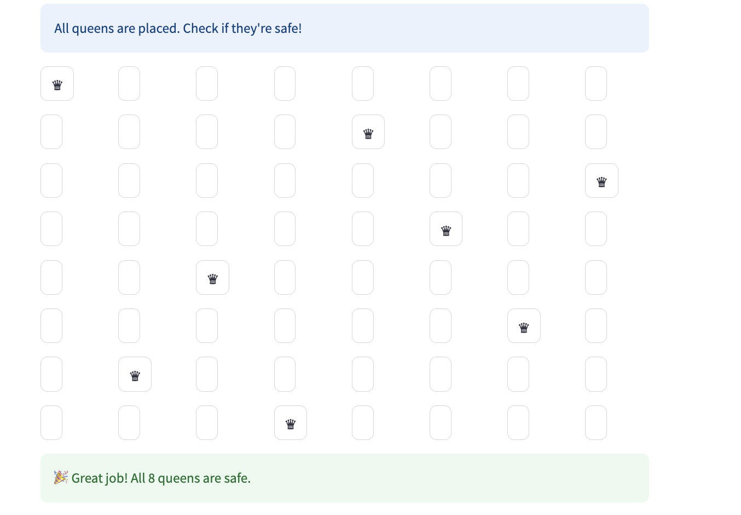
Solution

Slide 9

Break
Ten minutes timer

Slide 10
📦 Monkey's Inventory
List = group of items (ordered, can repeat)
Set = unique items (unordered)
Dictionary = key-value pairs

Slide 11
🍌 List Example
Loop through list
Eat if yellow, skip others

Slide 12
🌴 Set and Dictionary
fruits = {"banana", "apple", "banana"}
banana_tree = {"Tree1": "yellow", "Tree2": "black"}

Slide 13
🧰 Built-in Modules
time.sleep(seconds) - make monkey nap
random.randint(a, b) - random tree

Slide 14
🧪 Mini Challenges
Monkey checks 20 trees
Monkey reacts to banana colors in a list
Random banana drops with sleep

Slide 15
📚 Wrap-Up
For Loop: for i in range(n)
If-Else: if, elif, else
List: [1, 2, 3]
Set: {1, 2, 3}
Dict: {"key": "value"}
Modules: random, time

Slide 16
📝 Homework
Randomly pick 5 fruits
If it's a banana, check color
Sleep 1 sec between fruits
Print monkey's reaction

