Slide 1
REAL-TIME FINANCIAL ANOMALY DETECTION USING MACHINE LEARNING AND STREAMING ANALYTICS Srudhan Eerla 24MCB1002
Guide: Dr. S . Deepa Nivethika

Slide 2
INTRODUCTION
With the rapid growth of digital banking and online payments, financial transactions are generated continuously and at a very high speed. Along with this growth, fraudulent and abnormal activities are also increasing, making traditional detection methods less effective. Most existing systems rely on fixed rules and batch processing, which often detect suspicious transactions only after a delay. To overcome these limitations, machine learning can be used to learn normal transaction behavior and identify unusual patterns automatically. This project focuses on developing a real-time financial anomaly detection system that analyzes streaming transaction data and provides timely insights through a live dashboard.

Slide 3
PROBLEM STATEMENT
Financial institutions handle a large number of transactions every second, making it difficult to monitor and identify abnormal activities in a timely manner. Most existing fraud detection systems rely on predefined rules and batch-based analysis, which often detect suspicious transactions only after a delay. Such delayed detection can lead to financial losses and increased security risks. Additionally, fixed rules are not flexible enough to adapt to changing fraud patterns. Therefore, there is a need for a real-time system that can continuously analyze financial transactions and automatically identify anomalies using machine learning techniques.

Slide 4
RESEARCH OBJECTIVES
To build a system that can identify unusual financial transactions as they occur
To study financial transaction data in a continuous, real-time environment
To use machine learning methods to learn normal transaction behaviour and detect anomalies
To assign a risk or anomaly score to each transaction
To store detected anomalies for further analysis and review
To present the results through a live dashboard for easy monitoring

Slide 5
PROPOSED SYSTEM
The proposed system is a real-time financial anomaly detection framework that continuously monitors transaction streams and identifies unusual behavior using unsupervised machine learning.
Unlike traditional batch-based systems, this system:
Detects anomalies as transactions occur
Does not depend on predefined fraud rules
Adapts to changing transaction patterns

Slide 6
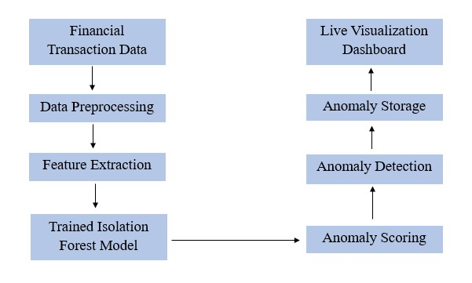
PROPOSED SYSTEM DIAGRAM
The architecture shows an end-to-end pipeline where transaction data flows through preprocessing, anomaly detection, storage, and visualization layers

Slide 7
MODULES
Data Ingestion Module:
Responsible for loading transaction data from CSV
Acts as the source of transaction streams
Provides structured input to the preprocessing pipeline
Data Preprocessing Module:
Removal of duplicate records
Handling missing values:
Categorical → "UNKNOWN"
Numerical → Median value
Ensures data consistency and quality

Slide 8
MODULES
Feature Encoding & Scaling Module:
Feature Encoding:
Label Encoding applied to categorical variables
Converts non-numeric fields into numeric format
Feature Scaling:
StandardScaler used
Transforms features to zero mean and unit variance
Reason:
Prevents dominance of high-magnitude features
Improves Isolation Forest performance

Slide 9
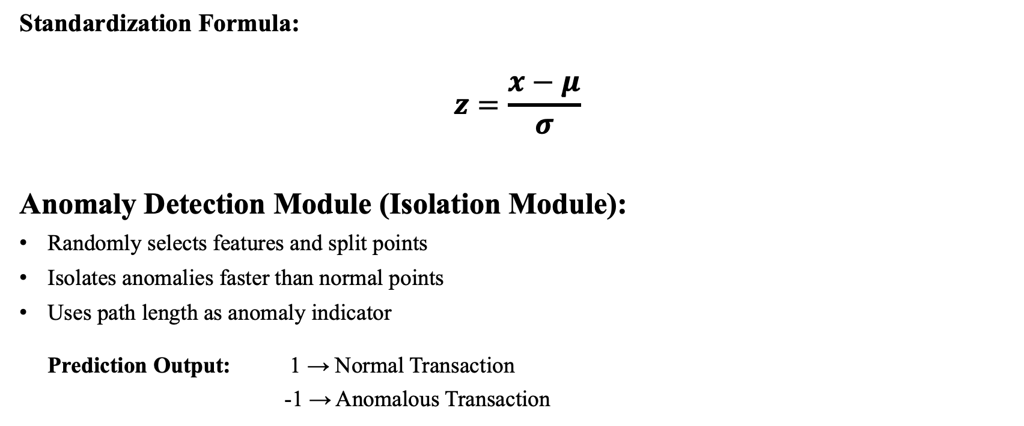
MODULES
Standardization Formula:
$$z=\frac{x−μ}{σ}$$
Anomaly Detection Module (Isolation Module):
Randomly selects features and split points
Isolates anomalies faster than normal points
Uses path length as anomaly indicator
Prediction Output: 1 → Normal Transaction
-1 → Anomalous Transaction

Slide 10
MODULES
Real-time Streaming Simulation Module:
It simulates real-time transaction flow by processing transactions one at a time with a small artificial delay using time.sleep().
Each transaction is evaluated immediately by the anomaly detection model
Anomaly Logging and Storage Module:
Detected anomalies are stored in a CSV file (anomalies_live.csv) along with timestamp, anomaly score, and detection reason.
Advantages:
Separates detection and visualization
Supports historical analysis

Slide 11
MODULES
Visualization & Monitoring Module:
A live dashboard is built using Streamlit to monitor anomalies in real time.
Displayed Metrics:
Total anomaly count
Recent anomalies
Time-based trends
Anomaly score distribution

Slide 12
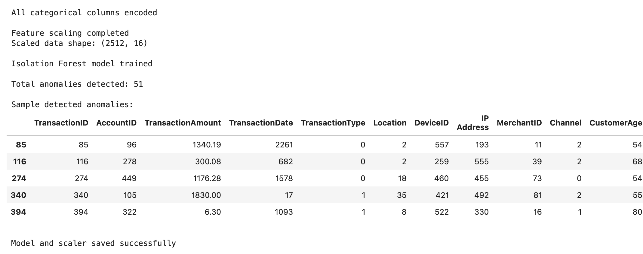
RESULTS
Above Image represents the Isolation Forest model training output showing successful preprocessing, feature scaling, and total number of anomalies detected in the dataset.

Slide 13
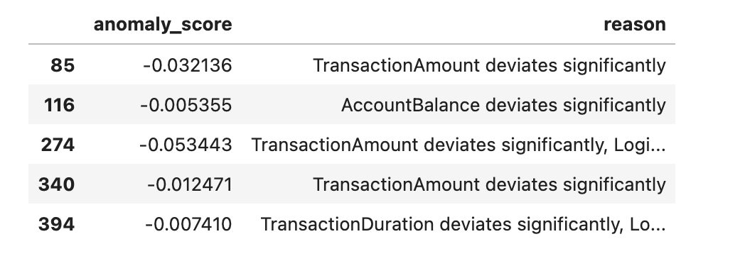
RESULTS
Above Table represents the Anomaly scores with corresponding detection reasons, showing which transaction features contributed to each anomaly.

Slide 14
RESULTS & FINDINGS
Observations:
Anomalies form a small percentage of total transactions
Isolation Forest successfully detects rare patterns
Real-time detection achieved with low latency

Slide 15
INTERPRETATION & DISCUSSION
Interpretations:
Lower anomaly scores indicate higher abnormality
Detected anomalies align with extreme transaction patterns
Discussions:
System is effective for unlabeled financial data
Suitable for real-time risk monitoring
Can be scaled with streaming frameworks

Slide 16
REFERENCES
Dumitrescu, B., Băltoiu, A., & Budulan, Ş. (2022). Anomaly detection in graphs of bank transactions for anti money laundering applications. IEEE Access, 10, 47699-47714.
Daksa, R. Procediaala, A. P. (2025). A Comparative Study On Real Time Data Streaming For Fraud Detection Using Kafka With Apache Flink And Apache Spark. Procedia Computer Science, 269, 192-199.
Stahmann, P., Nebel, M., & Janiesch, C. (2025). AI-based real-time anomaly detection in industrial engineering: A structured literature review, taxonomy, and research agenda. Computers & Industrial Engineering, 111236.
Mandlik, A. S., Ganeshpure, M. S., Kadadas, C. N., Korra, L., Kidav, J. U., & Lavadkar, M. A. (2025, August). AI-Driven Real-Time Threat Detection for UPI Transactions. In 2025 International Conference on Applications of Machine Intelligence and Data Analytics (ICAMIDA) (pp. 1-3). IEEE.
Gadimov, E., & Birihanu, E. (2025). Real-time suspicious detection framework for financial data streams. International Journal of Information Technology, 1-17.

Slide 17
REFERENCES
Wang, F., Jiang, Y., Zhang, R., Wei, A., Xie, J., & Pang, X. (2025). A survey of deep anomaly detection in multivariate time series: taxonomy, applications, and directions. Sensors (Basel, Switzerland), 25(1), 190.
Jain, R., & Deshwal, S. ‘Anomaly detection in bank transactions using machine learning. Tech. Rep.
Li, Y., Wu, N., Tang, D., & Zhang, X. (2025, June). Research on Anomaly Detection Algorithm System for Financial Transaction Data Processing Based on Deep Learning. In 2025 IEEE 3rd International Conference on Image Processing and Computer Applications (ICIPCA) (pp. 1562-1566). IEEE.
Rahmati, M. (2025). Real-Time Financial Fraud Detection Using Adaptive Graph Neural Networks and Federated Learning. Int. J. Management and Data Analytics, 5(1), 98-110.
Acharjee, S., Bhattacharjee, P., Mondal, S., Goswami, S., Sadhukhan, S., Mukherjee, A., & Das, A. (2025, July). Streaming-Based Anomaly Detection for Real-Time Scalable Credit Card Fraud Prevention: A Comparative Study. In 2025 International Conference on Engineering Innovations and Technologies (ICoEIT) (pp. 736-740). IEEE.

Slide 18
Thank you

