Slide 1
EYETRACKMOUSE: A HANDS-FREE HUMAN-COMPUTER INTERACTION SYSTEM
Srudhan Eerla
24MCB1002
Guide: Dr. S . Deepa Nivethika

Slide 2
INTRODUCTION
In today’s technology, controlling the cursor typically requires the use of a mouse or touchpad, which depends on hand or finger movements. This poses a major challenge for individuals with upper limb disabilities, such as amputees, who cannot operate these devices. To overcome this limitation, eye movement can serve as an alternative mode of control, where the direction of the eyeball is tracked and mapped to the cursor’s movement on the screen. Such an eye tracking mouse holds great significance as it enhances accessibility, promotes inclusivity, and empowers amputees to interact with digital systems independently.

Slide 3
PROBLEM STATEMENT
In today’s computing environment, the computer mouse remains the primary device for cursor control. However, this creates significant accessibility challenges for people with physical disabilities such as amputees, quadriplegics, or individuals with impaired hand mobility, as they cannot operate traditional input devices. While some commercial eye-tracking systems exist, they are often expensive, require specialized hardware, and are not widely available. There is a need for a low-cost, hands-free, and user-friendly system that allows users to interact with a computer using only natural facial and eye movements. This project addresses that problem by developing a webcam-based eye tracking mouse, which enables cursor control and mouse actions through eye gestures, blinking, and head movements without the need for additional hardware.

Slide 4
RESEARCH OBJECTIVES
To design a hands-free mouse control system using facial landmarks and eye gestures.
To implement real-time facial detection and tracking using Python libraries such as OpenCV and Dlib.
To translate identified gestures into cursor operations like left click, right click, double click, and scroll.
To develop a low-cost, software-based solution that eliminates the need for external hardware.
To enhance human–computer interaction for users with physical disabilities or limited mobility.

Slide 5
PROPOSED SYSTEM
A vision-based mouse control system that uses facial landmarks and eye gestures to perform mouse operations.
Works in real time using a webcam to track eye blinks and mouth movements.
Uses OpenCV for image and video processing, and Dlib for facial landmark detection.
Calculates Eye Aspect Ratio (EAR) and Mouth Aspect Ratio (MAR) to identify user gestures.
Performs mouse actions such as left click, right click, double click, and scroll using PyAutoGUI.
Provides a hands-free and cost-effective solution without the need for external sensors.

Slide 6
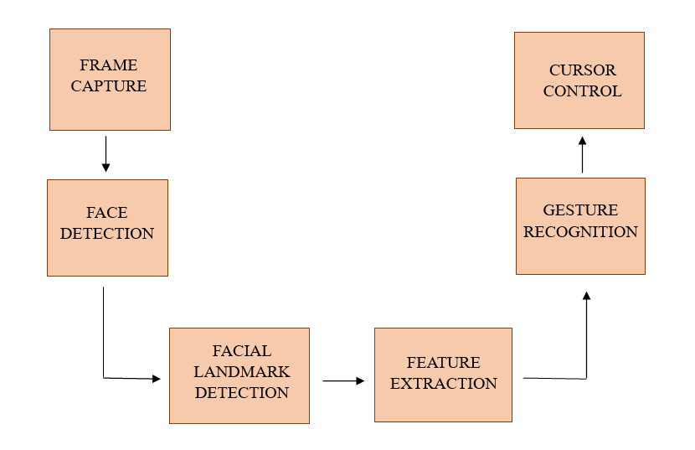
BLOCK
DIAGRAM

Slide 7
LIST OF MODULES
OpenCV -for image capture, frame processing, and visualization.
Dlib – for face and landmark detection.
Imultils – for simplifying landmark extraction and frame operations.
PyAutoGUI – for controlling cursor movement and clicks.

Slide 8
MODULES
OpenCV Module:
Captures frames from the webcam (cv2.VideoCapture()).
Handles all image processing parts of the project.
Dlib Module:
Detects face regions in video frames.
Uses shape_predictor_68_face_landmarks.dat for facial landmark detection.
Provides precise coordinates of eyes, nose, and mouth.

Slide 9
MODULES
Imutils Module:
Simplifies OpenCV operations like resizing and landmark mapping.
Provides face_utils to extract eye, nose, and mouth coordinates easily.
PyAutoGUI Module:
Used to control the mouse (move, click, scroll).
Functions used: moveRel(), click(), scroll().
Converts gesture detections into real mouse actions.

Slide 10
RESULTS
System detects facial gestures with high accuracy in normal lighting.
Real-time response achieved.
Gestures successfully mapped to:
  Left Wink → Left Click
  Right Wink → Right Click
  Mouth Open → Enable/Disable Input Mode
  Face squeeze → Toggle Scroll Mode
Nose direction accurately moves cursor in all four directions.

Slide 11
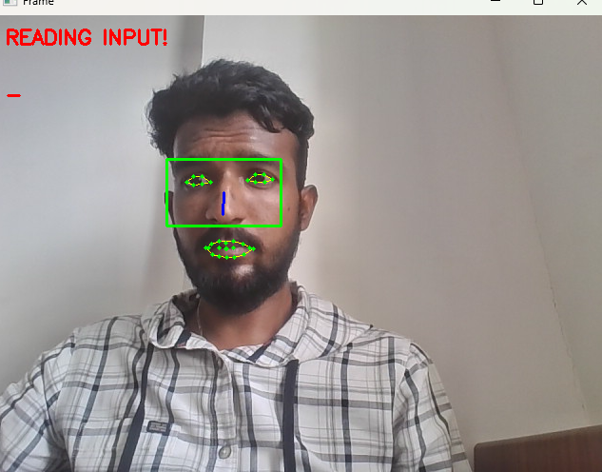
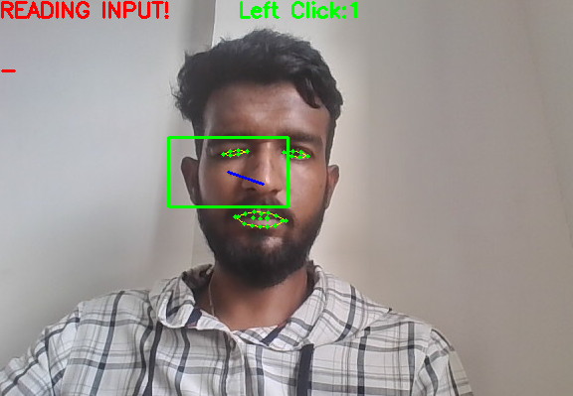
RESULTS

Slide 12
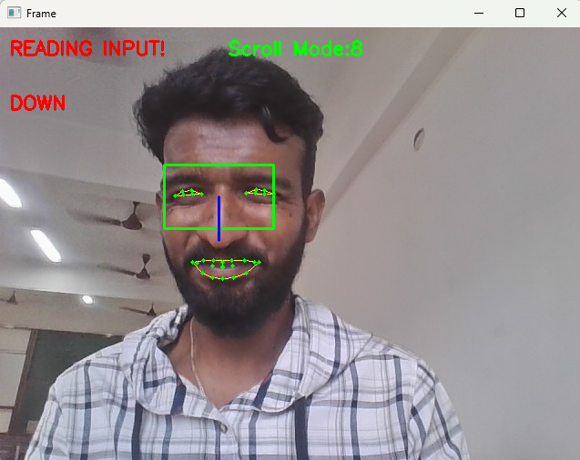
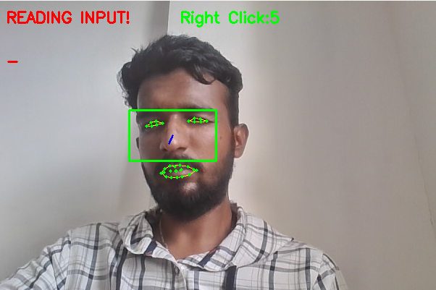
RESULTS

Slide 13
CONCLUSION & FUTURE WORK
The proposed system provides a hands-free computer control method using facial landmarks and eye gestures.
It detects eye blink amd mouth movements in real time using OpenCV, Dlib, and PyAutoGUI.
The system performs essential mouse actions like left click, right click, double click, and scrolling with good accuracy.
Future improvements include adding drag-and-drop and gaze-based cursor movement, improving accuracy under different lighting conditions, and extending the system to gaming, virtual reality, and assistive technologies.

Slide 14
REFERENCES
S. P. K. Mygapula, M. L. Saini, C. S. R. Dheeraj, S. Maji and D. Gupta, "Controlling Mouse Cursor through Eye Movement," 2024 International Conference on Signal Processing and Advance Research in Computing (SPARC), LUCKNOW, India, 2024, pp. 1-5, doi: 10.1109/SPARC61891.2024.10828631.
S. K R, P. R, A. N.S and M. Rathishree, "Cursor Control Based on Eyeball Movement Using Deep Learning," 2023 Intelligent Computing and Control for Engineering and Business Systems (ICCEBS), Chennai, India, 2023, pp. 1-5, doi: 10.1109/ICCEBS58601.2023.10448773.
Abiyev, R. H., & Arslan, M. (2019). Head Mouse Control System for People with Disabilities. IEEE Access.
Murthy, M. S., et al. (2024). Mouse Cursor Control with Eye Gestures. IEEE International Conference on Inventive Communication and Computational Technologies (ICICT).
Kanakaprabha, S., et al. (2023). Mouse Cursor Controlled by Eye Movement for Individuals with Disabilities. Proceedings of the 7th International Conference on Intelligent Computing and Control Systems (ICICCS).

Slide 15
REFERENCES
Miah, P., et al. (2022). Mouse Cursor Movement and Control using Eye Gaze- A Human Computer Interaction. 2022 International Conference on Artificial Intelligence of Things (ICAIoT).
Jayalakshmi, M., et al. (2024). Multi-model Human-Computer Interaction System with Hand Gesture and Eye Gesture Control. 2024 5th International Conference on Innovative Trends in Information Technology (ICITIIT).
Vasisht, V. S., et al. (2019). Human computer interaction based eye controlled mouse. Proceedings of the Third International Conference on Electronics Communication and Aerospace Technology (ICECA).
Schoemann, M., et al. (2021). Using mouse cursor tracking to investigate online cognition: Preserving methodological ingenuity while moving toward reproducible science. Psychonomic Bulletin & Review.
Sreeni, S., et al. (2023). Mouse Cursor Control Using Facial Movements-An HCI Application. International Journal of Techno-Engineering (IJTE).
Dhanaraju, M., Mekala, S., Rao, A. H. V., Kumar, C. P., & Lokesh, R. (2022). Human-Eye Controlled Virtual Mouse. International Journal for Research in Applied Science & Engineering Technology (IJRASET).

Slide 16
Thank you

