Slide 1





Spatio-temporal Motion Planning for Autonomous Vehicles with Trapezoidal Prism Corridors and Bézier Curves
Srujan Deolasee¹, Qin Lin², Jialun Li³, John M. Dolan⁴
¹ Birla Institute of Technology and Science, Pilani
² Cleveland State University
³ Dajiang Innovation Technology Co. Ltd.
⁴ The Robotics Institute, Carnegie Mellon University
* This work was sponsored by NSF.
Notes:
Hi, my name is __, and I am a __ at __ University. This work was done with my __ at __ University. Our work is titled Spatio-temporal Motion Planning for Autonomous Vehicles with Trapezoidal Prism Corridors and Bézier Curves

Slide 2
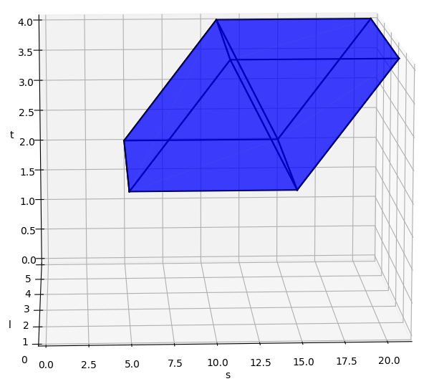


Planning in Frenet Frame – SLT Graph
In contrast to Cartesian space planning, Frenet frame is independent with arbitrary road geometry
longitudinal direction s
lateral direction l
time t
vehicle length
vehicle width
Car A
longitudinal S (along the road)
Non-Convex space for trajectory generation
lateral L (across the road)
Notes:
Any agent on the road can be represented in the SLT graph. For example, the orange colored car here is given by the blue polygon above. To tackle this challenge, we propose constructing a series of connected convex corridors within the gray colored non-convex free space. Each corridor contains a segment of the trajectory and joining them forms the final trajectory.

Slide 3
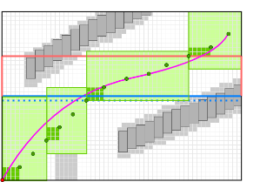
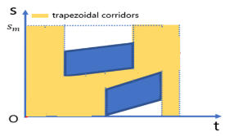
Corridor generation in 3D
s
Wasted space for optimization
3D cuboidal corridors used for direct optimization in 3D
t
Corridor generation in 2D (projected subspace)
trapezoidal corridors
convex free space h
trapezoidal corridors
trapezoidal corridors
2D corridors used for layered planning:
path planning (S-L graph)
construct trapezoidal corridors in the S-T graph
trapezoidal corridors
¹ W. Ding et al., “Safe trajectory generation for complex urban environments using spatio-temporal semantic corridor,” IEEE Robotics and Automation Letters, 2019
² J. Li et al., “Motion planning by search in derivative space and convex optimization with enlarged solution space,” IEEE/RSJ International Conference on Intelligent Robots and Systems (IROS), 2022
Notes:
Previous research in spatio-temporal planning focused on constructing cuboidal corridors, but they led to suboptimal comfort levels due to the wasted space.
We are inspired from our previous research of constructing 2D trapezoidal corridors which considered layered planning.

Slide 4
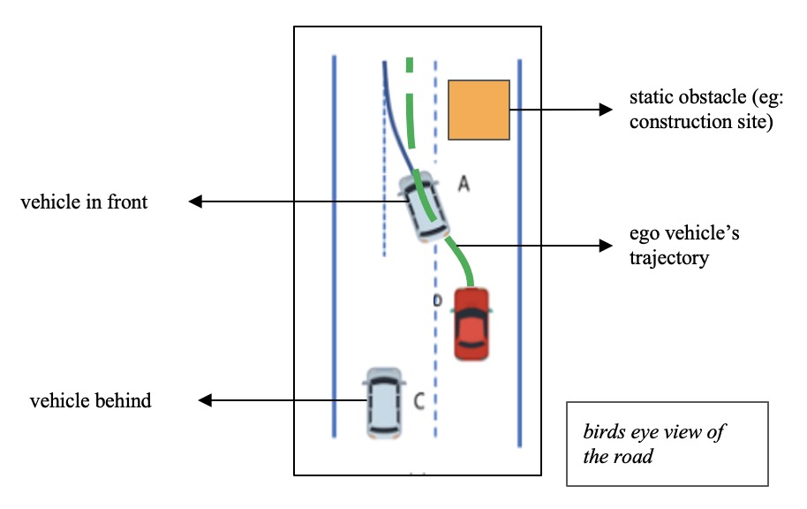
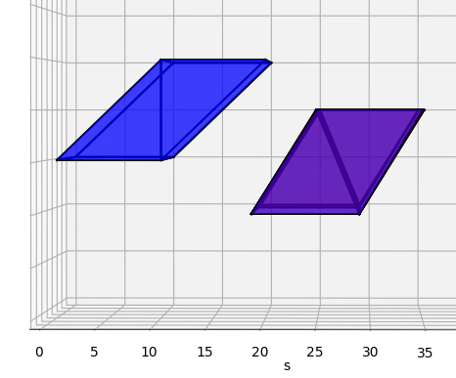
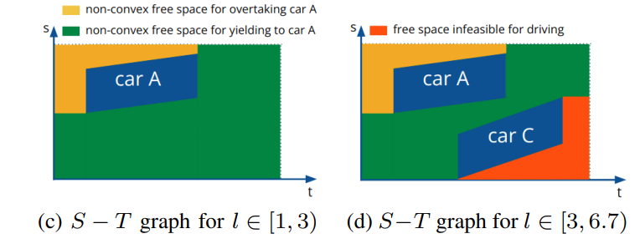

Proposed Approach
Two-step convexification procedure:
Depending on different S-T graphs, we get chunks w.r.t. L-dimension
car A
car C
car A
car A
car C
Notes:
Our approach capitalizes on the static nature of the SLT graph. A 2D slice of the graph taken along the lateral axis changes only when cars appear or disappear. By constructing trapezoidal corridors in the 2D slices and extending them along the lateral axis until encountering a new car, we obtain 3D convex trapezoidal prism corridors. These corridors serve as the search space for trajectory optimization.

Slide 5
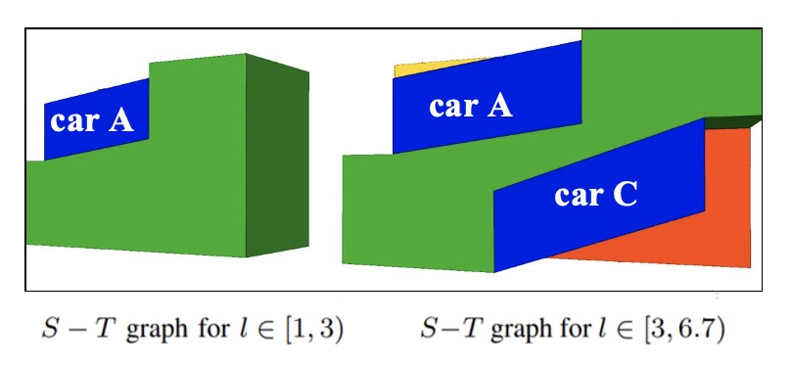
Proposed Approach
Two-step convexification procedure:
Depending on different S-T graphs, we get chunks w.r.t. L-dimension
For each non-convex chuck, we can construct piece-wise convex trapezoidal prisms
car A
car C
Notes:
Our approach capitalizes on the static nature of the SLT graph. A 2D slice of the graph taken along the lateral axis changes only when cars appear or disappear. By constructing trapezoidal corridors in the 2D slices and extending them along the lateral axis until encountering a new car, we obtain 3D convex trapezoidal prism corridors. These corridors serve as the search space for trajectory optimization.

Slide 6
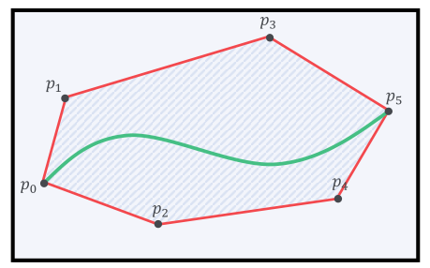
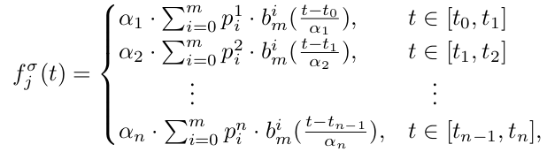



Trajectory generation and Bézier Polynomials
Why Bézier Polynomials?
Convex hull property: Bézier trajectory is confined within a convex hull consisting of control points, which can be selected inside a safe corridor.
A piecewise Bézier curve is used for trajectory generation.
Each corridor has one piece of Bézier curve
Adding more degrees of freedom
Bernstein polynomial
scaling factor for each segment
dimension - {s, l}
control points
Notes:
To generate smooth and comfortable trajectories within each corridor, we employ piecewise Bezier curves. Bezier polynomials possess desirable properties such as convex hull and hodograph, making them suitable for our purpose.

Slide 7
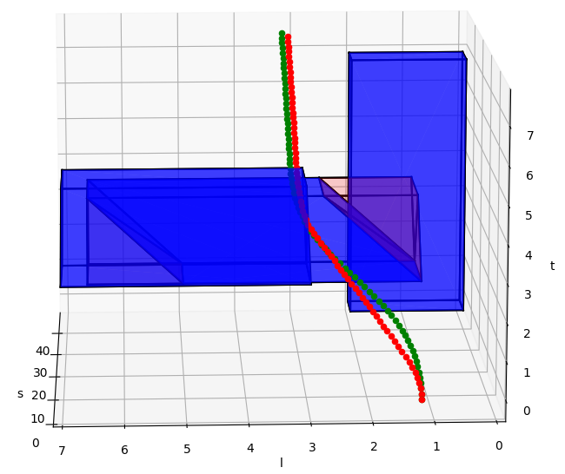
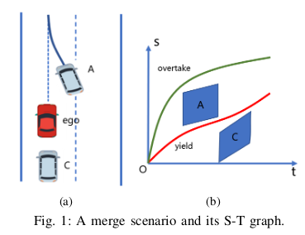



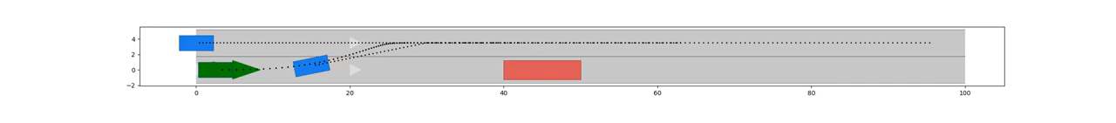
Result: Lane changing into traffic due to road construction
Car A changes lane; car C continues straight driving
Ego vehicle changes lane but yields to car A
static obs
static obstacle (eg: construction site)
car A
car C
t
s
l
Notes:
In our evaluation, we simulated a scenario where the ego vehicle and a car in front needed to change lanes to avoid a static obstacle, while car behind can continue straight as its already in a safe lane. We compared our trapezoidal prism corridors approach with the baseline cuboidal corridor approach.

Slide 8
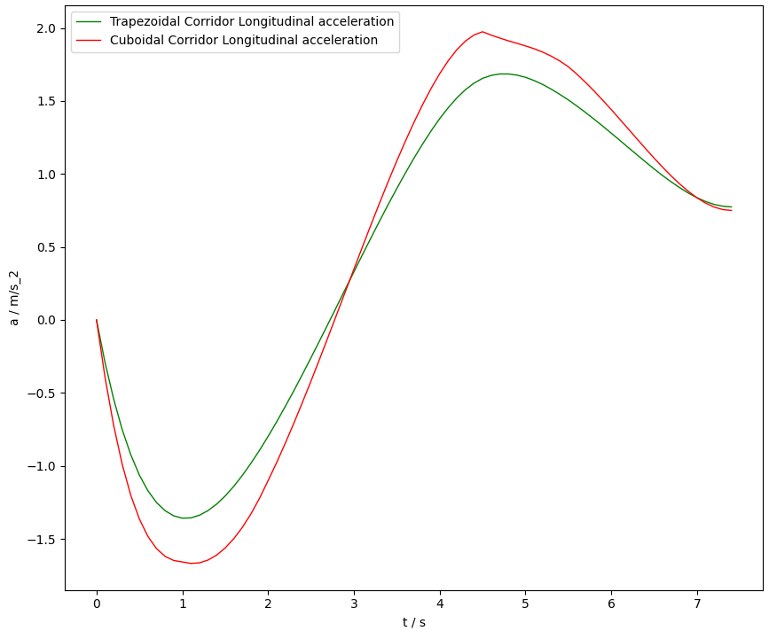
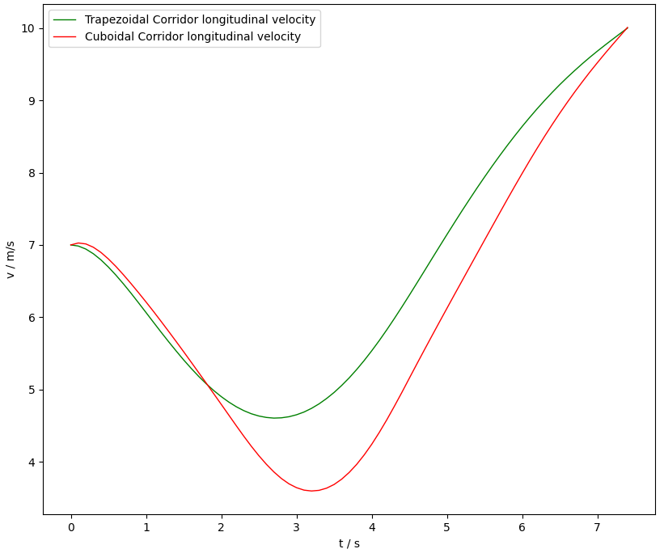
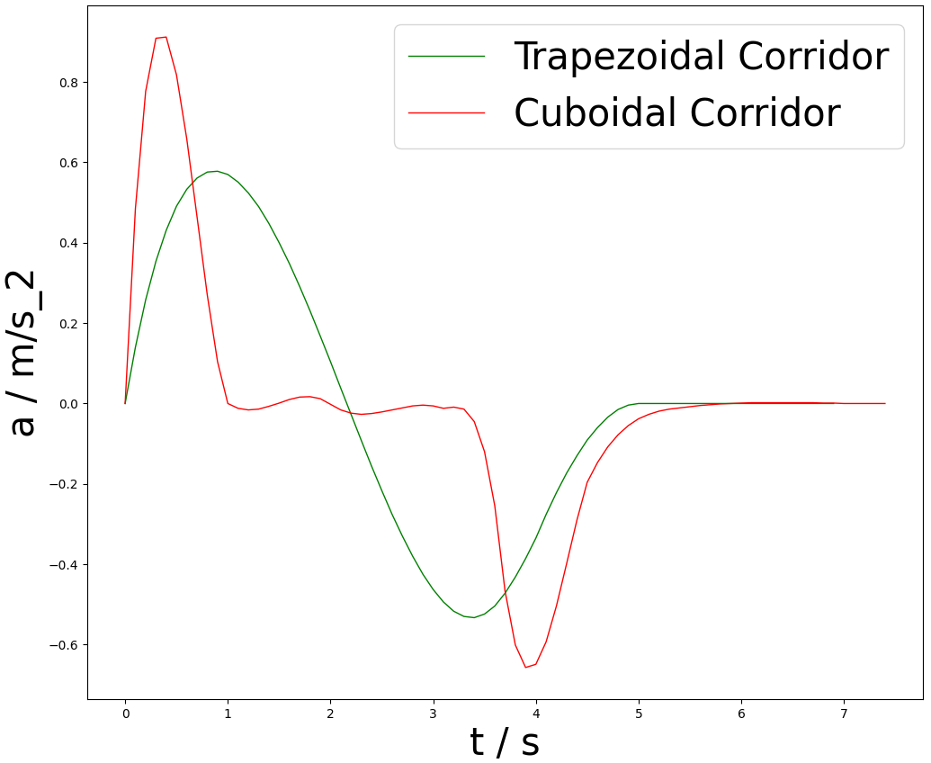
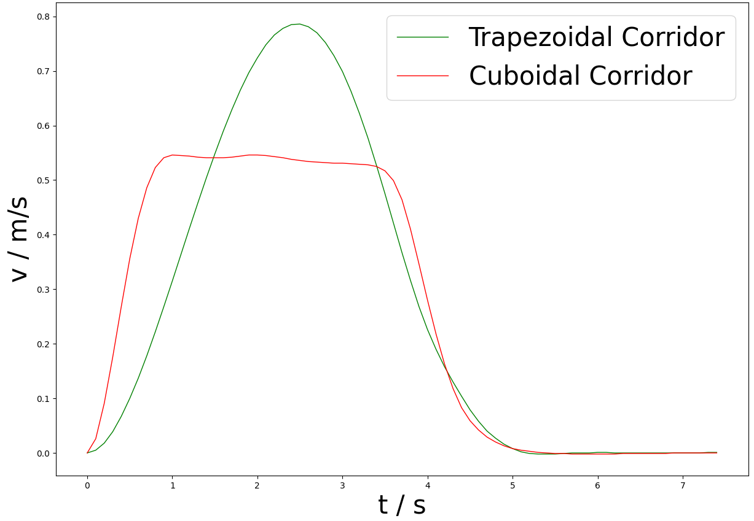
Longitudinal acceleration
Longitudinal velocity
Lateral acceleration
Lateral velocity
Notes:
The results clearly indicated that our approach produced smoother acceleration and velocity profiles, leading to a more comfortable trajectory. Notably, the lateral velocity plot showed a peak between one and four seconds, representing the ego vehicle's lane-changing maneuver.

Slide 9
Contributions
Spatio-temporal optimization
Solution space enlarged using trapezoidal prism-shaped 3D corridors
Real-time computation
Provable safety guarantee by providing sufficient conditions of control points in the corridors (check with the proof in our paper)
Notes:
In conclusion, our proposed trapezoidal prism-shaped corridors successfully enlarged the search space and enabled real-time trajectory optimization, ensuring both safety and passenger comfort.

