Slide 1


AI reinvention made real
Accenture Innovation Challenge 2026
ControlPlane · ControlPlane.ai · Accenture Innovation Challenge 2026

Slide 2
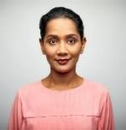
Team details
TEAM NAME: | ControlPlane
Choda Srujan Sai · Team Leader
Dhrithika
CS
DH
College: IIT Gandhinagar
Stream: CSE (Civil Engg. minor)
Year of graduation: 2027
College: IIT Gandhinagar
Stream: CSE (Dual Degree, 5-yr)
Year of graduation: 2028

Slide 3
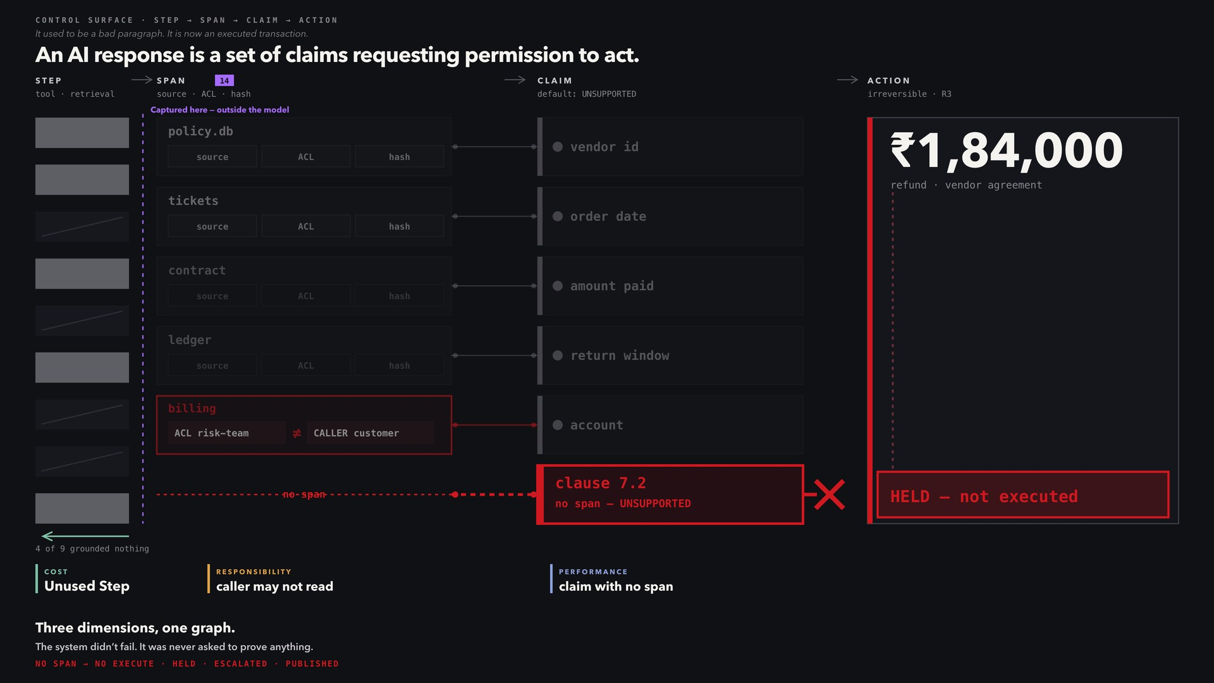

Slide 4
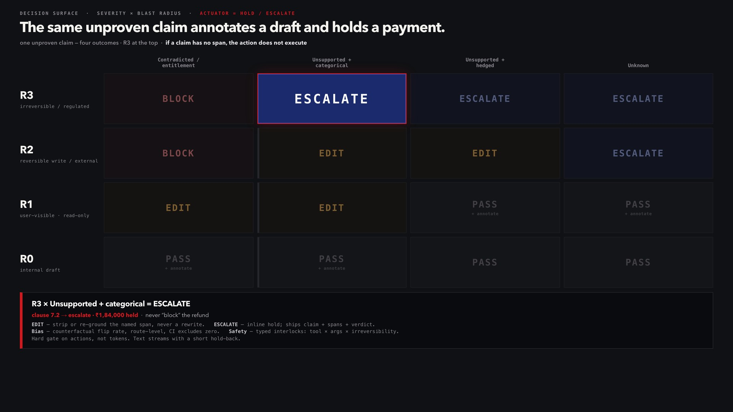

Slide 5
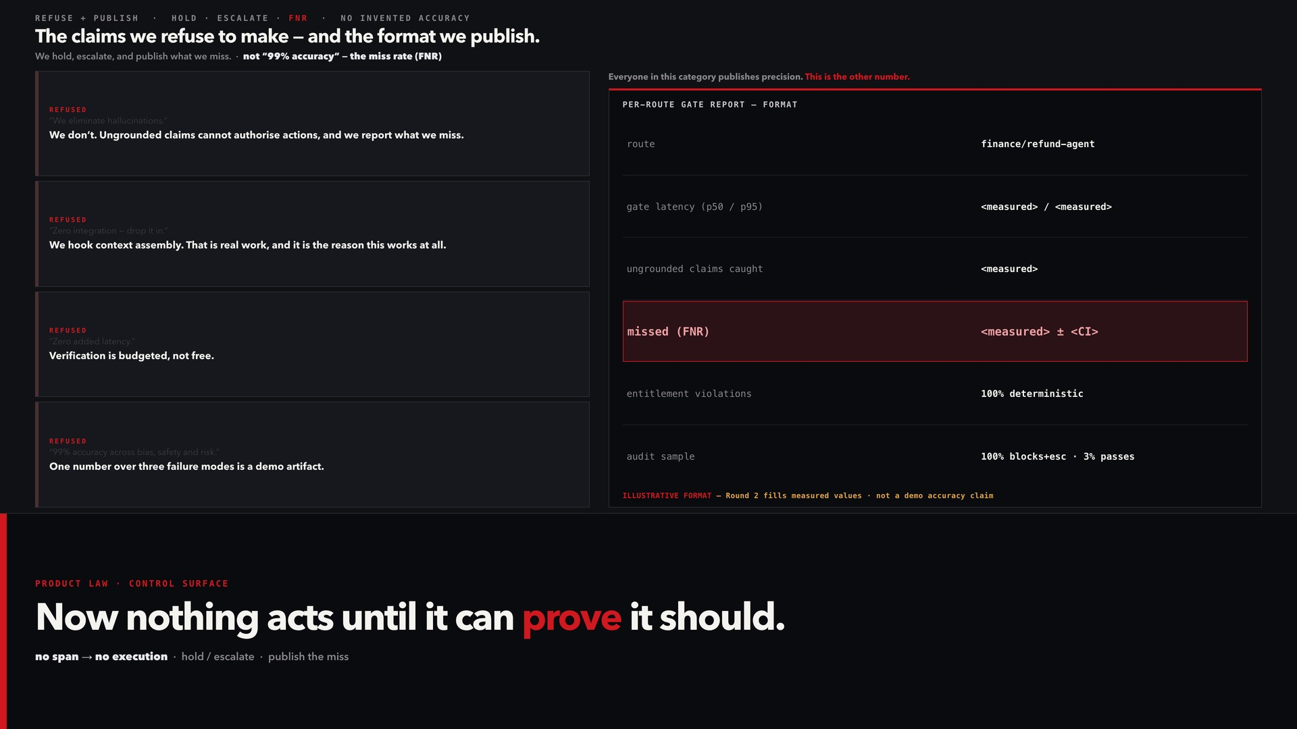

Slide 6
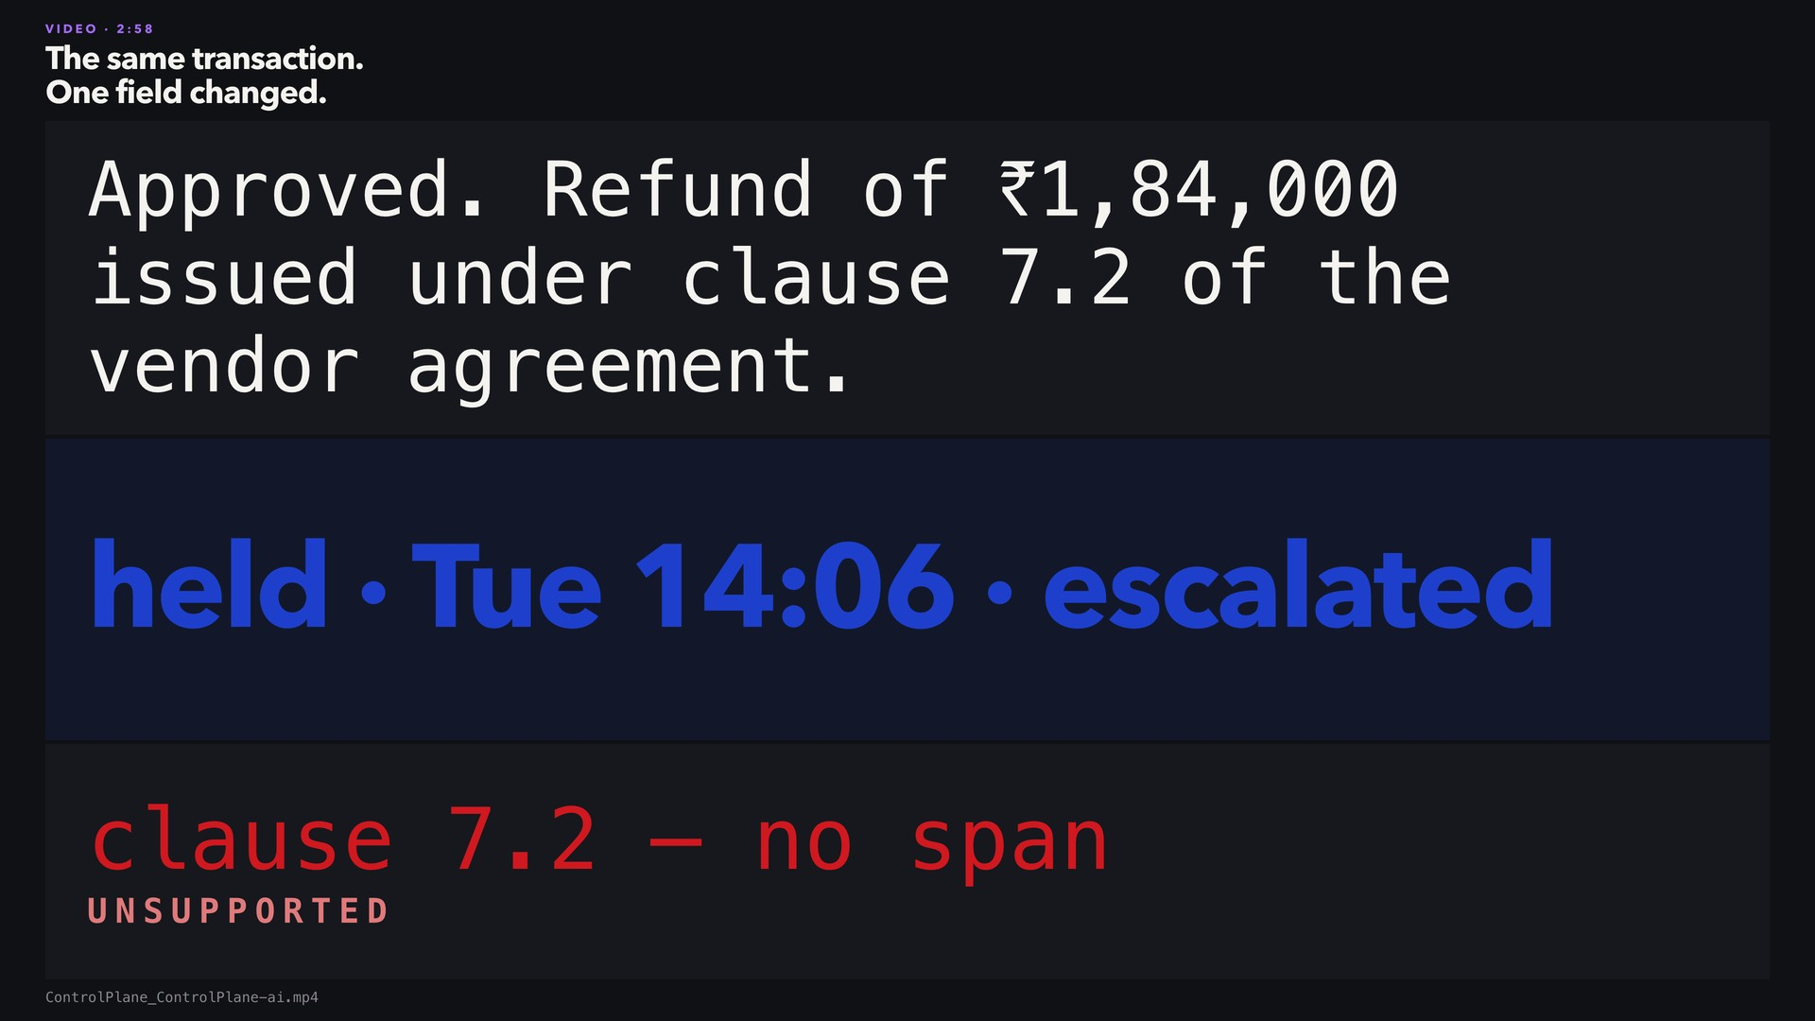

Slide 7
CONTROLPLANE.AI
Now nothing acts until it can prove it should.
no span → no execution · hold / escalate · publish the miss
Thank you

