Slide 1
AcademiTrack
Academic Project Management and Progress Tracking System
Team ID: (Your Team ID Here)
Instructor: Prof. Swarnalatha P.
Team Members:
• Srujan Rajput (23BCT0104) - Team Leader
• Aditya Raj Kar (23BCT0079)
• Rakshan Singh (23BCB0062)

Slide 2
Individual Member Contributions
Srujan Rajput (23BCT0104) • Agile Project Leadership • Backend Auth & RBAC Middleware • Selenium Testing Automation Aditya Raj Kar (23BCT0079) • System Architecture Design • UI/UX Workflow Planning • Student Interfaces & API Integration Rakshan Singh (23BCB0062) • UML Behavioral Modeling (Sequence/Activity)
• Database Schema Design
• Faculty Dashboard Logic

Slide 3
Problem Statement
Current academic project tracking relies on fragmented manual workflows.
• Inefficient Tracking: Spreadsheets and emails result in lost deliverables.
• Lack of Transparency: Supervisors cannot see real-time progress.
• Coordination Issues: Grading and feedback trails are often disconnected from submissions.
Our Solution: AcademiTrack centralizes milestones, file uploads, and faculty grading into a single, immutable digital audit trail.

Slide 4
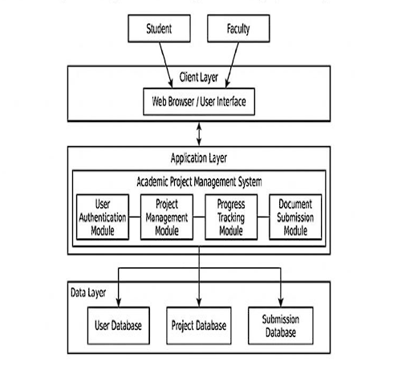
System Architecture & Technology Stack
A modern, decoupled Three-Tier Architecture:
1. Presentation Layer (Frontend)
• React.js with Vite
• Tailwind CSS for UI
2. Application Layer (Backend)
• Node.js & Express.js
• Custom JWT Authentication Middleware
3. Data Layer (Database)
• MongoDB & Mongoose ODM

Slide 5
System Design (UML Modeling)
Our software behavior is strictly mapped using standard UML specifications:
• Use Case Diagram: Enforces isolated roles between Student and Faculty actors.
• Class Diagram: Structures Mongoose schemas (Users, Projects, Milestones).
• Sequence Diagram: Dictates HTTP logic and UI states during auth flows.

Slide 6
The Student Workflow
The primary actor's journey from genesis to delivery:
• Authentic Registration: Encrypted sessions (Bcrypt + JWT).
• Dynamic Mapping: Creating projects and directly linking registered Faculty guides.
• Sequential Tracking: Adding specific milestones on a timeline.
• Document Archival: Secure Multer uploads mapped strictly to milestones.

Slide 7
The Faculty Workflow & Evaluation
The evaluation loop enforcing project integrity:
• Data Isolation: Faculty A can never access Faculty B's nested group data.
• Dynamic UI: Projects grouped neatly under the names of specific assigned students.
• Evaluation: One-click status updates (In Progress -> Approved).
• Immutable Feedback: Faculty assign letter grades and textual feedback saved permanently on record.

Slide 8
Software Testing & Quality Assurance
Extensive validation verifying functional completion:
• Automated Regression (Selenium): 52 UI Test Cases executing dynamically over Node.js Chrome bindings -> Achieved 96.2% Pass Rate.
• Boundary Checks: Intercepted and patched Multer bypass flaws.
• Performance Testing (Python): System scales to handle 733 REST requests per second natively.

Slide 9
Conclusion & Future Scope
AcademiTrack successfully digitizes administrative chaos into a streamlined, high-performance application enforcing accurate evaluations.
Future Scope:
• Dedicated University SSO (OAuth2) identity providers.
• Cloud Blob Storage (AWS S3) for massive submission archives.
• Dedicated Dean/HOD analytical dashboard monitoring.
Thank you!

