Slide 1

CAPSTONE PROJECT · IIIT-HYDERABAD · JUNE 2026
Helix.
The Autonomous Data Scientist
A nine-agent AI system that takes a CSV and a plain-English goal, then plans, codes, executes, self-heals and reports — turning raw data into a board-ready report in minutes, not days.
9 AI AGENTS
SELF-HEALING CODE
100% EXPLAINABLE
helix-henna.vercel.app · github.com/Srujan29112001/helix

Slide 2
CAPSTONE TEAM
The team behind Helix
A seven-member capstone group · IIIT-Hyderabad · 2026
SK
Srujan K
SB
Satish B
RJ
Renuka Jataprolu
SR
Saumya Ratan
PL
Priyanka Laha
SV
Santosh Vaddadi
SK
Sameer Kohli
PRESENTING TO
Prof. Ponnurangam Kumaraguru (PK)
Professor, Computer Science · IIIT-Hyderabad
HELIX · The Autonomous Data Scientist
02 / 23

Slide 3
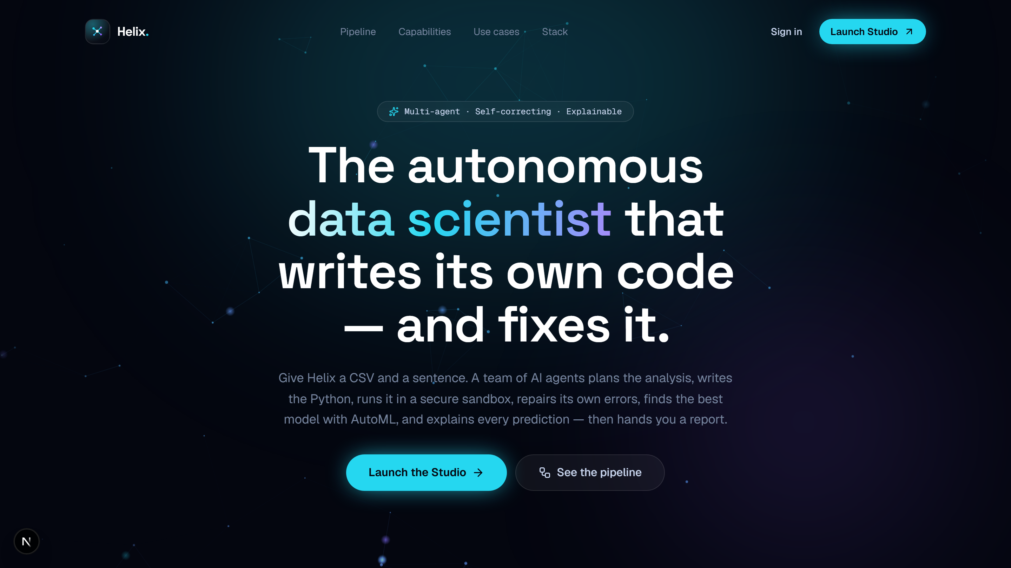
OVERVIEW
What is Helix?
An autonomous, multi-agent data-science studio. Describe your goal in plain English, point it at a CSV, and nine specialized AI agents collaborate to clean, analyze, model, visualize and explain your data — with zero manual coding.
You provide
A CSV + a goal in the Studio
↓
AI processes
Four sample datasets + upload — the live product.
9 agents analyze & interpret
↓
9
8
You receive
AI agents
LLM providers
Charts, report & strategy
16+
Dual
SVG charts
sandbox
HELIX · The Autonomous Data Scientist
03 / 23

Slide 4

THE PROBLEM
Why Helix exists
60–70% of a data scientist's time is lost to repetitive prep — loading, cleaning, encoding — not analysis.
The bottleneck
Business teams queue for days; insights arrive too late to act on.
The repetitive grind
Every dataset demands the same boilerplate pipeline, rewritten by hand.
Brittle iteration
When goals shift or models fail, the whole pipeline is rebuilt manually.
HELIX · The Autonomous Data Scientist
04 / 23

Slide 5
THE SOLUTION
Days of manual work → minutes of autonomy
BEFORE HELIX
AFTER HELIX
✕
Manual pipeline takes days to weeks
✓
Autonomous pipeline finishes in minutes
✕
Data-scientist time is the bottleneck
✓
Plain-English goal → board-ready report
✕
Non-technical stakeholders locked out
✓
Anyone can run a full ML analysis
✕
Every iteration means manual rework
✓
Re-run instantly with a one-line change
✕
Results arrive after the context shifts
✓
Self-healing agents fix their own errors
Helix replaces days of manual work with minutes of autonomous, explainable analysis.
HELIX · The Autonomous Data Scientist
05 / 23

Slide 6
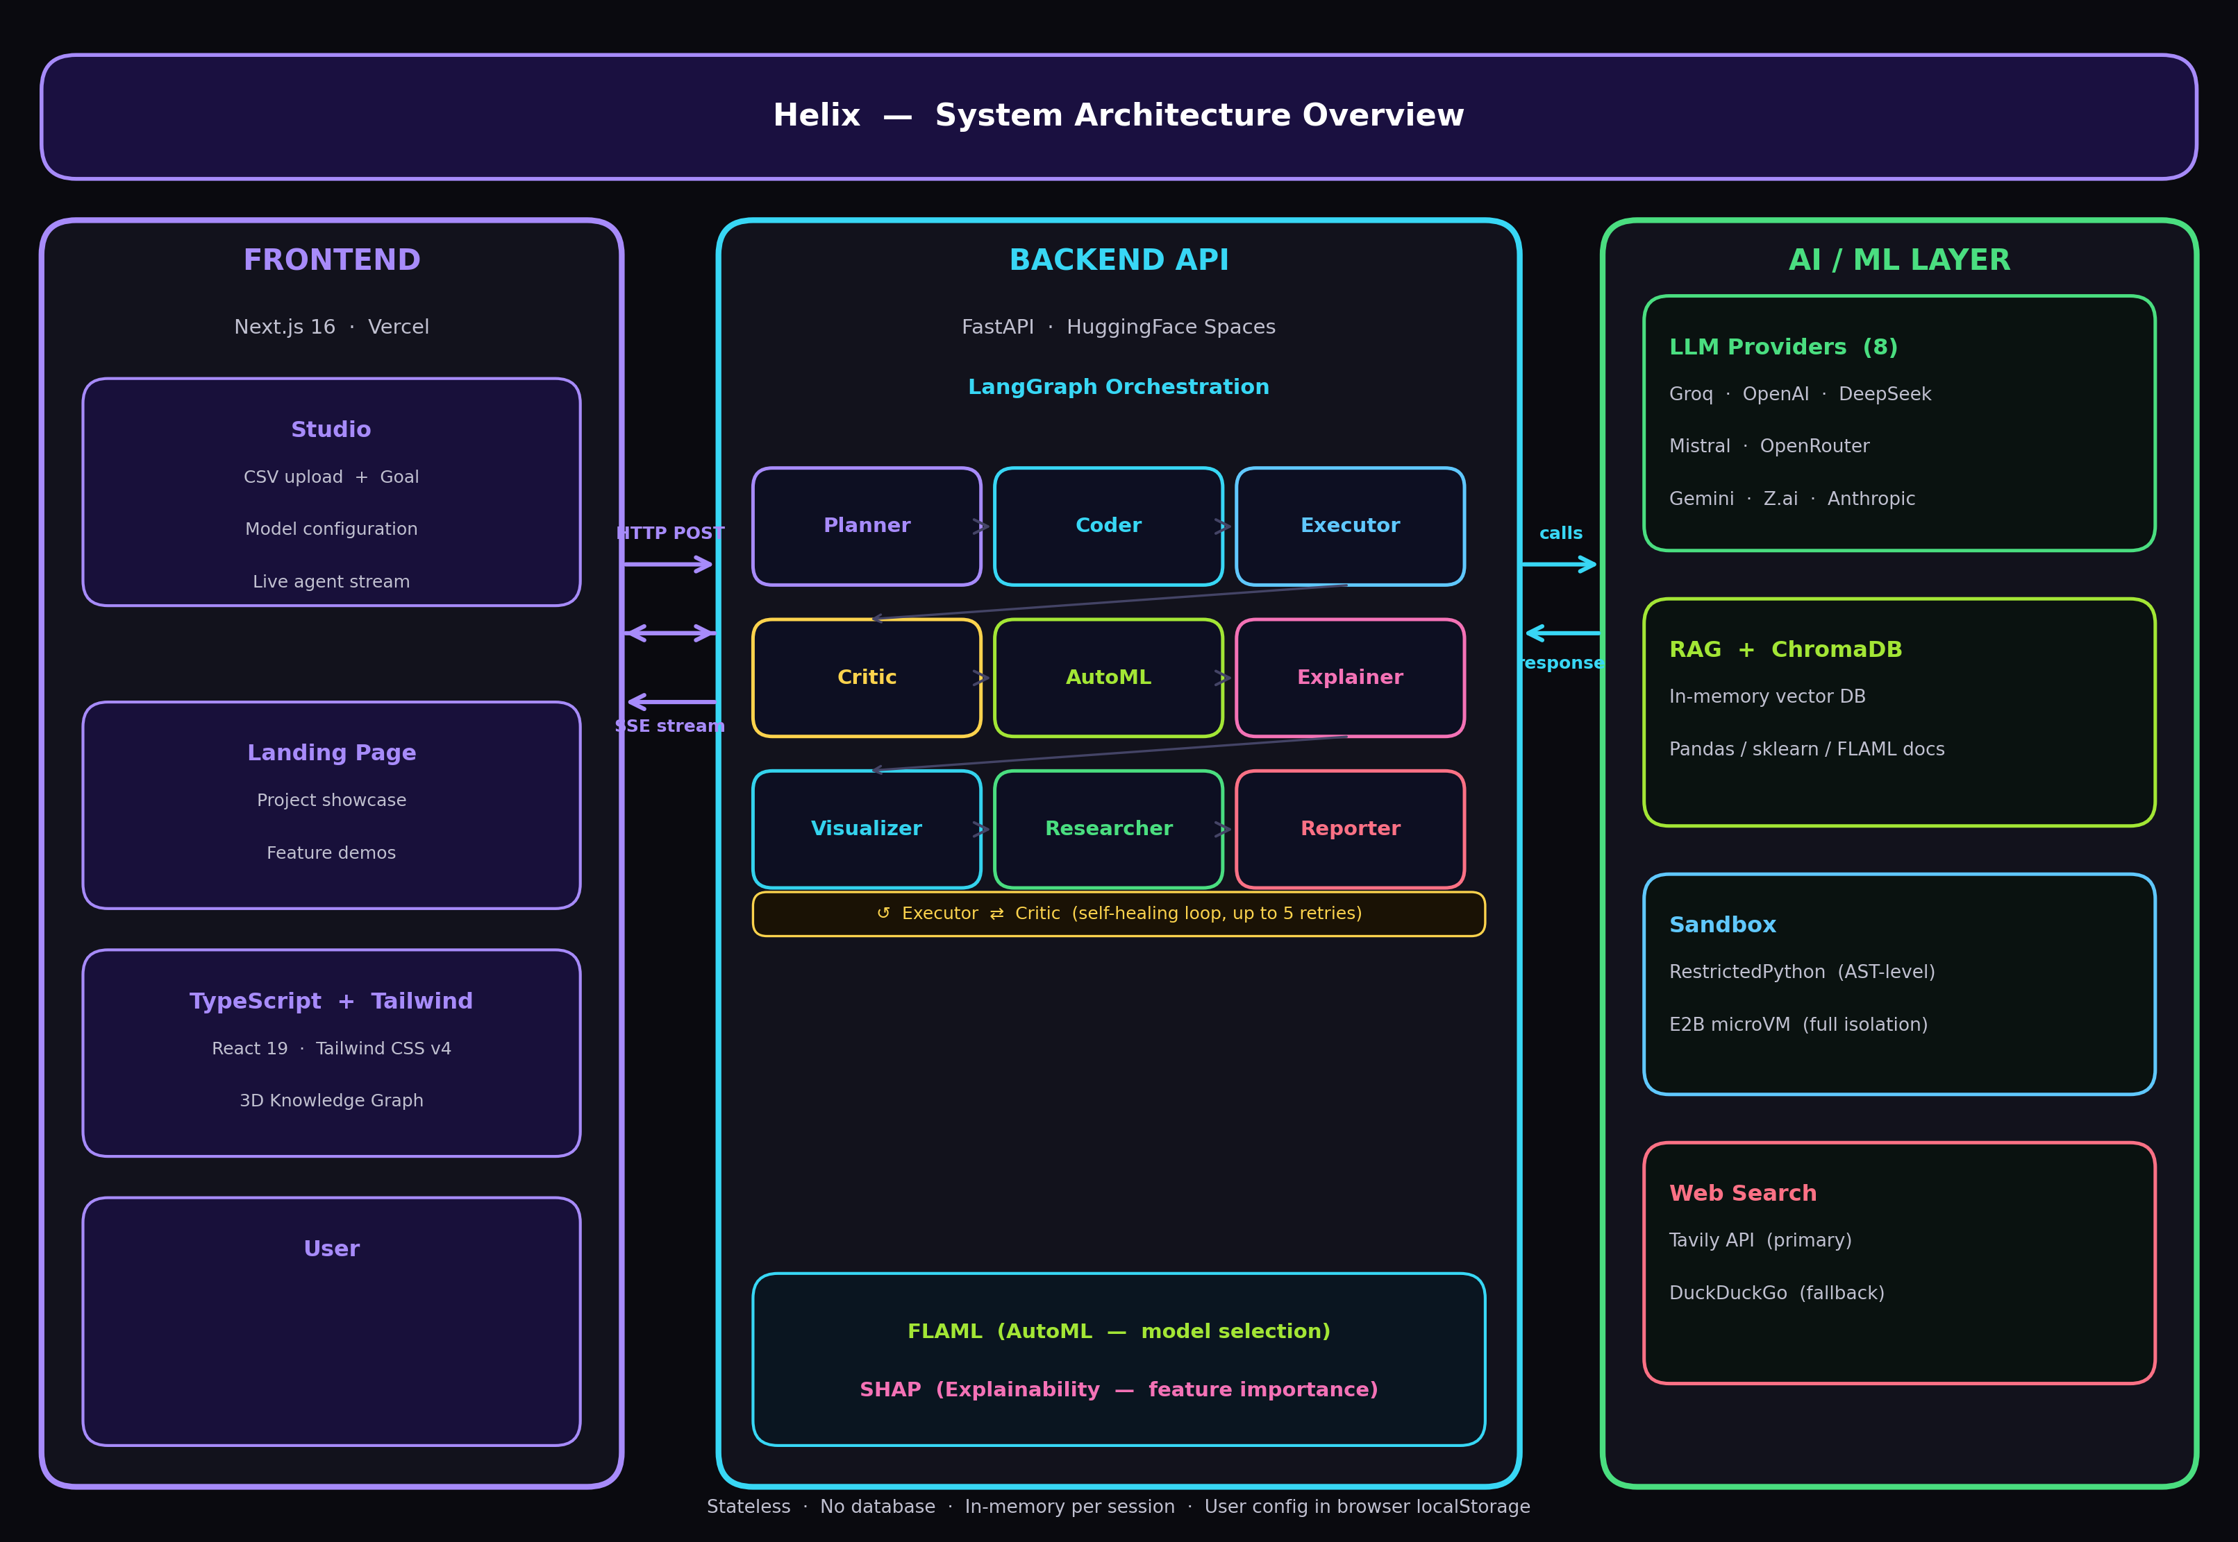
SYSTEM ARCHITECTURE
A three-tier, stateless pipeline
Stateless · no database · in-memory per request · agents stream live to the UI via Server-Sent Events.
HELIX · The Autonomous Data Scientist
06 / 23

Slide 7
CORE ARCHITECTURE
The nine-agent pipeline
1
Planner
2
Coder
3
Executor
Numbered analysis plan from your goal
Writes Python via a RAG-grounded LLM
Runs the code in a secure sandbox
4
Critic
5
AutoML
6
Explainer
Debugs & fixes errors (≤5 retries)
FLAML searches for the best ML model
SHAP feature importance + direction
7
Visualizer
8
Researcher
9
Reporter
Picks the best of 16+ chart types
Live web search for domain context
Writes the business report
FLOW Planner → Coder → Executor → Critic → AutoML → Explainer → Visualizer → Researcher → Reporter
HELIX · The Autonomous Data Scientist
07 / 23

Slide 8
DEEP DIVE · PART 1
Plan · Code · Execute · Critique
1 Planner
2 Coder
Reads your goal and data schema, then designs a step-by-step analysis plan. Planning first prevents wasted computation downstream.
Converts the plan into executable Python (pandas, scikit-learn) — grounded by RAG over library docs to cut hallucinated APIs.
3 Executor
4 Critic
Runs the generated code inside an isolated sandbox (RestrictedPython / E2B). Untrusted code never touches the host.
Audits outputs for errors. On failure it feeds a correction back to the Coder — the self-healing loop, up to 5 retries.
HELIX · The Autonomous Data Scientist
08 / 23

Slide 9
DEEP DIVE · PART 2
Model · Explain · Visualize · Research · Report
5 AutoML
6 Explainer
FLAML searches LightGBM, XGBoost, RF & Logistic Regression — selecting the best model under a time budget, no manual tuning.
SHAP turns metrics and feature importances into plain-English drivers any stakeholder understands — with direction.
7 Visualizer
8 Researcher
Chooses the best chart from 16+ pure-SVG types; the engine fills every number from real data — a chart can't fabricate a value.
RAG + live web search (Tavily / DuckDuckGo) enrich findings with industry benchmarks and domain context.
9 Reporter
Assembles the deliverable: a 6–7 paragraph executive report with drivers, risks and prioritized recommendations.
HELIX · The Autonomous Data Scientist
09 / 23

Slide 10
KEY INNOVATION
The self-healing loop
When generated code fails, Helix doesn't stop. The Critic diagnoses the error and feeds a correction back to the Coder — the pipeline repairs itself, autonomously, up to five times.
→
→
Pass → AutoML
Coder
Executor
Critic
writes Python
runs in sandbox
audits output
✕ error → diagnosis → corrected code → retry (max 5×)
≤ 5
0
100%
autonomous retries per step
manual debugging required
responses always complete
HELIX · The Autonomous Data Scientist
10 / 23

Slide 11
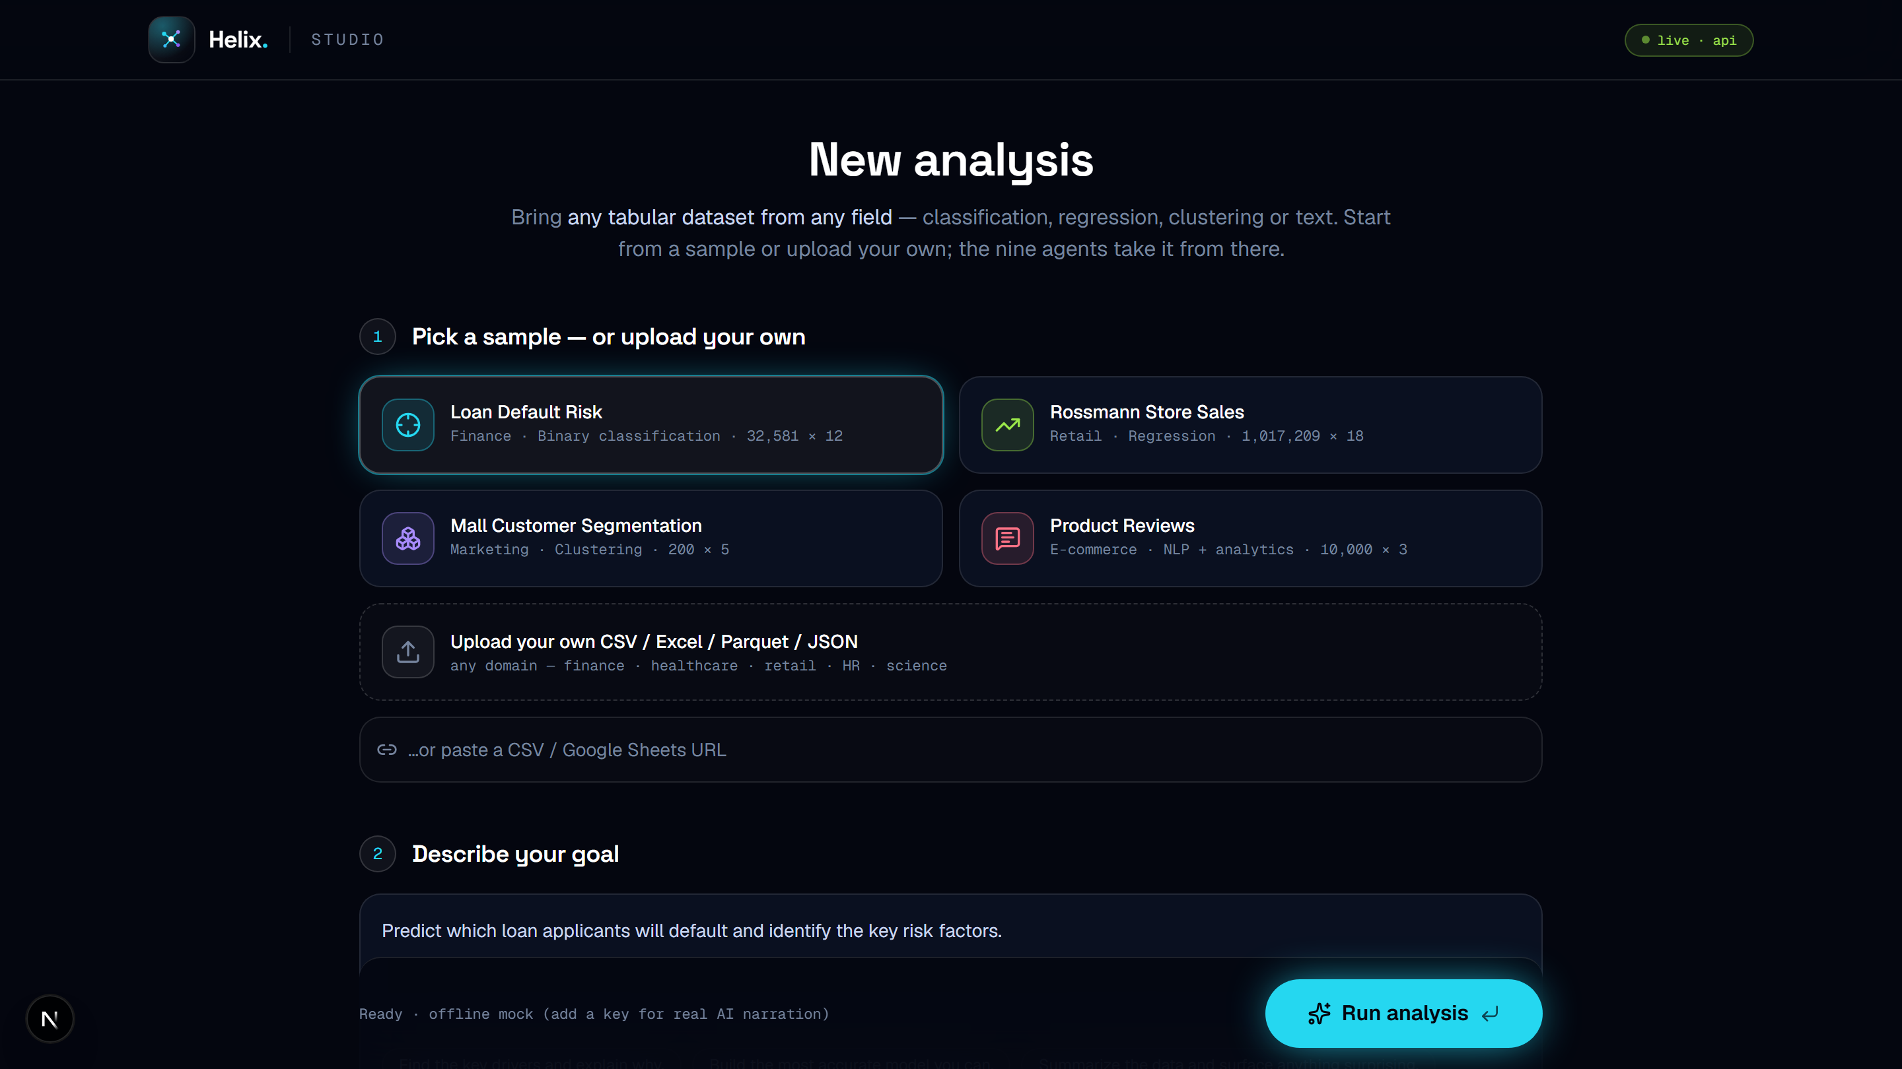
TECHNOLOGY · FRONTEND
The Studio — set up in four fields
Dataset
Sample, or upload CSV / Excel / Parquet / JSON, or paste a URL / Sheet.
Goal
Your question in plain English — feeds the Planner & Reporter.
Target + Task
Column to predict (or Auto) and task (or Auto) — hides for clustering.
AI engine
Provider, model, per-agent temperature & key — keys stay in your browser.
HELIX · The Autonomous Data Scientist
11 / 23

Slide 12
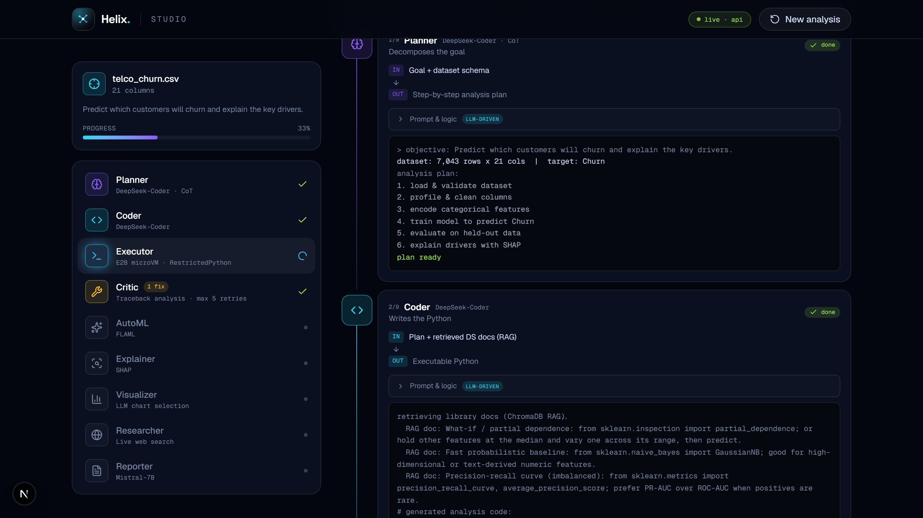
WATCH IT WORK
Full transparency — every step, live
Real-time SSE
An asyncio.Queue event bus pushes each agent's status the instant it happens — sub-second latency.
Colab-style
Complete code, stdout and tracebacks — never truncated.
Prompt & logic
Each agent's exact system prompt + the sandbox rules, on tap.
See the heal
The Critic's diagnosis and corrected code, in real time.
HELIX · The Autonomous Data Scientist
12 / 23

Slide 13
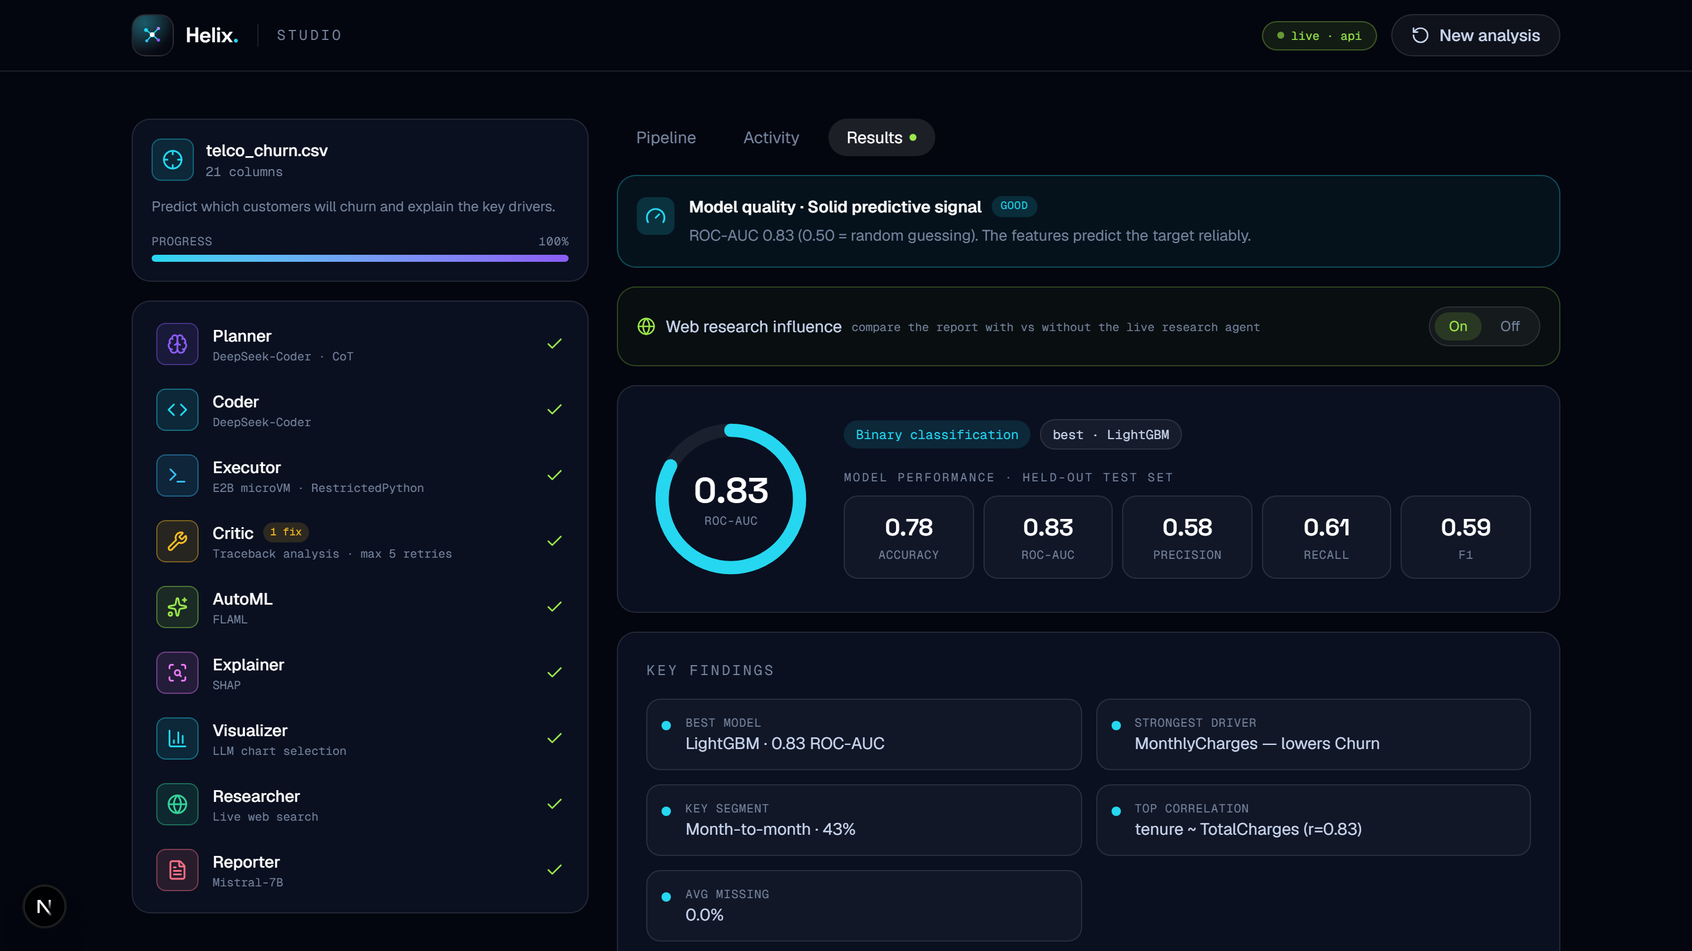
THE PAYOFF
A results dashboard anyone can read
Honest verdict
Grades the signal from strong to near-chance — weak data labels itself.
Interactive charts
Hover any point or line for the exact value; real numeric axes.
Key findings
Best model, top driver, key segment, correlations — at a glance.
Business report
Narrative + recommendation, grounded in live web context.
HELIX · The Autonomous Data Scientist
13 / 23

Slide 14

TECHNOLOGY · BACKEND
Where the intelligence lives
FastAPI + Uvicorn
LangGraph
Async Python, native SSE streaming.
9-agent StateGraph + self-heal loops.
FLAML AutoML
SHAP
Fast model search under a budget.
Exact, game-theoretic explainability.
ChromaDB + MiniLM
RestrictedPython + E2B
In-memory RAG over DS recipes.
Dual sandbox — jail or microVM.
Stateless, async Python — the core analysis engine powers cleaning, modeling, explainability and the chart gallery.
HELIX · The Autonomous Data Scientist
14 / 23

Slide 15
HOW IT WORKS
End-to-end data flow
1 User input
2 Data cleaning
3 Agent pipeline
Upload a CSV, set a plain-English goal, configure the LLM per agent role.
Strip, coerce numerics, impute missing values, label-encode, parse dates.
LangGraph runs 9 agents with the Executor → Critic self-healing loop.
4 Model training
5 Explainability
6 Outputs
FLAML 80/20 split, optimizing ROC-AUC or R² for the best model.
SHAP ranks features with the direction of impact + statistical tests.
Model verdict, 16+ charts, a 3D graph and a board-ready report.
Every stage streams real-time status to the frontend via SSE — minutes, not days, from upload to insight.
HELIX · The Autonomous Data Scientist
15 / 23

Slide 16

AI MODELS
Eight providers, one brain
PROVIDER
DEFAULT MODEL
COST
Groq
llama-3.3-70b
FREE
OpenAI
gpt-4o-mini
token
Anthropic
claude (Sonnet)
token
DeepSeek
deepseek-chat
token
Mistral
mistral-small
token
Gemini
gemini-2.0-flash
FREE
OpenRouter
deepseek-chat
token
Z.ai
glm-4.6
token
A unified layer routes each task to the right model — capability matched to complexity. Priority: UI settings → per-role env → global env → MockLLM fallback (runs with no keys at all).
HELIX · The Autonomous Data Scientist
16 / 23

Slide 17
AI MODELS
Prompt engineering & determinism
Six of the nine agents are LLM-powered. Each carries an engineered system prompt — an expert persona, a strict output schema and domain context — so results are structured, parseable and reproducible.
▌ SYSTEM PROMPT · Coder agent
6 of 9 agents use LLMs
Planner · Coder · Critic · Visualizer · Researcher · Reporter.
role: "senior data scientist"
Temperature 0.2
task: write Python for the plan
Low temperature across providers for deterministic output.
grounding: RAG over pandas / sklearn
Strict JSON schema
output: FULL runnable script only
Machine-readable output → the UI renders charts directly.
rule: no prose, no markdown fences
MockLLM fallback
temp: 0.2 (deterministic)
Zero-config: the system runs with no API keys at all.
HELIX · The Autonomous Data Scientist
17 / 23

Slide 18
BREADTH
Nine task types, auto-detected
Classification
Regression
Clustering
binary + multiclass
predict a number
segments (k by silhouette)
NLP + analytics
Anomaly detection
Dimensionality reduction
topics · sentiment · keywords
Isolation Forest
PCA → 2-D map
Time-series
Survival analysis
Recommendation
Holt-Winters ETS + seasonality
Kaplan-Meier + Cox PH
content-based similarity
Plus statistics, model-evaluation diagnostics, SMOTE, feature engineering, a what-if simulator and natural-language Q&A.
HELIX · The Autonomous Data Scientist
18 / 23

Slide 19
RIGOR
Statistics + evaluation, not just a score
Statistical significance
Model evaluation · diagnostics
Auto-picks the right test — Welch t / Mann-Whitney, ANOVA / Kruskal, chi-square, Pearson — each with a p-value, an effect size (Cohen's d, Cramér's V, |r|) and a plain-English verdict.
Stratified k-fold cross-validation
Confusion matrix + per-class P/R/F1
ROC & precision-recall curves
Calibration + learning curves
So a weak dataset explains itself instead of looking broken — the honest answer, with the maths to back it.
Residuals (predicted vs actual)
Model-comparison vs baselines
HELIX · The Autonomous Data Scientist
19 / 23

Slide 20

SECURITY
Sandboxing & secure execution
AI-generated code is never trusted blindly. Helix runs it behind a defense-in-depth dual sandbox and auto-selects the strongest layer available.
RestrictedPython
Default layer. AST-level restriction blocks dangerous imports — os, sys, socket — and unsafe attribute access before code runs.
E2B microVM
Production layer. Full VM isolation: no host filesystem or network, with a hard execution timeout.
Input sanitization
CSV files are scanned and column names / values sanitized before any exposure to an LLM.
HELIX · The Autonomous Data Scientist
20 / 23

Slide 21
RESILIENCE
Graceful degradation — it never breaks
Every external dependency has a fallback. If something is missing or fails, Helix degrades one level instead of breaking — the app always returns a complete response.
LEVEL 1
LEVEL 2
LEVEL 3
LLM → MockLLM
RAG → keyword match
Tavily → DuckDuckGo
LEVEL 4
LEVEL 5
LEVEL 6
E2B → RestrictedPython
Pipeline error → mock events
Backend down → client simulation
Real-time SSE: an asyncio.Queue bus + anti-buffering headers push every agent event to the UI with sub-second latency.
HELIX · The Autonomous Data Scientist
21 / 23

Slide 22
DEPLOYMENT & EDGE
Deploy anywhere — how Helix compares
Vercel + Hugging Face
CAPABILITY
HELIX
OTHERS
Production — global CDN frontend + containerized backend.
Plain-English input
✓
✕
Self-healing code (5×)
✓
✕
9 collaborating agents
✓
✕
Docker Compose
Real ML training (FLAML)
✓
partial
Local — one command: docker compose up --build.
SHAP explainability
✓
manual
Live web research
✓
✕
Google Colab
Business report
✓
✕
Quick demo — pre-built notebooks, zero install.
9 task types
✓
partial
3D knowledge graph
✓
✕
HELIX · The Autonomous Data Scientist
22 / 23

Slide 23

CONCLUSION
Data science, reimagined
Helix proves a nine-agent pipeline can run the entire data-science workflow autonomously — from a plain-English goal to a board-ready report with real ML, SHAP explainability, 16+ charts and web-grounded insight.
Hybrid LLM hosting 8 providers, task-matched, MockLLM fallback
Dual-sandbox execution RestrictedPython + E2B, auto-selected
LangGraph orchestration shared state, conditional self-healing
Stateless architecture no DB, no sessions — failure classes gone
Days → Minutes.
helix-henna.vercel.app · github.com/Srujan29112001/helix · IIIT-H · June 2026
HELIX · The Autonomous Data Scientist
23 / 23

