Slide 1
Agenda
Introduction
Data Collection & Preprocessing
Algorithms used
Logistic regression model interpretation and results
Decision tree model interpretation and results
Compare findings
Business Insights and Recommendation

Slide 2
Heart stroke prediction Classification of heart stroke using Logistic Regression and Classification Tree and the factors influencing it
Team members :
Srujan Gundapaneni
Sai Phani Charan Jammula
Shreya Reddy Maranganti

Slide 3

Introduction
"New data analysis found that deaths from heart attacks rose significantly during the Covid pandemic time”
“Preventive measures must be taken to prevent deaths caused by heart stroke”
Brief Overview of the Problem Objectives Importance of the Project
Objective 1: Develop a classification model for the detection of heart stroke.
Objective 2: Provide insights on the factors influencing the risk of stroke
Objective 3: Improve the strategic decisions of the hospital management team to improve patient’s care, resource allocation and overall healthcare efficiency.

Slide 4
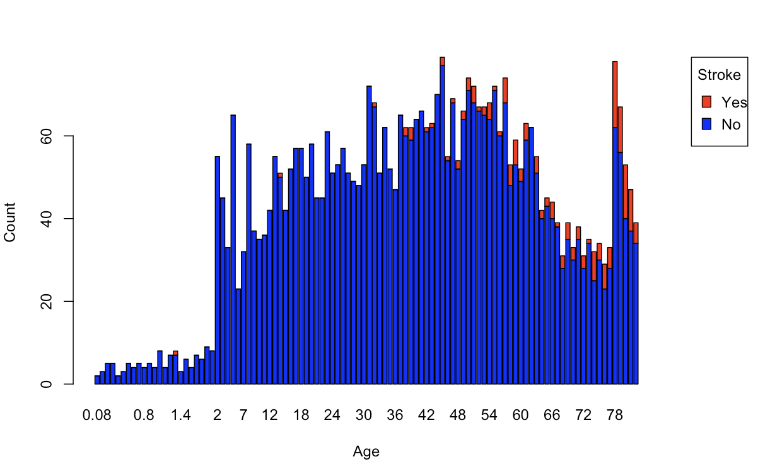
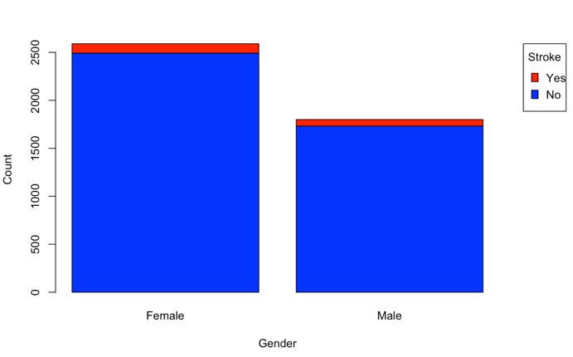
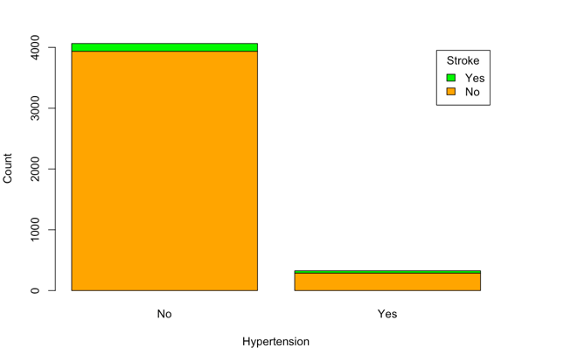
Data collection and preprocessing
Data exploration and summary measures
Missing values are checked in the dataset .
NA values are replaced with the mean in the bmi column due to more number of NA values.
The challenging part is that the values are in the form of N/A . They are first converted to NA and then they are replaced.
Outliers are also checked using boxplot from three rows having numerical values.
Outliers are treated by eliminating the rows having outliers.
Binary variables are converted to “Yes” or “No” for better understanding in the graphs.

Slide 5
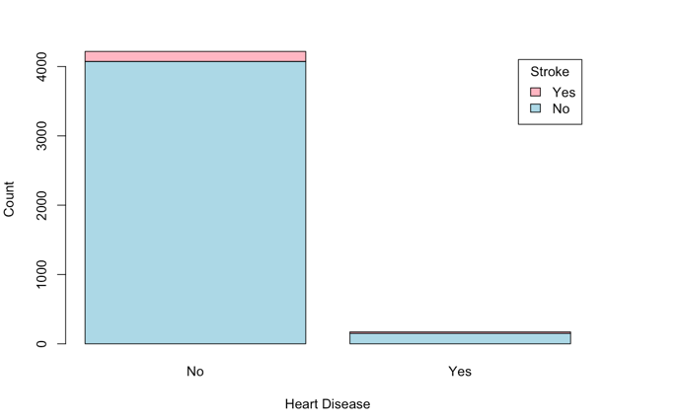
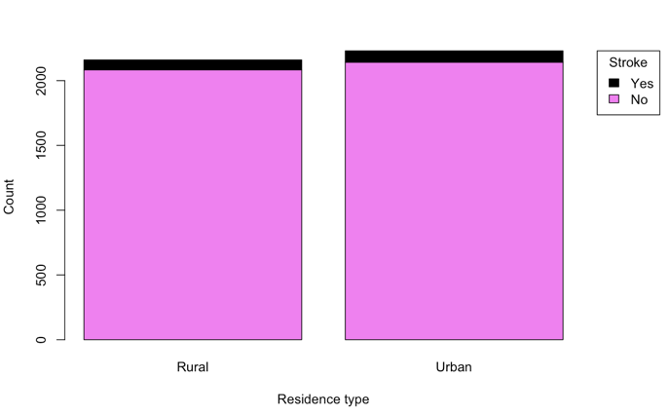
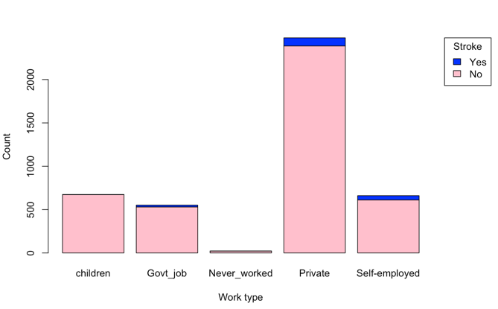
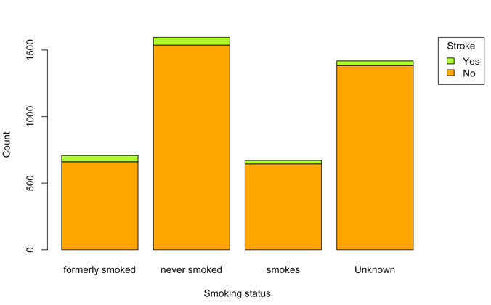
Few more graphical interpretations

Slide 6
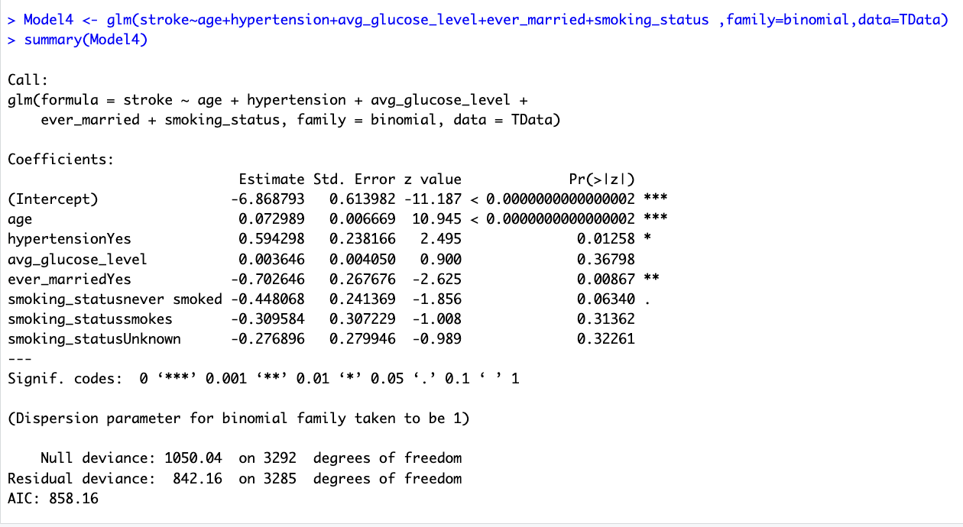
Logistic regression model
Out of all the factors , age is the most influencing factor for heart stroke, followed by hypertension, smoking status ,glucose level and marital status.
Performance measures:
Accuracy: 88.331814
Sensitivity:45.238095
Specificity: 90.047393
AIC value: 858.16.
This is the best model out of the five models we had created using logistic regression. This is the best fitting model in comparison to other models because of higher accuracy, sensitivity, specificity and lower AIC value.

Slide 7
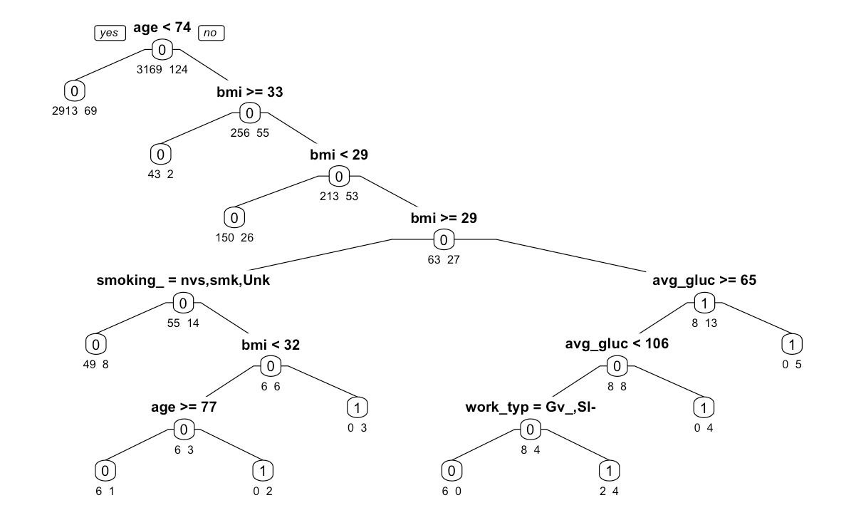
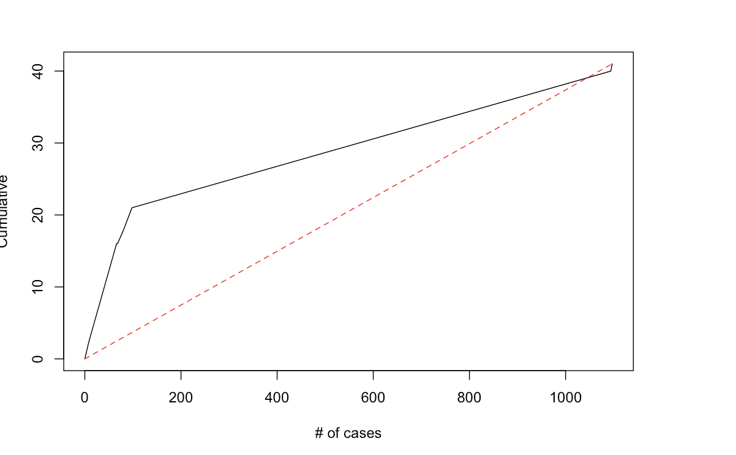
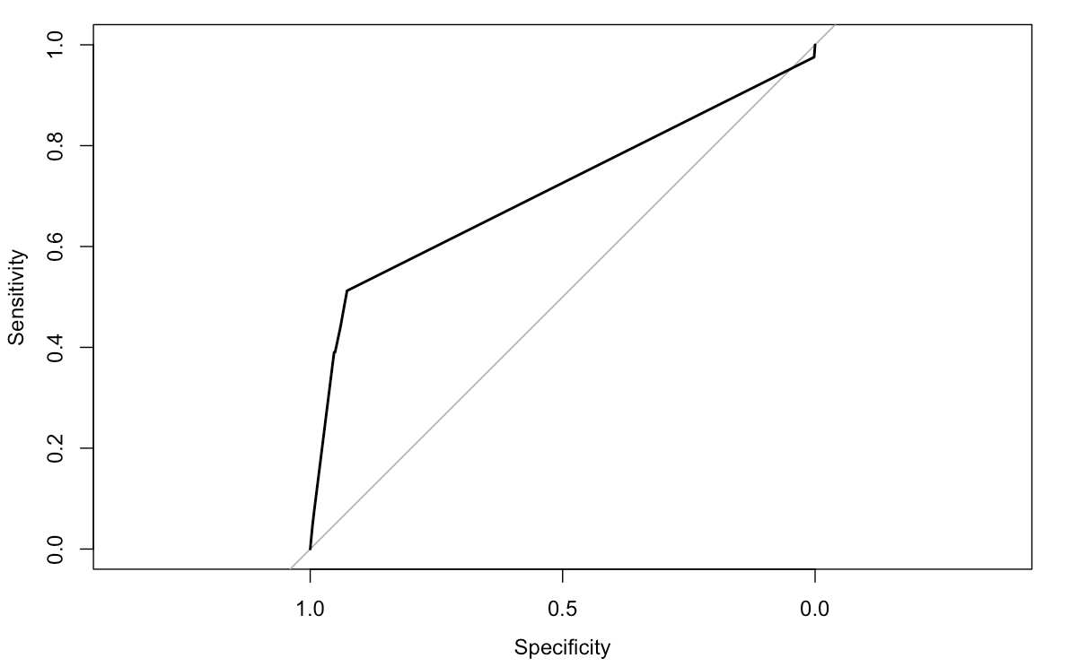
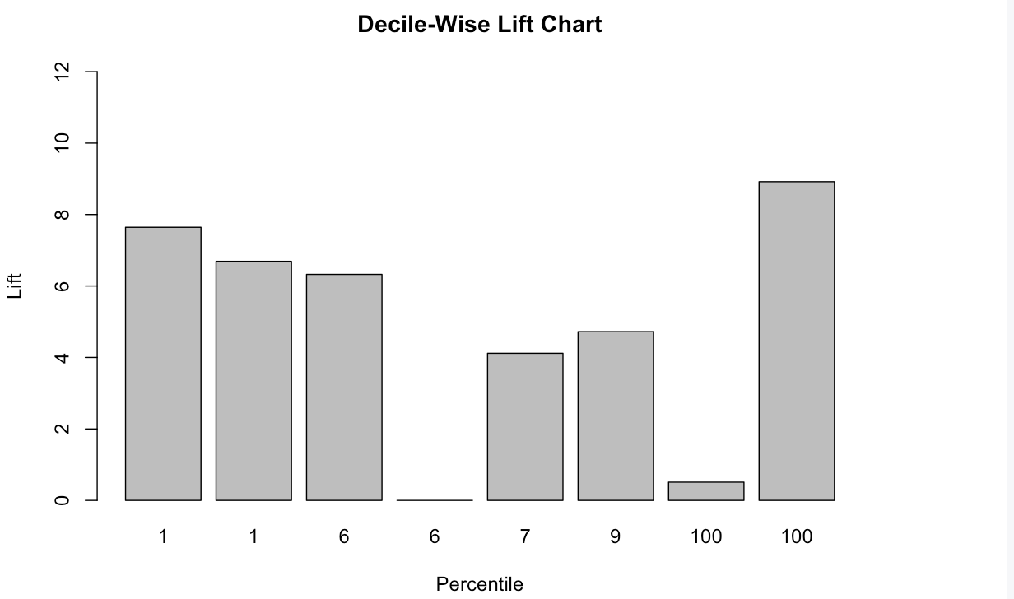
Classification tree
The model fits the data well because of higher accuracy of nearly 90 %.
Here also ,age seems to be the most important factor followed by bmi, avg glucose level and smoking status.
Here are the graphs of cumulative lift chart, decile chart and ROC chart.

Slide 8
Comparison of the two models
Out of both the models, classification tree evidently seems to be the better option due to higher accuracy, sensitivity and specificity.
Also, sensitivity is less because of our dataset being imbalanced.
Many 1’s came into the training dataset making the validation set with fewer 1 values.

Slide 9

Business insights and recommendations
The models can determine which patients are at risk for a heart attack so that prompt medical attention can be provided.
The hospital's management team may make strategic decisions to improve patient care, resource allocation, and overall healthcare efficiency by following recommendations based on heart stroke prediction models.
To identify patients at risk of heart stroke, the hospital management team can use these models to develop and implement early warning systems .
Implementing a heart stroke prediction project demonstrates the hospital's commitment to technological innovation in healthcare. This can enhance the hospital's reputation and position it as a leader in adopting advanced analytics for patient care.

