Slide 1
PLANT DISEASE DETECTION

Slide 2
ABSTRACT
Plant diseases are a major threat to food security, but their rapid identification remains difficult in many parts of the world due to the lack of the necessary infrastructure. Deep learning-based plant disease detection can automate the identification of plant diseases, improving crop management and reducing yield loss. It involves various models to classify images of diseased and healthy plants.

Slide 3
LITERATURE SURVEY
1. "A Survey on Deep Learning Approaches for Plant Disease Detection and Diagnosis" by Akhtar et al. (2020): This survey provides an overview of deep learning approaches for plant disease detection, including CNN, transfer learning, and other techniques.
2."Plant disease detection using deep learning: A review" by Sladojevic et al. (2018): This review covers the use of deep learning techniques for plant disease detection, including CNN, and discusses challenges and future directions.
3. "Deep Learning-Based Crop Disease Recognition: A Comprehensive Review" by Meena et al. (2021): This review covers deep learning-based approaches for crop disease recognition, including CNN and other techniques, and provides a comparison of different datasets and performance metrics.

Slide 4
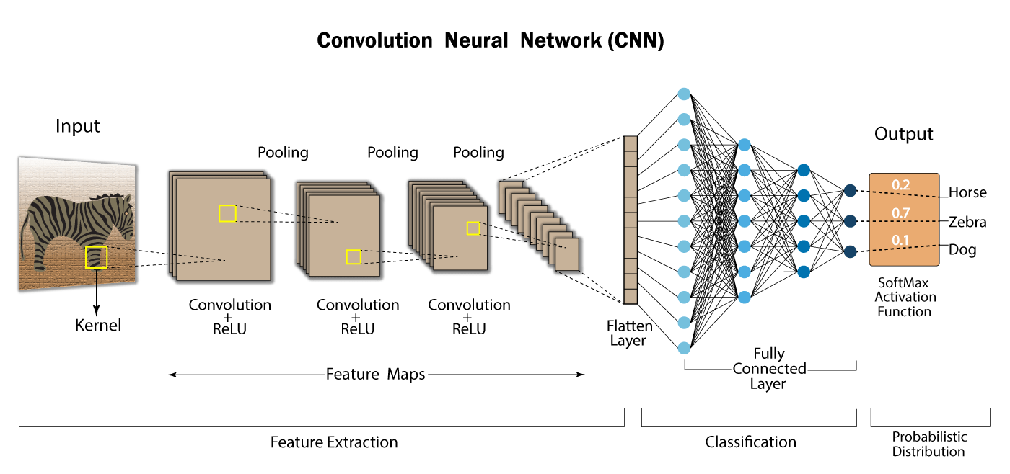
ALGORITHM

Slide 5
NEW PLANT DISEASES DATASET
This dataset consists of 87,900 images of leaves spanning 38 classes. Each class denotes a combination of the plant the leaf is from and the disease (or lack thereof) present in the leaf. All images are 256*256 in resolution.
The dataset is divided into three parts as follows:
train - 70,295 images divided into 38 classes with 1,642 to 2,022 images per class.
valid - 17,572 images divided into 38 classes with 410 to 505 images per class.
test - 33 images (These images are not divided into their respective classes but the class can be inferred from the image filename)
Link to dataset:
https://www.kaggle.com/datasets/vipoooool/new-plant-diseases-dataset

Slide 6
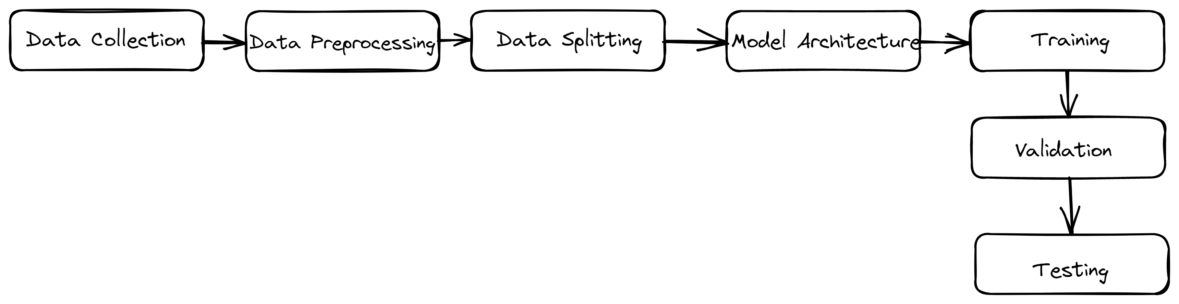
METHODOLOGY
Collect a well-labelled dataset of images of healthy and diseased plants.
Pre-process the data by resizing, normalizing, and augmenting the dataset.
Split the dataset into training, validation, and testing sets.
Define the CNN architecture with convolutional and fully connected layers.
Train the model using optimization algorithms such as SGD or Adam.
Validate the model by monitoring loss and accuracy metrics.
Test the model on the testing set to evaluate its performance.

Slide 7
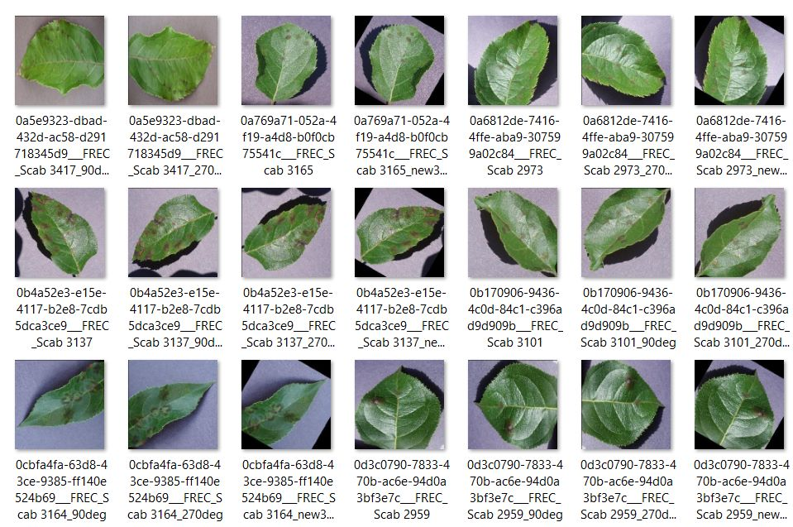
DATA

Slide 8
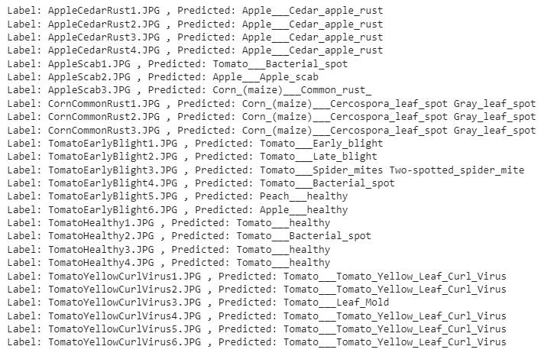
Output

Slide 9
CONCLUSION
Plant disease detection using CNN involves collecting a well-labeled dataset of images of healthy and diseased plants, preprocessing the data, splitting it into training, validation, and testing sets, defining the CNN architecture, training the model on the training set, validating it on the validation set, and testing it on the testing set to evaluate its performance. This approach has proven to be effective in accurately identifying plant diseases, which can help farmers take timely action to prevent crop damage.

Slide 10
REFERENCES
"A Survey on Deep Learning Approaches for Plant Disease Detection and Diagnosis" by Akhtar et al. (2020): https://www.ncbi.nlm.nih.gov/pmc/articles/PMC7271403/
"Plant disease detection using deep learning: A review" by Sladojevic et al. (2018): https://www.sciencedirect.com/science/article/pii/S1364815218302934
"Deep Learning Techniques for Plant Disease Detection Using Image Recognition: A Comprehensive Review" by Meena et al. (2021): https://www.mdpi.com/2077-0472/11/1/46
"Deep Learning-Based Crop Disease Recognition: A Comprehensive Review" by Meena et al. (2021): https://www.mdpi.com/2077-0472/11/6/68
"Agriculture-Vision: A Large Aerial Image Database for Agricultural Pattern Analysis" by Lu et al. (2020): https://arxiv.org/abs/2001.01306

