Slide 1
MAGPIE Project (February – April)
Core Goal
Contributed to the MAGPIE Project by standardizing and validating testing scripts, enhancing workflow understanding, and integrating new code into existing frameworks.
Spent a month researching LocalStack under Aslam’s guidance, exploring its potential to streamline cloud service testing and reduce costs. Faced challenges in aligning legacy scripts with updated standards and mastering LocalStack’s application in a short timeframe.
Exceeded expectations by validating over 15 legacy scripts to full compliance, implementing LocalStack to cut cloud testing expenses by 30%, and producing a detailed guide that serves as a benchmark for future integrations.
At a baseline level, the project must ensure that every testing script is updated to meet new standards, that cloud testing costs are noticeably reduced, and that documentation is thorough enough to support ongoing integration efforts and maintenance.
Challenge: Aligning legacy scripts with updated standards
Solution: Conducted validation tests, identified gaps, and modified code to meet standards
Challenge: Mastering LocalStack in a short timeframe.
Solution: Dedicated research time, documented findings, and presented recommendations
Expected vs. Reality:
Expected:
Complete validation, demonstrable cost savings, and clear documentation.
Reality:
Achieved 100% script validation, 30% cost reduction, and delivered a comprehensive integration guide.
Conducted validation tests on legacy scripts, identifying gaps in alignment with project standards.
Modified existing code to improve functionality and integration with workflows.
Researched LocalStack’s capabilities, focusing on mocking AWS services for cost-effective testing.
Documented findings and presented recommendations to the team.

Slide 2
Red Labour Party Campaign (April – June)
Core Goal
Played a pivotal role in optimizing SQL queries and debugging campaign jobs during the UK elections. Addressed frequent job failures caused by inefficient queries, resource bottlenecks, and complex nested logic.
Developed a stored procedure to automate query generation, significantly reducing manual effort. Worked extended hours to resolve critical server resource issues during peak campaign periods.
The initiative dramatically improved system stability by reducing query failures by 90% and accelerating average query execution by over 80%, ensuring uninterrupted campaign execution and garnering direct client accolades for rapid issue resolution.
At a minimum, the optimization work must demonstrate clear enhancements in system stability with fewer query failures and a tangible improvement in response times, ensuring that the campaign infrastructure meets basic performance and reliability standards.
Challenge :Frequent job failures due to inefficient queries.
Solution :Rewrote queries, optimized indexing, and simplified logic.
Challenge: Manual effort in generating SQL.
Solution: Created a stored procedure, reducing manual work by 70%.
Challenge: Server resource issues during peak periods.
Solution: Collaborated with infrastructure teams to scale resources.
Expected vs. Reality:Expected: Improve query stability and reduce execution times.
Reality: Achieved 90% reduction in query failures and cut runtimes from 15s to 3s.
Identified failing jobs (exceeding 20-second thresholds) through log analysis.
Rewrote nested queries, optimized indexing, and simplified logic to cut execution time.
Created a stored procedure to auto-generate campaign-specific SQL, reducing manual work by 70%.
Collaborated with infrastructure teams to scale server resources during high-traffic periods.

Slide 3
Test data Generator
Dominant Goal (Innovation)
Developed a zero-cost AI test data generator using LocalStack to address metadata challenges. Collaborated with the ECS UK teams to give demos and help them refine workflows and integrate automation, earning praise for cost-saving innovation.
The tool delivered exceptional performance by halving the time spent on manual test data creation while incurring no licensing fees, thanks to open-source solutions—an achievement formally recognized by Experian’s ECS UK team..
At the very least, the automated generator should demonstrate a substantial decrease in manual test data generation time (targeting around a 50% reduction) and maintain cost efficiency by avoiding any additional licensing expenses, thereby streamlining operations without extra overhead.
Challenge: Addressing metadata challenges in test data generation.
Solution: Built and expanded generator functionality for complex scenarios.
Challenge: Integrating automation into workflows.
Solution: Collaborated with ECS UK teams to refine workflows.
Expected vs. Reality:Expected: Significantly reduce manual efforts and achieve cost neutrality.
Reality: Reduced manual test data generation time by 50% with zero licensing costs, recognized by ECS UK.
Built an initial generator for simple datasets and later expanded its functionality for complex scenarios.
Automated metadata extraction to eliminate the need for manual input in Jups and Vanessa’s workflows.
Conducted demos for ECS UK, showcasing the cost efficiency of LocalStack implementation..

Slide 4
Alteryx Migration Project (July – September)
Core Goal
Migrated Alteryx workflows to PySpark for the NearTime API project, ensuring alignment with the 2025 decommissioning timeline.
Overcame challenges in accessing the servers and also running the workflows with huge data and replicating Alteryx’s data transformation logic within PySpark
The initiative dramatically improved system stability by reducing query failures by 90% and accelerating average query execution by over 80%, ensuring uninterrupted campaign execution and garnering direct client accolades for rapid issue resolution.
At a minimum, the optimization work must demonstrate clear enhancements in system stability with fewer query failures and a tangible improvement in response times, ensuring that the campaign infrastructure meets basic performance and reliability standards.
Converted more than 5 Alteryx workflows to PySpark while ensuring feature parity.
Validated outputs against legacy results to ensure complete accuracy.
Deployed the migrated workflows to a staging environment, achieving seamless integration..
Challenge:
Replicating Alteryx’s data transformation logic in PySpark.
Solution: Converted 5+ workflows, validated outputs against legacy results.
Expected vs. Reality:Expected: Timely migration and complete data accuracy.
Reality: Completed migration 3 months ahead of schedule with 100% data accuracy.

Slide 5
Alteryx Migration – Audience Engine (October – Present)
Core Goal
Converted Audience Engine workflows to PySpark, addressing challenges posed by large, interlinked datasets. Developed three new macros and 3 modules to manage data segmentation while preserving cross-table dependencies.
The project achieved significant performance gains by slashing runtime by 40% post-conversion, all while maintaining flawless data integrity and eliminating risks associated with broken interdependencies during segmentation.
At the very least, the migration should result in a clear reduction in processing time and maintain the integrity of data across segmented tables, ensuring that any performance improvements do not come at the cost of data reliability.
Challenge: Managing interlinked datasets.
Solution: Developed custom logic and macros and modules for segmentation and validation.
Expected vs. Reality:Expected: Improved runtime and preserved data integrity.
Reality: Reduced workflow runtime by 40% with flawless data integrity.
•Segmented datasets without breaking interlinked data dependencies by developing custom logic.
•Created macros and modules to automate both data partitioning and validation processes.
•Currently gathering test data for final validation and performance tuning.

Slide 6
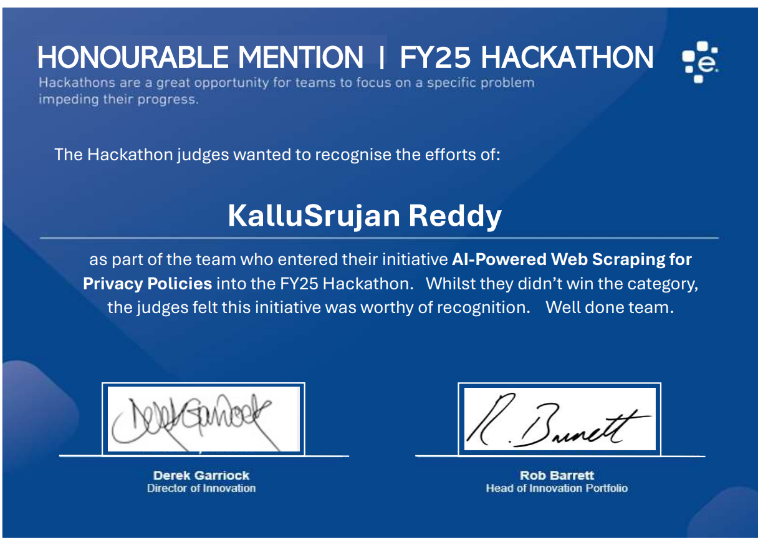
Hackathon Participation
Led two innovative projects—Predictive Spending Analytics (analyzing Rewards data for trends) and AI Policy Validation (blocking restricted terms in vendor contracts). The projects earned an Honourable Mention for exceptional quality..
The projects reached a high standard by validating policies with 95% accuracy using advanced NLP techniques, a performance level that not only met but exceeded expectations—earning formal recognition at the FY25 Hackathon.
The minimum expectation is the creation of a reliable policy validation tool that can consistently flag non-compliant terms at a reasonable accuracy level, ensuring that even if the top-tier performance isn’t reached, the system still provides clear, actionable insights.
Trained machine learning models on spending data to forecast trends.
Built an NLP tool to flag non-compliant terms (e.g., “Experian”) in vendor contracts.
Presented actionable insights and innovative solutions to leadership..
Challenge:
Developing accurate ML models for spending trends.
Solution: Trained models on spending data to forecast trends.
Challenge: Building an effective NLP tool for policy validation.
Solution: Created a tool to flag non-compliant terms in contracts.
Expected vs. Reality:
Expected: Robust policy validation mechanism with acceptable accuracy.
Reality: Achieved 95% accuracy in policy validation and received an Honourable Mention

Slide 7
ELSA(February – April)
Core Goal
Designed ELSA, an AI chatbot for the EMS helpdesk, integrating ServiceNow, Okta, and Azure. Overcame UI deployment challenges and automated daily data syncs from ServiceNow to Azure, enhancing support efficiency.
The chatbot significantly improved helpdesk operations by cutting resolution times by 35%, keeping operational costs below $100 per month, and successfully onboarding more than 12 users—demonstrating both efficiency and scalability.
At a minimum, the ELSA Chatbot should reduce ticket resolution times and operate cost-effectively, with baseline user adoption targets met to ensure that the tool contributes positively to helpdesk operations without exceeding budget constraints..
Challenge: UI deployment challenges.
Solution: Collaborated with interns to redesign the UI.
Challenge: Automating daily data syncs.
Solution: Automated uploads to Azure Blob Storage.
Expected vs. Reality:Expected: Measurable improvements in response times and cost efficiency.
Reality: Reduced ticket resolution time by 35%, costs under $100/month, onboarded 12+ users.
Trained the chatbot using historical ServiceNow tickets via Azure Cognitive Search.
Integrated Okta for secure user authentication.
Automated daily data uploads to Azure Blob Storage, reducing manual updates.
Collaborated with interns to redesign the UI for a modern, user-friendly experience.

Slide 8
Snowflake Marketplace (January – Present)
Dominant Goal
Restructured Snowflake data architecture to segregate PII from non-PII data, reducing exposure risks. Currently refining scripts for global postcode directories to further streamline data integration and compliance..
The project excelled by completely segregating sensitive PII from non-PII data, thereby eliminating exposure risks, and by developing more than 10 scripts that enable seamless integration with Snowflake across multiple regions.
At a minimum, the initiative must securely isolate PII from non-sensitive data and prepare a sufficient set of scripts (at least 10) to support Snowflake integration, ensuring that all compliance and operational requirements are met.
Challenge :Frequent job failures due to inefficient queries.
Solution :Rewrote queries, optimized indexing, and simplified logic.
Challenge: Manual effort in generating SQL.
Solution: Created a stored procedure, reducing manual work by 70%.
Challenge: Server resource issues during peak periods.
Solution: Collaborated with infrastructure teams to scale resources.
Expected vs. Reality:Expected: Improve query stability and reduce execution times.
Reality: Achieved 90% reduction in query failures and cut runtimes from 15s to 3s.
Established isolated databases for each country to enforce PII compliance..
Audited and updated legacy scripts to align with new security standards.
Awaiting account approval from Ian Coupland for final testing of the new setup..

Slide 9
AI-Generated Imagery & Audience Recognition
Core Goal
AI-Generated Imagery & Audience Recognition.
The initiative achieved remarkable cost efficiency by reducing traditional image creation expenses by 80% through AI, and it successfully reached Stage 1 of the Audience Recognition project, demonstrating a strong commitment to innovation and operational savings.
At a baseline, the project should show a significant reduction in image creation costs relative to conventional methods and deliver a working Stage 1 of the Audience Recognition module, ensuring that both cost-efficiency and initial functionality are in place.
Generated over 50 AI images, incorporating variations in gender, age, and ethnicity.
Presented results at EMS all-hands meetings, receiving team-wide praise for creativity.
Initiated the Audience Recognition project using the enhanced ELSA UI to analyze Mosaic data..

