Slide 1
Optimizing Wind Speed Forecasting & Insurance Pricing with Random Forest
Team 19

Slide 2
Problem Overview
🌪 Challenge: NOAA is defunded → InsuraCorp needs a data-driven insurance pricing model.
📊 Goal: Predict 5-day wind speed in GANopolis and set optimal insurance prices.
💡 Key Constraints: Pricing must balance profitability & fairness, using risk-based adjustments.

Slide 3
01
Why Random Forest?

Slide 4
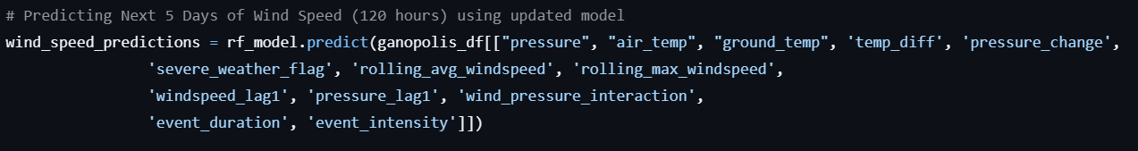
Handles non-linearity well (wind speed is influenced by multiple interacting factors, rolling_avg_windspeed, pressure_change, event_intensity, and wind_pressure_interaction..
Feature importance interpretation: Helps us understand what affects wind speed most.
Robust to noise: Performs well on real-world data.
Final MSE: 0.0000210296
Tried to use Time Series Forecasting but MSE was higher at 0.004

Slide 5
02
Prediction Model

Slide 6
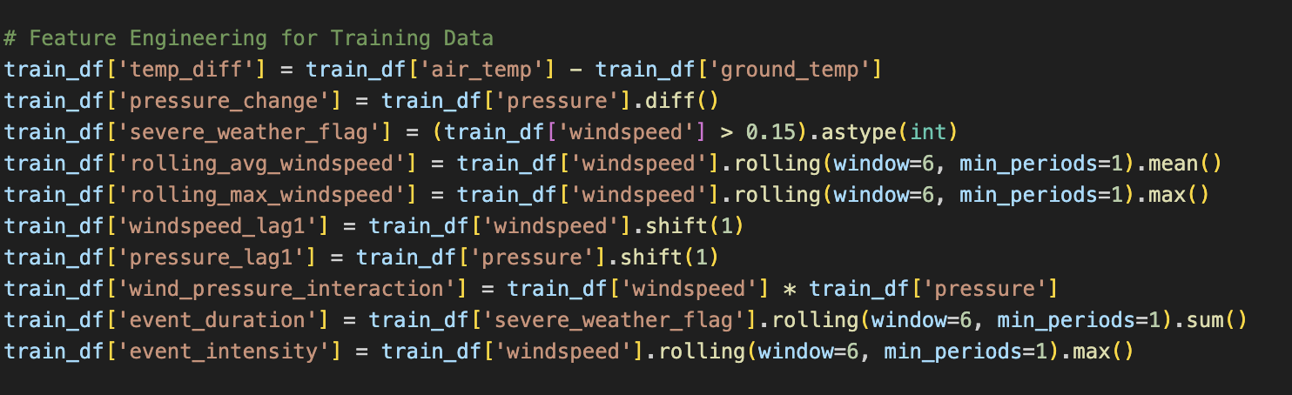
Historical Data from the Training Dataset
Train - test split: 80% - 20%

Slide 7
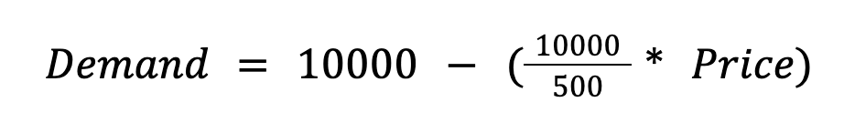
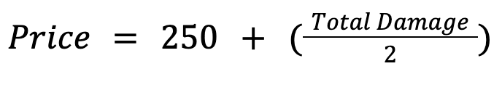
Pricing Model
Profit = Demand × (Price − Expected Damage)
Price−Damage
Used forecasted wind speed → estimated total damage.
Final Profit Calculation: Profit=(10000−20×Price)×(Price−Damage)

Slide 8
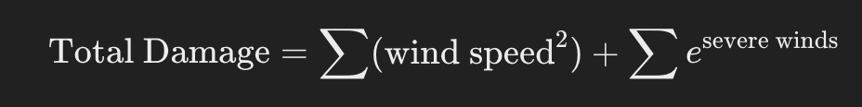
How We Estimated the Damage?
Damage Function:
Wind damage is proportional to wind speed squared.
Exponential scaling for severe winds (winds > 0.2).
Why This Works?
Captures both constant wind damage and rare extreme events.
Helps us price insurance more effectively.

Slide 9
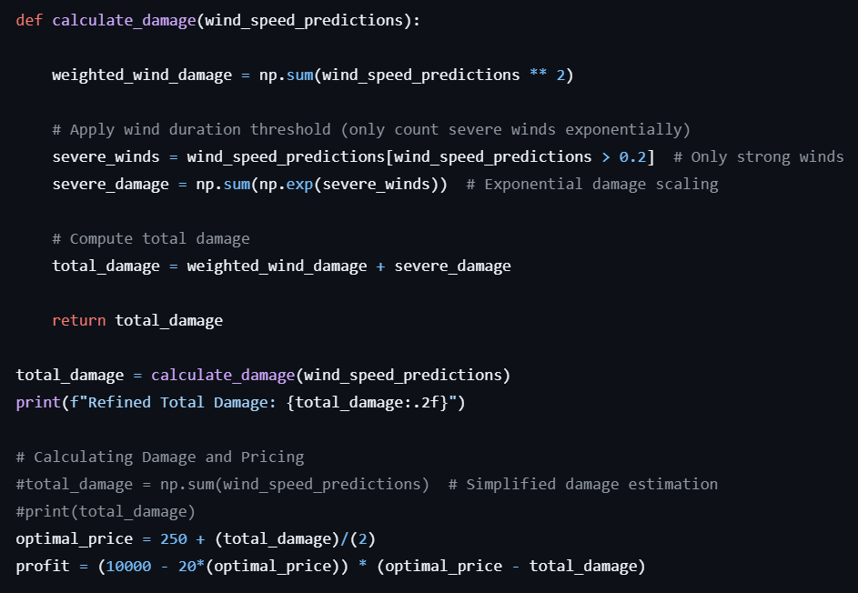
Insurance Pricing
https://www.desmos.com/calculator/31ibga1bix
Live Demo with the Code

Slide 10
05
Q&A

