Slide 1
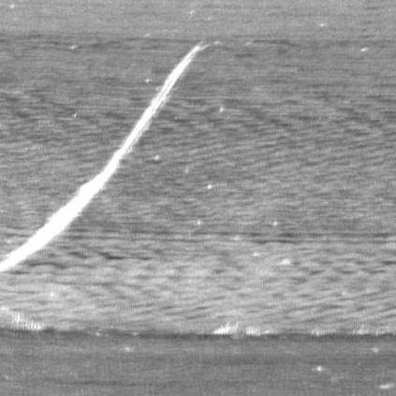

Generating Useful Surface Defect Images When Real Data Is Scarce
Conditional GAN experiments on metal surface defects
Srujan Vaddiparthi
Supervisor: Abu Islam Sri Priya Das
Golisano Institute for Sustainability
Rochester Institute of Technology

Slide 2
Agenda
Why this problem matters
Research question
How a conditional GAN works
Experimental progression and results
Key lessons, challenges, and next steps

Slide 3
Why this problem matters
Defect images are often scarce in industrial settings

Slide 4
Why this problem matters
Defect images are often scarce in industrial settings
Small datasets limit computer vision performance

Slide 5
Why this problem matters
Defect images are often scarce in industrial settings
Small datasets limit computer vision performance
Useful synthetic images could support inspection, reuse, and reduced waste

Slide 6
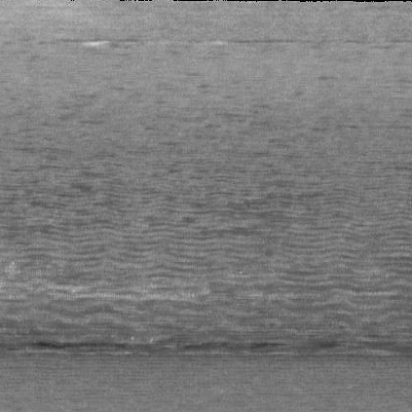
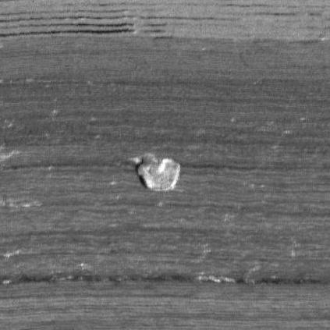
Why this problem matters
Defect images are often scarce in industrial settings
Small datasets limit computer vision performance
Useful synthetic images could support inspection, reuse, and reduced waste
This is not a general image-generation problem. It is a low-data, defect-faithful industrial generation problem.
Normal
Scratch
Spot

Slide 7
Research Question
Can AI generate useful defect images when real surface-defect data is scarce?

Slide 8
Research Question
Can AI generate useful defect images when real surface-defect data is scarce?
What I wanted to understand:

Slide 9
Research Question
Can AI generate useful defect images when real surface-defect data is scarce?
What I wanted to understand:
Can the model generate the defect type I ask for?

Slide 10
Research Question
Can AI generate useful defect images when real surface-defect data is scarce?
What I wanted to understand:
Can the model generate the defect type I ask for?
Which defect types are easier to learn?

Slide 11
Research Question
Can AI generate useful defect images when real surface-defect data is scarce?
What I wanted to understand:
Can the model generate the defect type I ask for?
Which defect types are easier to learn?
What improves output quality when data is both scarce and imbalanced?

Slide 12
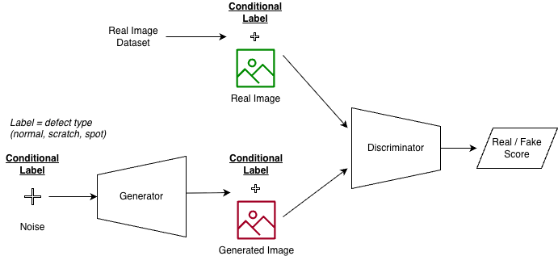
How a Conditional GAN Works (Simplified)
The label steers what the generator creates and what the discriminator expects.

Slide 13
How I Judged Progress
How I evaluated outputs:
Visual Realism 👁
Class Consistency 🏷
Diversity ▤▥▦▨

Slide 14
Starting Point: 3-Class Baseline
One cDCGAN for normal / scratch / spot

Slide 15
Starting Point: 3-Class Baseline
One cDCGAN for normal / scratch / spot
Learned shared metal texture

Slide 16
Starting Point: 3-Class Baseline
One cDCGAN for normal / scratch / spot
Learned shared metal texture
Weak defect-specific generation

Slide 17
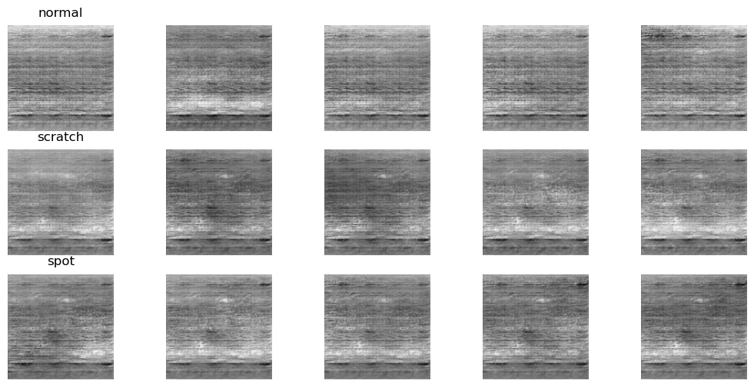
Starting Point: 3-Class Baseline
Generated Output:

Slide 18
Starting Point: 3-Class Baseline
Generated Output:
The 3-class setup learned metal texture better than defect structure.

Slide 19
Why I Simplified the Problem
From 3 classes to binary experiments.

Slide 20
Why I Simplified the Problem
From 3 classes to binary experiments.
The 3-class setup weakened class-specific generation.

Slide 21
Why I Simplified the Problem
From 3 classes to binary experiments.
The 3-class setup weakened class-specific generation.
I split the problem into:
normal vs scratch
normal vs spot

Slide 22
Why I Simplified the Problem
From 3 classes to binary experiments.
The 3-class setup weakened class-specific generation.
I split the problem into:
normal vs scratch
normal vs spot
I trained each setup for the same number of epochs, and also checked intermediate results.

Slide 23
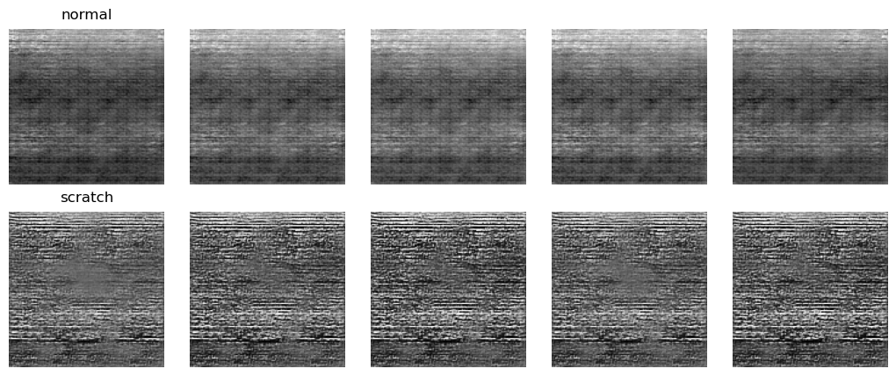
Normal vs Scratch: What Changed
Baseline Output:

Slide 24
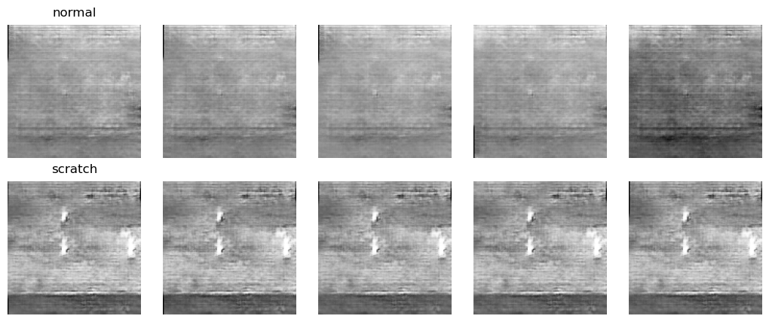
Normal vs Scratch: What Changed
Baseline Output:
Final Setup Output:

Slide 25
Normal vs Scratch: What Changed
Baseline Output:
Evaluation | Judgement
Visual Realism 👁 | Medium
Class Consistency 🏷 | Medium
Diversity ▤▥▦▨ | Low
Final Setup Output

Slide 26
Normal vs Scratch: What Changed
Baseline Output:
Evaluation | Judgement
Visual Realism 👁 | Medium
Class Consistency 🏷 | Medium
Diversity ▤▥▦▨ | Low
Final Setup Output
Binary setup + enhancement improved scratch-vs-normal separation
Diversity stayed low, and scratches were still hard to model

Slide 27
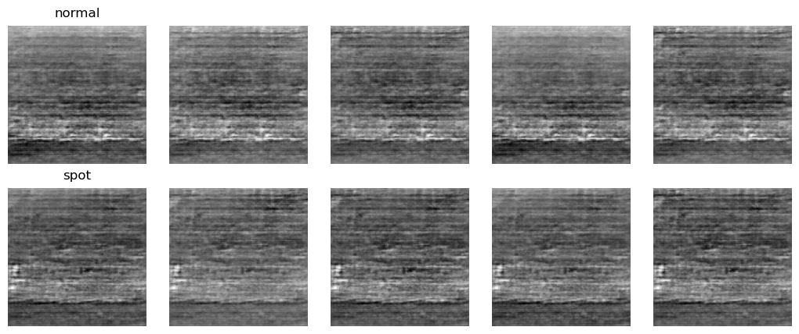
Normal vs Spot: What Changed
Baseline Output:

Slide 28
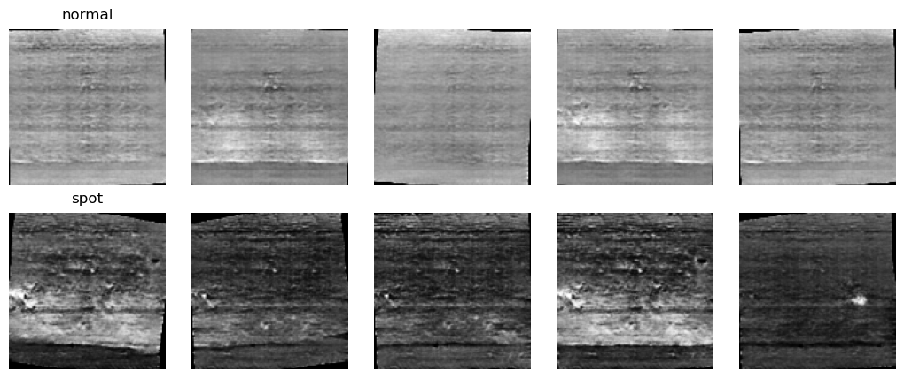
Normal vs Spot: What Changed
Baseline Output:
Final Setup Output

Slide 29
Normal vs Spot: What Changed
Baseline Output:
Evaluation | Judgement
Visual Realism 👁 | Medium
Class Consistency 🏷 | High
Diversity ▤▥▦▨ | Low
Final Setup Output

Slide 30
Normal vs Spot: What Changed
Baseline Output:
Evaluation | Judgement
Visual Realism 👁 | Medium
Class Consistency 🏷 | High
Diversity ▤▥▦▨ | Low
Final Setup Output
Spots were easier to learn than scratches
Class consistency improved, but diversity stayed low

Slide 31
What I learned
Spot-like defects were easier to generate than scratches
Repeated examples and limited surface variety strongly shaped what the model learned
The model could separate classes better, but still repeated similar outputs

Slide 32
Challenges
Structured defects were harder than localized ones
Narrow and repeated data reduced diversity
The current cDCGAN learned texture more easily than controlled defect structure
Best-looking outputs sometimes appeared before the final epoch

Slide 33
What comes next
More diverse defect data
Stronger conditioning / better architectures
Image-to-image translation approaches
More reliable ways to identify the best outputs

Slide 34
What comes next
More diverse defect data
Stronger conditioning / better architectures
Image-to-image translation approaches
More reliable ways to identify the best outputs
These findings suggest a path from low-data generation experiments toward more controllable and useful defect synthesis.

Slide 35
Conclusion
The cDCGAN learned metal texture and some class-specific cues
Spots were easier to learn than scratches
Diversity remained the main limitation
These results point clearly to the next set of experiments

Slide 36
References / Acknowledgments
Mirza & Osindero — Conditional Generative Adversarial Nets
Radford et al. — DCGAN
Isola et al. — pix2pix
Zhu et al. — CycleGAN
Defect-Transfer GAN paper
Advisor: Abu Islam
Co-mentor / support: Sri Priya Das
RIT Research Computing

Slide 37
Thank You!

