Slide 1
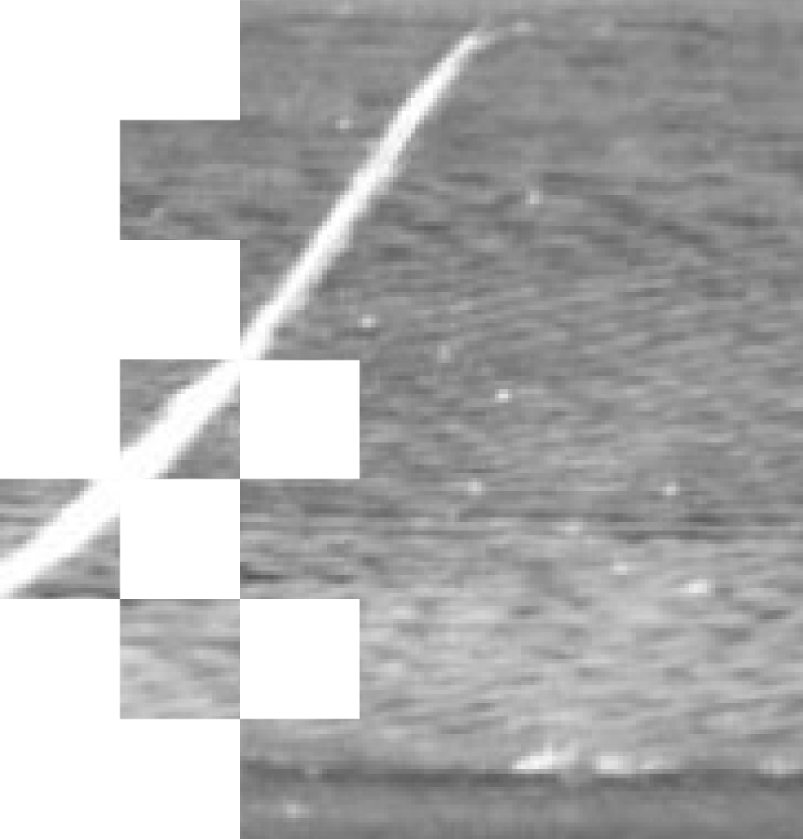

04/08/2026
Generating Useful Surface Defect Images When Real Data Is Scarce
Conditional GAN experiments on metal surface defects
SRUJAN VADDIPARTHI
SUPERVISOR: ABU ISLAM, SRI PRIYA DAS
GOLISANO INSTITUTE FOR SUSTAINABILITY
ROCHESTER INSTITUTE OF TECHNOLOGY

Slide 2




04/08/2026
Agenda
01
02
03
Why this problem matters
Research question
How a conditional GAN works
04
05
Experimental progression and results
Key lessons, challenges, and next steps
SRUJAN VADDIPARTHI
2

Slide 3

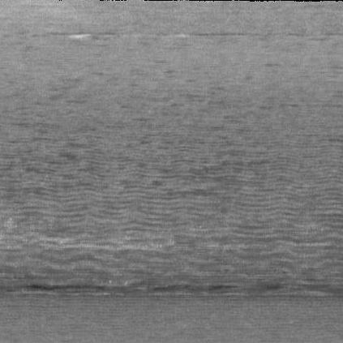
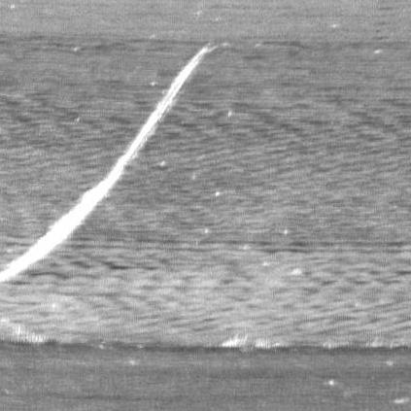
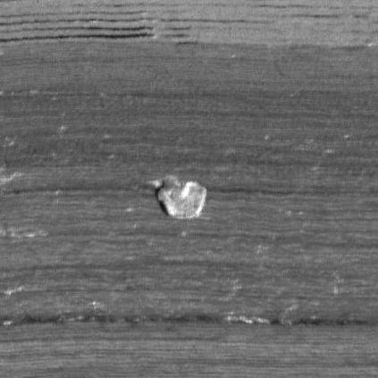
04/08/2026
Why this problem matters
-Defect images are often scarce in industrial settings
-Small datasets limit computer vision performance
-Useful synthetic images could support inspection, reuse, and reduced waste
Normal
Scratch
Spot
This is not a general image-generation problem. It is a low-data, defect-faithful industrial generation problem.
SRUJAN VADDIPARTHI
3

Slide 4
04/08/2026
Research Question
Can AI generate useful defect images when real surface-defect data is scarce?
What I wanted to understand:
Question 1
Question 2
Question 3
Can the model generate the defect type I ask for?
Which defect types are easier to learn?
What improves output quality when data is both scarce and imbalanced?
SRUJAN VADDIPARTHI
4

Slide 5
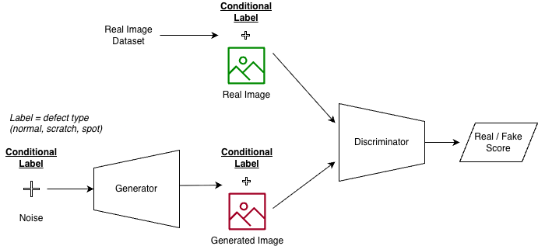
04/08/2026
How a Conditional GAN Works
(Simplified)
Caption
The label steers what the generator creates and what the discriminator expects.
SRUJAN VADDIPARTHI
5

Slide 6





04/08/2026
How I Judged Progress
How I evaluated outputs:
Class Consistency
Visual Realism
Diversity
SRUJAN VADDIPARTHI
6

Slide 7
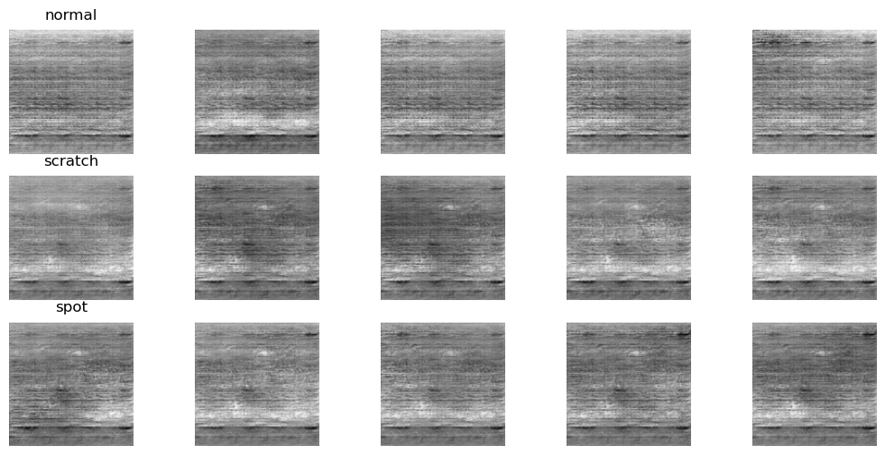
04/08/2026
Starting Point: 3-Class Baseline
-One cDCGAN for normal / scratch / spot
-Learned shared metal texture
-Weak defect-specific generation
Generated Output:
The 3-class setup learned metal texture better than defect structure.
SRUJAN VADDIPARTHI
7

Slide 8

04/08/2026
Why I Simplified the Problem?
From 3 classes to binary experiments.
-The 3-class setup weakened class-specific generation.
-I split the problem into:
normal vs scratch
normal vs spot
-I trained each setup for the same number of epochs, and also checked intermediate results.
SRUJAN VADDIPARTHI
8

Slide 9
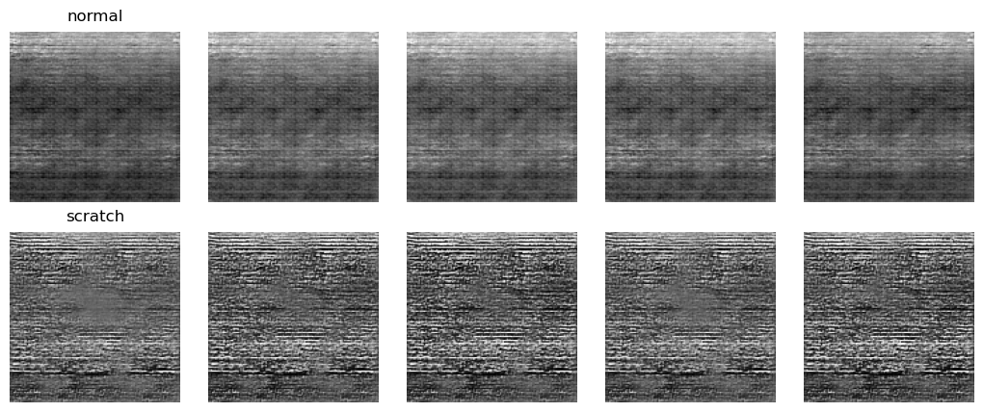
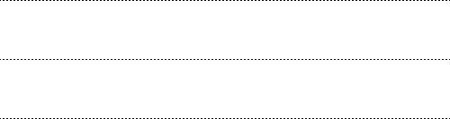
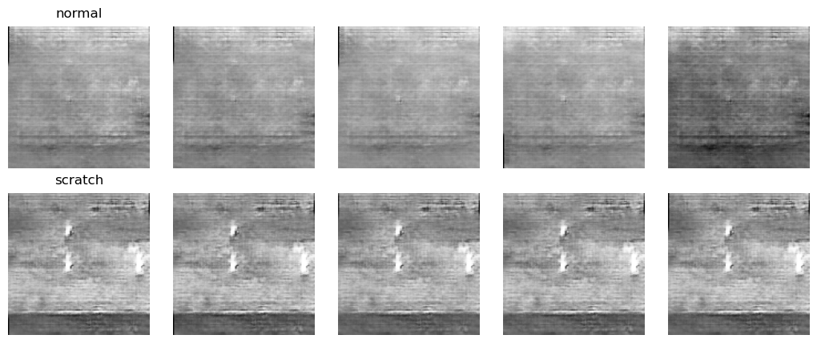
04/08/2026
Normal vs Scratch: What Changed
Baseline Output:
Evaluation
Judgement
Visual Realism
Medium
Class Consistency
Medium
Diversity
Low
Final Setup Output
Binary setup + enhancement improved scratch-vs-normal separation
Diversity stayed low, and scratches were still hard to model
SRUJAN VADDIPARTHI
9

Slide 10
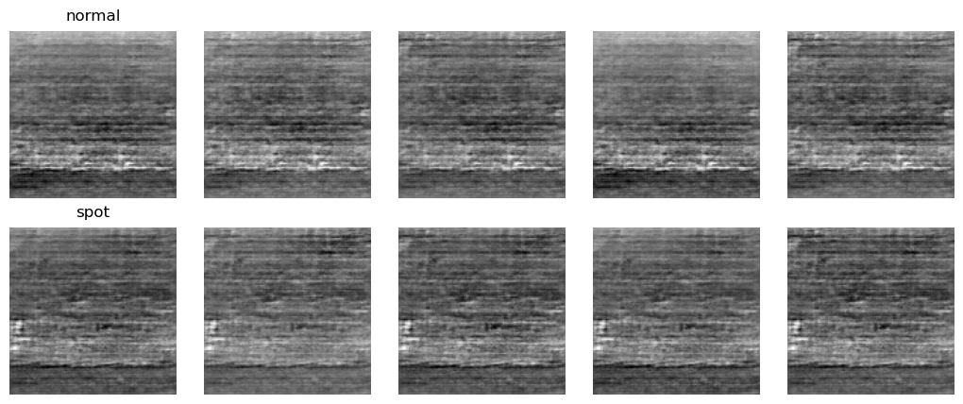
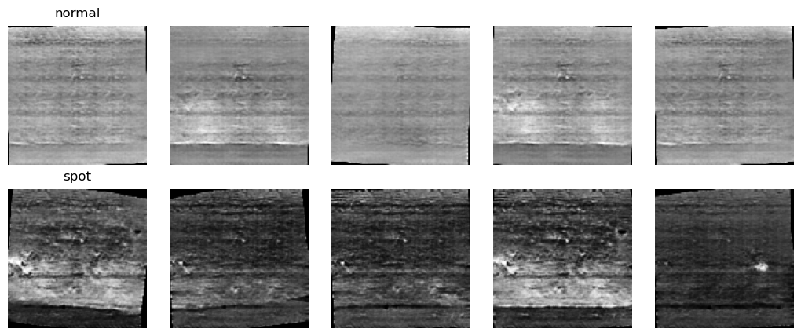
04/08/2026
Normal vs Spot: What Changed
Baseline Output:
Baseline Output:
Evaluation
Judgement
Visual Realism
Medium
Class Consistency
High
Diversity
Low
Final Setup Output
Spots were easier to learn than scratches
Class consistency improved, but diversity stayed low
SRUJAN VADDIPARTHI
10

Slide 11
04/08/2026
What I learned
Repeated examples and limited surface variety strongly shaped what the model learned
Spot-like defects were easier to generate than scratches
The model could separate classes better, but still repeated similar outputs
SRUJAN VADDIPARTHI
11

Slide 12

04/08/2026
Challenges
01
Structured defects were harder than localized ones
02
Narrow and repeated data reduced diversity
03
The current cDCGAN learned texture more easily than controlled defect structure
04
Best-looking outputs sometimes appeared before the final epoch
12
SRUJAN VADDIPARTHI

Slide 13

04/08/2026
What comes next
More diverse defect data
Image-to-image translation approaches
01
02
03
04
Stronger conditioning / better architectures
More reliable ways to identify the best outputs
These findings suggest a path from low-data generation experiments toward more controllable and useful defect synthesis.
13
SRUJAN VADDIPARTHI

Slide 14

04/08/2026
Conclusion
The cDCGAN learned metal texture and some class-specific cues
Spots were easier to learn than scratches
Diversity remained the main limitation
These results point clearly to the next set of experiments
SRUJAN VADDIPARTHI
14

Slide 15

04/08/2026
References / Acknowledgments
Mirza & Osindero — Conditional Generative Adversarial Nets
Radford et al. — DCGAN
Isola et al. — pix2pix
Zhu et al. — CycleGAN
Defect-Transfer GAN paper
Advisor: Abu Islam
Co-mentor / support: Sri Priya Das
RIT Research Computing
SRUJAN VADDIPARTHI
15

Slide 16


04/08/2026
Thank You ;)
16
01
SRUJAN VADDIPARTHI

