Slide 1
Class One
ISTE 782 Visual Analytics
2235 Charles Border, Ph.D.

Slide 2
Announcements
Office hours TuTh 12:30 to 2:00 via ZOOM, phone or in-person in GOL 2615.
All assignments coordinated through MyCourses
Two sections meet in person:
01 TuTh 11:00 to 12:15 GOL 2520
03 TuTh 2:00 to 3:15 GOL 2650
You are welcome to attend either
Course textbook:
Nussbaumer Knaflic, Cole; Storytelling with Data: A Data Visualization Guide for Business Professionals 1st edition: ISBN-13 978-1119002253, Publisher: Wiley, 2015.

Slide 3
Course Assignments
Four Team Labs:
1/26 Azure DevOps Semester Plan
2/9 E-Commerce/ERP
2/23 Crime Project
3/8 Health/Ecology
All projects start with an Azure DevOps project summary and plan
All projects use Google Big Query and Data Looker and public data sets
Teams can be up to three people

Slide 4
Course Assignments
Final Team Project
Topic of your choosing
3/28 Starts with Azure DevOps project plan
4/1 I will give feedback
4/9 Work on project
4/16 Work on project
4/23 Work on project
4/30 Project presentation due
Can use same team as for other assignments, but you can change teams.

Slide 5
Course Assignments
Final Exam
Take home: posted 3/26, due 3/30
Answer two questions out of six or eight
Two three to five page essays

Slide 6
Project Ideas
Must use multiple data sources
Can be done in Big Query/Data Looker
Should be related to your final capstone
Should be interesting to your team
I am open to discussion about topics, be creative!

Slide 7
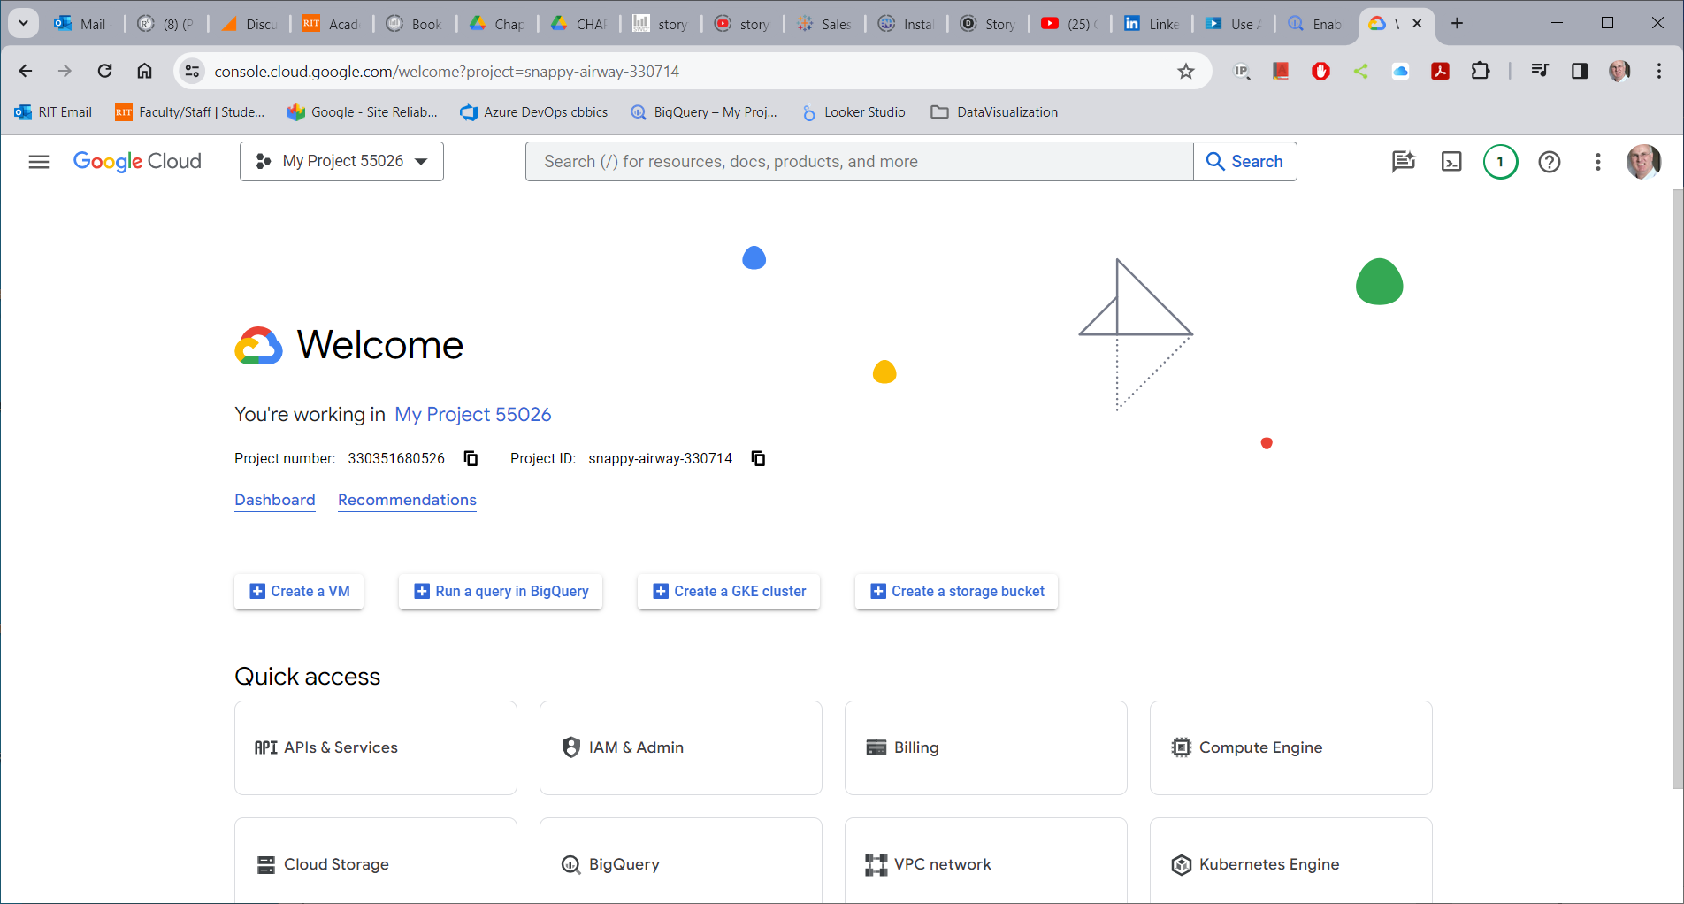
Google Big Query and Data Looker Studio

Slide 8
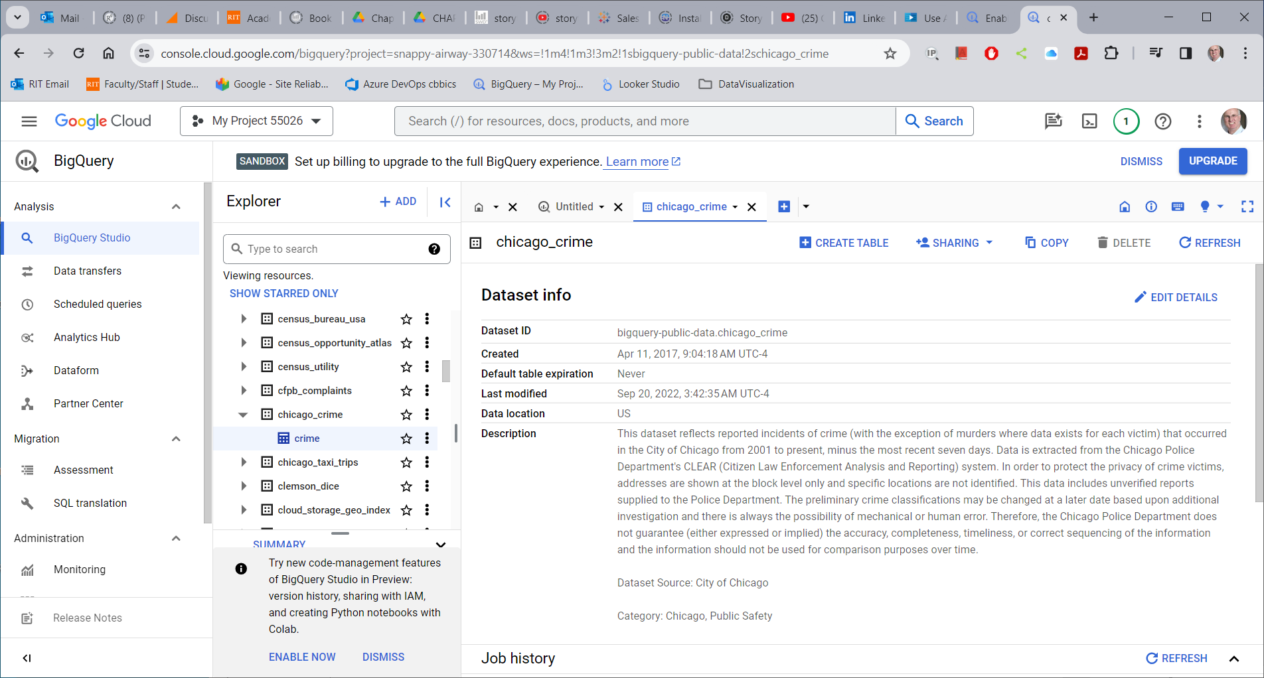
Public Data Sets

Slide 9
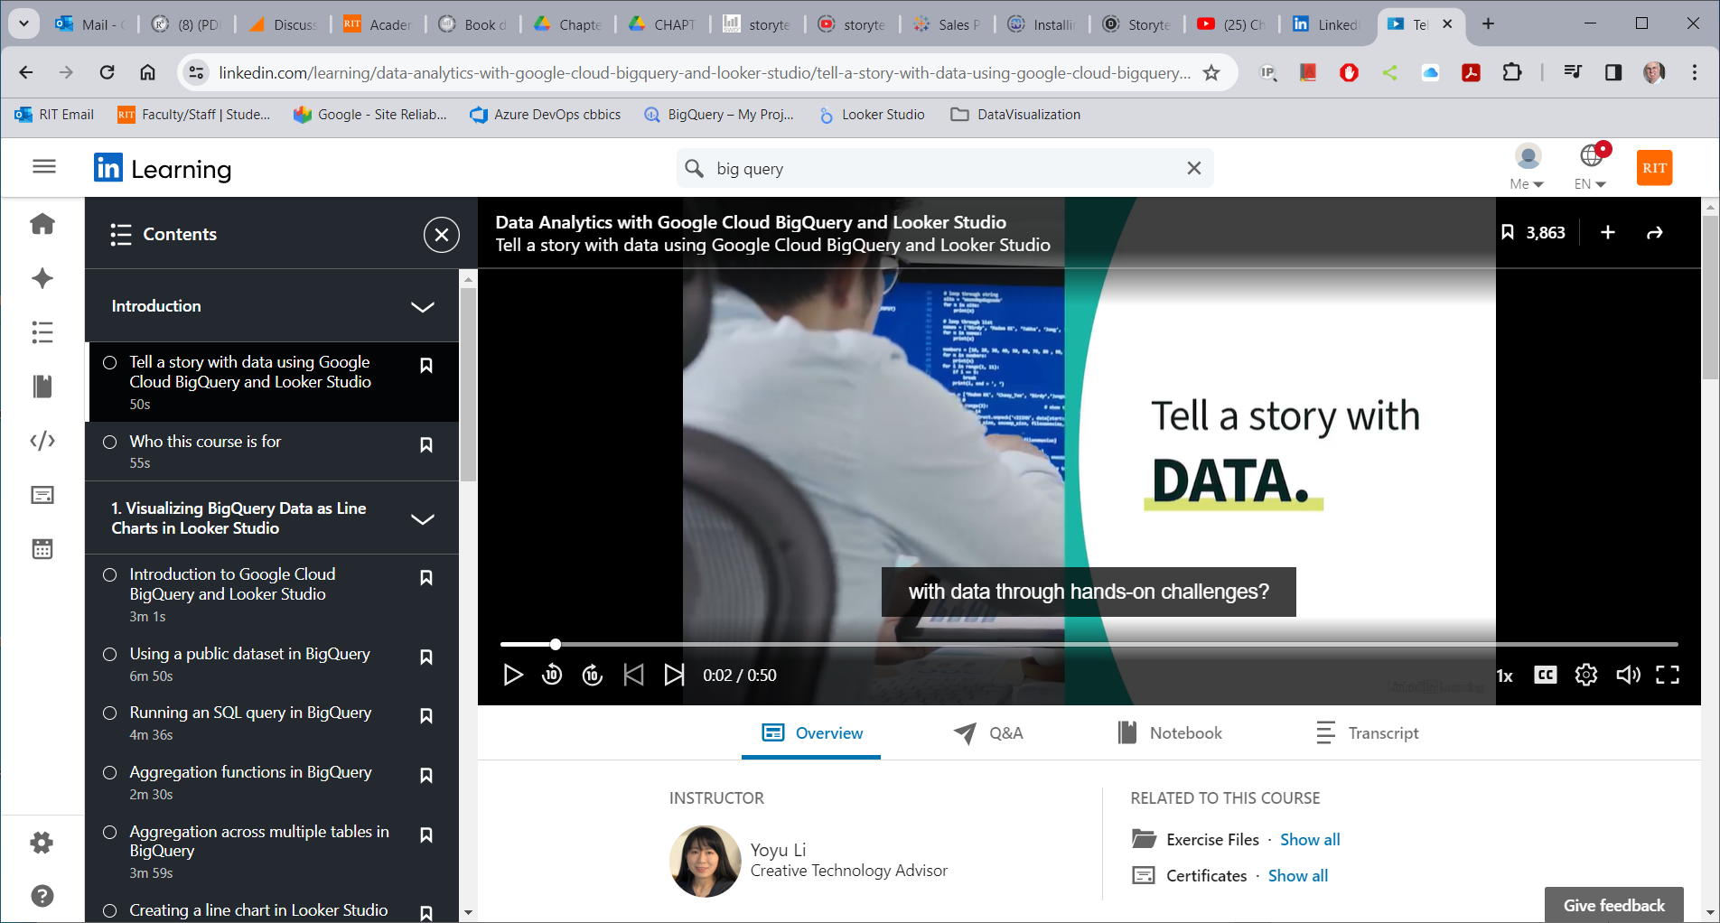
Learning to Work with Big Query and Data Looker Studio

Slide 10
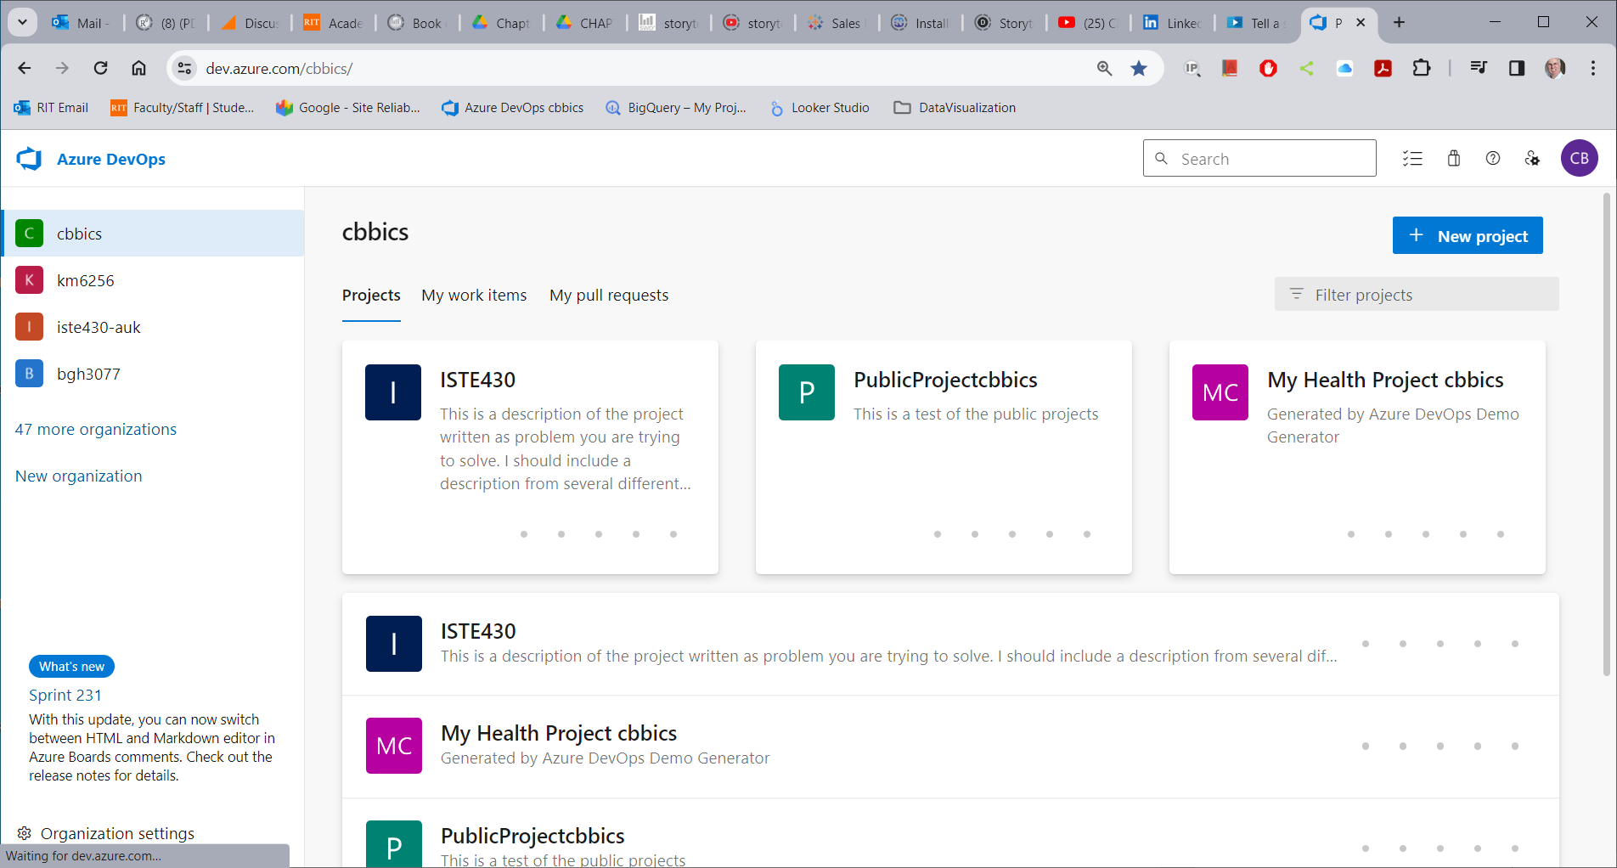
Working with Microsoft Azure DevOps

Slide 11
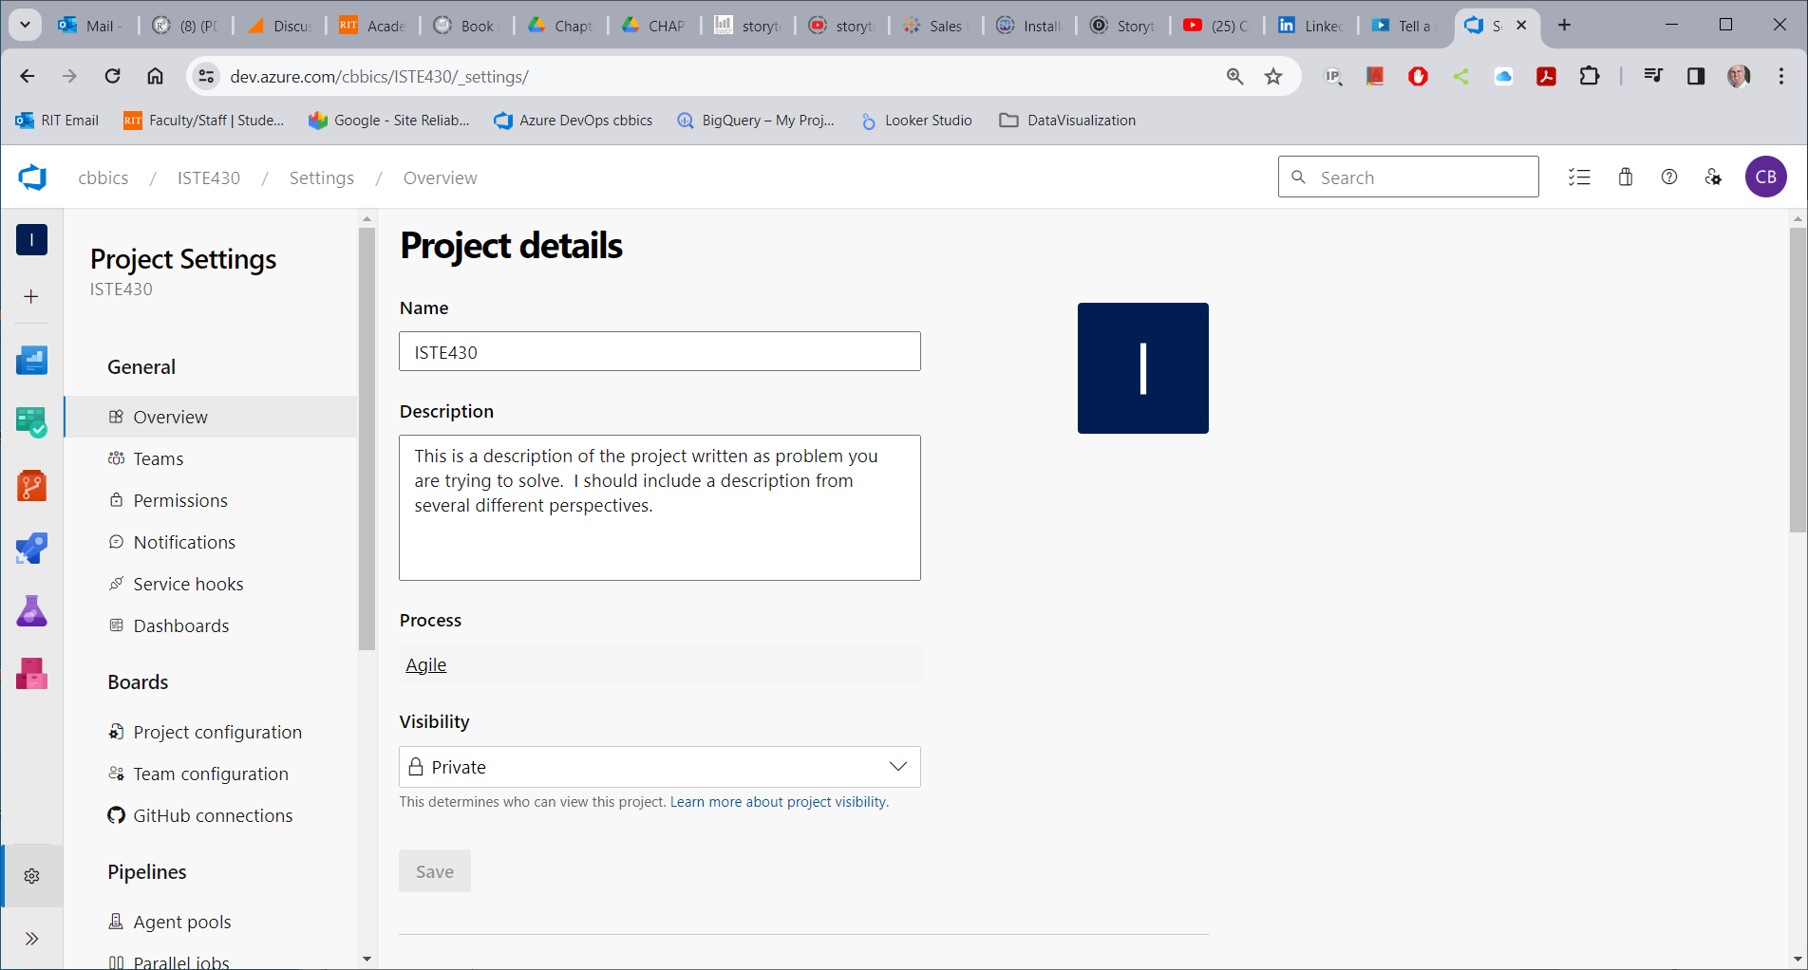
Project Settings for Azure DevOps

Slide 12
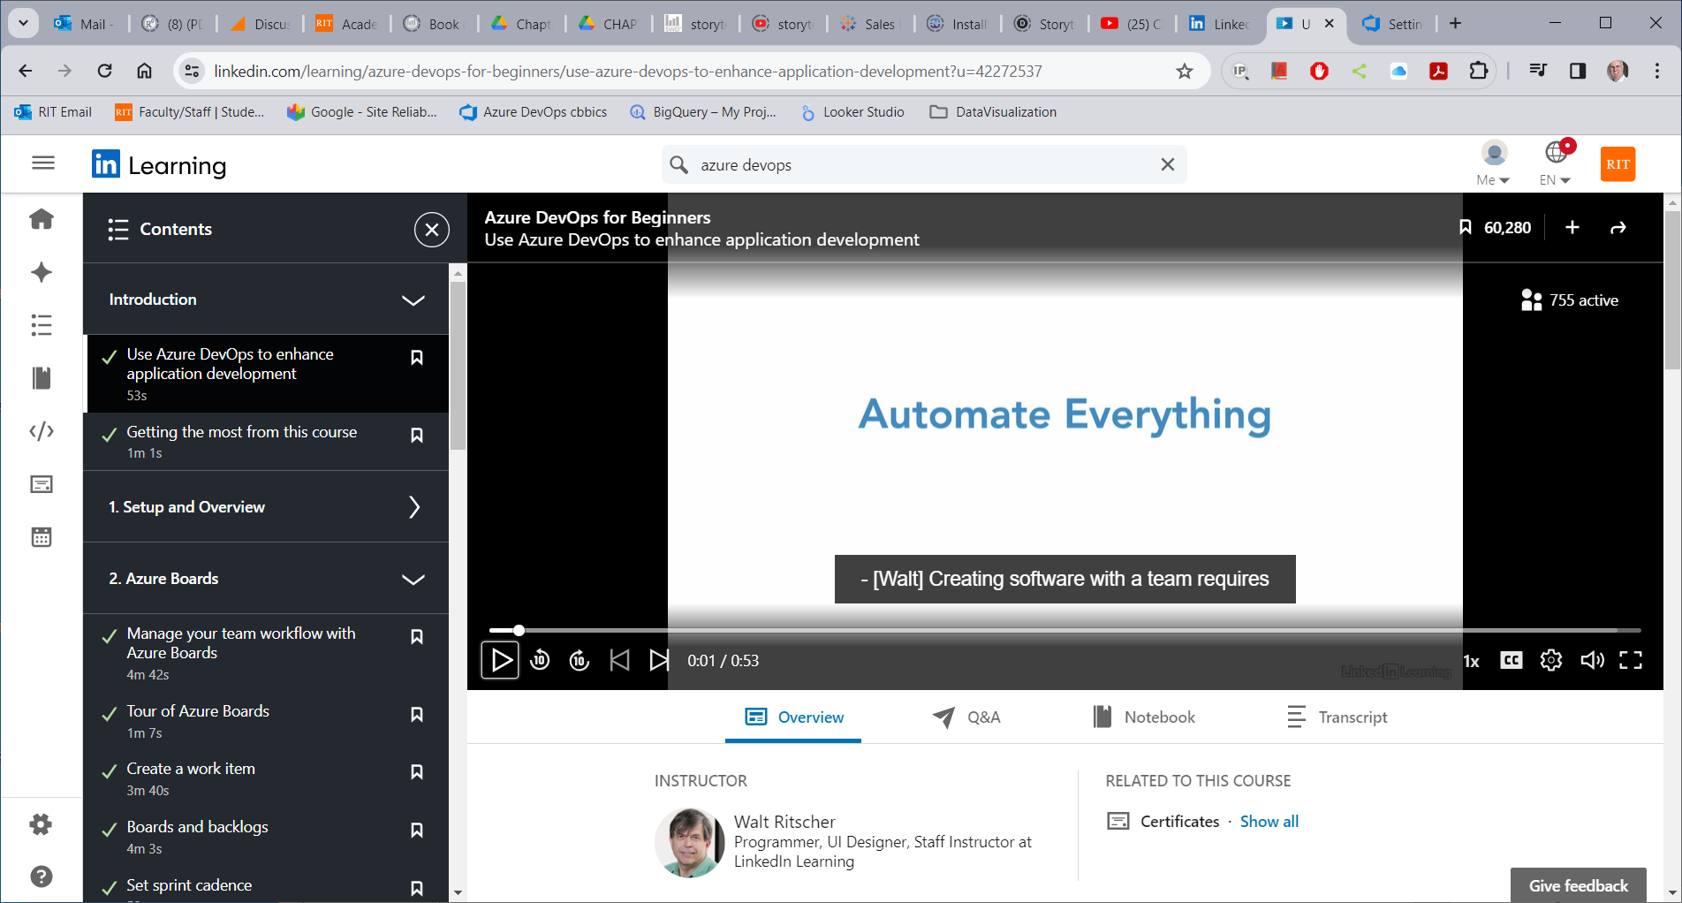
Learning to Work with Azure DevOps

Slide 13
Project Summary
Post to MyCourses by 3/28 and I will give feedback by 4/2
Introduction:
What you want to do and why you want to do this project
Lit Review:
How have other people addressed similar projects?
The following steps are linked together
Methodology:
How are you going to do what you plan to do?
A series of steps, at the end of each step something has changed. That changed something is a: Deliverables.
Deliverables:
Besides a project report, what else are you going to show me when you are done?
Each deliverable takes time to complete. These times together form your: project plan.
Project plan:
Meta-analysis of your project. Including timeline and what parts will be hard and what will be easy.
Gantt chart shows dependencies within deliverables.

Slide 14
Project Presentation
Recording Posted by 4/30
The project presentation should take about 20 minutes
Include:
Title page
Agenda
Introduction
Lit Review (has anyone done anything similar?)
Results (what happened?)
Future research

Slide 15
Data Visualization
Communicating with Data
Requirements
Domain knowledge
Well understood question
Access to data
Plan for your group
Understanding of the different charts and what they work best for
Access to technology

Slide 16
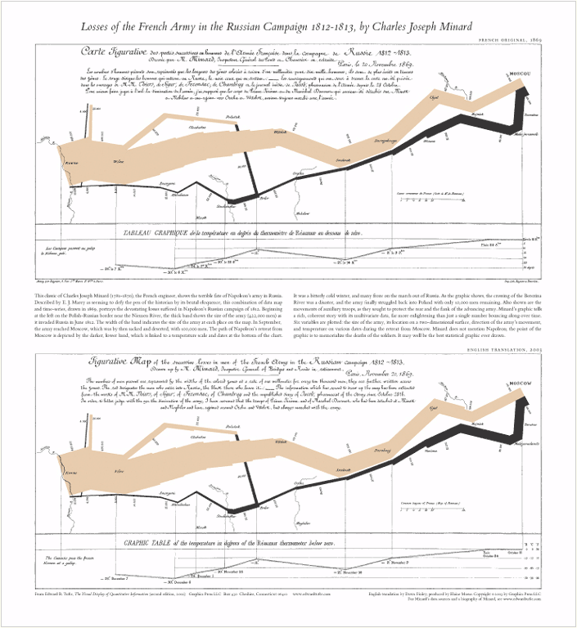
Classic Infographics by Charles Minard

Slide 17
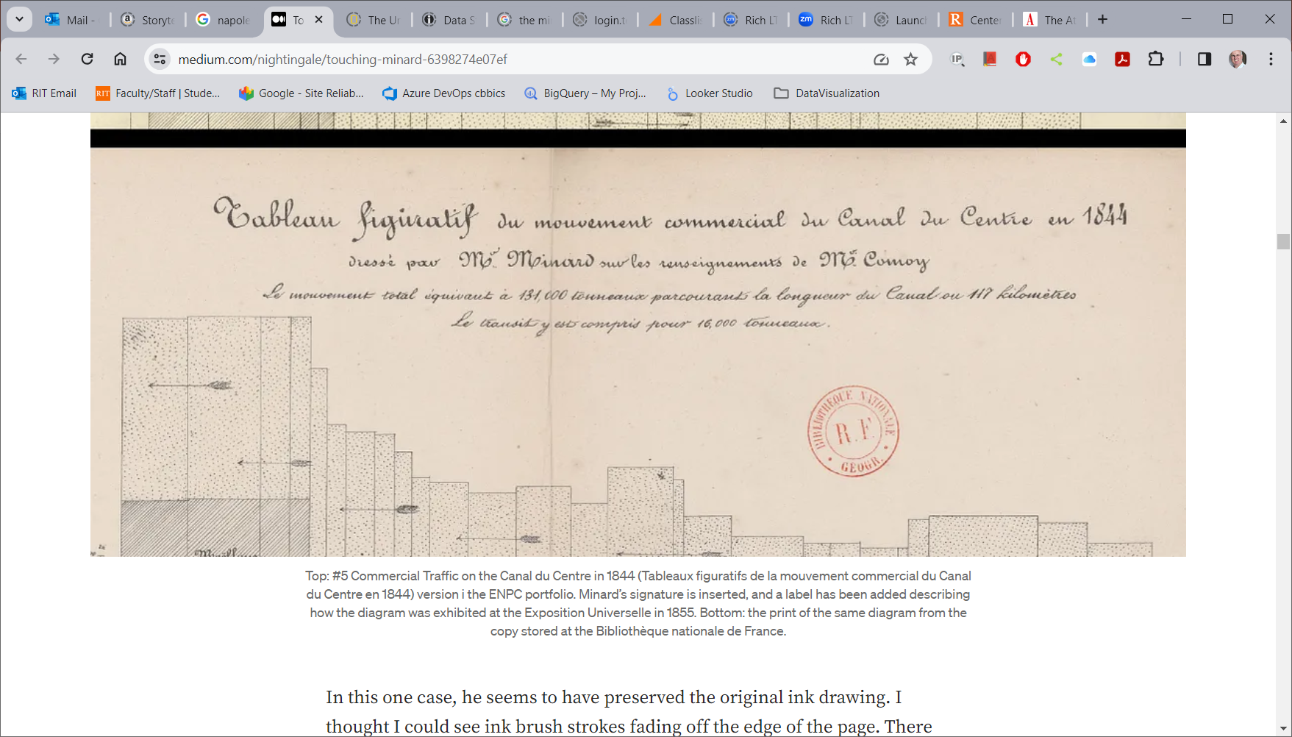
Classic Infographics

