Slide 1
Class Two
ISTE 782 Visual Analytics
2235 On-Line Charles Border, Ph.D.

Slide 2
Announcements
Office hours TuTh 12:30 to 2:00 via ZOOM, phone or in-person in GOL 2615.
Oracle Public Data Sets: https://opendata.oraclecloud.com/ords/r/opendata/opendata/home

Slide 3
Project Management for this Course
Fundamental idea: develop a plan now that can help you stay organized throughout the course
Course Deliverables: Three team labs and one team project
Get a process in place that works for your team
Divide each lab into a series of deliverables assigned to an individual
Each individual divide up their deliverables into sub deliverables
Maintain Azure DevOps throughout the course so all the team members know what is going on

Slide 4
Azure DevOps Semester Plan
Treat each course deliverable as an agile “Epic”
Each “Epic” can be divided up into “Backlog work items”
Work items can be written as “User Stories” or descriptions of outcomes from the perspective of a user
User stories can have “Acceptance Criteria”
Work items from the backlog can be organized into “sprints”
Shared files can be maintained in the “Repos” for all group members to access

Slide 5
Agile Epics
Projects are divided up into Epics, User Stories and Acceptance Criteria
An Epic is a grouping of one or more features or functionalities that we want to build.
Usually takes more than one sprint to build
Examples:
Team Lab One
Implement photo sharing in direct messages.

Slide 6
Epic Spec Sheets
Epic spec sheets are documents that contain all the requirements for building a product or completing a specific Team lab
Their purpose is to allow everyone in the team to read and understand what they have to build.

Slide 7
Epic Spec Sheet Outline
Introduction:
Summary of what the features you are building are for and why you are building them.
What metrics are you trying to improve
Documentation links
Marketing plans, legal requirements
Early wireframes
Product Requirements
What is required for the specific features you want to build
Design Requirements
Sketches, prototypes
Engineer Requirements
What must be done on the technical side.

Slide 8
User Stories
User stories are a way to describe a thing we’re going to build that delivers some type of functionality to the end user.
Example:
As a user I want to send pictures in a direct message to my friends so that I can share my favorite photos with them.
As an e-commerce marketing person I want to know which product lines are rising in popularity so that I can alert our manufacturers to produce more inventory and avoid a stock outage.
Standard Format:
As an “X” I want to do “Y” so that I can “Z”.
Project managers are responsible for the “what” and the “why” and the engineers and designers are responsible for the “how”.
User stories are written on tickets in the project management tool
Acceptance criteria are a set of conditions that the software must satisfy to be considered complete.

Slide 9
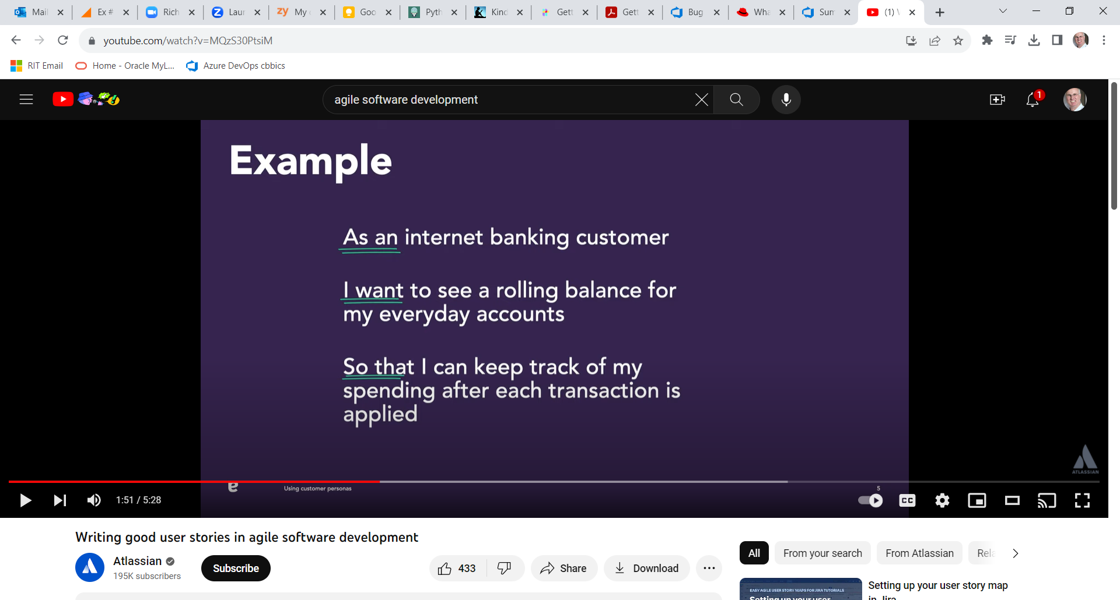
Example: https://www.youtube.com/watch?v=MQzS30PtsiM

Slide 10
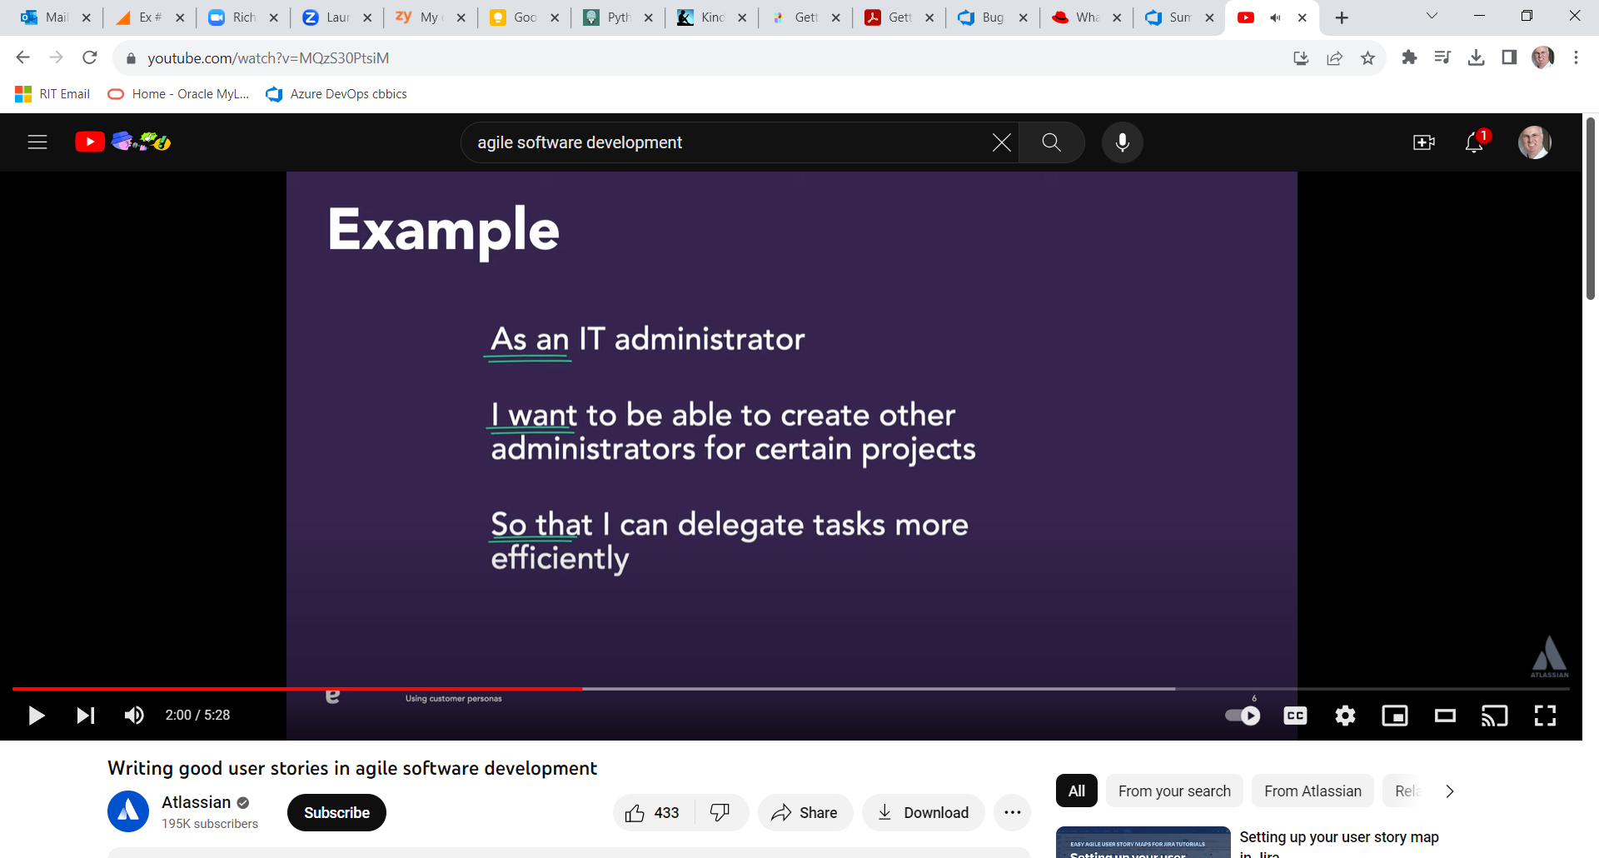
Another Example

Slide 11
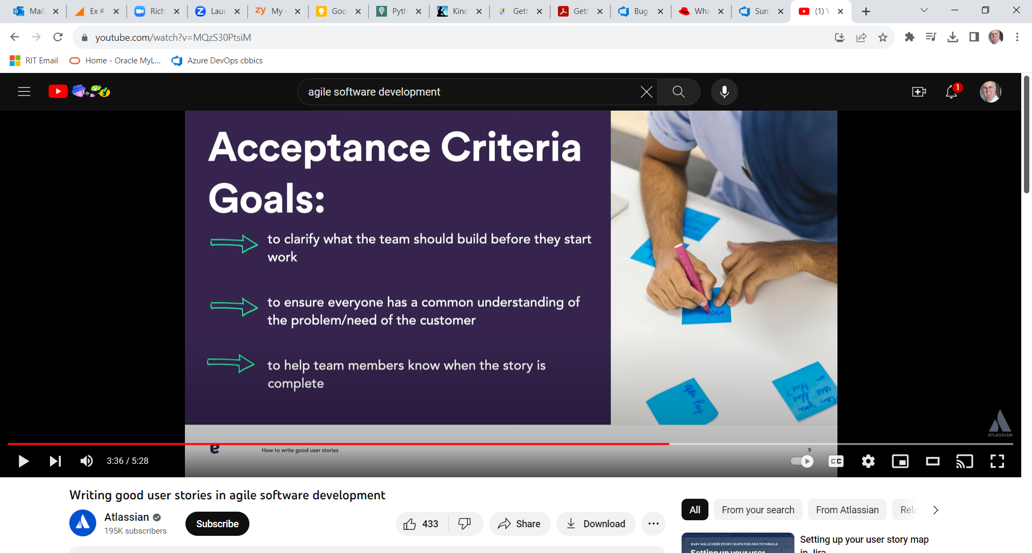
Acceptance Criteria

Slide 12
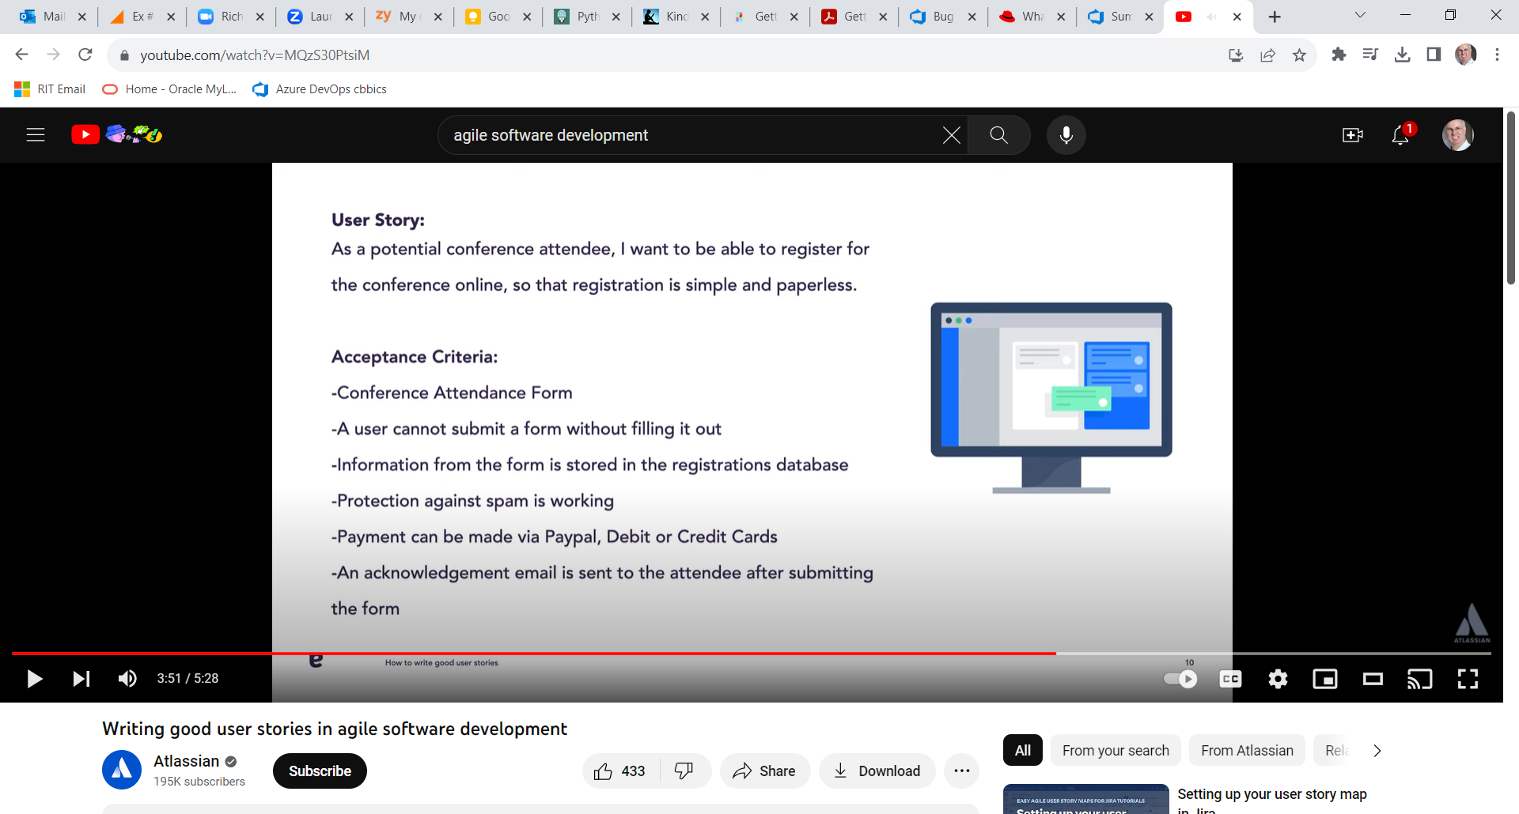
User Story and Acceptance Criteria

Slide 13
Acceptance Criteria
What does a component need to do so that you can declare the user story satisfied.
Given I am a user and I click the “add picture” button in the direct message, I am presented with a popup window to choose the file I can upload, submit it with the upload button and see a preview of the uploaded image.
Given I am a user who has successfully uploaded a photo from my computer, when I click send, the image is sent to my friend through the direct message and it appears in the chat.

Slide 14
Story Points
Measuring the difficulty of a task by using a rating system that everybody in the company understands
Velocity: the number of story points we were able to accomplish in a two week sprint.

Slide 15
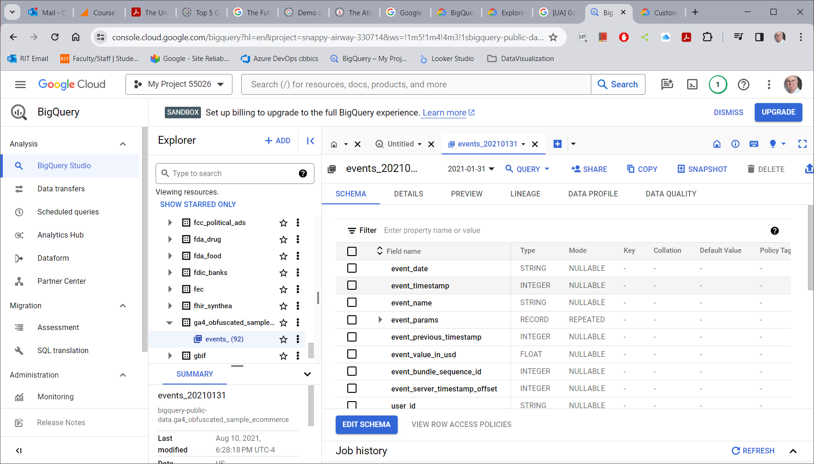
E-Commerce Analytics Data
https://support.google.com/analytics/answer/7586738?hl=en#zippy=%2Cin-this-article

Slide 16
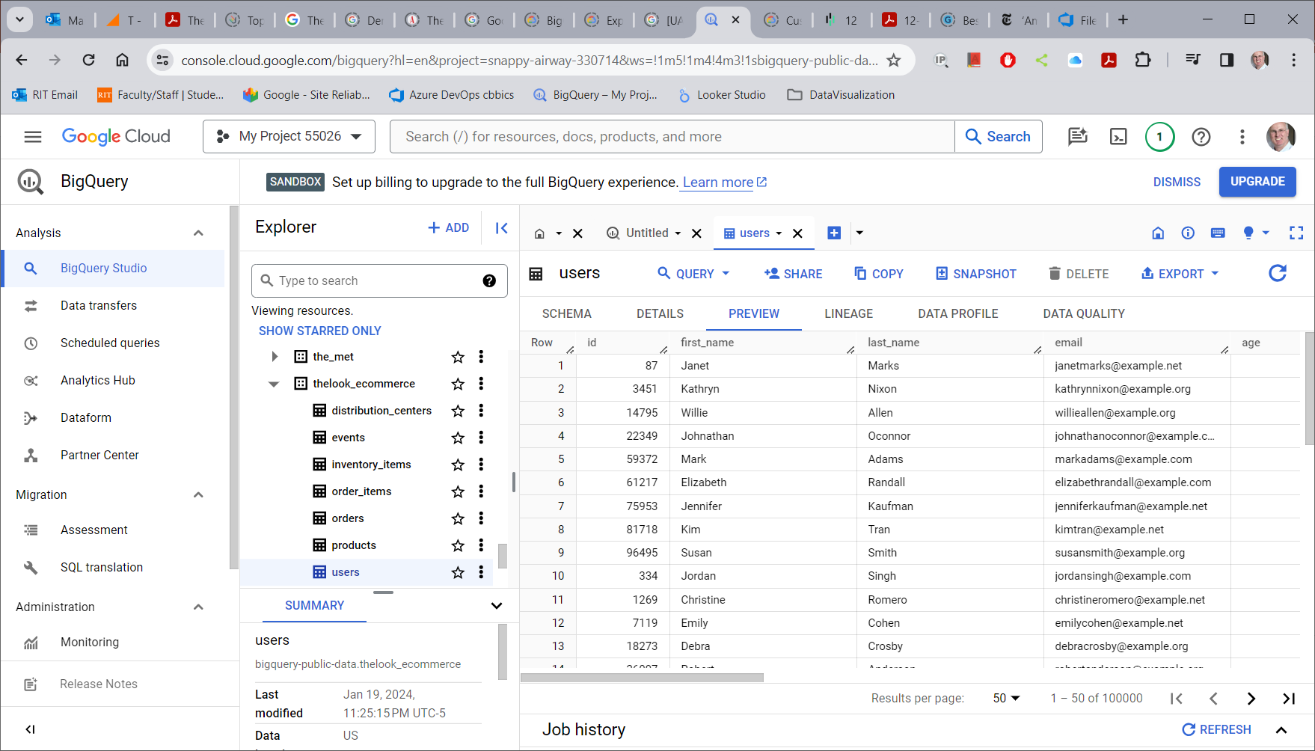
E-Commerce Transactional Database

