Slide 1
Week Four
ISTE 782 Visual Analytics
2235 Charles Border, Ph.D.

Slide 2
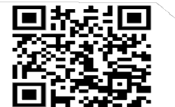


How Data Can Save Family Farms Monday, February 5 | 11am-12pm Speaker: Jamie Sonneville, Agri-Trak
Zoom Registration: http://tinyurl.com/ZoomLoveData24
LOVE DATA
2024
The Intersection of Data and Photojournalism
Tuesday, February 6 | 11:30am-12:30pm Speakers: Jenn Poggi, CAD; Josh Meltzer, CAD
Wallace Library, 05-2410
Learning to Program By Transforming Data into Information Visualization
Tuesday, February 13 | 11am-12pm Speaker: W. Michelle Harris, GCCIS
Wallace Library, 05-2410
Bee my Valentine: Data Visualization in Tableau Workshop
Wednesday, February 14 | 1pm-2pm Speaker: Rebekah Walker, RIT Libraries
Wallace Library, 05-2410
Citizen Archivists: Empowering Student-Run Organizations to Preserve their History Thursday, February 15 | 5pm-6pm
Speakers: RIT Archives Staff
Wallace Library, RIT Archives Research Center (05-3650)
February 05-15, 2024
To register for one or more events: http://tinyurl.com/RITlovedata24
For interpreting services, please request at: myaccess.rit.edu

Slide 3
Announcements
Office hours TuTh 12:30 to 2:00 via ZOOM, phone or in-person in GOL 2615.
Next project Chicago Crime Data
What are the big challenges with preventing crime?
What are the trends in analyzing crime data?
What can you learn about the Chicago Crime Dataset in BigQuery?
What should the project manager for the Chicago Crime Data project be working on now?

Slide 4
Team Lab 2 Ecommerce
You work for Google in a region/country of your choice. Google is reviewing the server load generated by the Google Merchandise store in your region/country. They would like to compare the workload generated in your region/country with a region/country that has a similar workload so that they can compare the workload generated by the Merchandise store in the two regions/countries. We do not have access to information related to server performance, but your job is to create a dashboard that can be used to compare the workload generated in one region/country with another region/country over a one year period of your choice.
Some of the metric you might want to include relate to pageviews, number of transactions, as well as total revenue generated. You are not so much interested in what people buy, as the number of pages they view prior to purchase and the volume of individual purchases.
You may want to research regions/countries that are more comparable. You are looking for two that have similar characteristics that lead you to think they would have a similar impact on Googles servers. You can work with as small or as large a region/country as you like, they just need to be comparable in terms of the workload they put on the servers that provide the Google Merchandise store.
Use your creativity to big into this question. You should have at least six different graphic elements in your dashboard. Color matters, creativity matters, layout matters, technical accuracy matters.

Slide 5

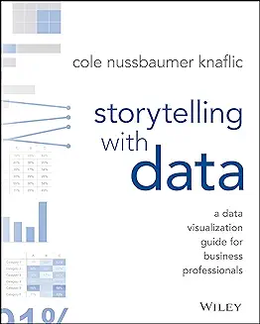
Your Text

Slide 6
Key Steps to Weave a Good Story from Data
Understand the context
Choose an appropriate display
Eliminate clutter
Draw attention where you want it
Think like a designer
Tell a story

Slide 7
Understand the Context
Questions to ask to ground the context of our explanatory work
To whom are we communicating ?
What do we want the audience to know or do?
How can we make use of the data to make the point?

Slide 8
Digging for Context
Building your understanding of the context for your work.
Questions that can aid us are:
What background information is relevant or essential?
Who is the decision maker? What do we know about them?
What biases does our audience have that might make them supportive of or resistant to our message?
What data is available that would strengthen our case? Is our audience familiar with this data, or is it new?
What would a successful outcome look like?

Slide 9
Communications Aids that Might Help
3-minute story — a very concise story that contains all the important messages.
Big idea— Conveys the most important insight in a sentence. Story Boarding — visually arranging the information in a sequence you would want to present to an audience. Use a low tech approach like writing down ideas in a piece of paper rather than getting too much attached to a presentation software.

Slide 10
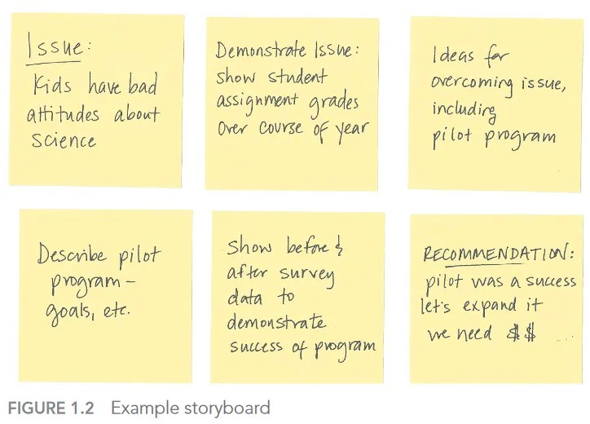
Story Board

