Slide 1

Netflix Dataset Analysis: Content Trends for Strategic Recommendations
Remudala Srujana Yadav
Apply ID: APPLY_1755065973689c2e75a8e2a

Slide 2

PROBLEM STATEMENT
Netflix has become one of the most prominent global streaming platforms, continuously expanding its library with a mix of original productions and licensed content. However, with growing competition from platforms like Amazon Prime, Disney+, and regional OTT providers, Netflix must strategically analyze its content catalog to identify strengths, gaps, and opportunities.
The specific problem to be addressed in this project is 'Content Trends Analysis for Strategic Recommendations'. The aim is to uncover how Netflix’s content distribution (Movies vs. TV Shows, genres, and country contributions) has evolved over the years. This will enable the identification of key genres, audience preferences, and strategic insights into global content expansion.

Slide 3
Project Description
This project focuses on analyzing Netflix’s dataset to uncover key patterns and trends in its content library. With streaming competition on the rise, understanding what types of content attract and retain viewers is crucial for strategic growth. By examining factors such as genre distribution, release year patterns, regional availability, and content type (movies vs. TV shows), the project provides actionable insights into audience preferences and platform strategy. The analysis highlights emerging trends, identifies gaps in content categories, and explores correlations between attributes like release timing and popularity. These findings can be leveraged by Netflix to optimize content acquisition, production, and recommendation strategies, ultimately strengthening its competitive advantage in the global streaming market.

Slide 4

WHO ARE THE END USERS?
Content Strategists & Business Analysts – to identify what type of content (genre, region, release year) performs best and guide strategic decisions.
Marketing Teams – to understand audience preferences and design targeted campaigns.
Recommendation System Developers – to improve personalization algorithms using insights from content patterns.
Content Creators & Producers – to align future productions with trending genres and viewer demand.
Investors & Stakeholders – to evaluate Netflix’s growth strategies and potential investment directions.
Researchers & Students – who want to study data-driven insights in media, entertainment, and consumer behavior.

Slide 5

Technology Used
Python-Core programming language
Pandas & NumPy-Data cleaning and preprocessing
Scikit-learn-Machine learning (model training, regression, evaluation)
Matplotlib/Seaborn-Data visualization and feature importance
Google Colab-Cloud-based environment for running the project
File handling libraries- openpyxi (for Excel) and built-in CSV handling

Slide 6
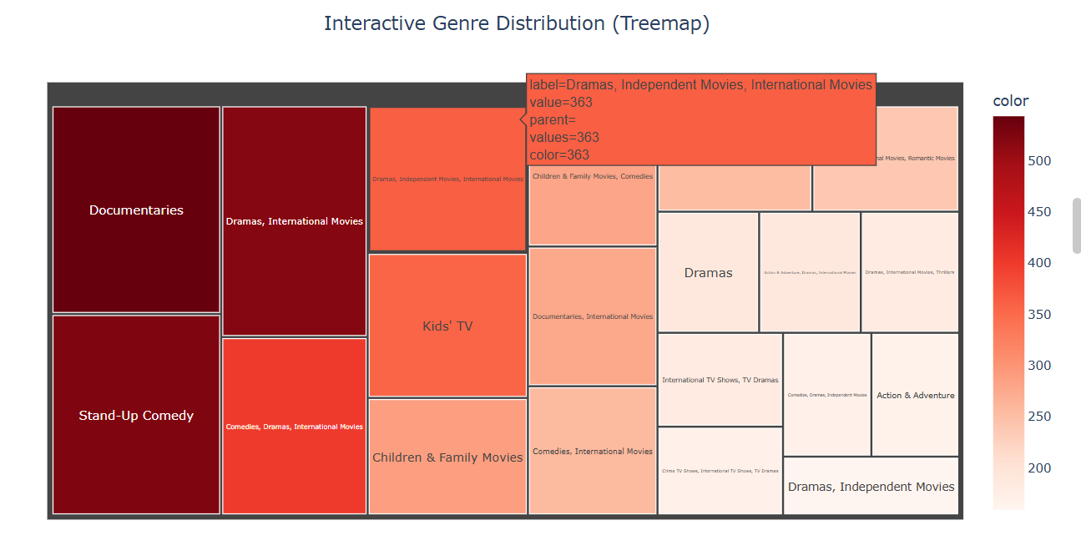
RESULTS1

Slide 7
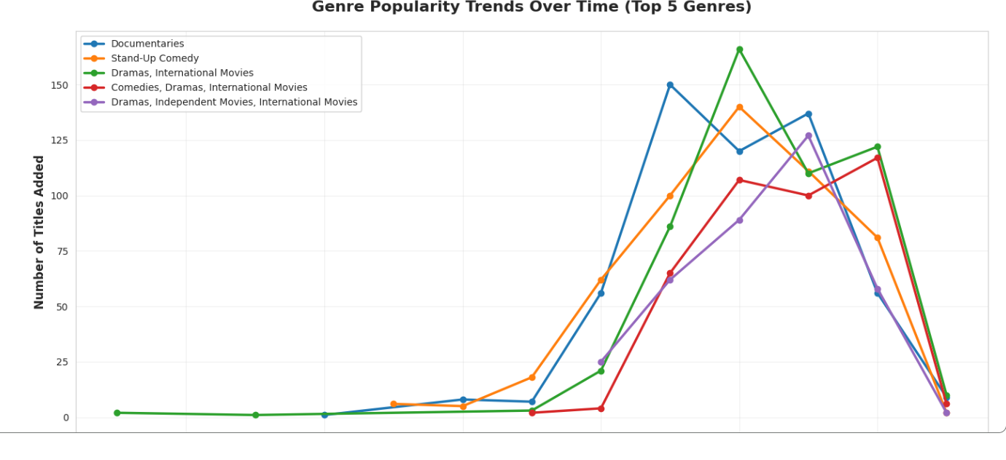
RESULTS2

Slide 8
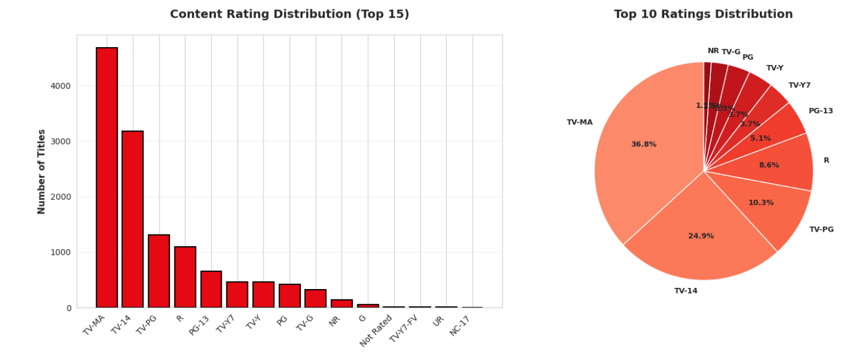
RESULTS3

Slide 9
GitHub repository
https://github.com/Srujana-379/VOIS_AICTE_Oct2025_MajorProject_Srujana-.git

Slide 10
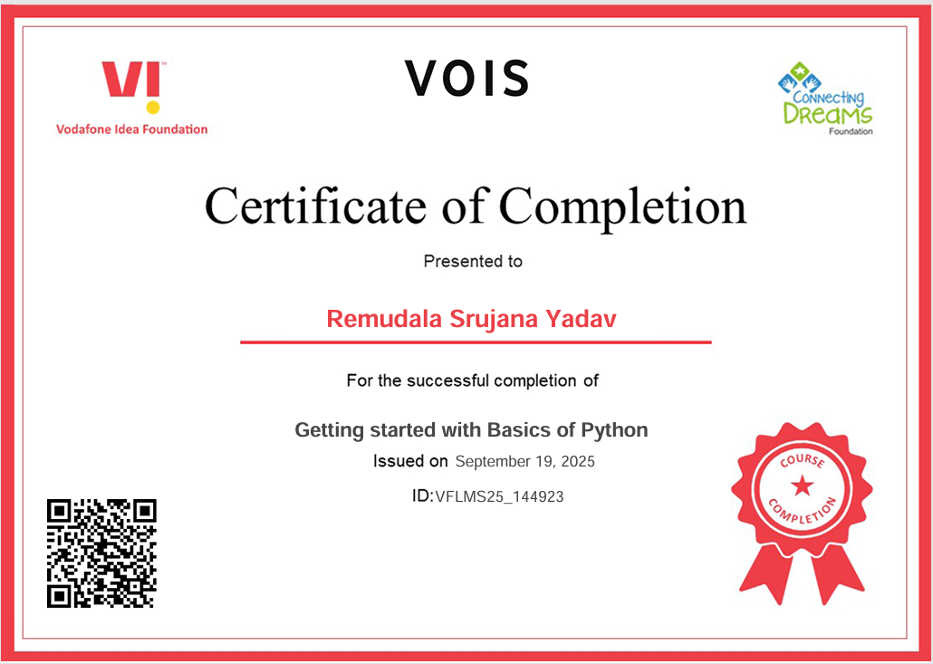
Getting started with Basics of Python Certificate

Slide 11

Data Visualization Certificate

Slide 12
Thank you
.
.

