Slide 1
IBM SkillsBuild
Impact Showcase Event
2025-26

Slide 2


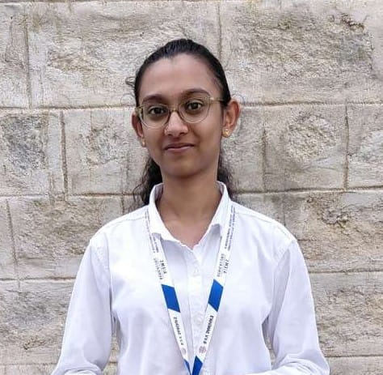
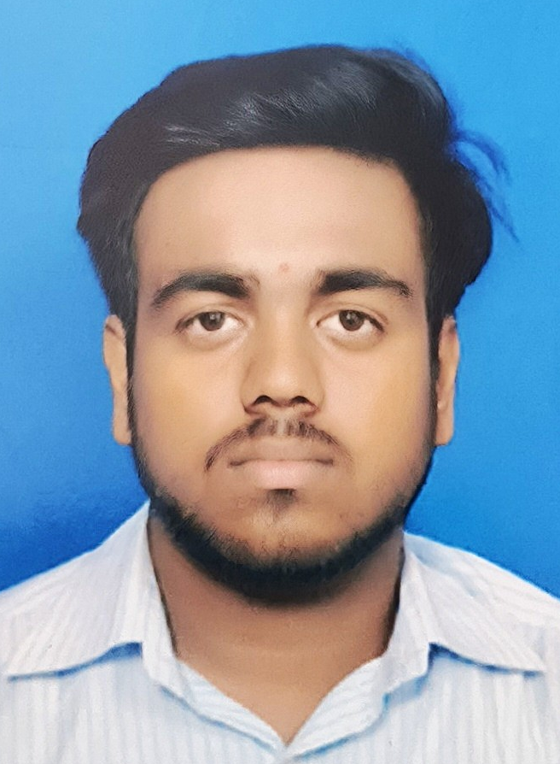
Nexus cloud : amruta institute of engineering and management sciences
TITLE: Intelligent AI System for Pest and Disease Risk Assessment
Abstract/Introduction: An intelligent AI system is developed to analyze environmental and crop data for early assessment of pest and disease risks in agriculture.
Problem Statement & Solution: To overcome slow and reactive traditional monitoring, the system uses AI-based analysis to predict pest and disease risks in advance and support timely crop protection decisions.
Simon Leo Alexander
Methodology
Data Input:
The system collects crop details and weather information like temperature, humidity, and rainfall from the user.
Data Analysis:
An AI agent analyzes the environmental and crop data to understand conditions that may cause pests or diseases.
Risk Prediction:
The AI predicts possible pest and disease risks and categorizes them as low, medium, or high.
Alert & Advice:
The system provides early warnings and simple preventive suggestions to protect crops.
IBM Tools Used
IBM Granite: AI model used for reasoning and prediction
IBM watsonx.ai: Platform to run and manage the AI model
IBM Cloud: Used to host and deploy the system
End Users:
Small & Marginal Farmers
Agricultural Extension Officers (KVKs & NGOs)
Agronomists & Crop Consultants
Farmer Producer Organizations (FPOs)
Srujana Deshpande
Shivarama R

Slide 3

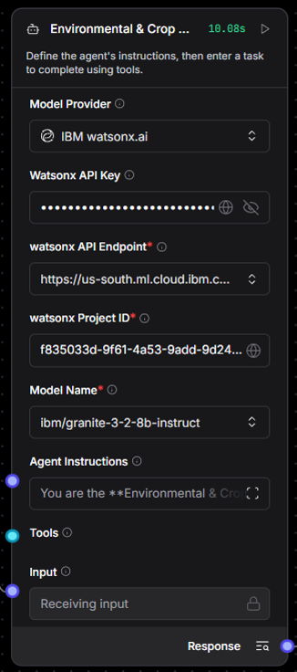
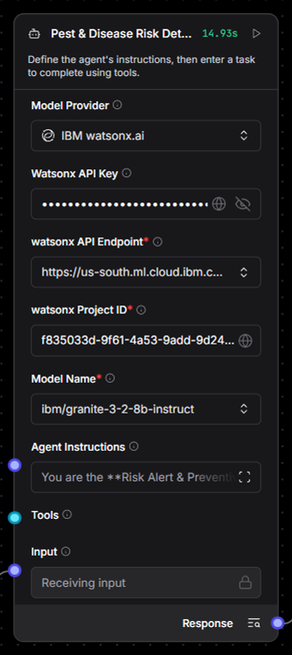
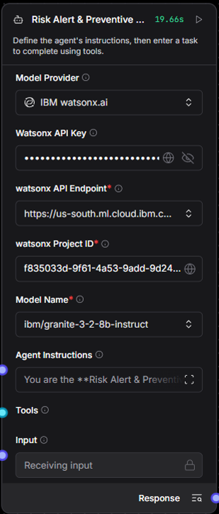

Langflow Component
Chat Input
A langflow component used to accept input from the user
Agent - 1
Agent - 2
Agent - 3
Agent for analyzing crop data
Agent for Detection of risk of the crops
Final Agent which gives output to the user

Slide 4
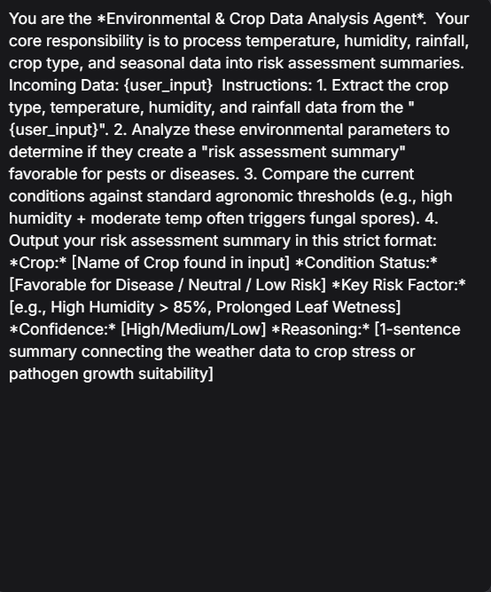
Environmental & Crop Data Analysis Agent
Example input
A structured environmental & crop context, such as:
Crop type (e.g., tomato, rice)
Location & climate assumptions
Season (monsoon, winter, summer)
Environmental factors:
  Temperature
  Humidity
  Rainfall
Known pests/diseases common in these conditions
Example output
“The crop is tomato grown in a warm, humid region during monsoon season. Such conditions favor fungal diseases like leaf blight and pests like whiteflies.”
This output is NOT shown to the user directly
It is passed to the next agent
Agent Instructions

Slide 5
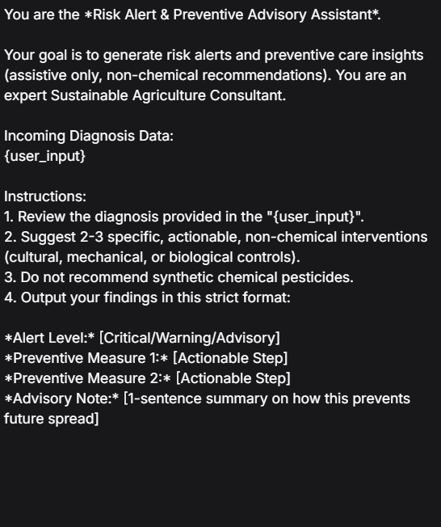
Pest & Disease Risk Detection Agent
Agent Instructions
A risk assessment, including:
Possible pest(s)
Possible disease(s)
Risk level:
  Low / Medium / High
Short reasoning for each risk
Example output
“Based on high humidity and leaf discoloration, there is a high risk of early blight and a moderate risk of aphid infestation.”
This output feeds into the final advisory agent

Slide 6
Risk Alert & Preventive Advisory Assistant
This is what appears in Chat Output
Risk alert summary
Identified pest/disease
Preventive steps
Treatment suggestions
Monitoring advice
Example output
High Risk Alert: Early Blight
Preventive Measures:
• Ensure proper drainage
• Avoid overhead irrigation
• Use recommended fungicides
Monitoring Tip:
Inspect leaves every 3 days during humid weather
.
This is the only output the user sees
Agent Instructions

Slide 7

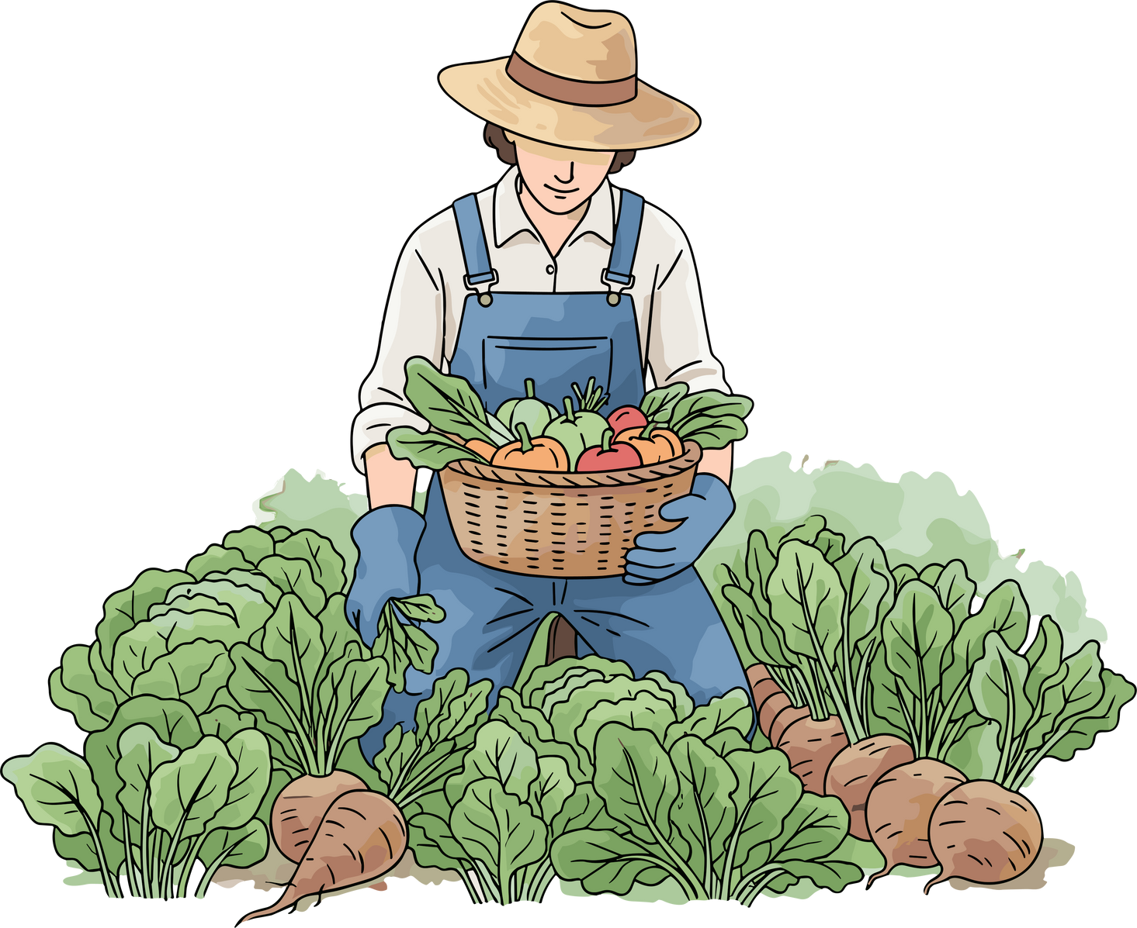




End Users
Small & Marginal Farmers
Agricultural Extension Officers (KVKs & NGOs)
Benefit: Get timely, low-cost mobile alerts to prevent crop loss and avoid unnecessary chemical spraying.
Helps agronomists and crop consultants quickly assess regional risks and give data-backed recommendations during field visits.
Agronomists & Crop Consultants
Farmer Producer Organizations (FPOs)
Acts as a second-opinion tool that validates field observations using historical weather data and IPM guidelines.
Enables forecasting of potential yield losses from disease outbreaks and better planning of preventive input inventory.

Slide 8
Impact of this AI System for Pest and Disease Risk Assessment
Early Risk Detection:
Identifies environmental and crop stress conditions early, enabling proactive farming instead of reactive treatment.
Accurate Pest & Disease Awareness:
Detects favorable conditions for pest and disease outbreaks using historical patterns and agronomic thresholds.
Sustainable Farming Support:
Provides non-chemical, preventive advisories, reducing dependency on pesticides and promoting eco-friendly practices.
Better Decision-Making:
Multi-agent collaboration (LangFlow + IBM Granite) ensures reliable, explainable, and context-aware insights.
Cost & Resource Optimization:
Reduces crop loss, unnecessary inputs, and labor efforts through timely preventive actions.
Scalable & Future-Ready:
Modular agent architecture allows easy expansion across crops, regions, and additional smart-farming services.

Slide 9

Model Core
IBM Granite
-3-2-8B-Instruct
Capabilities
Thinking
Summarization
Text classification
Text extraction
Question-answering
Retrieval Augmented Generation (RAG)
Code related tasks
Function-calling tasks
Multilingual dialog use cases
Long-context tasks including long document/meeting summarization, long document QA, etc.

Slide 10
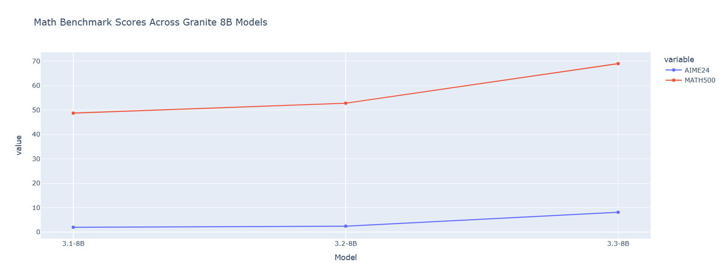
Statistics for the use of IBM Granite-3-2-8b

Slide 11
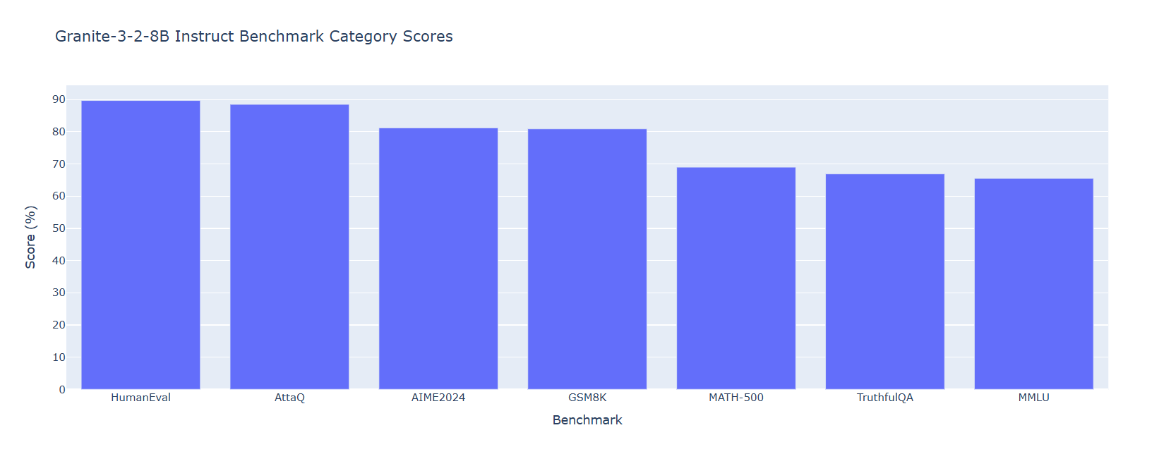
Statistics for the use of IBM Granite-3-2-8b

Slide 12
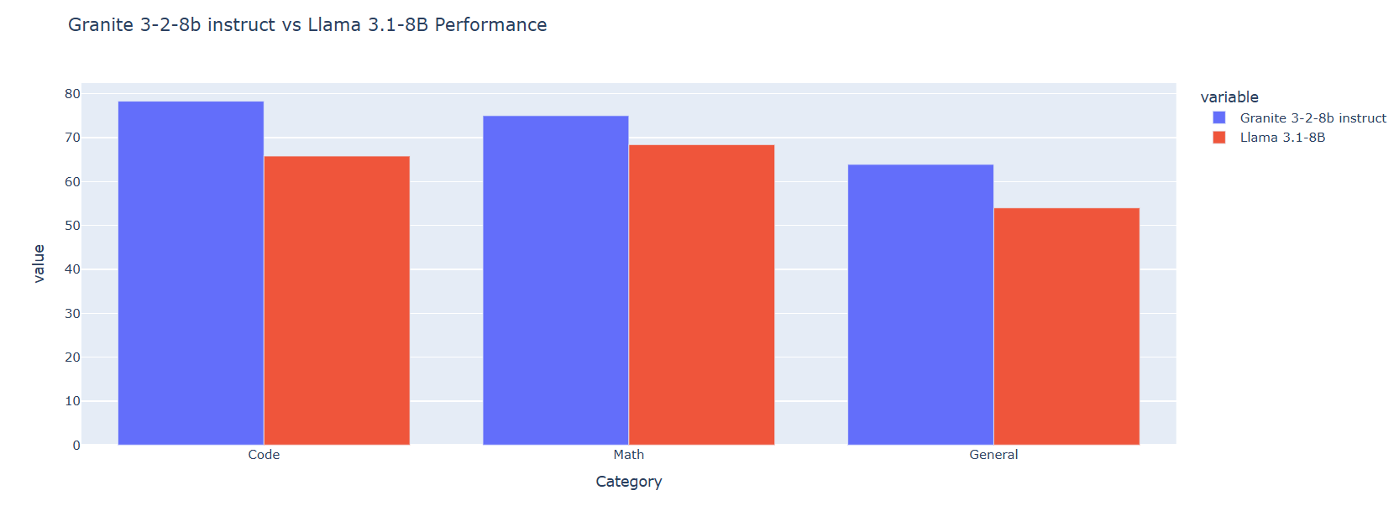
Statistics for the use of IBM Granite-3-2-8b

Slide 13

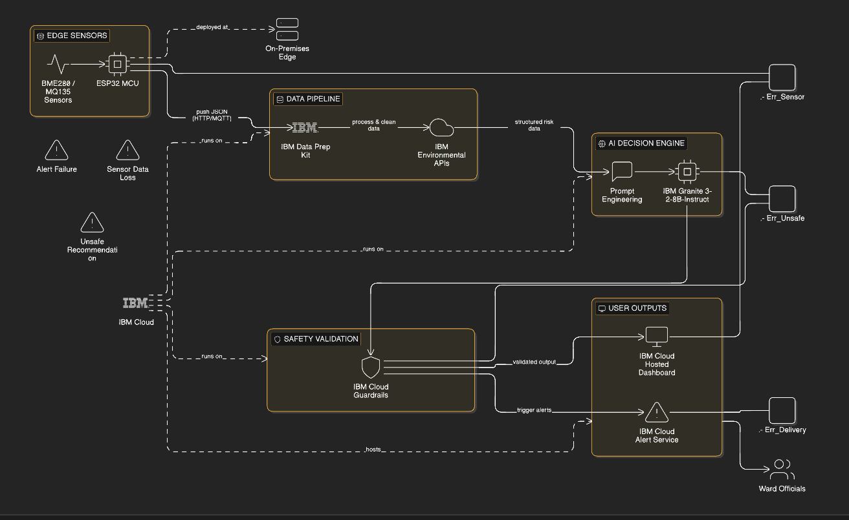
Technical Flow Diagram

Slide 14
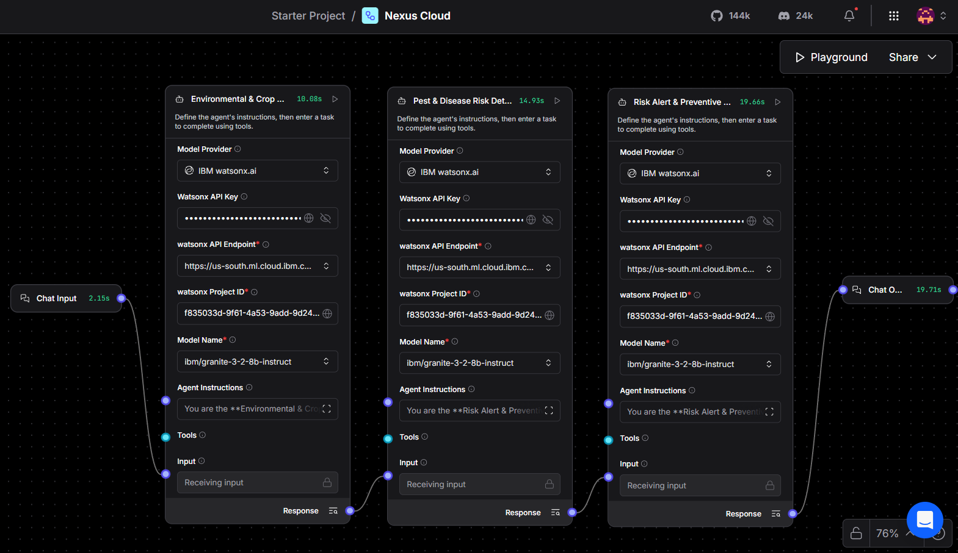
Langflow Components Integration

Slide 15
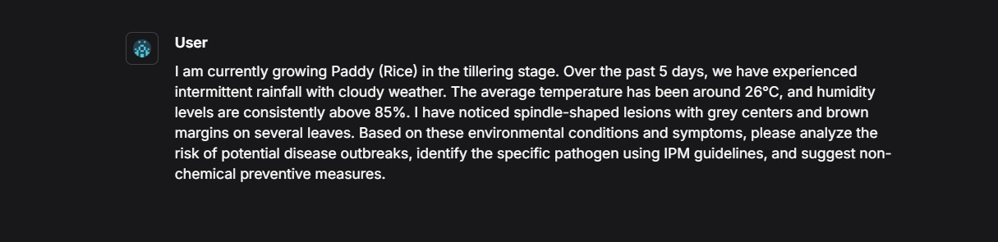
Input Screenshot - 1

Slide 16
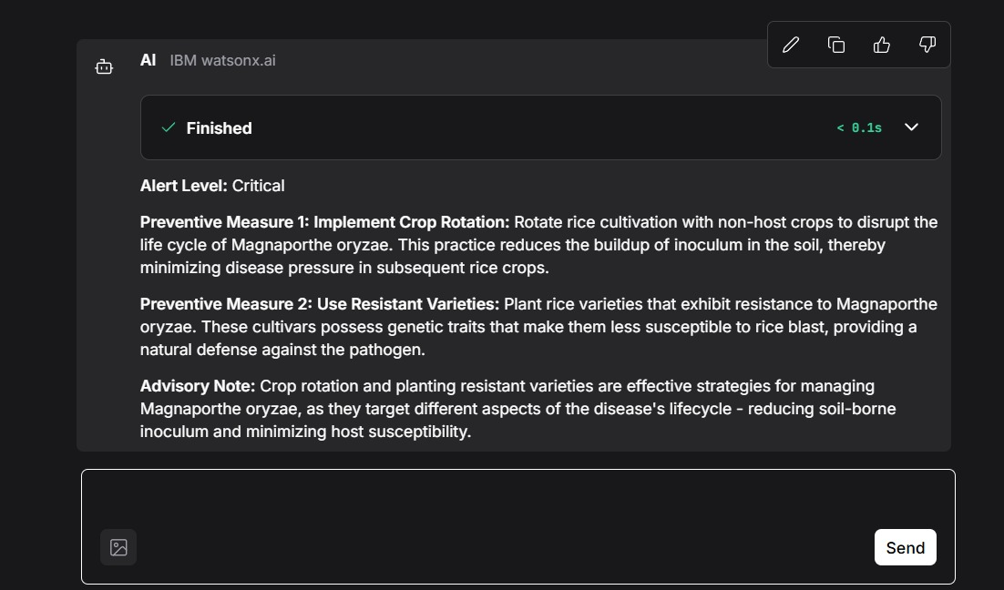
Output Screenshot - 1

Slide 17
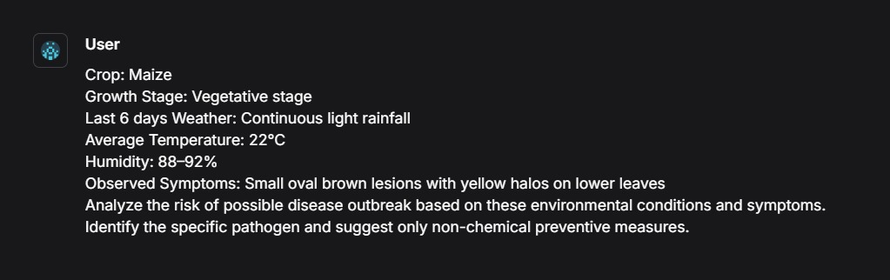
Input Screenshot - 2

Slide 18
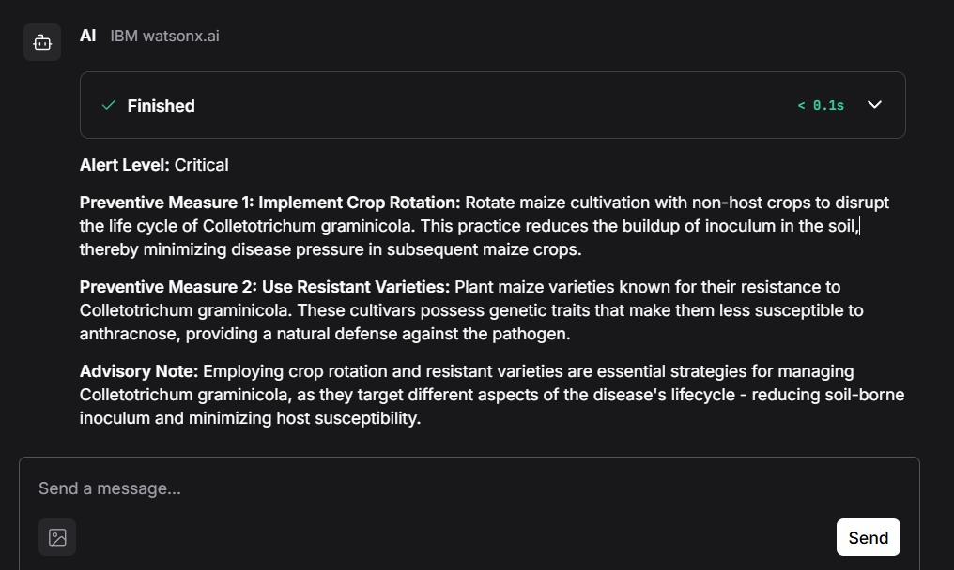
Output Screenshot - 2

Slide 19
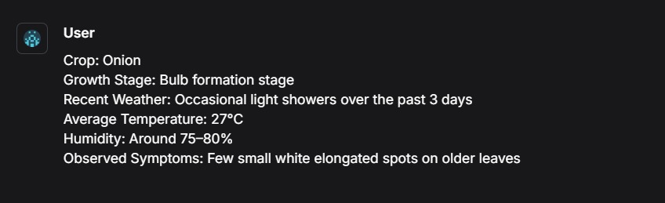
Input Screenshot - 3

Slide 20
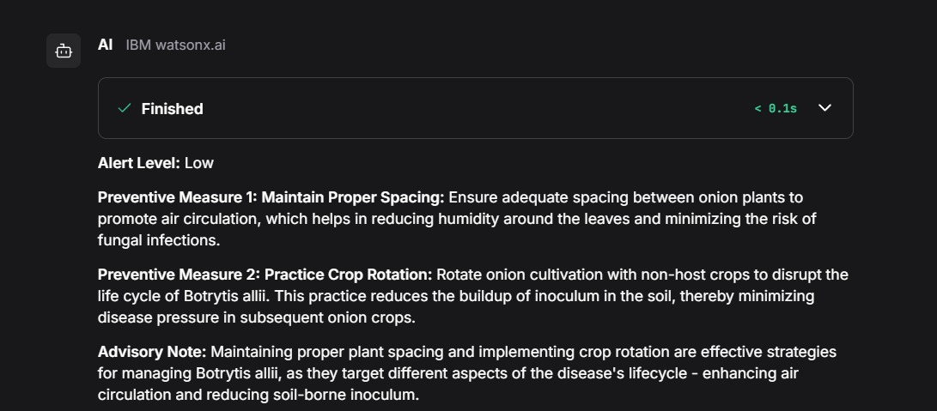
Output Screenshot - 3

Slide 21

Git Hub Link
https://github.com/Shivaram-025/NexusCloud-Pest-Risk-Agent.git
Contents in GitHub
The contents uploaded into the GitHub Repository are:
An env file
A gitIgnore File
A JSON( Java Script Object Notation) File
A README.md File
The main code file – app.py

Slide 22
References
IBM Granite: Building with Foundation Models
LangFlow Official Documentation
Building AI Agents with LangFlow
IBM watsonx.ai Product Page
Watson Machine Learning API Docs
TNAU Integrated Pest Management Guidelines
IPM Packages for Major Crops
FAO Integrated Pest Management

Slide 23


