Slide 1
A16
Police FIR Narrative
Translator & Simplifier
Making legal documents accessible to every citizen
Team A16
Guide
Srujana Pagi
Sinchana V M
Prasad Morab
Shreeniketh Joshi
111 · 01FE23BCS058
113 · 01FE23BCS067
118 · 01FE23BCS094
136 · 01FE23BCS376
Dr. Guruprasad Konnurmath

Slide 2

The Problem
The Challenge
FIR documents filed by police are filled with dense legal terminology — IPC/BNS section numbers, formal legal language, and procedural jargon. Ordinary complainants and accused persons cannot understand what these documents actually say or what rights they have.
Legal jargon
No discrepancy check
Language barrier
IPC/BNS sections are incomprehensible to the average citizen without a law degree
Differences between police narrative and complainant statement go undetected
Documents in English are inaccessible to Hindi and Kannada speaking citizens

Slide 3



Our Solution
An end-to-end AI pipeline that transforms complex FIR documents into plain, multilingual, legally explained reports — accessible to every citizen.
FIR ingestion & parsing
Plain-language explanation
IPC/BNS section lookup
PDF, image, raw text
Per section, citizen-readable
Definition + punishment + bail
Discrepancy detection
Dual-language output
Police vs. complainant facts
English + Hindi / Kannada

Slide 4
System Architecture
Input
Ingestion
Agents
RAG Engine
Output
FIR file
Language
OCR
Docling
Extract
Simplify
Discrep.
FAISS
BNS DB
LLM
Dashboard
Translation
Shared knowledge base: IPC/BNS Database · NCRB Dataset · ILDC 35k+ SC Judgments · IndicCorp FIR Text
Orchestrated by LangChain multi-agent framework

Slide 5
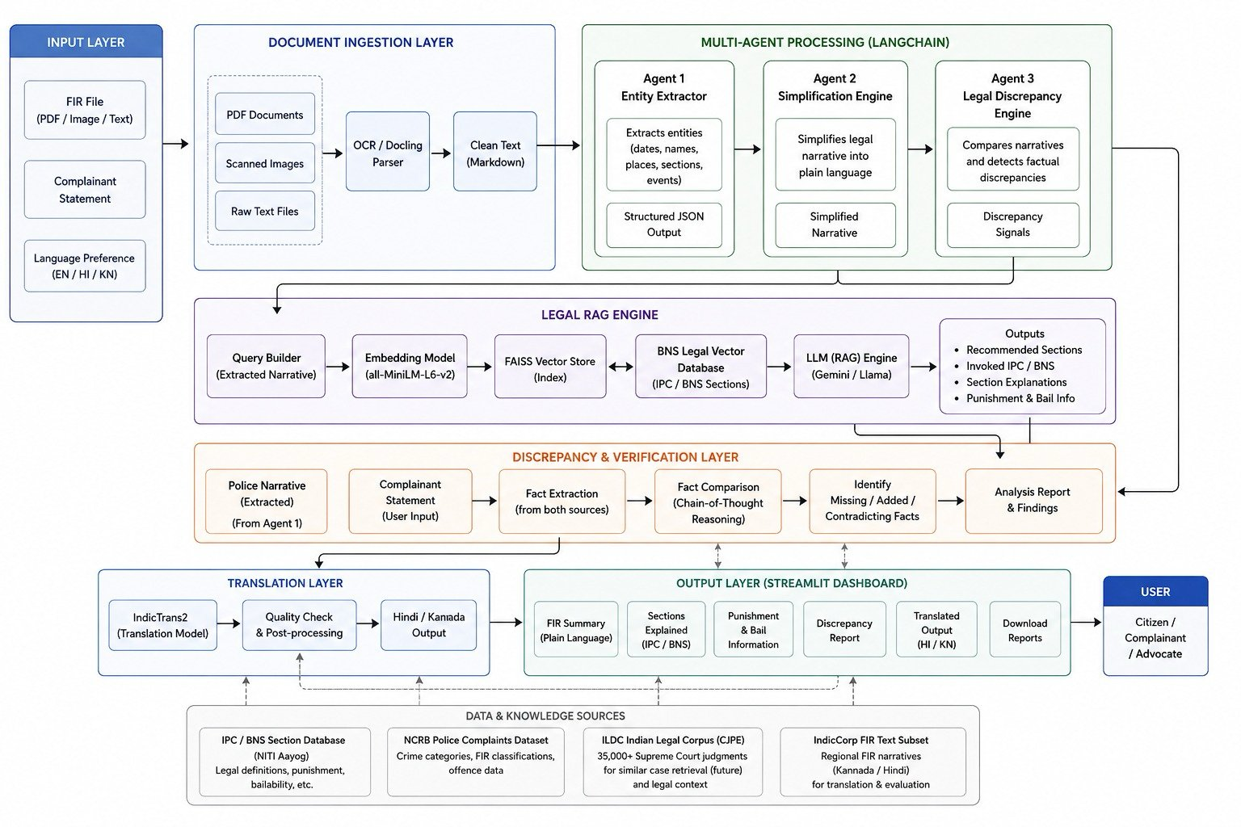
Detailed Architecture Diagram

Slide 6
Tech Stack
Frontend
AI Orchestration
LLM Inference
Streamlit (dashboard)
Python
LangChain
LangGraph (multi-agent)
Gemini 1.5 Flash
Llama 3 via Ollama
OCR & Parsing
RAG & Embeddings
Translation
Docling
Tesseract OCR
PyMuPDF / PyPDF2
all-MiniLM-L6-v2
FAISS vector store
sentence-transformers
IndicTrans2 (ai4bharat)
Hindi + Kannada

Slide 7

Dataset Used
Bharatiya Nyaya Sanhita (BNS) Dataset
The BNS dataset is the legal knowledge base of our system, containing official section data used to build a FAISS-based RAG system.
Legal Knowledge Base
Dataset Contents
BNS Section Numbers · Offence Names · Legal Definitions · Description of Sections · Punishment Information
5 structured fields per section
FAISS Vector Database
BNS sections are converted into embeddings and stored in a vector database for fast semantic retrieval during FIR processing.
RAG-based retrieval system
How It Works
Whenever an FIR is uploaded, the system retrieves the most relevant BNS sections and provides accurate legal explanations based on official legal data.
FIR upload triggers retrieval

Slide 8

Expected Output
1. Simplified FIR Summary
Streamlit Dashboard
Converts complex legal language into plain language understandable by common citizens. Example: “The accused is alleged to have stolen a motorcycle.”
Simplified FIR Summary
BNS Section ID & Explanation
2. BNS Section Identification & Explanation
Punishment Information
Discrepancy Report
Identifies applicable BNS sections (e.g. Section 303) and provides a plain-language explanation. Example: “This section deals with theft, taking another person’s property without permission.”
3. Punishment Info, Discrepancy & Multilingual Report
Hindi / Kannada Output
Download Reports
Displays punishment for each section. Flags factual differences between complainant statement and FIR narrative. Generates final report in English, Hindi, and Kannada.

Slide 9

Impact & Vision
35,000+
3
6
SC judgments in training corpus
languages supported (EN / HI / KN)
dashboard output panels
Who benefits?
Complainants who filed an FIR and cannot parse the legal document
Accused persons who need to understand the charges against them
Advocates who need a quick structured summary before a hearing
Legal aid NGOs supporting underserved communities in rural India

