Slide 1


B.Tech Project Review | Simulation-based study
Soft Actor-Critic Based Semantic-Aware Power & Time Allocation from Hybrid NOMA & OFDMA
Base station
An AI agent that learns to share power and time between mobile users
Guide: Dr N Lava Prasad
Users sharing the same radio resources in pairs
B. Sri Srujana
2520040005
S. Tejitha
2520040008
M. Gnaneshwari
2520040020
Notes:
Good morning. Our project is 'Soft Actor-Critic based semantic-aware power and time allocation from hybrid NOMA and OFDMA'. In simple words: a mobile tower has limited power and time, and many users want data. We train an AI agent to decide how to share these resources smartly, giving more care to important users. This is a simulation-based B.Tech project. Our guide is Dr N Lava Prasad. Team: B. Sri Srujana (2520040005), S. Tejitha (2520040008) and M. Gnaneshwari (2520040020).

Slide 2



Problem Statement
Every user is different
Different distance, signal quality, data demand and importance (priority).
Our question
Can an AI agent learn to share power and time smartly and favour high-priority users?
Resources are limited
One tower has limited power, time and bandwidth to share among all users.
Near: strong signal
Fixed sharing is wasteful
Equal split ignores who needs more, so important users may wait longer.
Far: weak signal
Notes:
The problem: in a wireless network every user is different. Some are near the tower and have strong signal, some are far. Some have a lot of data to download and some carry very important traffic. But the tower has only limited power, time and bandwidth. If we simply split everything equally, we waste resources and important users may wait longer. So our question is: can an AI agent learn to share power and time smartly, giving priority to important users? Note: this is a simulation, we do not control any real network.

Slide 3





Key Terms in Simple Words
OFDMA
Users take turns using separate slices of the channel. No interference, but less sharing.
NOMA
Two users use the same slice at the same time with different power levels. Receiver separates them (called SIC).
Hybrid NOMA & OFDMA
Mix both: for each user pair, decide how much time uses NOMA and how much uses OFDMA.
Soft Actor-Critic (SAC)
An AI that learns by trial and reward. It keeps trying new options (exploration) so it does not get stuck.
Semantic-aware
Important data gets more care. Here, user priority (1 to 5) is used as a stand-in for importance.
Notes:
Let me explain the terms. OFDMA: users take turns, each gets a separate slice, so there is no interference. NOMA: two users share the same slice at the same time, but with different power levels; the receiver separates them using something called SIC. Hybrid means we use both and let the system decide the mix. SAC, Soft Actor-Critic, is a reinforcement learning method: the agent tries actions, gets a reward, and improves; the 'soft' part means it keeps exploring. Semantic-aware means important data gets more care. In our prototype we use the user priority from 1 to 5 as a proxy for importance; we have not built a real semantic encoder.

Slide 4


Proposed Methodology: SAC Learning Loop
1. State
2. SAC Agent
3. Action
4. Network
Channel, priority, demand, distance, power, slots of every user
Actor proposes; twin critics judge; memory replays past experience
Pair time share, user power, OFDMA split, NOMA time fraction
Simulated hybrid NOMA-OFDMA network serves the users
Agent learns from the reward and improves next time
5. Reward
Score for the allocation
Rewarded for: high weighted throughput, fairness, meeting priority targets
Penalised for: long delay (queue waiting time) and wasted power
Notes:
This is our proposed method. Step 1: the agent looks at the state, which has six numbers per user: channel quality, priority, remaining data demand, distance, available power and time slots. Step 2: the SAC agent decides. The actor proposes an allocation, two critics judge how good it is, and a replay memory lets it learn from past experience. Step 3: the action is the time share of each user pair, each user's power, how to split OFDMA time, and how much time to use NOMA. Step 4: the simulated network serves the users. Step 5: we compute a reward. It is high for good weighted throughput, fairness and meeting priority targets, and it is reduced for delay and wasted power. The agent repeats this loop thousands of times and slowly learns a good policy. Avoid the reward formula unless asked; the weights are our design choice.

Slide 5




Project Workflow & Implementation
1
2
3
4
5
6
Dataset
Simulator
Reward
Train SAC
Evaluate
Results
8 synthetic users (6 and 10 user versions too)
Gymnasium environment with user pairs
Throughput, fairness, priority, delay, power
Stable-Baselines3; 20,000 steps for 8 users
20 matched episodes vs equal-share baseline
It shows results
Tools used
Python | Gymnasium | Stable-Baselines3 (SAC) | Google Colab notebook | Flask dashboard
Notes:
This is our implementation workflow in six steps. One: we prepared a synthetic dataset of 8 users, plus 6-user and 10-user versions for extra testing. Two: we built a Gymnasium simulator where users are grouped in fixed pairs. Three: we designed the reward. Four: we trained the SAC agent with Stable-Baselines3, for 20,000 steps for the 8-user case and 5,000 steps for the 6 and 10 user cases. Five: we evaluated the trained agent against an equal-share baseline using the same 20 random episodes, so the comparison is fair. Six: a small Flask dashboard displays the results. Everything runs in a Google Colab notebook.

Slide 6

Simulation Setup & Dataset
User | Channel quality | Priority | Demand (MB) | Distance (m)
U01 | 0.91 | 5 | 1.80 | 85
U02 | 0.73 | 4 | 1.25 | 140
U03 | 0.62 | 3 | 2.10 | 210
U04 | 0.88 | 5 | 0.95 | 105
U05 | 0.49 | 2 | 1.60 | 320
U06 | 0.67 | 4 | 1.10 | 245
U07 | 0.35 | 1 | 2.40 | 460
U08 | 0.81 | 3 | 1.45 | 175
4 fixed user pairs
Each pair gets a share of one frame
1 MHz bandwidth, 4 W power
Simulated limits shared by all users
3 test cases
6, 8 and 10 users, one SAC model each
Baseline for comparison
Equal time and power, OFDMA only
Synthetic data for 8 users. Priority (1 to 5) stands in for semantic importance. No real network is used.
Notes:
This slide shows our simulation setup. The table is the 8-user dataset: each user has a channel quality, a priority from 1 to 5, a data demand in megabytes and a distance from the tower. The data is synthetic, not from a real operator. Users are grouped into four fixed pairs, and the simulated system has 1 MHz bandwidth and 4 watts total power. We also tested 6-user and 10-user cases, with a separate SAC model for each because the input size changes. Our baseline gives equal time and equal power and uses OFDMA only, so we can see whether the learned policy really helps.

Slide 7
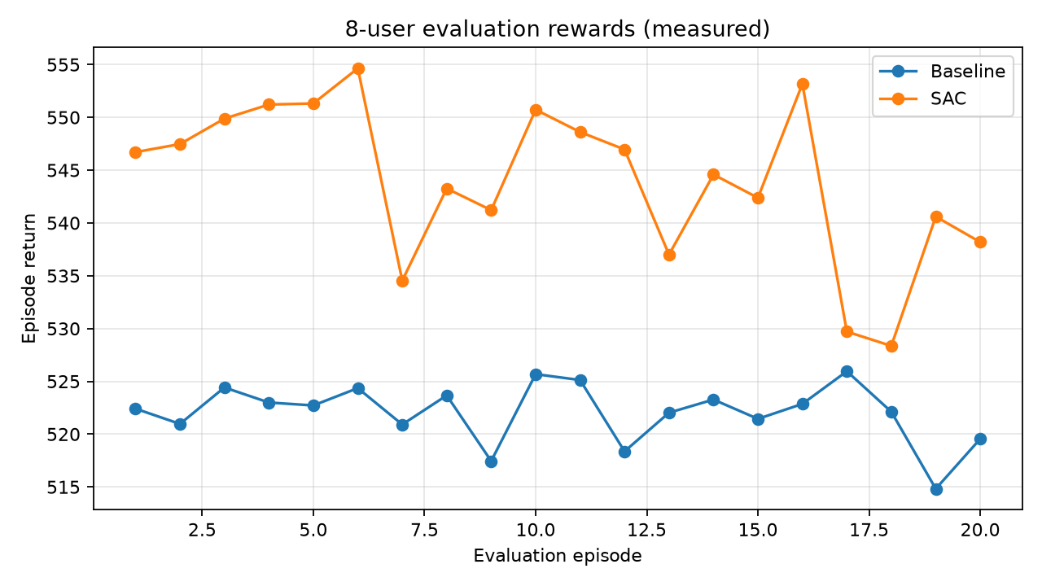
Results: SAC vs Baseline (8 Users)
544.03
SAC average reward
522.05
Baseline average reward
+4.2%
Reward improvement
Episode return over 20 evaluation episodes (from our results folder)
SAC also had lower estimated delay: 8.15 s vs 9.56 s, and slightly higher throughput: 4.32 vs 4.27 Mbps.
Notes:
These are the real results from our project folder. The graph shows the return, that is the total reward, of the baseline in blue and the SAC agent in orange over 20 evaluation episodes. The SAC line stays above the baseline in every episode. On average SAC scored 544.03 against 522.05 for the baseline, an improvement of about 4.2 percent. SAC also had a lower estimated queue delay, 8.15 seconds against 9.56, and slightly higher throughput. Please note the delay is a simulator estimate, not a measured packet delay. Also note this graph shows evaluation episodes, not a training curve.

Slide 8
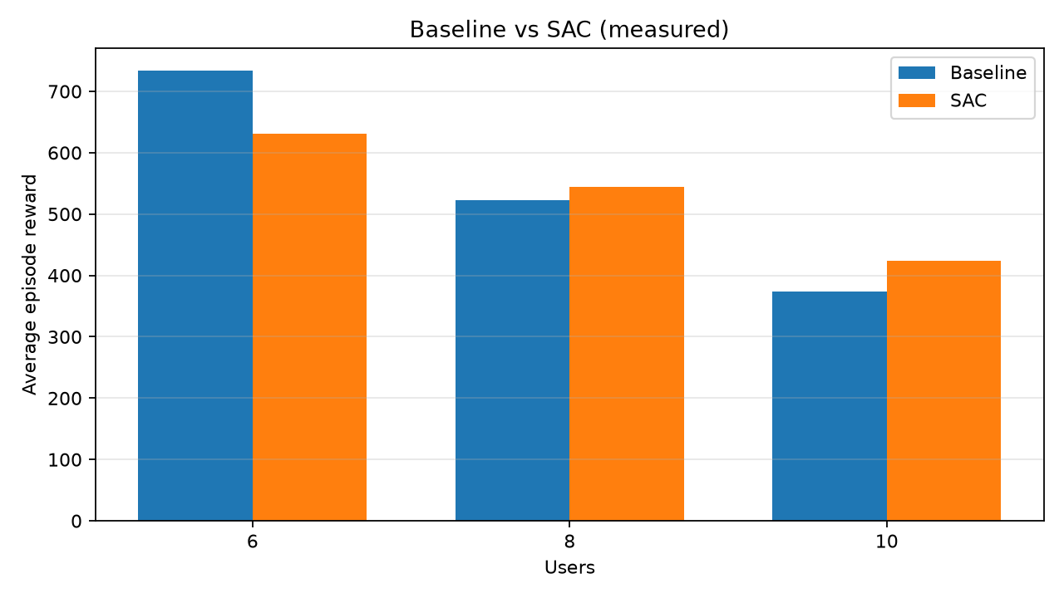
Results: 6, 8 and 10 Users
SAC scores higher at 8 and 10 users, but lower at 6 users.
Delay improved at 8 and 10 users, but priority satisfaction dropped in all three cases.
Reward falls as more users share the same 1 MHz.
Users | Reward (Base > SAC) | Delay s (Base > SAC) | Priority met (Base > SAC) | Mbps (Base > SAC)
6 | 733.5 > 631.5 | 6.61 > 7.19 | 1.00 > 0.81 | 5.52 > 4.68
8 | 522.1 > 544.0 | 9.56 > 8.15 | 1.00 > 0.50 | 4.27 > 4.32
10 | 374.1 > 424.2 | 10.00 > 9.39 | 0.69 > 0.48 | 3.29 > 3.52
Notes:
This bar chart is also from our results folder and compares baseline and SAC for 6, 8 and 10 users. SAC wins at 8 and 10 users, but loses at 6 users; that 6-user model was trained for only 5,000 steps. In the table, delay improves for 8 and 10 users, but the priority-satisfaction score, which is the fraction of users meeting their priority rate target, is lower for SAC in all cases, for example 0.50 against 1.00 at 8 users. We report this honestly: the reward improved, but SAC does not win on every metric. The reward drops as users increase because the same 1 MHz is shared by more users. Fixing the priority trade-off is our main future work.

Slide 9


Current Progress & Remaining Work
Completed
Remaining work
8-user dataset (plus 6 and 10 user versions)
Tune reward weights to raise priority satisfaction
Gymnasium simulator with reward design
Repeat training with several seeds and confidence intervals
SAC trained for 6, 8 and 10 users
Add a real semantic model (accuracy), not just priority
20-episode evaluation vs baseline
Add dynamic pairing and imperfect SIC
Result charts and CSV files saved
Flask dashboard for results
Compare with other RL and optimization methods
Notes:
Completed so far: the dataset, the simulator with reward design, SAC training for 6, 8 and 10 users, evaluation against the baseline with saved charts and CSV files, and a Flask dashboard. Remaining work: first, tune the reward weights so priority satisfaction improves without losing throughput; second, repeat training with several random seeds and report confidence intervals, because each model was trained only once; third, replace the priority proxy with a real semantic model that measures task accuracy; fourth, make the simulator more realistic with dynamic pairing and imperfect SIC; fifth, compare with other RL and optimization methods.

Slide 10

Conclusion
SAC learned a working power and time allocation policy in simulation.
8 users: reward +4.2% and lower estimated delay than the equal-share baseline.
Next: improve priority satisfaction and add a real semantic model.
Thank you | Questions?
B. Sri Srujana (2520040005) | S. Tejitha (2520040008) | M. Gnaneshwari (2520040020)
Notes:
To conclude: our SAC agent learned a working allocation policy in simulation, improved the 8-user reward by about 4.2 percent and reduced the estimated delay compared with the equal-share baseline. It does not win on every metric, so our next steps are to improve priority satisfaction and add a real semantic model. Thank you, we are happy to take questions.

