Slide 1
FINAL PROJECT PRESENTATION | 2026–27
HYBRID WIRELESS SYSTEM
Soft Actor-Critic-Based
Semantic-Aware Power and Time
Allocation for Hybrid NOMA–OFDMA Networks
OFDMA SUBCHANNEL 1
NOMA Pair 1 and Pair 2 share airtime
OFDMA SUBCHANNEL 2
Machine Learning • Wireless Resource Allocation
NOMA Pair 3 and Pair 4 share airtime
B. Sri. Srujana | 2520040005
S. Tejitha | 2520040008
M. Gnaneshwari | 2520040020
BS
U1
U3
U5
U7
Guide: N.L. Prasad • Department of ECE
U2
U4
U6
U8
Koneru Lakshmaiah Education Foundation (KLEF)
8 simulated users • 4 fixed NOMA pairs • 2 OFDMA subchannels

Slide 2
01 • INTRODUCTION
The challenge: deliver useful tasks without wasting power
Power and airtime are limited, while users have different channels, demands, deadlines and task priorities.
CHANNEL QUALITY
TASK URGENCY
ENERGY BUDGET
Fading and path loss make users experience different achievable rates.
A task with a short deadline or higher importance can be more valuable to serve now.
Using maximum power continuously can increase goodput, but also energy consumption.
Resource allocation must balance
TASK VALUE
priority-weighted useful service
DEADLINES
complete tasks before expiry
ENERGY
reduce joules per useful bit
This project evaluates the trade-off in a controlled, reproducible simulation—not on a live 5G network.
SAC • SEMANTIC-AWARE NOMA–OFDMA RESOURCE ALLOCATION
2

Slide 3
02 • OBJECTIVES
What the project implements
A simulation-first study of continuous resource control with SAC and feasible baseline policies.
01
MODEL THE NETWORK
02
MODEL TASK VALUE
Build a hybrid NOMA–OFDMA environment with 8 users, 4 fixed pairs and 2 subchannels.
Represent demand, task deadline and importance using a configurable synthetic task model.
03
LEARN RESOURCE CONTROL
04
ENFORCE FEASIBILITY
Train SAC to jointly choose pair power, NOMA power split and airtime preference.
Transform continuous actions so configured power and airtime constraints are respected.
05
EVALUATE HONESTLY
Compare against equal, semantic-priority and random feasible allocation on held-out seeds.
SAC • SEMANTIC-AWARE NOMA–OFDMA RESOURCE ALLOCATION
3

Slide 4
03 • SYSTEM MODEL
Hybrid NOMA–OFDMA scenario
OFDMA separates the two frequency subchannels; two candidate NOMA pairs time-share each subchannel.
SUBCHANNEL 1 • 180 kHz
SUBCHANNEL 2 • 180 kHz
PAIR 1
PAIR 2
PAIR 3
PAIR 4
Users 1 and 2
Simultaneous power-domain NOMA
Users 3 and 4
Simultaneous power-domain NOMA
Users 5 and 6
Simultaneous power-domain NOMA
Users 7 and 8
Simultaneous power-domain NOMA
Airtime fractions τ₁ + τ₂ ≤ 1
Airtime fractions τ₃ + τ₄ ≤ 1
8 users • 4 NOMA pairs
Pmax = 1.0 W total
0.5 W subchannel budget
50 frames × 10 ms = 0.5 s
SAC • SEMANTIC-AWARE NOMA–OFDMA RESOURCE ALLOCATION
4

Slide 5
04 • APPROACH
How the proposed policy is evaluated
The experiments compare SAC with three simple, reproducible control strategies under the same simulator.
EQUAL ALLOCATION
SEMANTIC PRIORITY
RANDOM FEASIBLE
PROPOSED SAC
• Equal airtime between candidate pairs
• Fixed weak/strong split β = 0.75
• Full configured per-subchannel power
• Heuristic pair ranking
• Uses task importance and urgency
• No learned long-horizon policy
• Random continuous allocation
• Actions mapped to feasible ranges
• Reference for uncoordinated control
• Learns from interaction and reward
• Continuous power and airtime choices
• Evaluated on 20 held-out seeds
Research framing
This project investigates a specific joint-control formulation. It does not claim that combining SAC, NOMA–OFDMA and semantic task weights is a completely new concept.
The distinctive implementation choices are explicit continuous airtime control, a priority-weighted task-progress reward proxy, and feasibility enforcement by analytical action transformations.
SAC • SEMANTIC-AWARE NOMA–OFDMA RESOURCE ALLOCATION
5

Slide 6
05 • ARCHITECTURE
End-to-end system pipeline
SAC observes the wireless/task state, proposes actions, and learns from the result of each simulation step.
STATE
SAC AGENT
MAPPING
ENVIRONMENT
REWARD
49 observations
8 users + horizon
Actor network
12 continuous values
Power split +
airtime projection
Channel, NOMA,
OFDMA and queues
Semantic utility −
energy/deadline cost
REPLAY BUFFER + CRITIC/ACTOR UPDATES
SAC uses replayed transitions to update the policy and value estimates.
One step: observe → act → enforce constraints → simulate service → update tasks → compute reward → learn.
SAC • SEMANTIC-AWARE NOMA–OFDMA RESOURCE ALLOCATION
6

Slide 7
06 • WIRELESS MODEL
Channel conditions and simulation assumptions
The environment uses a configurable log-distance path-loss model with independent Rayleigh fading per frame.
PATH LOSS
SMALL-SCALE FADING + NOISE
PLᵢ = PL₀ + 10 n log₁₀(dᵢ / d₀)
Carrier frequency: 3.5 GHz
Path-loss exponent: n = 3.5
User distance: 30–250 m
Reference distance: 1 m
gᵢ(t) = 10^(−PLᵢ/10) · |hᵢ(t)|²
Rayleigh fading: hᵢ(t) ∼ CN(0,1)
Noise density: −174 dBm/Hz
Receiver noise figure: 7 dB
Subchannel bandwidth: 180 kHz
Interpretation
Channel gain changes affect the achievable rates of the weak and strong users in each NOMA pair. Fading is re-sampled independently across frames; temporal channel correlation is not modelled.
Simulation only • no live radio hardware
Ideal successive interference cancellation
Fixed user pairing and subchannel assignment
SAC • SEMANTIC-AWARE NOMA–OFDMA RESOURCE ALLOCATION
7

Slide 8
07 • RESOURCE MODEL
How power and airtime affect each pair
NOMA uses power-domain sharing within a pair; OFDMA subchannels are orthogonal and separate pairs time-share each subchannel.
PAIR-LEVEL POWER
RATE + AIRTIME
P_g = η_g · Pmax / M, 0 ≤ η_g ≤ 1
p_w,g = β_g P_g
p_s,g = (1 − β_g) P_g
0.5 ≤ β_g ≤ 0.95
γ_w = p_w g_w / (p_s g_w + N)
γ_s = p_s g_s / N (ideal SIC)
Rᵢ = B log₂(1 + γᵢ)
τ_g ∈ [0,1], with Σ τ_g ≤ 1 per subchannel
FIXED PAIR MAPPING
SC 1
Pair 1
Pair 2
SC 2
Pair 3
Pair 4
This is a simplified Shannon-rate simulation with ideal SIC, not a link-level PHY model with coding errors or residual interference.
SAC • SEMANTIC-AWARE NOMA–OFDMA RESOURCE ALLOCATION
8

Slide 9
08 • SEMANTIC TASK MODEL
Semantic importance is represented by a priority-weighted service proxy
Each simulated user task has demand, deadline, and a scalar importance weight; no neural semantic encoder is used.
DATA DEMAND
TASK DEADLINE
IMPORTANCE WEIGHT
2,000–10,000 bits per task
2–6 frames remaining
wᵢ ∈ [0.2, 1.0]
USEFUL SERVICE
SEMANTIC UTILITY
sᵢ(t) = min(qᵢ(t), cᵢ(t))
qᵢ: remaining demand • cᵢ: bits served this frame
U_sem(t) = (1/K) Σᵢ wᵢ · sᵢ(t) / Dᵢ
Task progress is capped at remaining demand.
Important interpretation: “semantic utility” is a synthetic priority-weighted task-progress measure. It is not semantic similarity, BLEU, accuracy, or actual text/image meaning preservation.
SAC • SEMANTIC-AWARE NOMA–OFDMA RESOURCE ALLOCATION
9

Slide 10
09 • REINFORCEMENT LEARNING
SAC observation, action and reward design
The policy controls 4 NOMA pairs with continuous actions at each simulation step.
STATE • 49 FEATURES
ACTION • 12 VALUES
REWARD
For each of 8 users: 6 features
• normalized channel gain
• normalized distance
• remaining demand ratio
• original demand
• semantic importance
• remaining deadline ratio
+ 1 global horizon feature
3 continuous values per pair
• η: power utilization
• β: weak-user power fraction
• z: airtime preference
Action space: [-1, 1]¹²
rₜ = U_sem(t) − λ_E E_norm(t) − λ_D Mₜ
λ_E = 0.01
λ_D = 0.5
Balances useful task progress, energy and deadline misses.
Soft Actor-Critic is an off-policy actor–critic algorithm for continuous control. The policy learns by maximizing cumulative reward with entropy-regularized exploration.
Continuous control problem
Not supervised classification
Accuracy / F1 are not primary metrics
SAC • SEMANTIC-AWARE NOMA–OFDMA RESOURCE ALLOCATION
10

Slide 11
10 • CONSTRAINT HANDLING
Feasibility is enforced by action transformations
The implementation maps raw SAC outputs into configured physical ranges before the simulator applies them.
POWER UTILIZATION
η_g = (a_η + 1) / 2 → [0, 1]
P_g = η_g Pmax/M, with M = 2
NOMA SPLIT
β_g = 0.5 + 0.45(a_β + 1)/2
Weak/strong shares sum to pair power
AIRTIME SHARING
z_g = (a_τ + 1)/2
Normalize candidate-pair preferences per subchannel so Στ_g ≤ 1
Max power violations: 0
Max airtime violations: 0
Zero violations were recorded for all four policies in the saved 80 policy-episode evaluations.
SAC • SEMANTIC-AWARE NOMA–OFDMA RESOURCE ALLOCATION
11

Slide 12
11 • IMPLEMENTATION
Training configuration and software stack
Values below are from run_20261014_194752/run_config.json and run_summary.json.
Algorithm
Network
Learning rate
SAC • MlpPolicy
[128, 128] hidden layers
3 × 10⁻⁴
Discount γ
Replay buffer
Batch size
0.99
25,000 transitions
128
Learning starts
Train frequency
Training budget
500 steps
4 steps / 1 gradient step
20,000 timesteps
Runtime
CPU limit
Seed
62.89 seconds
2 threads
42
Stack: Python • NumPy • PyTorch • Gymnasium • Stable-Baselines3 SAC • Pandas • Matplotlib • pytest (Streamlit dashboard optional)
SAC • SEMANTIC-AWARE NOMA–OFDMA RESOURCE ALLOCATION
12

Slide 13
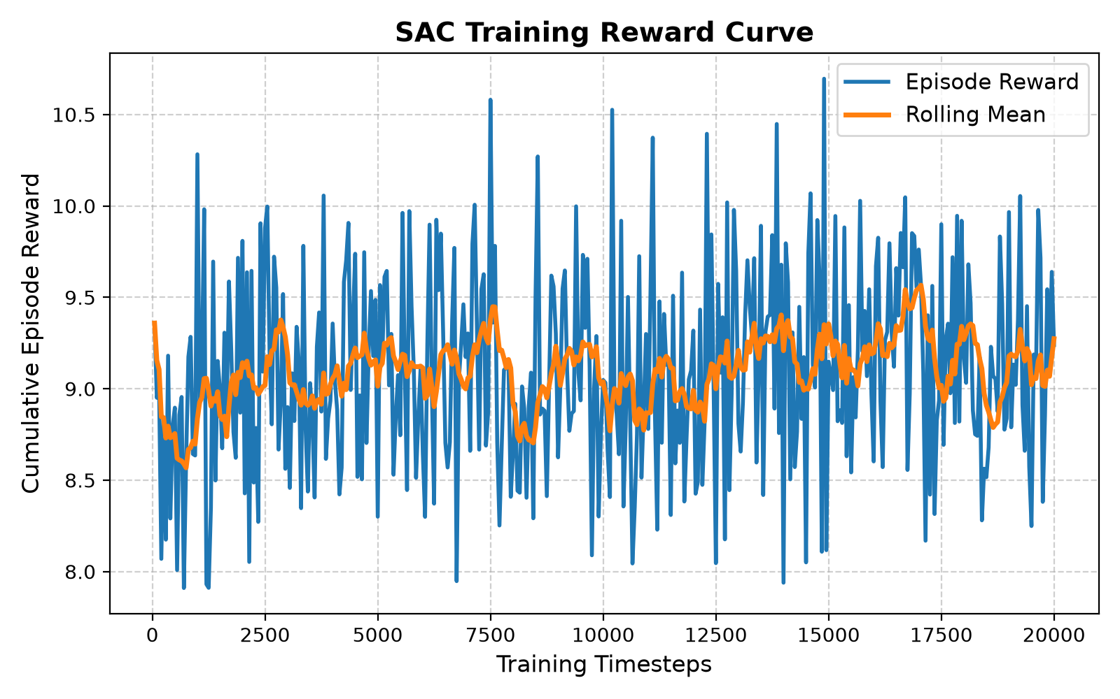
12 • TRAINING EVIDENCE
SAC training reward across 20,000 timesteps
The saved reward curve shows variable episode rewards with a modestly improving rolling mean.
TRAINING BUDGET
20,000 completed timesteps
WALL-CLOCK TIME
62.89 seconds recorded
HOW TO READ IT
The curve reflects stochastic training. It does not prove global or asymptotic convergence; held-out evaluation is the main evidence.
SAC • SEMANTIC-AWARE NOMA–OFDMA RESOURCE ALLOCATION
13

Slide 14
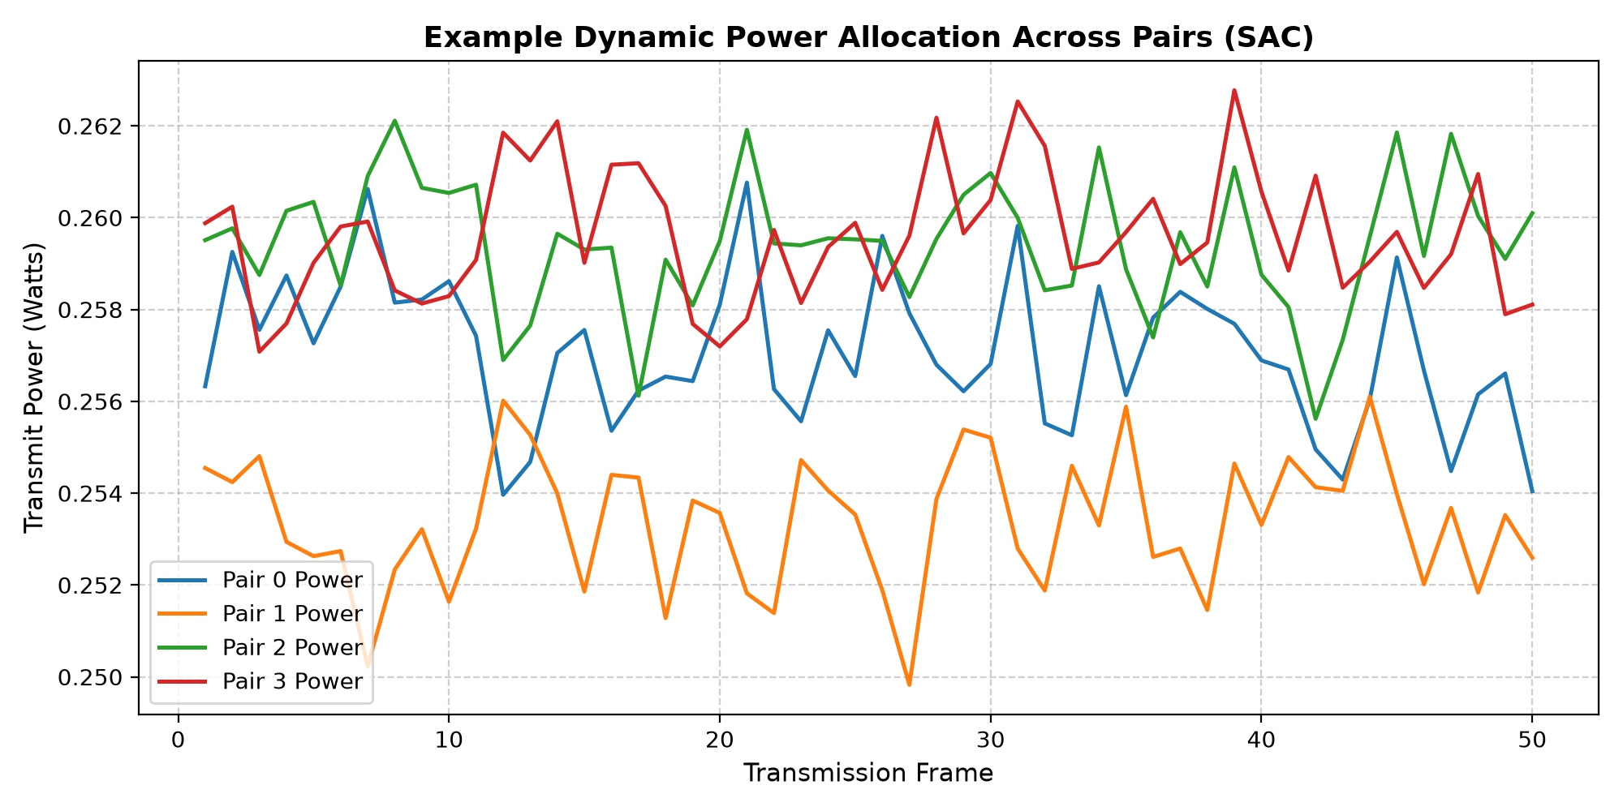
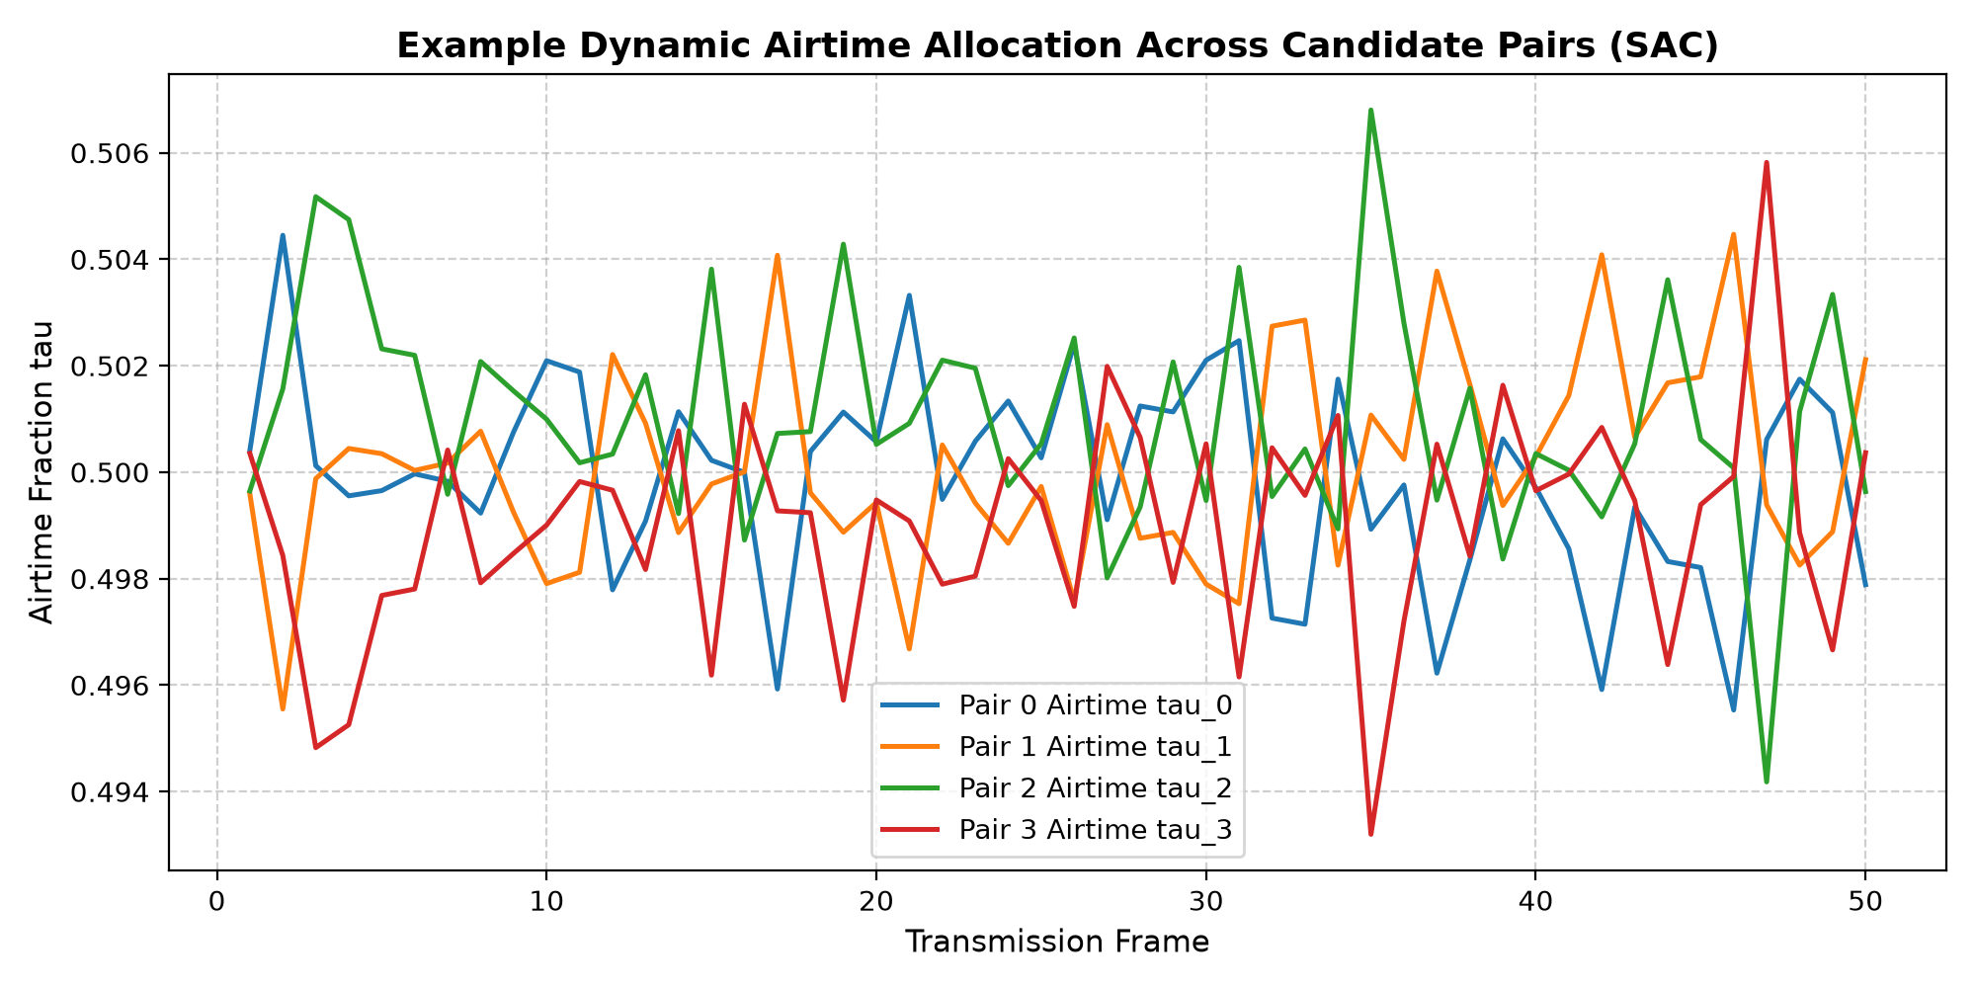
13 • POLICY BEHAVIOUR
Example resource-allocation traces from SAC
These are saved policy traces across 50 frames; use them as examples of learned controls, not as population-level statistics.
Pair-level transmit power
Airtime fractions by candidate pair
The saved traces show non-identical power choices and airtime preferences that remain within the designed feasible ranges.
SAC • SEMANTIC-AWARE NOMA–OFDMA RESOURCE ALLOCATION
14

Slide 15
14 • EVALUATION PROTOCOL
How the policies were compared
Training, validation and test seeds are separated; the reported table uses held-out test scenarios only.
TRAINING
VALIDATION
HELD-OUT TEST
Seed 42
SAC trained for 20,000 timesteps
Seeds 1000–1004
5 validation seeds in configuration
Seeds 2000–2019
20 test scenarios per policy
Four evaluated policies
SAC
trained policy
Equal Allocation
fixed power/airtime baseline
Semantic Priority
rule-based heuristic
Random Allocation
random feasible controls
Reported metrics: mean reward, semantic utility, goodput, sum rate, task completion, deadline-miss rate, latency, energy, energy efficiency, Jain fairness, constraint violations.
SAC • SEMANTIC-AWARE NOMA–OFDMA RESOURCE ALLOCATION
15

Slide 16
15 • RESULTS
Held-out comparison across 20 scenarios
Mean values from the saved evaluation summary; goodput is displayed in Mbps, rates rounded for readability.
POLICY
MEAN REWARD
SEM. UTILITY
GOODPUT (Mb/s)
TASK COMPLETE
DEADLINE MISS
SAC
12.145
0.2561
2.015
78.78%
16.94%
Equal Allocation
12.998
0.2760
2.180
82.46%
13.48%
Semantic Priority
12.234
0.2555
1.999
81.91%
13.64%
Random Allocation
8.963
0.1990
1.537
65.10%
29.85%
WHAT SAC DOES BEST
WHERE EQUAL ALLOCATION LEADS
Energy efficiency; all configured constraints are satisfied.
Semantic utility, goodput, task completion and lower deadline misses.
SAC • SEMANTIC-AWARE NOMA–OFDMA RESOURCE ALLOCATION
16

Slide 17
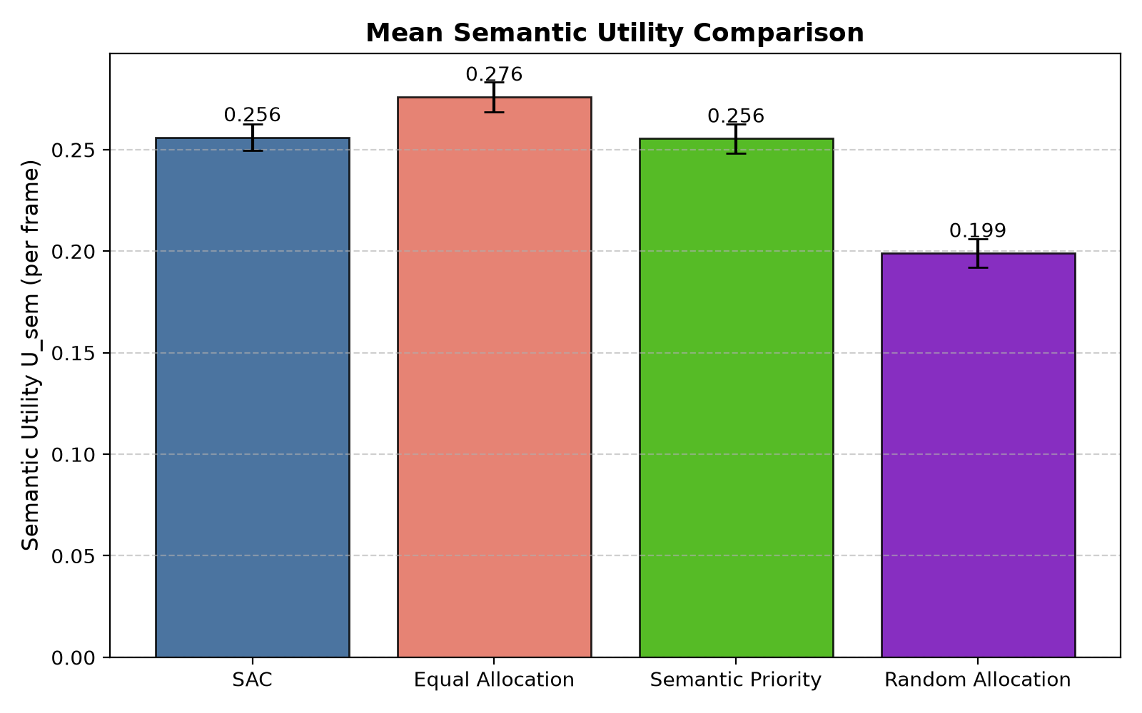
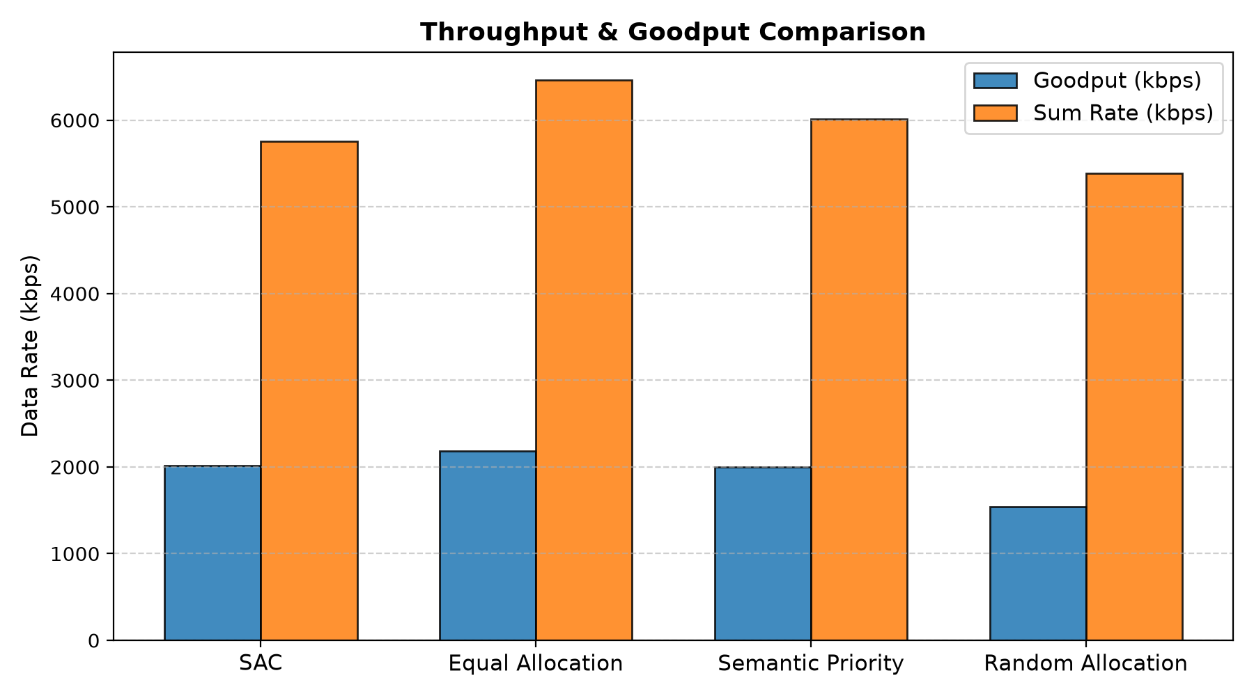
16 • SERVICE PERFORMANCE
Task-value and rate metrics remain a trade-off
Equal allocation delivered slightly more service in this run; SAC traded some service performance for lower energy use.
Mean semantic utility: SAC 0.2561 • Equal 0.2760
Mean goodput: SAC 2.02 Mb/s • Equal 2.18 Mb/s
Goodput is useful delivered bits per simulated time in this environment; it is not a measurement from a physical wireless testbed.
SAC • SEMANTIC-AWARE NOMA–OFDMA RESOURCE ALLOCATION
17

Slide 18
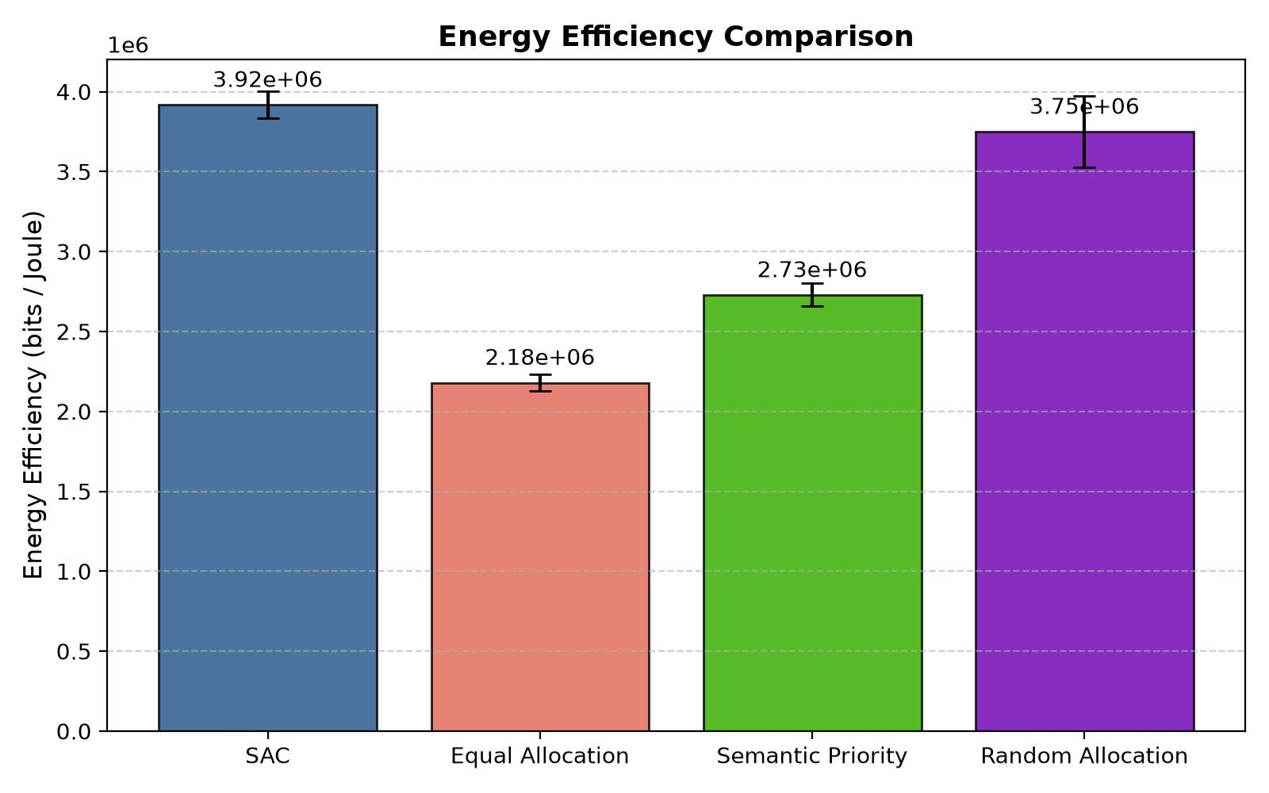
17 • ENERGY EFFICIENCY
SAC reduces energy per episode and improves bits per joule
The clearest advantage in the saved evaluation is energy efficiency compared with the equal-allocation baseline.
ENERGY CONSUMPTION
SAC: 0.257 J • Equal: 0.500 J
ENERGY SAVING
≈48.6% lower than equal allocation
ENERGY EFFICIENCY
3.92 × 10⁶ bits/J for SAC; +79.8% vs equal
This gain does not imply the highest goodput or task completion: the objective includes an energy penalty, so the comparison illustrates a multi-objective trade-off.
SAC • SEMANTIC-AWARE NOMA–OFDMA RESOURCE ALLOCATION
18

Slide 19
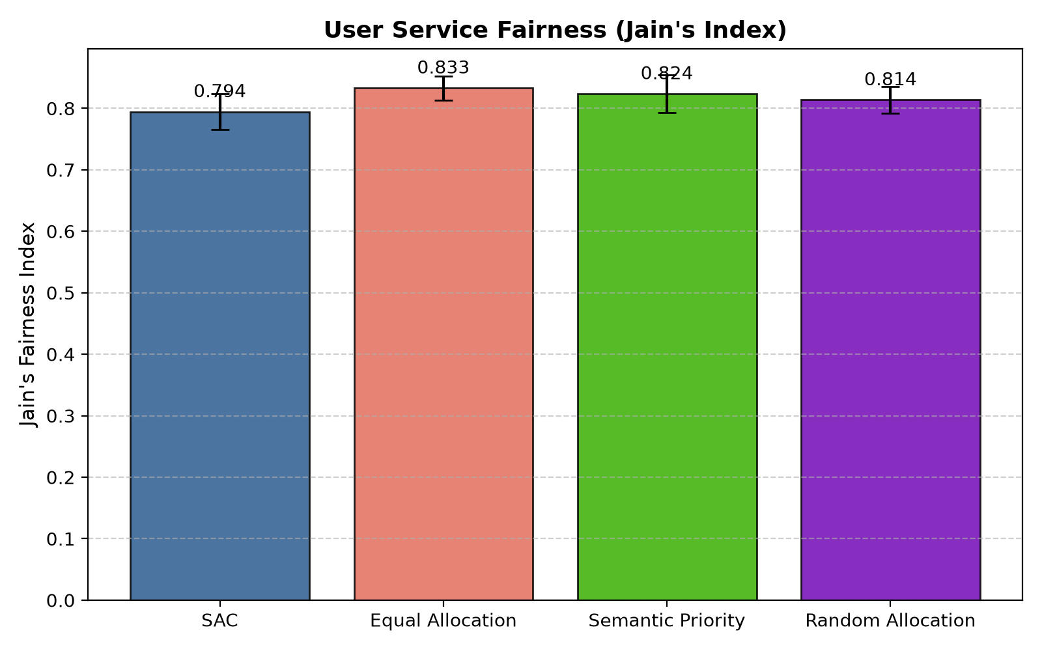
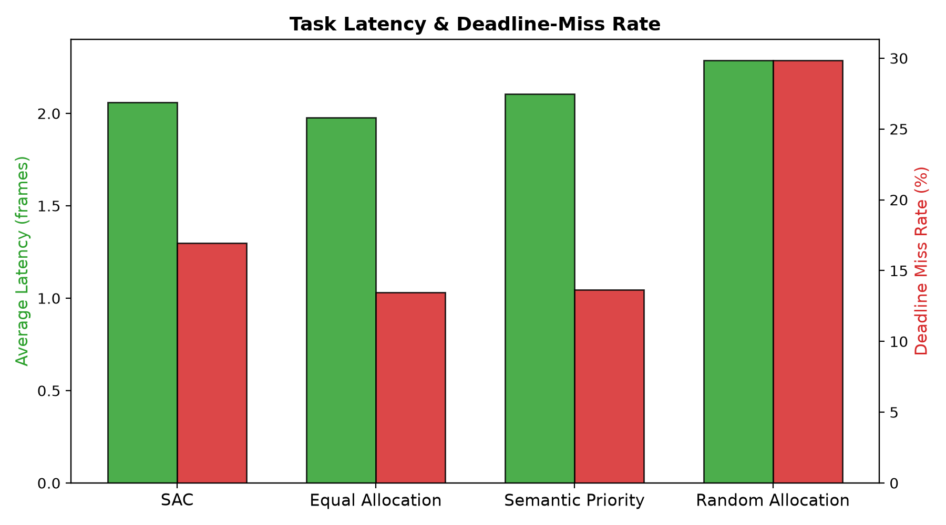
18 • QOS AND FEASIBILITY
Deadline misses, latency and fairness
SAC meets the configured hard constraints, but equal allocation performs better on several task-delivery measures.
SAC: 2.06 frames latency • 16.94% deadline-miss rate
Jain fairness: SAC 0.794 • Equal 0.833
Power violations: 0 across policies
Airtime violations: 0 across policies
Lower deadline-miss rate and higher fairness are better; these favour equal allocation in the saved run.
SAC • SEMANTIC-AWARE NOMA–OFDMA RESOURCE ALLOCATION
19

Slide 20
19 • DISCUSSION
What the experiment demonstrates—and what it does not
The project is a working simulation prototype; the results should be interpreted within its modelling assumptions.
SUPPORTED BY SAVED RESULTS
MODELLING LIMITATIONS
NEXT EXPERIMENTS
• 20,000 SAC timesteps completed
• 20 held-out test seeds
• Energy per episode falls by ≈48.6% vs equal allocation
• Zero recorded power/airtime violations
• Synthetic task-importance proxy; no semantic encoder
• Ideal SIC and perfect simplified channel model
• Fixed NOMA pairing / subchannel assignment
• Independent frame-by-frame fading
• Simulation only; not real network deployment
• Tune reward weights and train longer
• Test more channel/task scenarios
• Add imperfect SIC and correlated fading
• Compare against more optimization baselines
• Explore dynamic pairing and real semantic models
Conclusion from current evidence: SAC improves energy efficiency, but does not dominate equal allocation across semantic utility, goodput, completion, deadline misses or fairness.
The next research step is to tune the service–energy trade-off and re-evaluate on broader held-out scenarios—not to claim universal superiority.
SAC • SEMANTIC-AWARE NOMA–OFDMA RESOURCE ALLOCATION
20

Slide 21
20 • REFERENCES
Selected research and implementation resources
Related literature and tools identified in the project documentation; references are background sources, not proof of novelty.
1. Haarnoja, T. et al. “Soft Actor-Critic: Off-Policy Maximum Entropy Deep Reinforcement Learning with a Stochastic Actor.” ICML, 2018. arXiv:1801.01290.
2. Zhang, H. et al. “DRL-Driven Dynamic Resource Allocation for Task-Oriented Semantic Communication.” IEEE Transactions on Communications, 71(7), 3992–4004, 2023. DOI: 10.1109/TCOMM.2023.3274145.
3. Pi, P. & Ren, G. “Soft Actor–Critic Optimization for Efficient NOMA Uplink in Intelligent Vehicular Networks.” Physical Communication, 68, 102581, 2025. DOI: 10.1016/j.phycom.2024.102581.
4. Zhang, Y. et al. “Reinforcement Learning-Based Resource Allocation for Multi-Task Multi-Codebook Semantic Communications.” Physical Communication, 75, 102982, 2026. DOI: 10.1016/j.phycom.2025.102982.
5. “DRL-Driven Resource Allocation for Hybrid NOMA-Assisted Semantic Communication Networks.” IEEE Transactions on Wireless Communications, 2026. DOI: 10.1109/TWC.2026.3686618.
6. Stable-Baselines3 documentation: SAC algorithm; Gymnasium API; PyTorch. Used for implementation and simulation tooling.
Paper details and DOI links are listed for follow-up reading; review the full papers before asserting a formal research gap.
SAC • SEMANTIC-AWARE NOMA–OFDMA RESOURCE ALLOCATION
21

Slide 22
FINAL PROJECT PRESENTATION | 2026–27
HYBRID NOMA–OFDMA
Thank you.
OFDMA SUBCHANNEL 1
NOMA pairs 1 and 2
Questions & Discussion
Soft Actor-Critic-Based Semantic-Aware Power and Time Allocation for Hybrid NOMA–OFDMA Networks
OFDMA SUBCHANNEL 2
NOMA pairs 3 and 4
B. Sri. Srujana • S. Tejitha • M. Gnaneshwari
Department of Electronics & Communication Engineering • KLEF
U1
U3
U5
U2
U4
Power and airtime are learned jointly; constraints remain feasible by construction.

