Slide 1


St. MARTIN’S ENGINEERING COLLEGE
UGC Autonomous
NBA & NAAC A+ ACCREDITED
Dhulapally, Secunderabad– 500100
Department of Computer Science And Engineering
Mini Project on
The Strategic Project Governance Platform
Batch No: D08
1. U. SOUMIL (23K81A05P9)
2. G. SAINATH (23K81A05M2)
3. M. RAGHU (23K81A05Q4)
Under the Guidance of
Mr. G. KISHOR
Assistant Professor
Department of Computer Science And Engineering

Slide 2
OUTLINE
Abstract
Detailed Design
Contribution of candidate
Results obtained
References
80 % code Implementation

Slide 3
ABSTRACT
The Strategic Project Governance Platform (SPGP) is software designed to move project management beyond simple task lists to strategic oversight, ensuring all work stays aligned with the company’s main goals.
It uses the Impact Score Visualization feature to act as a smart alarm, quickly figuring out and showing the cost and time damage caused by any delayed job, allowing managers to instantly prioritize fixing the most harmful issues.
The platform includes a system that links decisions to notes and documents, making sure all past team knowledge and the full reasons behind every key choice are clear, easy to find, and used to help leaders make smarter, faster decisions.

Slide 4
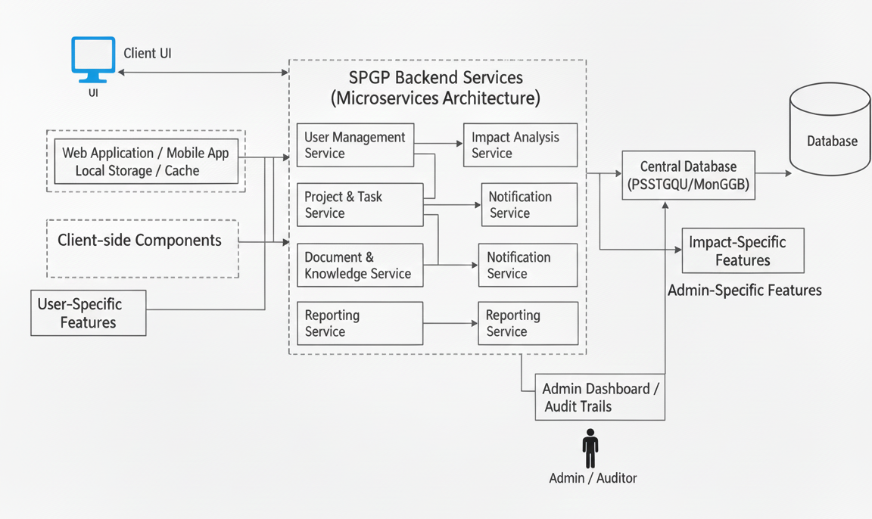
2. DETAILED DESIGN

Slide 5
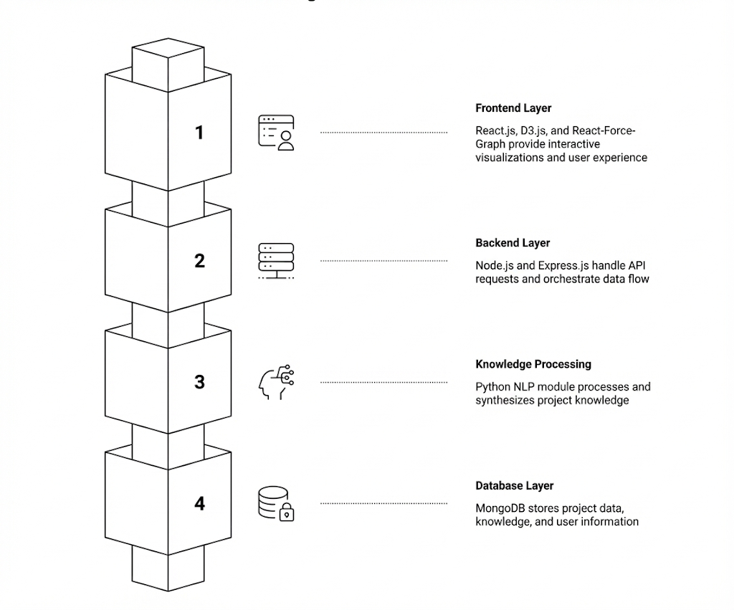
2.1 SYSTEM ARCHITECTURE DESIGN

Slide 6
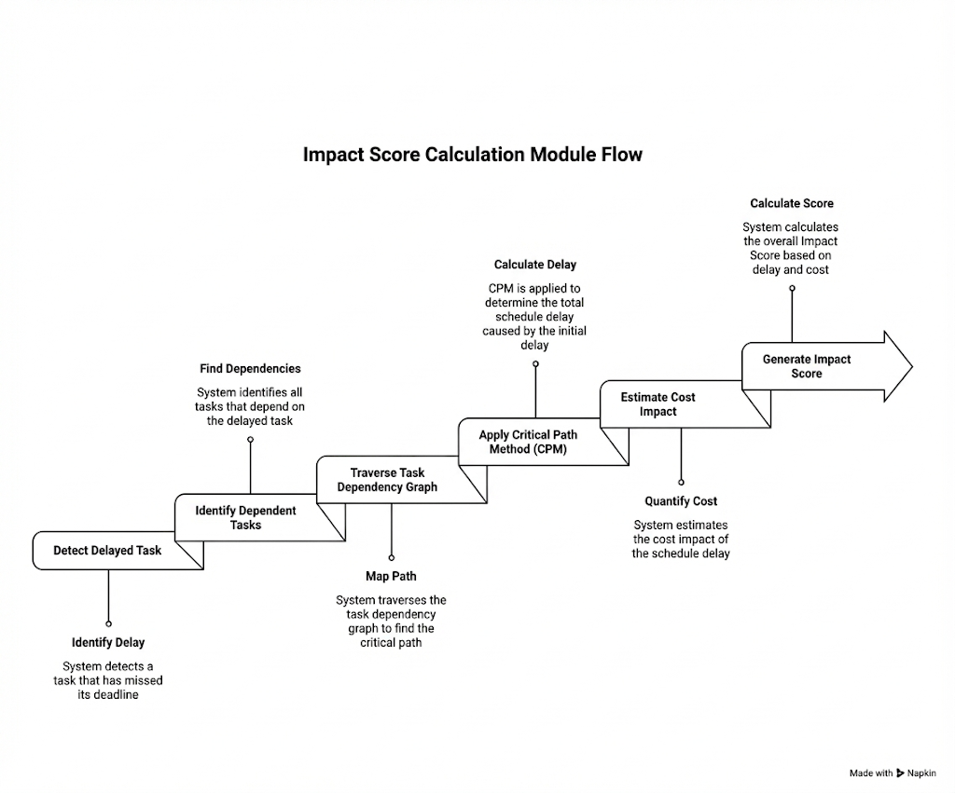
2.2 IMPACT SCORE ALGORITHM DESIGN

Slide 7
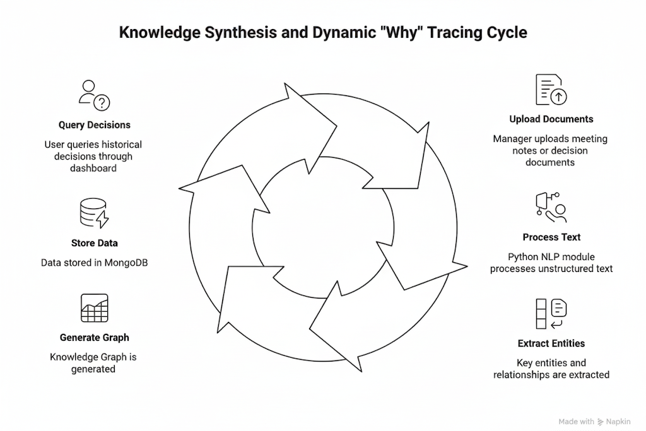
2.3 Knowledge Synthesis & Dynamic “Why” Tracing Design

Slide 8
3. Contribution of Candidate and Result Obtained
Candidate 1 – U. Soumil
Designed overall system architecture
Implemented Backend APIs using Node.js & Express
Developed Impact Score calculation logic
Created MongoDB schemas (Users, Tasks, Decisions)
Integrated authentication using JWT
Candidate 2 – G. Sainath
Designed and implemented React.js frontend
Developed dashboard UI and task visualization
Integrated D3.js for Impact Score visualization
Connected frontend with backend APIs
Candidate 3 – M. Raghu
Prepared complete project documentation and report formatting.
Designed presentation slides and review materials.
Assisted in requirement gathering and system flow planning.
Performed manual testing and validation.
Documented test cases and recorded system results.

Slide 9
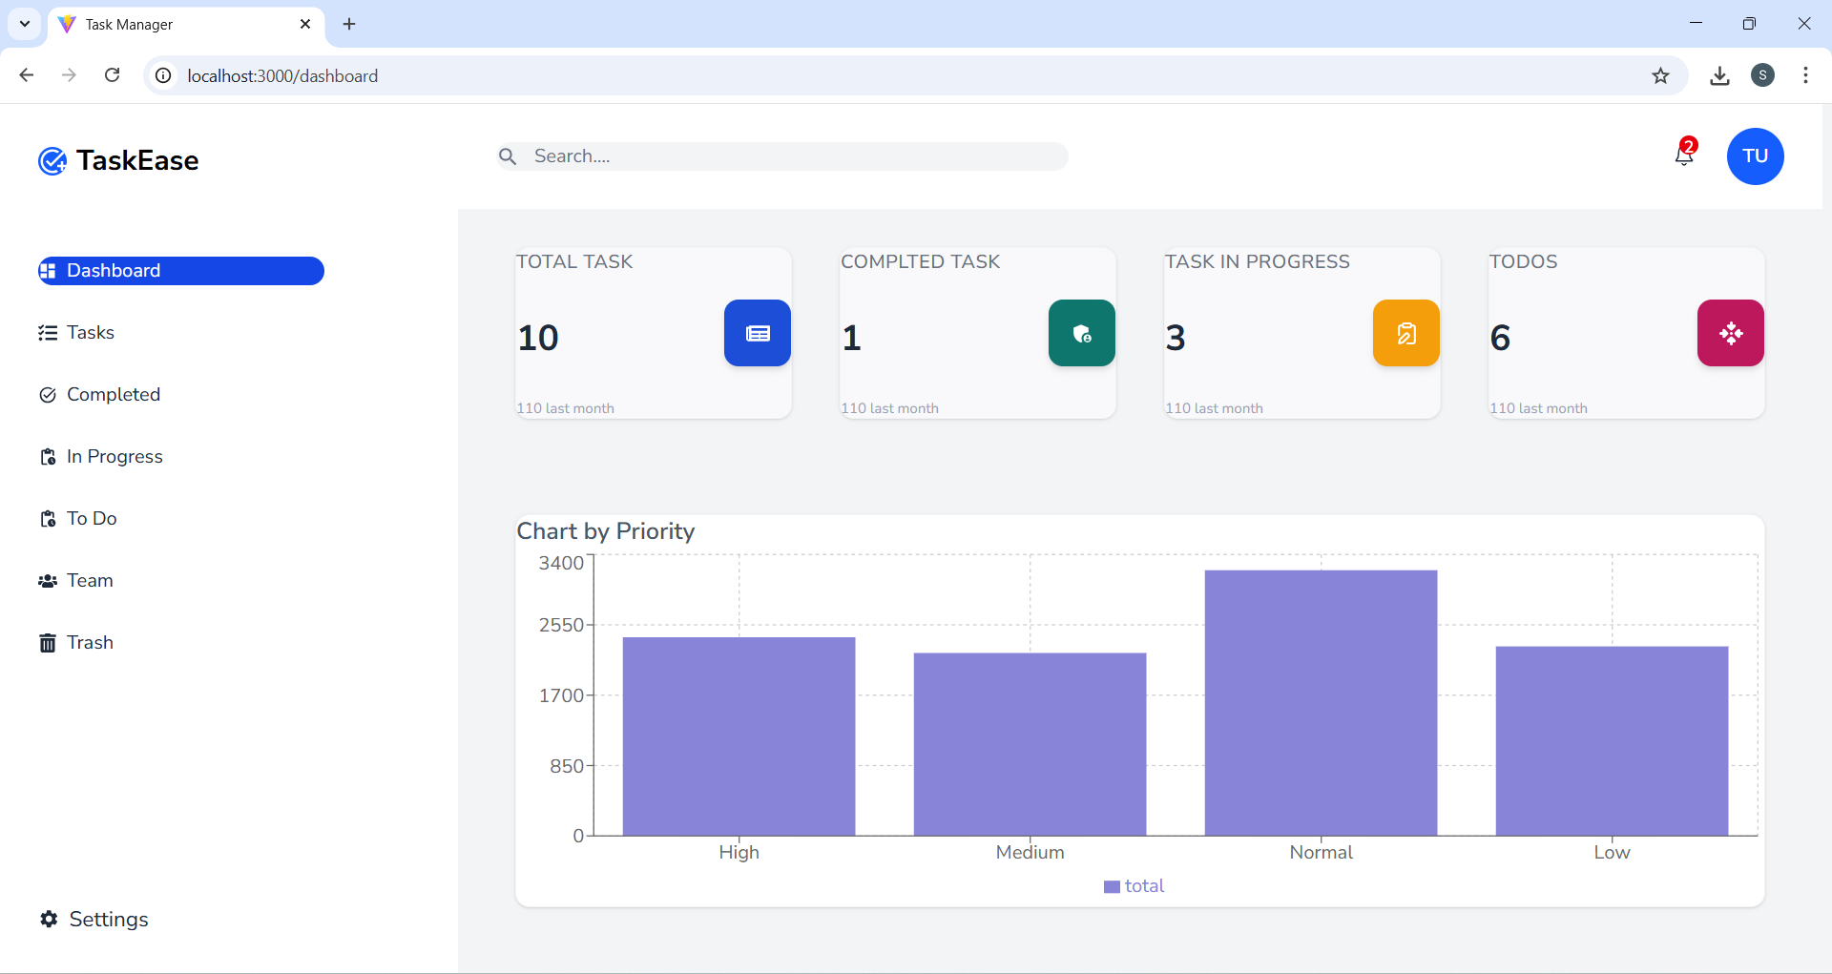
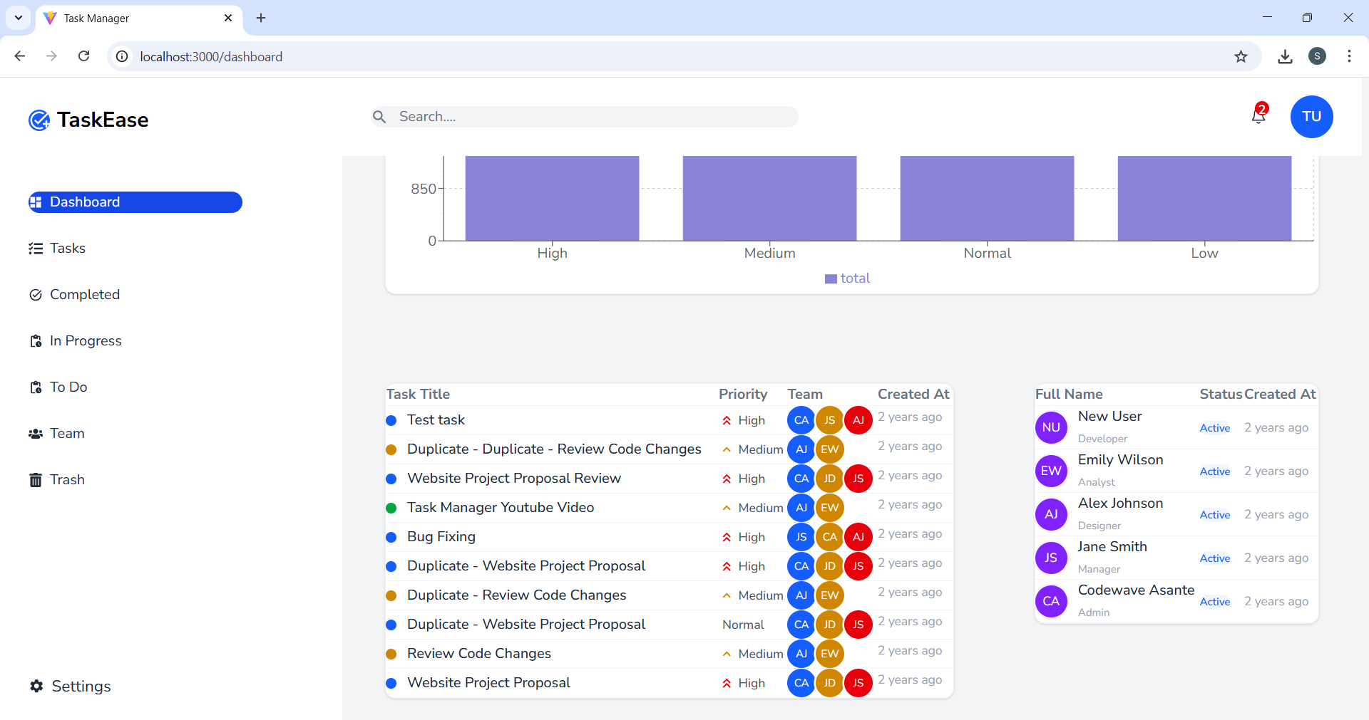
4. RESULTS OBTAINED

Slide 10
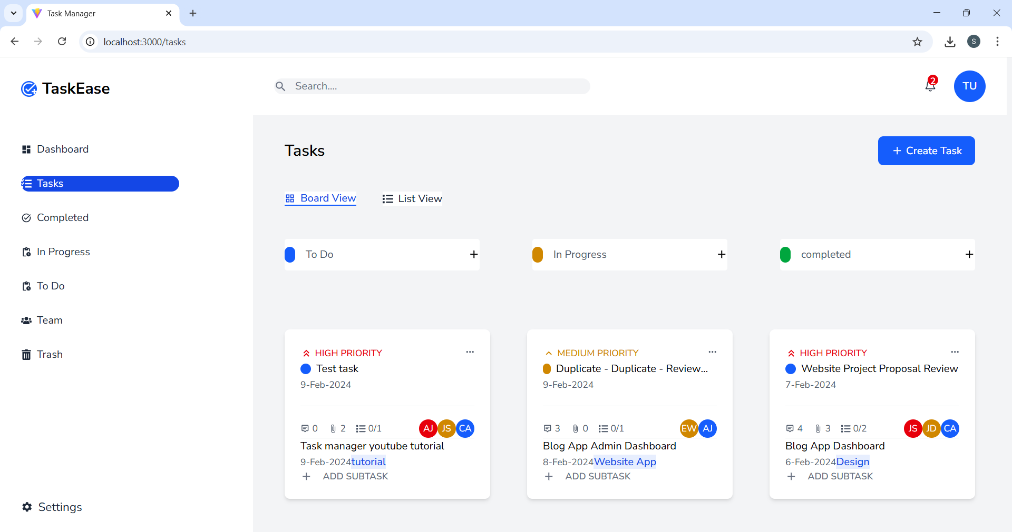
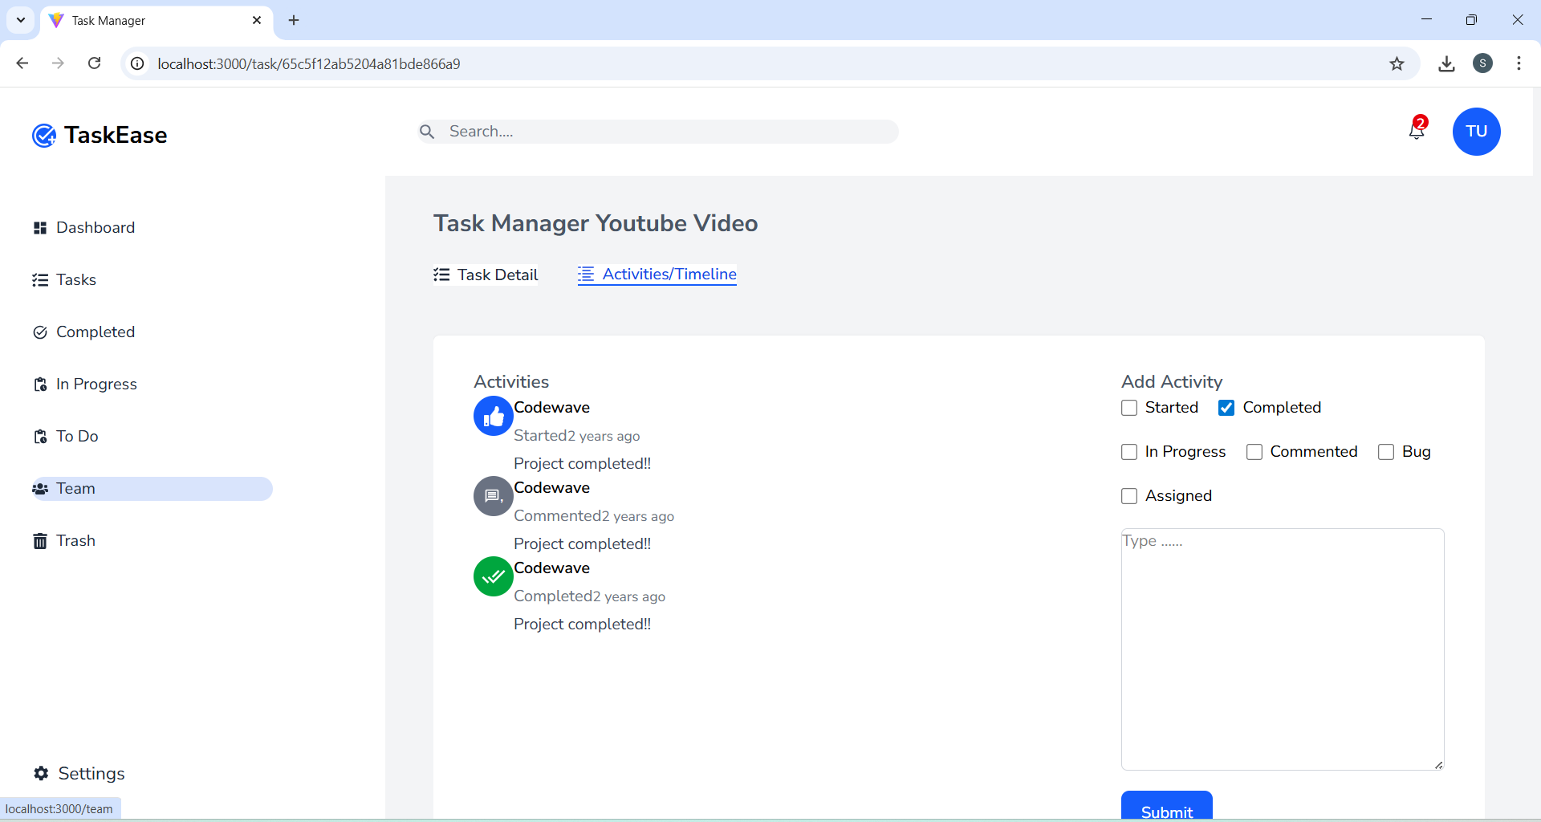
RESULTS OBTAINED

Slide 11
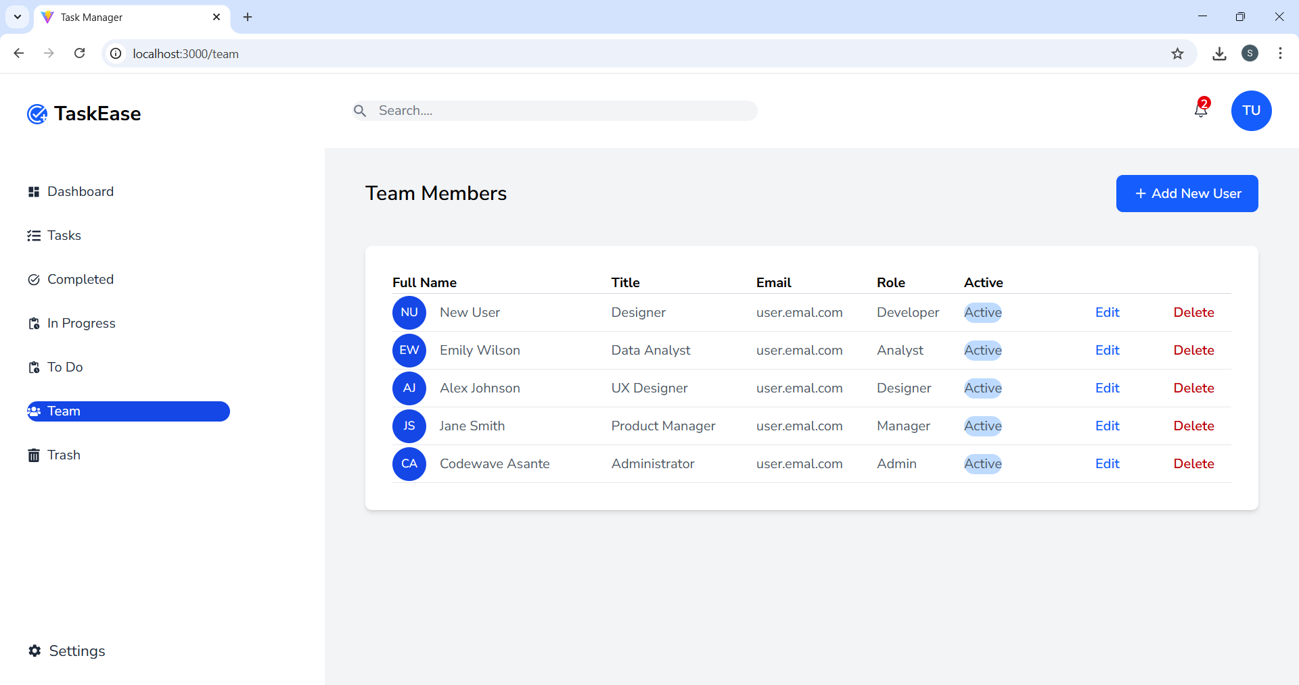
RESULTS OBTAINED

Slide 12
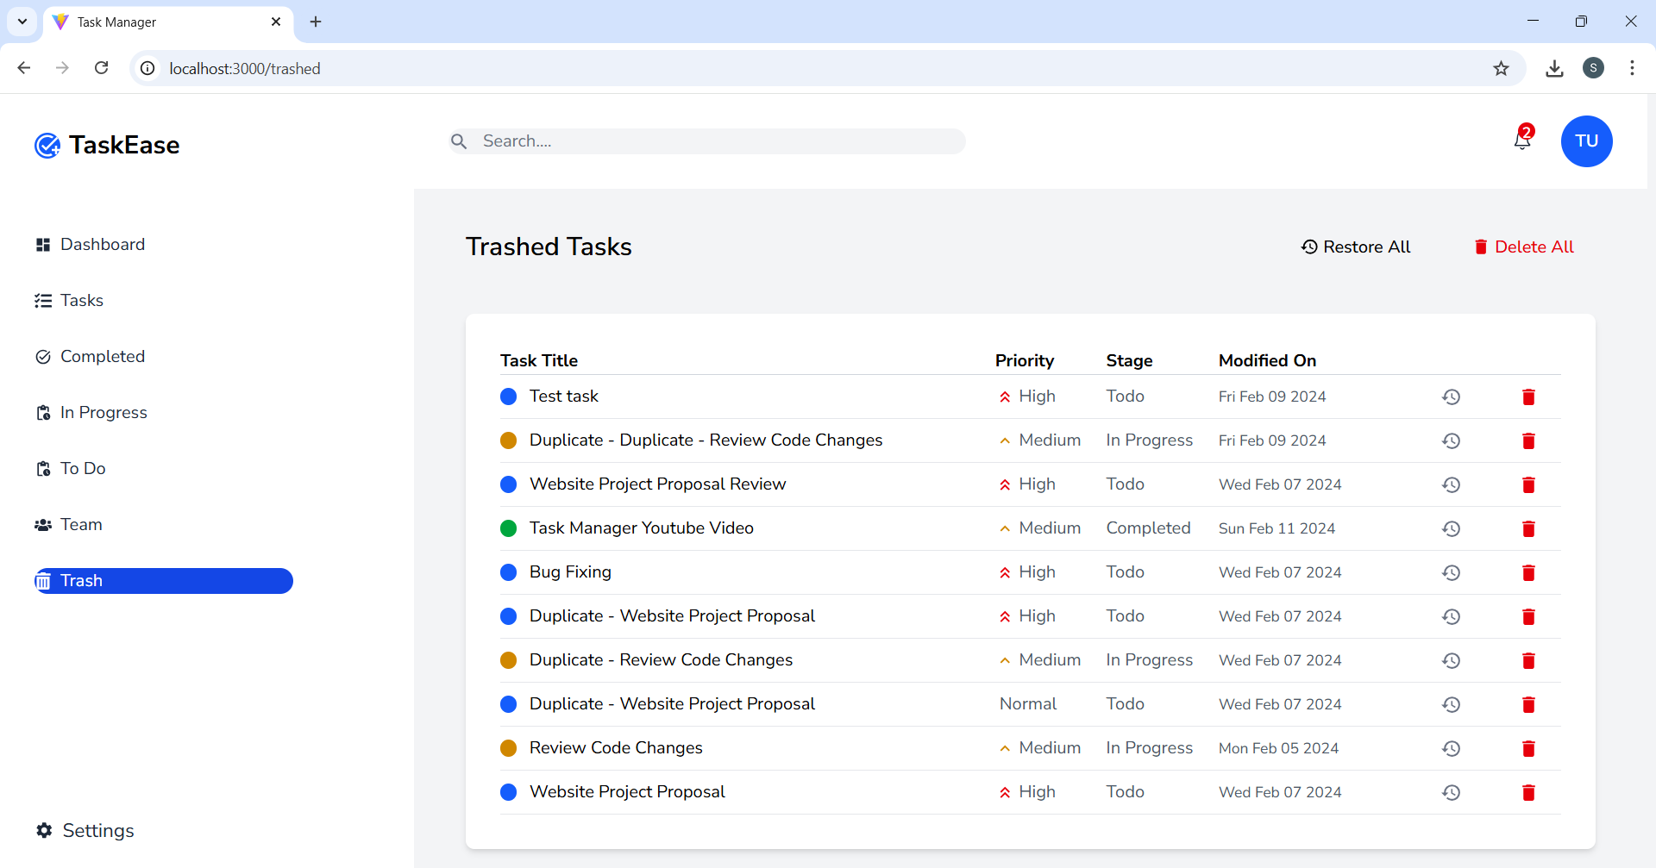
RESULTS OBTAINED

Slide 13
6. 80% CODE IMPLEMENTATION
import React from "react";
import { useForm } from "react-hook-form";
import { useSelector } from "react-redux";
import ModalWrapper from "./ModalWrapper";
import { Dialog } from "@headlessui/react";
import Textbox from "./Textbox";
import Loading from "./Loader";
import Button from "./Button";

Slide 14
SOURCE CODE(80%)
const AddUser = ({ open, setOpen, userData }) => {
let defaultValues = userData ?? {};
const { user } = useSelector((state) => state.auth);
const isLoading = false,
isUpdating = false;
const {

Slide 15
SOURCE CODE(80%)
register,
handleSubmit,
formState: { errors },
} = useForm({ defaultValues });
const handleOnSubmit = () => { };
return (
<>
<ModalWrapper open={open} setOpen={setOpen}>

Slide 16
SOURCE CODE(80%)
<form onSubmit={handleSubmit(handleOnSubmit)} className=''>
<Dialog.Title
as='h2'
className='text-base font-bold leading-6 text-gray-900 mb-4'
>
{userData ? "UPDATE PROFILE" : "ADD NEW USER"}
</Dialog.Title>
<div className='mt-2 flex flex-col gap-6'>
<Textbox

Slide 17
SOURCE CODE(80%)
placeholder='Full name'
type='text'
name='name'
label='Full Name'
className='w-full rounded'
register={register("name", {
required: "Full name is required!",
})}

Slide 18
SOURCE CODE(80%)
error={errors.name ? errors.name.message : ""}
/>
<Textbox
placeholder='Title'
type='text'
name='title'
label='Title'
className='w-full rounded'
register={register("title", {

Slide 19
SOURCE CODE(80%)
required: "Title is required!",
})}
error={errors.title ? errors.title.message : ""}
/>
<Textbox
placeholder='Email Address'
type='email'
name='email'
label='Email Address'

Slide 20
SOURCE CODE(80%)
className='w-full rounded'
register={register("email", {
required: "Email Address is required!",
})}
error={errors.email ? errors.email.message : ""}
/>
<Textbox
placeholder='Role'
type='text'

Slide 21
SOURCE CODE(80%)
name='role'
label='Role'
className='w-full rounded'
register={register("role", {
required: "User role is required!",
})}
error={errors.role ? errors.role.message : ""}
/>
</div>

Slide 22
REFERENCES
[1]. Pinto, J. K., Project Management: Achieving Competitive Advantage, 2018 (Defines Project Governance frameworks and strategic alignment).
[2].Kerzner, H., Project Management: A Systems Approach to Planning, Scheduling, and Controlling, 2017 (Standard source for Critical Path Method (CPM) and scheduling).
[3].T. Williams, Modelling project risk under conditions of uncertainty, 2004 (Key methods for quantifying schedule and cost risks in projects).
[4].Nonaka, I. & Takeuchi, H., The Knowledge-Creating Company, 1995 (Foundation for organizational knowledge creation and transfer).
[5].T. H. Davenport & L. Prusak, Working Knowledge: How Organizations Manage What They Know, 19198 (Principles of knowledge management systems and knowledge flow).

Slide 23
REFERENCES
[6]. D. Allemang & J. Hendler, Semantic Web for the Working Ontologist, 2011 (Theoretical basis for using Graph Databases for knowledge linking).
[7].Baker, I. D. & McCallum A. K., Distributional clustering of words for text classification, 2019 (Supports NLP techniques for knowledge extraction and organization).
[8].Z. Yang, A Document Clustering Algorithm for Web Search Engine Retrieval System, 2020 (Supports document organization and linking for "Why" Tracing).
[9].R. B. S. Turban, Information Technology for Management, 2020 (General context on using IT for strategic management and governance).
[10].V. H. Smith, Measuring the value of effective stakeholder management in projects, 2015 (Supports the governance aspect of managing communication and impact).

Slide 24
REFERENCES
[11]. R. S. Pressman, Software Engineering: A Practitioner's Approach, 2020 (General software engineering and system architecture principles).
[12]. M. S. Wibowo, A Survey of NoSQL Database in Cloud Computing, 2018 (Discusses MongoDB's role, performance, and scalability).
[13]. J. R. Cheng, D. V. Kalashnikov, Evaluating Probabilistic Queries over Imprecise Data, 2021 (Supports data uncertainty modeling crucial for risk scoring).
[14]. R. Robinson, J. Webber, & I. Eifrem, Graph Databases, 2015 (Practical guide on implementing and querying graph databases like Neo4j).
[15]. A. Shrivastava, M. Sahu, & S. K. Dwivedi, A Survey of Graph-based Approaches for Knowledge Discovery, 2021 (Review of techniques using graphs for knowledge discovery, directly supporting Dynamic Tracing).

Slide 25
QUERIES ??

Slide 26
THANK YOU

