Slide 1
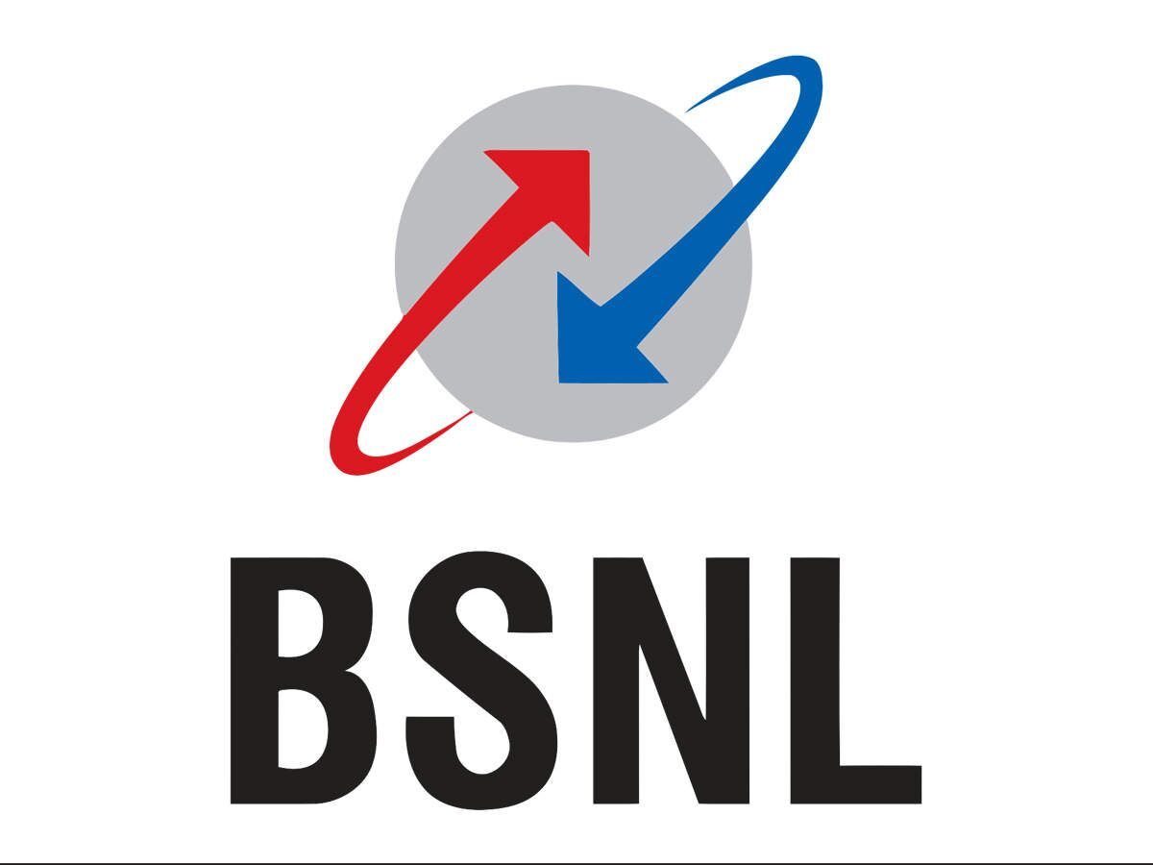
BSNL TELCO CUSTOMER RETENTION
Name of the Client:
Kranthi (Telco Service Manager)
Supervisors:
Mahesh(Data Scientist)
Bala Kiran(Senior Data Analyst)

Slide 2
CONTENT
Introduction
Business Challenges
Data Collection & Data Pre-Processing
Exploratory Data Analysis & Visualizations
Outcome Insights
Machine Learning Models
Model Selection
Deployment
Build Web Application

Slide 3
INTRODUCTION
The telecommunications sector has become one of the main industries in developed countries.
Customer retention is one of the fundamental aspects of customer relationship management (CRM).
Especially within the current economic environment, since it is more profitable to keep existing customers than attract new one.
A small improvement in customer retention can produce an increase in profit.
The early detection of future churners is one of the CRM strategies.
Mobile carries current focus on customer retentions.
Important for telecom companies to analyze all relevant customer data and accurate Churn Prediction model to retain customers and to form strategies for reducing customer attrition rates.

Slide 4
BUSINESS CHALLENGES
Problem Statement:
Churn:
Customers stop subscribing to service.
Churn is a problem for telecom companies because it is more expensive to acquire a new customer than to keep your existing one from leaving.
Early churn phenomenon i.e consumption of free credit on new subscriber activation with no recharge in future.
Fraudulent activations with zero revenue earnings.

Slide 5
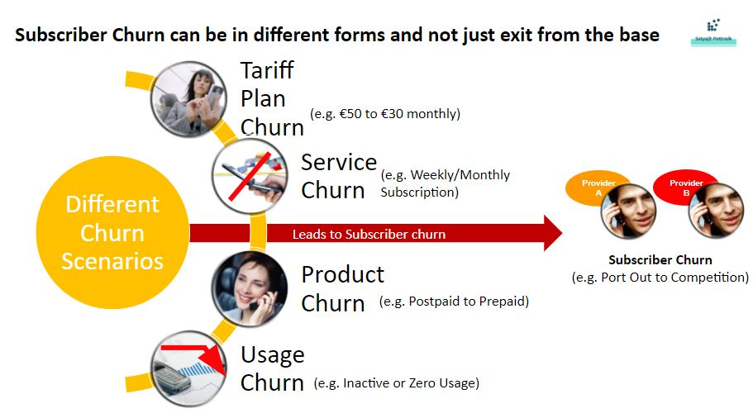

Slide 6
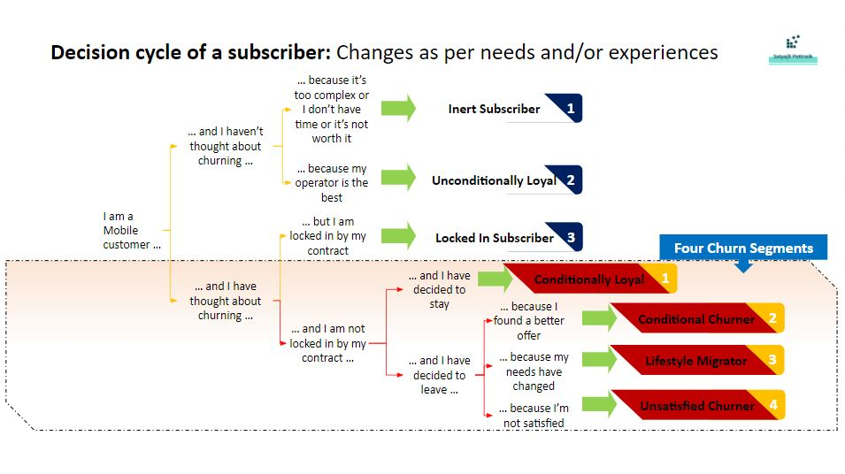

Slide 7

CHURN PREDICTION:
Churn prediction is one of the most popular big data use cases in business.
It consists of detecting customers who are likely to cancel a subscription to a service.
To predict if a telco customer will churn & build web application.
The goal is to explore the possibility of machine learning for churn prediction to retain a competitive edge in the industry.

Slide 8
DATA COLLECTION & PRE-PROCESS
Surveys:
The Ministry of National Economy collects on frequent basis Economic and Social indicators.
Monthly Charges
Total Charges
Customer whether churn or non-churn.
Pre-processing:
Data Cleaning
Data Transformation
Feature Engineering
Feature Selection

Slide 9
Main Features:
Demographic info:
Gender, Senior Citizen, Partner & Dependents.
Services subscribed:
Phone Service, Multiple Line, Internet Service, Online Security, Online Backup, Device Protection, Tech Support, Streaming TV, Streaming Movies.
Customer account info:
Customer ID, Contract, Paperless Billing, Payment Method, Monthly Charges, Total Charges, Tenure

Slide 10
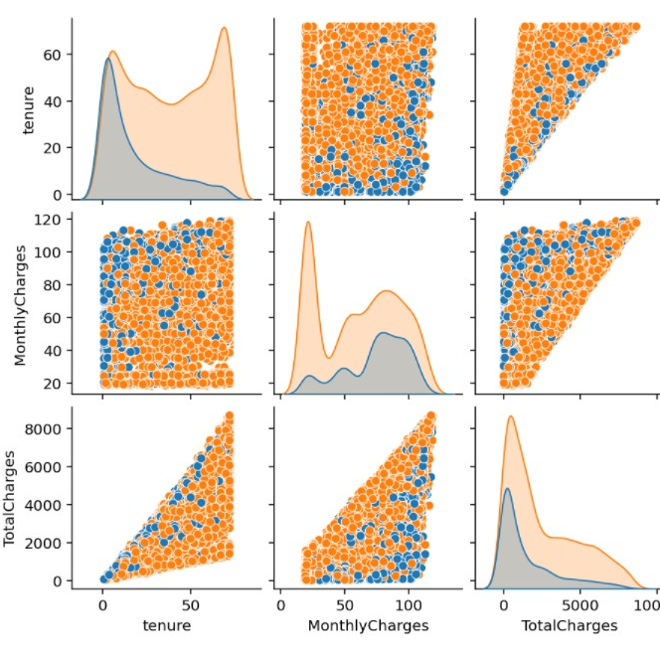
Feature Engineering
These 3 features Tenure, Monthly Charges and Total Charges are continuous data to be split into categories.
Split features into classes

Slide 11
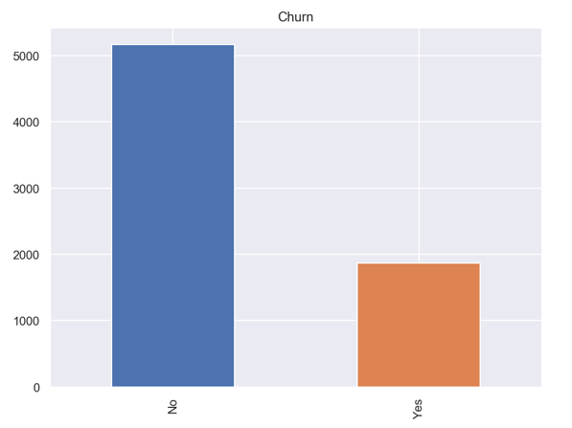
EXPLORATORY DATA ANALYSIS
Over 7000 customers.
26% of them has left in the last six(6) month.
Critical to business because it is often more expensive to acquire new customers than to keep existing ones.
26%

Slide 12
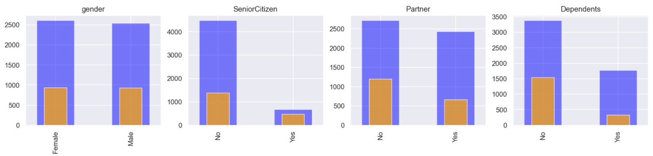
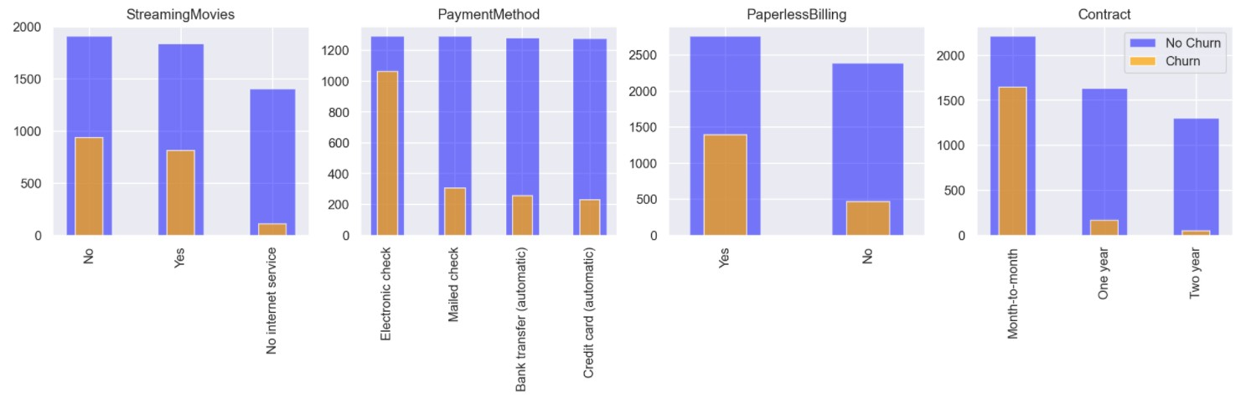
Personal Attributes
Customers without dependents are four times more likely to churn
Senior citizens are three times less likely to churn
Partners are almost two times less likely to leave.
The majority of customers that cancel their subscription have Month-to-month Contract type and Paperless Billing enabled
Customers that have Payment Method as Eletronic Check are more likely to leave

Slide 13
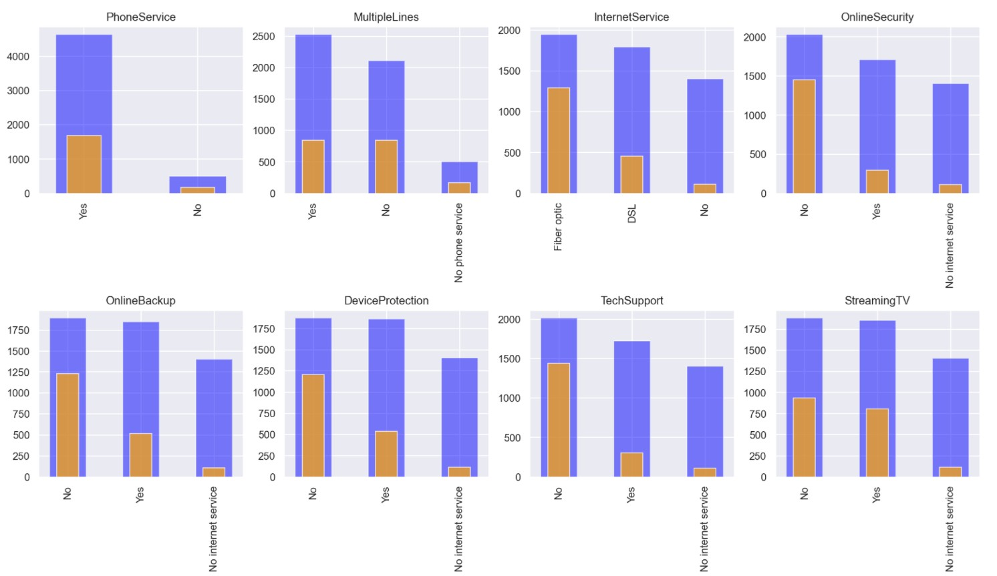
Services Attributes
The majority of customers that cancel their subscription have Phone Service enabled
Customers that have Internet Service as Fiber-Optic are more likely to cancel than those who have DSL
Customers that do not have Online Security, Device Protection, Online Backup, and Tech Support services enabled are more likely to leave

Slide 14


Derived Insights from above plots :
gender:- Has almost equal ratios of Male and Female
Senior Citizen:- Number of Senior Citizens are way less than normal citizens
Partner:- Has almost equal ratios of Partners and Non-Partners
Dependents:- Number of Dependent users are way less than Non-Dependent Users
Phone Service:- People who don't have Phone service are very few.
Multiple Lines:- Multiple Lines are fewer than normal lines and customers who do not have Phone Service do not belong to this category.
Internet Service:- Fiber optic cable is most common internet service. There is large population which doesn't have internet service
Online Security:- Online Security is not opted by maximum customers and customers who do not have Internet Service do not belong to any category.

Slide 15
Derived Insights from above plots(cont’d):
Device Protection:- Device Protection is not opted by maximum customers and customers who do not have Internet Service do not
belong to any category.
Tech Support:- Tech Support is not taken by maximum customers and customers who do not have Internet Service do not belong to any category.
Streaming TV:- Streaming TV is equiprobable between customers who have Internet Service and customers who do not have Internet Service do not belong to any category.
Streaming Movies:- Streaming Movies is equiprobable between customers who have Internet Service and customers who do not have Internet Service do not belong to any category.
Contract:- Month to month contract is more likely opted by customers
Paperless Billing:- Most customers have opted for Paperless Billing
Payment Method:- Electronic cheques is more preferred method of payment

Slide 16
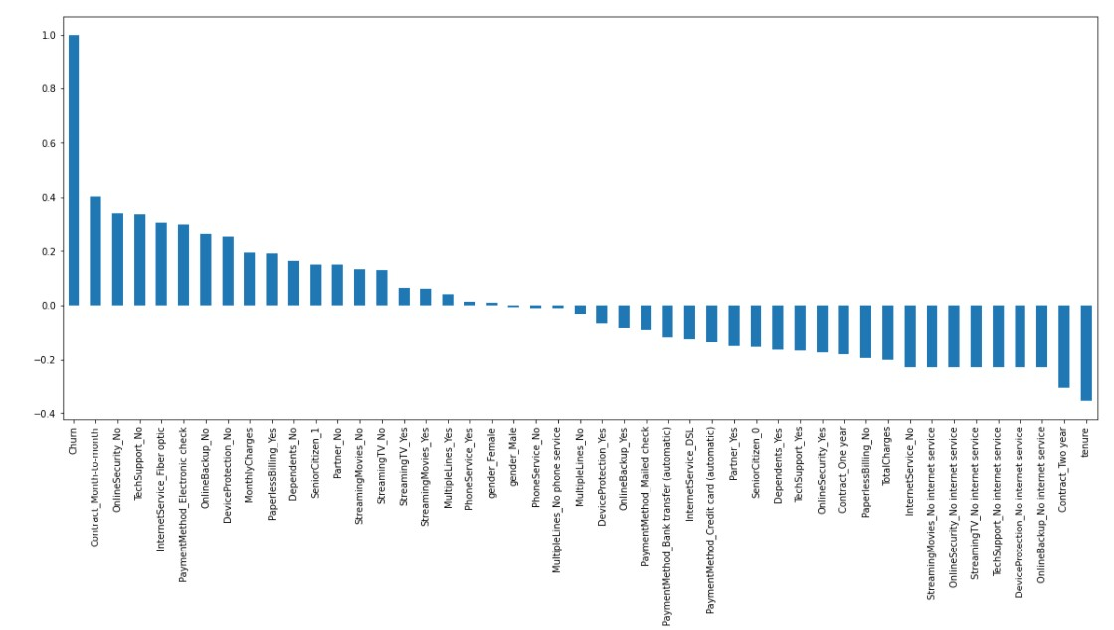
Data Co-relation
High Churn seen in case of Month-to-month contracts, No online security, No Tech support, First year of subscription and fiber Optics Internet
Low Churn is seen in case of Long-term contracts, Subscriptions without internet service and The customers engaged for 5+ years
Factors like Gender, Availability of Phone Service and # of multiple lines have almost NO impact on Churn

Slide 17

MACHINE LEARNING MODELS
Logistic Regression
K-Nearest Neighbours
Decision Tree Classifiers
Random Forest Classifiers
Linear SVC

Slide 18
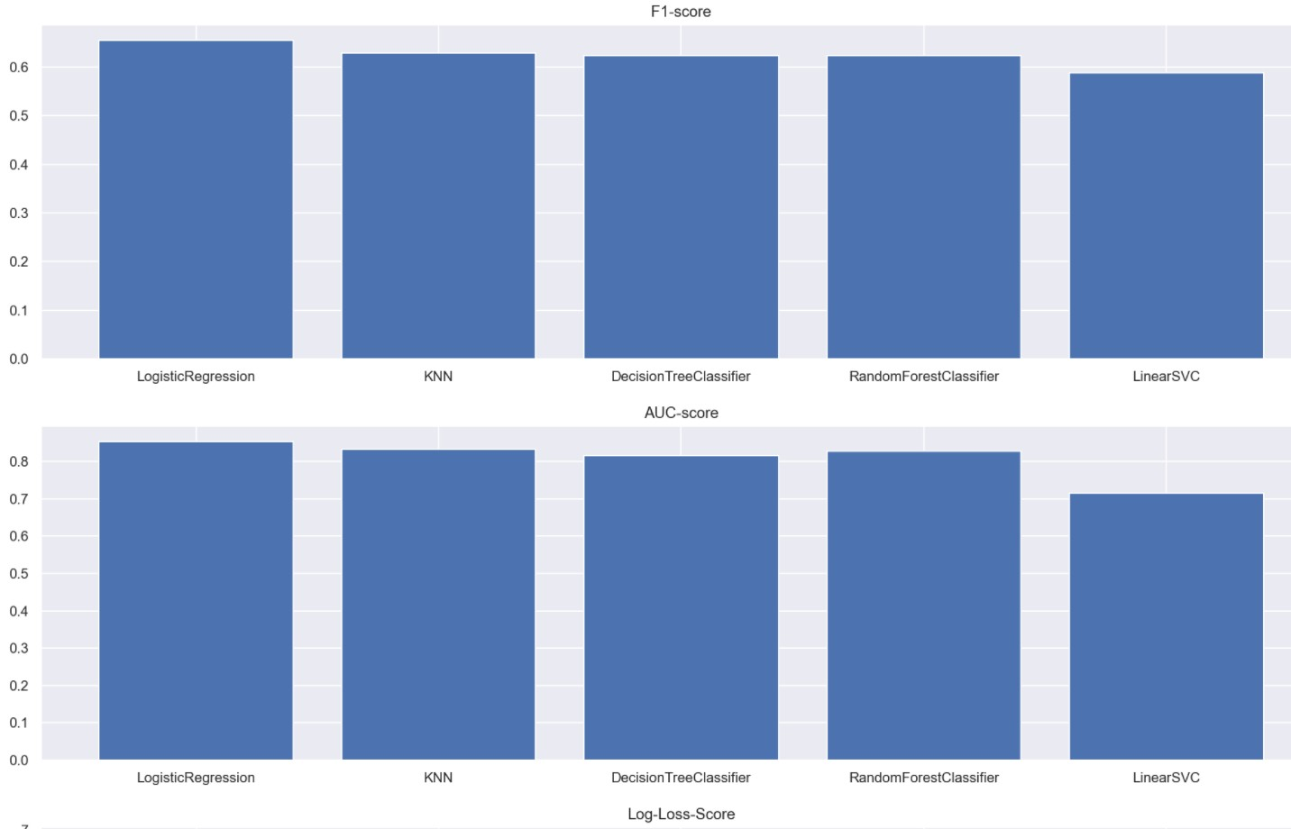
Model Comparison & Selection
Tested 5 classification models.
Trained all models.
Optimised.
Logistic Regression generally works well on binary classification and has performed better than the rest. F1-Score is a balance between Precision and Recall rates trade-off.

Slide 19
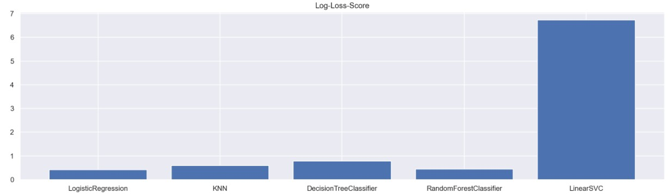
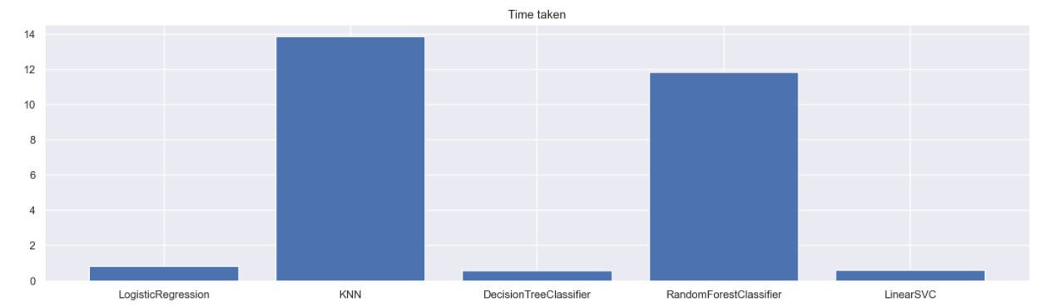
Model Comparison & Selection
Another performance metric is Log-Loss-Score where we look for the model with the lowest loss function. Once again Logistic Regression is the best, and thus it is the final selected model.
For time taken, Logistic Regression may not be the fastest, but it is definitely not the slowest. SVC is 10 times slower than Random Forest Classifier, which is 10 times slower than Logistic Regression.

Slide 20
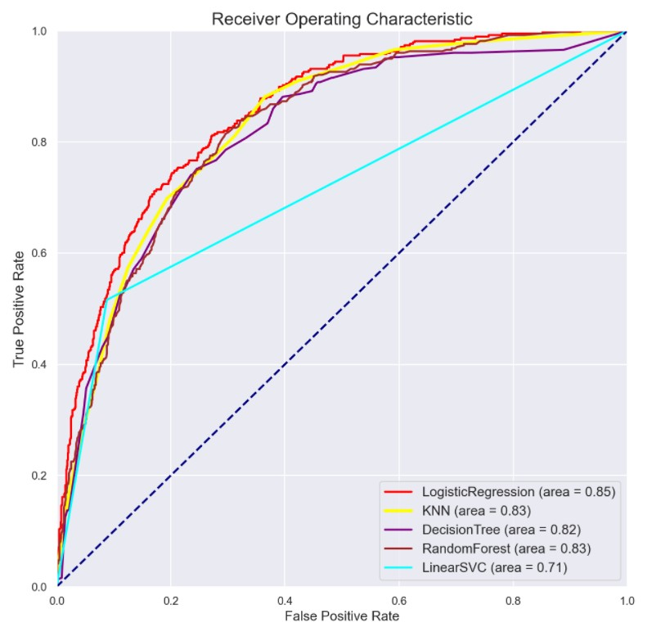
Receiver Operating Characteristics
The ROC curve is a relationship between True Positive Rate and False Positive Rate.
Logistic Regression, which is the red line, has an area of 0.85 under this curve.
It means the model has performed better than random guesses of 0.83, the diagonal line.

Slide 21
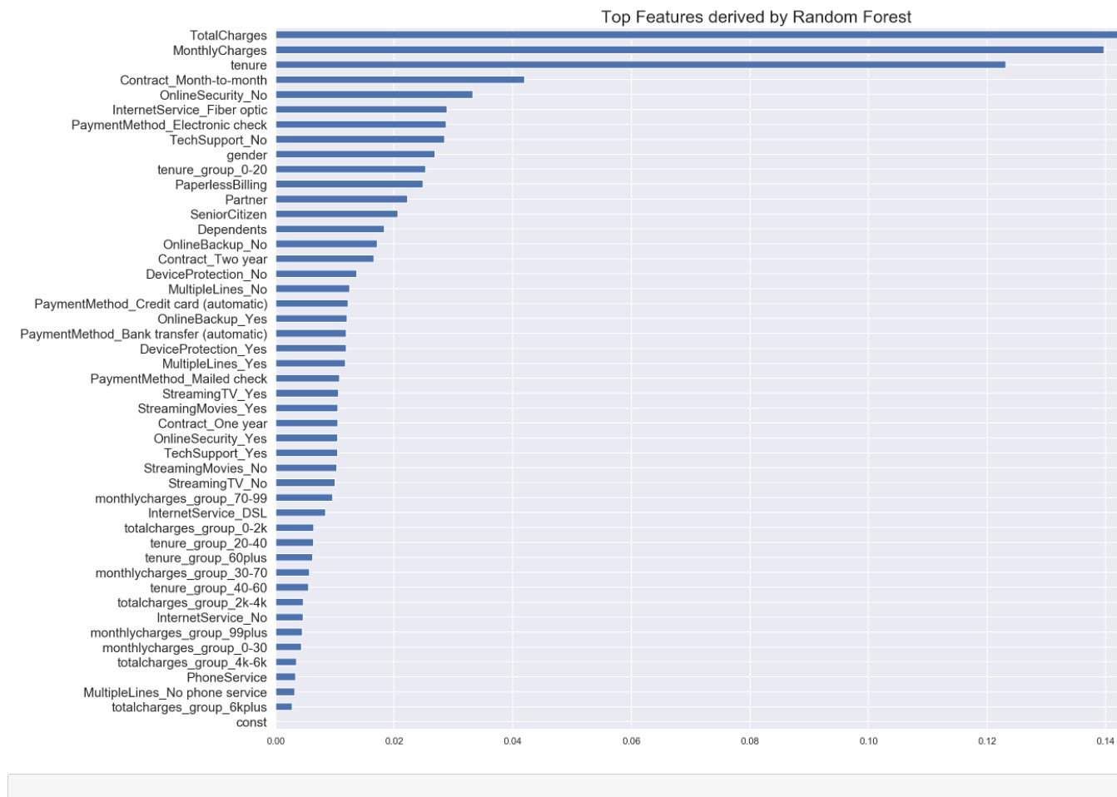
Top Features by Random Forest
I would propose to implement the Logistic Regression model with these top 18 features.
business can also focus on this list of features to understand whether a customer will likely to churn or not.

Slide 22
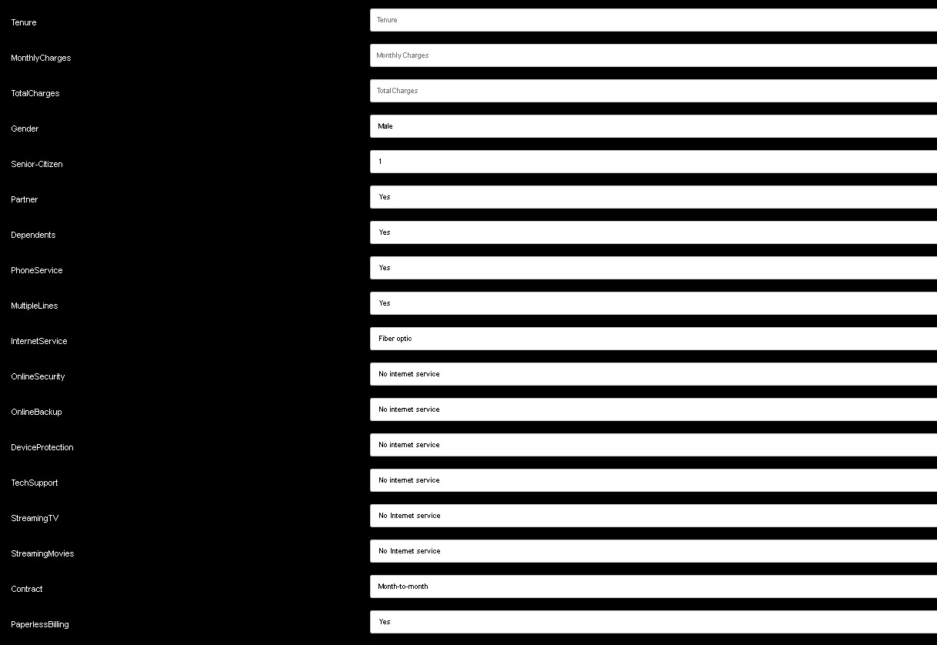
Deployment
Building Churn Prediction web Application:

Slide 23
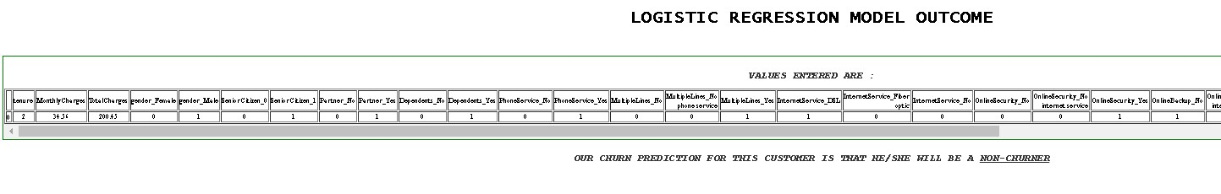
DEPLOYMENT(CONT’D)

Slide 24
BUSINESS IMPACT
Now a days, telecommunication industry is struggling with a notorious issue of customer churn. The issue has serious allegation on customer loyalty along with revenue loss in major perspective.
The only way is to retain the on the hand customers by using customer churn prediction model. Machine Learning techniques help telecom.
Industry in this perception by providing techniques to identify such customers so that retention actions could be targeted upon them.
Predict churn subscribers with web application.

Slide 25

Thank You

