Slide 1

Hotel Reservation Operations Analytics

Slide 2
About Me
Gnan Naga Sai Vikas
B.E(Electronics and Communication Engineering)
To build practical skills in SQL and data analytics and turn raw data into meaningful business decisions.
LinkedIn: https://www.linkedin.com/in/vikassai7/

Slide 3
Agenda
Introduction
Why This Project
Dataset Information
Database & Tables Overview
Table Structure Explanation
ER Diagram / Relationships
Problem Statement
SQL Queries
Key Analysis Questions
Insights (Business Understanding)
Conclusion — Insights, Recommendations & Challenges
Q&A

Slide 4
Introduction
This project analyzes staypoint hospitality hotel reservation data using MySQL.
The database models hotels, guests, rooms, bookings, stays and staff.
SQL is used to understand booking demand, guest behaviour, stay outcomes, room utilization and operational performance.
My role: Data Analyst — using SQL to turn reservation data into business answers.

Slide 5
Why This Project
.
• Build practical SQL and data-analysis skills using a realistic banking scenario.
• Understand customer, account, transaction and loan behaviour through relational data.
• Practice multi-table JOINs, aggregation, HAVING, subqueries, UNION / UNION ALL and ROLLUP.
• Produce business-oriented insights that can support banking decisions

Slide 6
Dataset Information
The project uses 6 CSV files representing Hotel Reservation and Stay Records.
• guests.— 350
• hotels — 25
• staff — 70
• rooms — 600
• bookings — 2,800
• stays — 3,200
The analysis focuses on completed hotel reservation on guests,hotels,staff,rooms,bookings,stays on how this is working and analysis.

Slide 7
Database & Tables Overview
Database: MySQL — Hotel Reservation Analytics
Tables: hotels, guests, staff, rooms, bookings and stays.
Relationships:
hotels → rooms
guests → bookings
hotels → bookings
bookings → stays
rooms → stays
staff → stays
SQL techniques: SELECT, JOINs, GROUP BY, HAVING, subqueries, UNION / UNION ALL, ROLLUP and date-based analysis.
Dataset size: 350 guests, 25 hotels, 70 staff, 600 rooms, 2,800 bookings , 3,200 stays.

Slide 8
Table Structure Explanation
Key fields used in the analysis:
hotels — hotel_id, hotel_name, city, star_rating, total_rooms, opened_date
guests — guest_id, guest_name, city, guest_type, preferred_room_type, loyalty_tier
staff — staff_id, staff_name, hire_date, rating, department, is_active
rooms — room_id, hotel_id, room_type, floor_number, max_occupancy, price_per_night
bookings — booking_id, guest_id, hotel_id, booking_date, room_type_requested, booking_channel, nights_booked, total_amount.
stays — stay_id, booking_id, room_id, staff_id, check_in_date, check_out_date, status, nights_stayed, service_requests, stay_duration_hrs.
Primary and foreign keys are used to connect related records. The fields above are the fields explicitly used by the project queries.

Slide 9
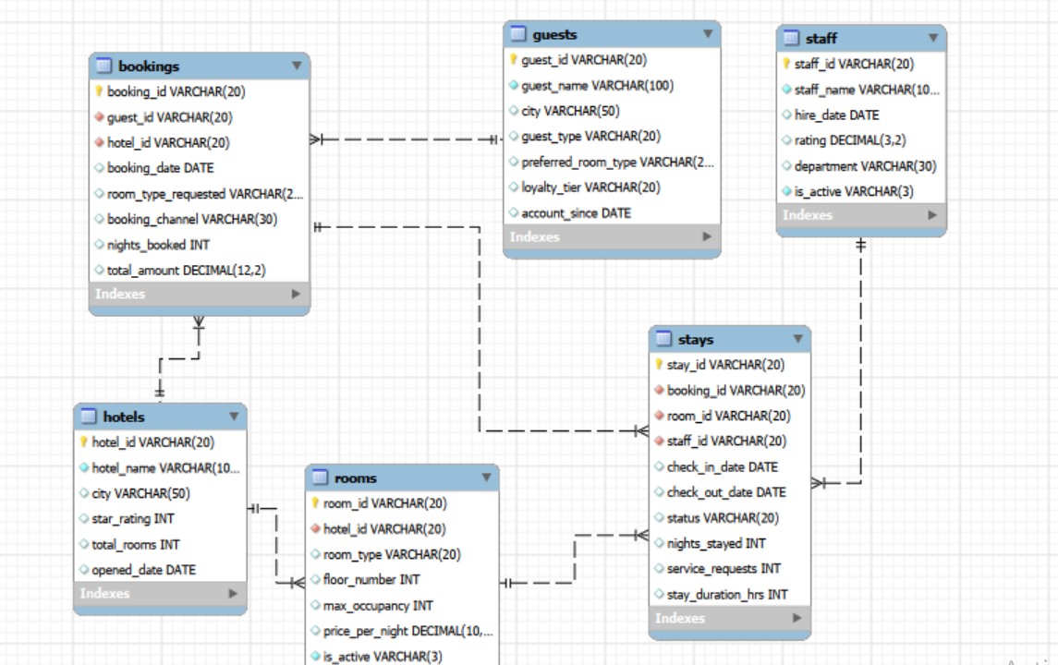
ER Diagram / Relationships

Slide 10
Problem Statement
Hotel reservation information is spread across multiple related tables, making it difficult to understand business performance from raw records alone.
The project addresses questions such as:
• Where and how are bookings generated?
• How do Individual and Corporate guests behave?
• How well are bookings converted into completed stays?
• How are staff and rooms being utilized?
• Which hotels and channels show higher problem-stay rates?

Slide 11
SQL Queries
The analysis uses business questions implemented in MySQL.
Core SQL concepts demonstrated:
• SELECT, WHERE and basic exploration
• INNER JOIN and LEFT JOIN across related tables
• GROUP BY with COUNT, SUM and AVG
• HAVING and ranking logic
• Subqueries for percentage and average-based comparisons
• DATE_FORMAT for monthly trend analysis
• Derived tables for per-hotel analysis

Slide 12
Query Results / Outputs
Total guests: 350 | Total bookings: 2,800 | Total stays: 3,200
4 room types, 5 booking channels, 63 active staff (of 70)
Total booking amount: ₹4,58,23,178.73 | Avg nights booked: 3.32
Stay outcomes: Checked-out 66.2%, No-show 16.9%, Cancelled 15.0%, In-progress 1.9%
Highest problem-stay hotel: StayPoint Kochi Palace (~39.2% no-show/cancelled)
OUTPUT
transaction_type | Count | Total_Amount
Credit | 290 | 2,338,007.84
Interest | 284 | 2,189,474.17
Transfer | 308 | 1,799,783.34
Debit | 280 | 1,613,463.57
ATM Withdrawal | 271 | 1,549,386.01
Fee | 255 | 1,486,437.43
SQL QUERY
SELECT transaction_type,
COUNT(*) AS transaction_count,
SUM(amount) AS total_amount
FROM transactions
WHERE status = 'Completed'
GROUP BY transaction_type
ORDER BY total_amount DESC;
KEY INSIGHT
Credit generates the highest completed transaction amount (2,338,007.84). GROUP BY and aggregate functions allow category-level comparison.

Slide 13
1. Which hotels show the strongest booking volume?
OUTPUT
SELECT h.hotel_name, COUNT(b.booking_id) AS total_bookings
FROM hotels h LEFT JOIN bookings b ON b.hotel_id=h.hotel_id
GROUP BY h.hotel_id, h.hotel_name
ORDER BY total_bookings DESC;
Metric | Result
Hotels analyzed | 25
Bookings / hotel | 98–129
Pattern | No single hotel dominates
KEY INSIGHT
Bookings are spread fairly evenly across all 25 hotels, so demand is diversified rather than concentrated in one property.

Slide 14
2. Which booking channels are most important?
OUTPUT
SELECT booking_channel, COUNT(*) AS total_bookings,
SUM(total_amount) AS total_amount, AVG(total_amount) AS avg_amount
FROM bookings GROUP BY booking_channel
ORDER BY total_bookings DESC;
Channel | Bookings | Avg. value
Website | 984 | ₹15,548
Mobile App | 875 | ₹17,427
Other channels | 941 | —
KEY INSIGHT
Website leads booking volume, while the Mobile App has a higher average booking value.

Slide 15
3. Which requested room type is most in demand?
OUTPUT
SELECT room_type_requested, COUNT(*) AS total_bookings,
SUM(total_amount) AS total_amount
FROM bookings GROUP BY room_type_requested
ORDER BY total_bookings DESC;
Room type | Bookings / value
Standard | 1,259 bookings
Suite | Highest avg value: ₹27,477
Standard | Avg value: ₹10,781
KEY INSIGHT
Standard rooms are the volume leader, while Suites generate much higher value per booking.

Slide 16
4. How do Individual and Corporate guests differ?
OUTPUT
SELECT g.guest_type, COUNT(DISTINCT g.guest_id) AS guests,
COUNT(b.booking_id) AS bookings, AVG(b.total_amount) AS avg_value
FROM guests g JOIN bookings b ON b.guest_id=g.guest_id
GROUP BY g.guest_type;
Guest type | Guests | Bookings | Avg. value
Individual | 233 | 1,903 | ~₹16K–16.5K
Corporate | 117 | 897 | ~₹16K–16.5K
KEY INSIGHT
Individual guests generate more than twice the bookings, but Corporate bookings have a similar ticket size.

Slide 17
5. What are the overall stay outcomes?
OUTPUT
SELECT status, COUNT(*) AS total_stays,
100*COUNT(*)/(SELECT COUNT(*) FROM stays) AS pct
FROM stays GROUP BY status;
Status | Stays | Share
Checked-out | 2,117 | 66.2%
No-show | 541 | 16.9%
Cancelled | 480 | 15.0%
In-progress | 62 | 1.9%
KEY INSIGHT
Only 66.2% of stays complete. No-shows and cancellations together account for roughly 1 in 3 stays.

Slide 18
6. Which hotel has the highest problem-stay rate?
OUTPUT
SELECT h.hotel_name, COUNT(*) AS total_stays,
SUM(CASE WHEN s.status IN ('No-show','Cancelled') THEN 1 ELSE 0 END) AS problem_stays
FROM stays s JOIN bookings b ON b.booking_id=s.booking_id JOIN hotels h ON h.hotel_id=b.hotel_id
GROUP BY h.hotel_name ORDER BY problem_stays/COUNT(*) DESC;
Hotel | Problem-stay rate
StayPoint Kochi Palace | ~39.2%
Overall no-show + cancelled | 31.9%
KEY INSIGHT
The worst hotel is well above the overall problem-stay rate, pointing to hotel-level operational factors.

Slide 19
7. Does staff workload track with staff ratings?
OUTPUT
SELECT st.staff_name, st.rating, COUNT(s.stay_id) AS stays_handled
FROM staff st LEFT JOIN stays s ON s.staff_id=st.staff_id
GROUP BY st.staff_id, st.staff_name, st.rating
ORDER BY stays_handled DESC;
Measure | Result
Busiest staff | 56–59 stays
Example high rating | 4.82
Example lower rating | 3.15
KEY INSIGHT
Higher caseload does not clearly correspond to lower ratings; the busiest staff include both high- and lower-rated employees.

Slide 20
8. Which room types drive volume versus premium value?
OUTPUT
SELECT r.room_type, COUNT(s.stay_id) AS stays, AVG(r.price_per_night) AS avg_price
FROM rooms r JOIN stays s ON s.room_id=r.room_id
GROUP BY r.room_type;
Room type | Key result
Standard | 1,440 stays
Suite | ₹8,865 avg price/night
Business view | Volume vs. premium value
KEY INSIGHT
Standard drives occupancy volume, while Suites represent the premium revenue lever.

Slide 21
9. Are service requests linked to no-shows or cancellations?
OUTPUT
SELECT s.status, AVG(s.service_requests) AS avg_service_requests
FROM stays s GROUP BY s.status;
Outcome | Observed pattern
No-show | Almost all: 0 requests
Cancelled | Almost all: 0 requests
Interpretation | Pre-arrival issue
KEY INSIGHT
Problem stays generally have no service requests, showing that the drop-off happens before in-stay service delivery.

Slide 22
Insights (Business Understanding)
• Booking demand is evenly spread across the 25 hotels.
• Website and Mobile App together drive ~66% of bookings; Mobile App has the higher average booking value
.
• Individual guests generate more than twice the bookings of Corporate guests, but average booking value is similar.
• About 1 in 3 stays never completes, with problem rates clustering by hotel.
• Standard rooms drive occupancy volume; Suites drive premium value.
• No-show and cancelled stays generally have zero service requests, indicating a pre-arrival problem.
KEY INSIGHT
Some bookings map to more than one stay record. The report flags this for validation as a possible re-booking pattern or data artifact.

Slide 23
Conclusion — Insights, Recommendations & Challenges
Insights Summary:
Booking demand is healthy and diversified, but ~34% of stays fail to complete and the problem is concentrated by hotel.
Recommendations:
• Investigate high-problem hotels individually.
• Treat No-show/Cancellation as a pre-arrival issue through confirmations, reminders and policy review.
• Lean into Mobile App revenue potential.
• Grow existing Corporate relationships.
• Plan Standard capacity and Suite pricing as two different business levers.
Challenges Faced:
• Mixed DD-MM-YYYY and YYYY-MM-DD date formats required STR_TO_DATE during import.
• LOAD DATA LOCAL INFILE required both server-side and client-side local-infile settings.

Slide 24
Q&A
Q1. What is the objective of this project?
To analyze hotel reservations using MySQL and produce business insights on booking demand, guest behaviour, stay outcomes and operations.
Q2. Why are foreign keys important?
They maintain referential integrity between hotels, guests, rooms, bookings, stays and staff.
Q3. Why did you use JOINs?
The required business information is distributed across related tables, so JOINs connect the records needed for analysis.
Q4. Why use GROUP BY and HAVING?
GROUP BY creates analysis groups; HAVING filters grouped results after aggregation.
Q5. Why use subqueries?
Subqueries help calculate benchmarks such as overall averages or percentages before the outer query compares results.
Q6. What is your strongest business insight?
About one-third of stays fail to complete, and the problem varies more by hotel than by booking channel.
Q7. Which channel has the highest average booking value?
The Mobile App, at about ₹17,427 per booking, higher than the Website at about ₹15,548.
Q8. What was the main challenge?
Handling mixed date formats and correctly connecting multiple tables without creating incorrect joins or orphaned records.

Slide 25
My Experience & Challenges
Multi-table joins: connecting customers → accounts → transactions and loans → loan payments required careful key matching.
Aggregation logic: GROUP BY and HAVING needed careful selection of grouped columns and measures.
Advanced SQL: understanding subqueries and ROLLUP took practice to apply correctly to real banking questions.
Data validation: imported CSV row counts and sample records were checked against the project documentation.
Outcome: the project strengthened SQL fundamentals and business-oriented analytical thinking for Data Analyst interviews.

Slide 26

THANK YOU

