Slide 1
Computer Vision Face Recognition using MATLAB
Srushanth Baride
MSc Machine Learning in Science
ID: 20409232
© University of Nottingham (2021)

Slide 2
Table of Contents
Face Recognition Applications
Steps taken
Pre-Processing
HOG (Histogram of Oriented Gradients)
SVM (Support Vector Machines)
Results

Slide 3
Face Recognition Applications
Face recognition is used in
Surveillance Systems
Security
Access Control
Biometric
Facilitate Secure Transactions
Video Indexing
Crime Prevention

Slide 4
Steps taken
Pre-process the master dataset
Select the Method for Extracting Features and training the Face Recognition model
HOG (Histogram of Oriented Gradients)
Distance between facial features
Deep Learning
Decision Trees
SVM (Support Vector Machines)
Train the model
Test the model
Refine the model if the accuracy is not adequate
Choose a different model
Change hyper-parameters
Test the model
Repeat from step 3 till the required accuracy is reached

Slide 5
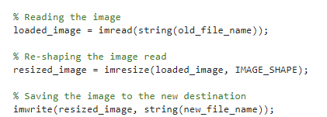
Pre-processing
Pre-processing is a crucial step
The major aspect of pre-processing step is
Resize the image to desired shape
Save the resized image to the desired destination

Slide 6
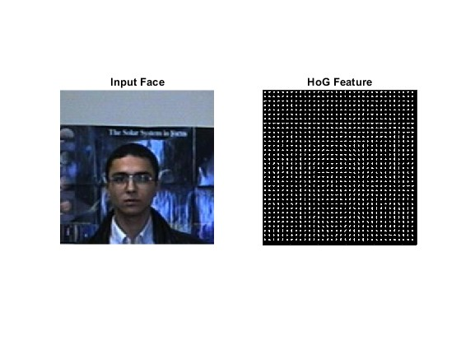
HOG (Histogram of Oriented Gradients)
HOG (Histogram of Oriented Gradients) is a feature descriptor used to extract features from an image
HOG is majorly used for
Object Detection
Object Recognition
HOG is extremely good at detecting the edges
HOG is also able to detect the direction of the edges as well

Slide 7
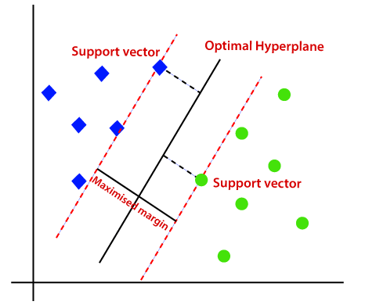
SVM (Support Vector Machines)
SVM (Support Vector Machines)
Is a Supervised Learning Algorithm
Highly Dependent on Support Vectors
Majorly used for Multi-class Classification
Can also be used for Regression tasks
Separates the classes using the hyper-planes
Linear
Non-linear

Slide 8
Results
The model gives an accuracy of 100% in both testing and validation stages
Total 8 different classes have been used
Each class contains 20 pictures of the class

Slide 9
Thank You
Code: https://github.com/Srushanth/UoN-COMP4106-Face-Recognition-using-MATLAB

