Slide 1
Computer Vision Face Recognition using MATLAB
Srushanth Baride
ID: 20409232
© University of Nottingham (2021)

Slide 2
Who am I
Srushanth Baride
Physics and Astronomy
Education
Work
Electronics and Communication Engineering
2012-2016
L&T Technology Services
Engineer
2017-2020
MSc Machine Learning in Science
2021-2022
Accenture International
Senior Data Analyst
2020-2021

Slide 3
Introduction to Project
Overview
Steps taken
Pre-Processing
HOG (Histogram of Oriented Gradients)
SVM (Support Vector Machines)
Results

Slide 4
Steps taken
Pre-process the master dataset
Select the Method for Training the Face Recognition model
HOG (Histogram of Oriented Gradients)
Deep Learning
Train the model
Test the model
Refine the model if the accuracy is not adequate
Test the model

Slide 5
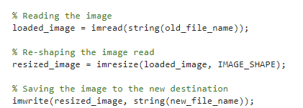
Pre-processing
Pre-processing is a crucial step
The major aspect of pre-processing step is
Resize the image to desired size
Save the resized image to the desired destination

Slide 6
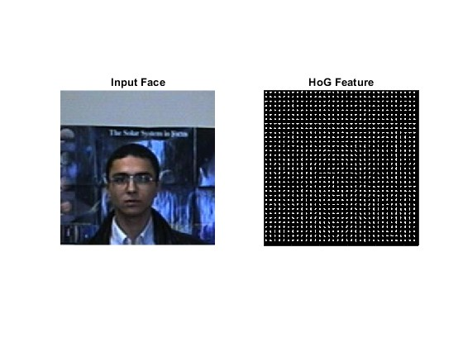
HOG (Histogram of Oriented Gradients)
HOG (Histogram of Oriented Gradients) is a feature descriptor used to extract features from an image
HOG is majorly used for
Object Detection
Object Recognition
HOG is extremely good at detecting the edges
HOG is also able to detect the direction of the edges as well

Slide 7
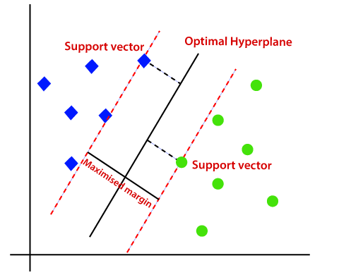
SVM (Support Vector Machines)
SVM (Support Vector Machines)
Is a Supervised Learning Algorithm
Highly Dependent on Support Vectors
Majorly used for Multi-class Classification
Can also be used for Regression tasks
Separates the classes using the hyper-planes
Linear
Non-linear

Slide 8
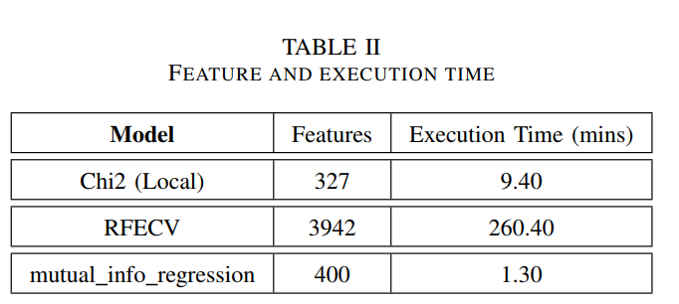
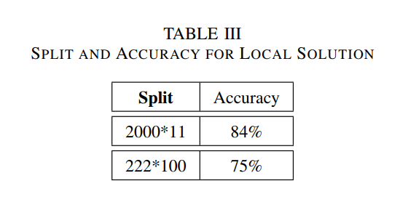
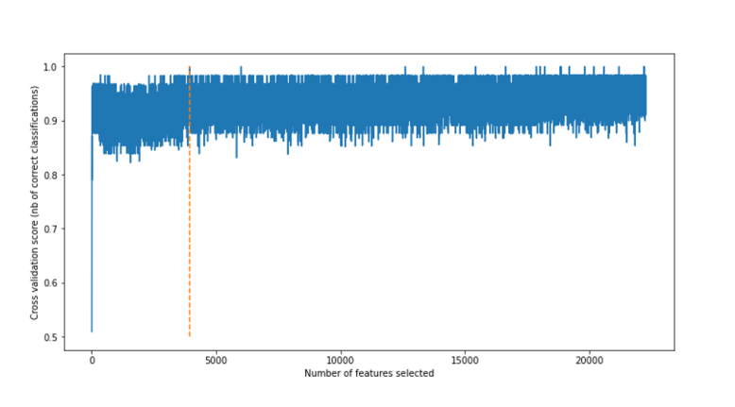
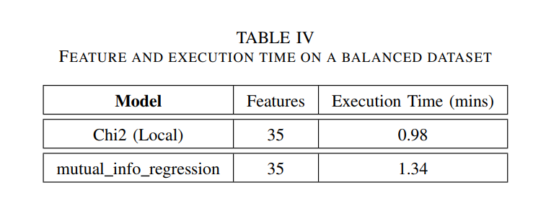
Results

Slide 9
Thank You

