Slide 1
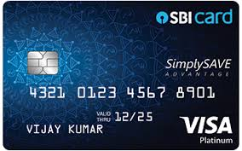
Credit Card Fraud Detection

Slide 2
Introduction
Dataset Description
Flowchart
Benefits
EDA
Data Preparation
Unsupervised Learning
Limitations and future work
Agenda

Slide 3
Introduction
Credit card fraud may happen in various ways, which depend on the type of fraud
concerned; it encapsulates bankruptcy fraud, theft fraud / counterfeit fraud,
application fraud and behavioral fraud.
We are living in a world which is rapidly adopting digital payments systems. Credit
card and payments companies are experiencing a very rapid growth in their
transaction volume.
It becomes challenging due to two major reasons–first, the profiles of normal and
fraudulent behaviors change frequently and secondly due to reason that credit
card fraud data sets are highly skewed.
Credit card companies shall be able to recognize fraudulent credit card transactions so that customers are not charged for items that they did not purchase.

Slide 4
Dataset Description
The datasets contains transactions made by credit cards by european cardholders.
This dataset presents transactions that occurred in two days, where we have 492 frauds out of 284,807 transactions.
The dataset is highly unbalanced, the positive class (frauds) account for 0.172% of all transactions.
It contains only numerical input variables which are the result of a PCA transformation.
Features V1, V2, ... V28 are the principal components obtained with PCA, the only features which have not been transformed with PCA are 'Time' and 'Amount’.
Feature 'Time' contains the seconds elapsed between each transaction and the first transaction in the dataset.
The feature 'Amount' is the transaction Amount
Feature 'Class' is the response variable and it takes value 1 in case of fraud and 0 otherwise.

Slide 5
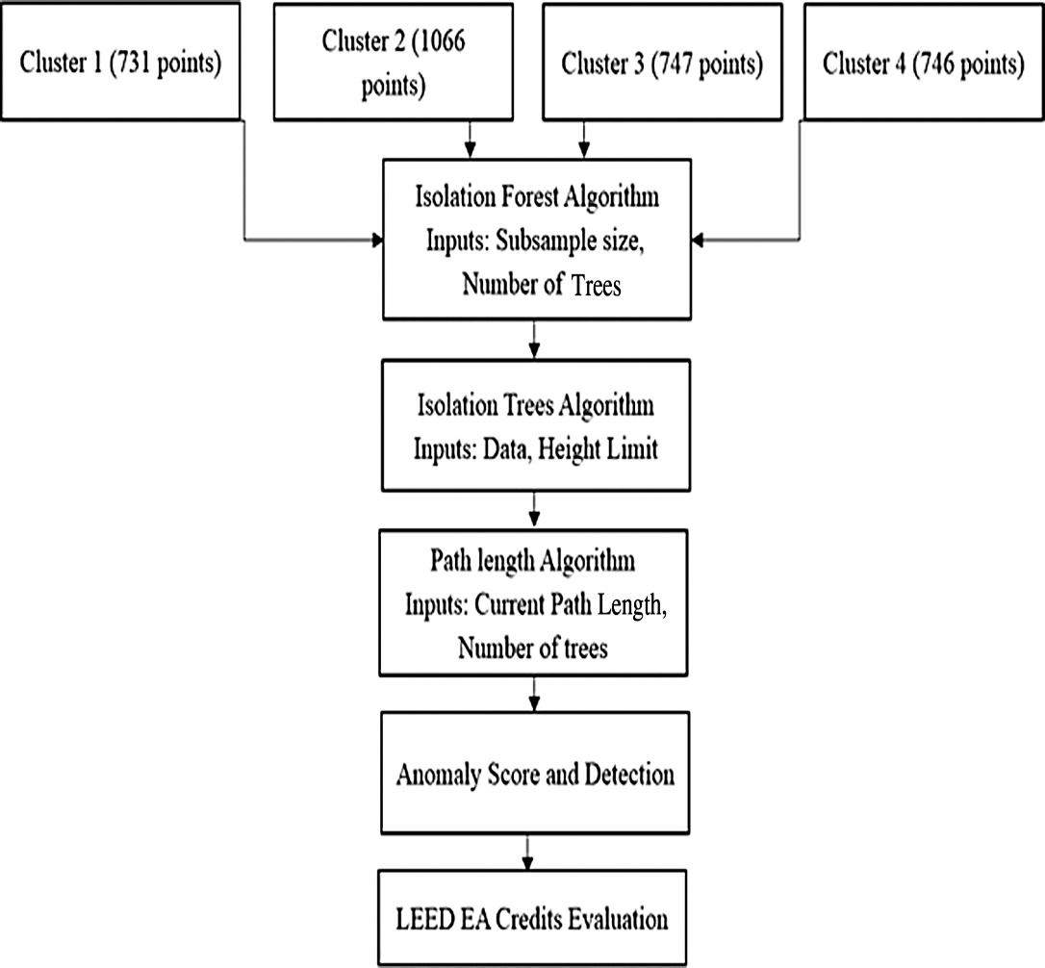
Flowchart

Slide 6
Exploratory Data Analysis (EDA)
Based on the mean and maximum, the distribution of the monetary value of all transactions is heavily right-skewed.
The vast majority of transactions are relatively small and only a tiny fraction of transactions comes even close to the maximum.

Slide 7
Creating a Training Set for a Heavily Imbalanced Data Set
There are two key points:
i)utilize random under-sampling to create a training dataset with a balanced class distribution that will force the algorithms to detect fraudulent transactions as such to achieve high performance.
ii)Use the Receiver Operating Characteristics-Area Under the Curve or ROC-AUC performance measure. Essentially, the ROC-AUC outputs a value between zero and one, whereby one is a perfect score and zero the worst. If an algorithm has a ROC-AUC score of above 0.5, it is achieving a higher performance than random guessing.

Slide 8
Outlier Detection & Removal
Box plots provides the idea of outliers as all transactions outside of 1.5 times the IQR (Inter-Quartile Range) are usually considered to be outliers.
However, removing all transactions outside of 1.5 times the IQR would dramatically decrease our training data size, which is not very large, to begin with.
Here,focus is on extreme outliers outside of 2.5 times the IQR.

Slide 9
Classifications Algorithms
The most popular classification algorithms:
Logistic Regression
Linear Discriminant Analysis
K Nearest Neighbors (KNN)
Classification Trees
Support Vector Classifier
Random Forest Classifier
XGBoost Classifier

Slide 10
Unsupervised Learning
This project builds and deploys the following two machine learning algorithms:
Local Outlier Factor (LOF)
Isolation Forest Algorithm

Slide 11
LIMITATIONS
The problem is if the dataset increases more it may lead to over fitting problem.

Slide 12
FUTURE WORK
Implement a new architecture capable of detecting fraudulent transactions in real time by combining Apache spark and isolation forest

Slide 13

Thank You
Prepared By:
Srushti N Suvarna(16CE128)

