Slide 1
WILCO construction company
By:
Gurleen kaur, srushti gangireddy, wenjie li

Slide 2
agenda
Introduction
Business Problem
Old Database Model
Proposed Database Model
Web Application Prototypes
Conclusion

Slide 3
introduction
Jack and Bob Wilson started the company twenty years ago
Very few official titles with an organized structure
Jack and Bob, together take care of decision making
Mary does all the office work
City, township, and country government projects

Slide 4
Business problems
Generation of EEOC Compliance reports
Calculation of complex payrolls
Tracking inventories and tools

Slide 5
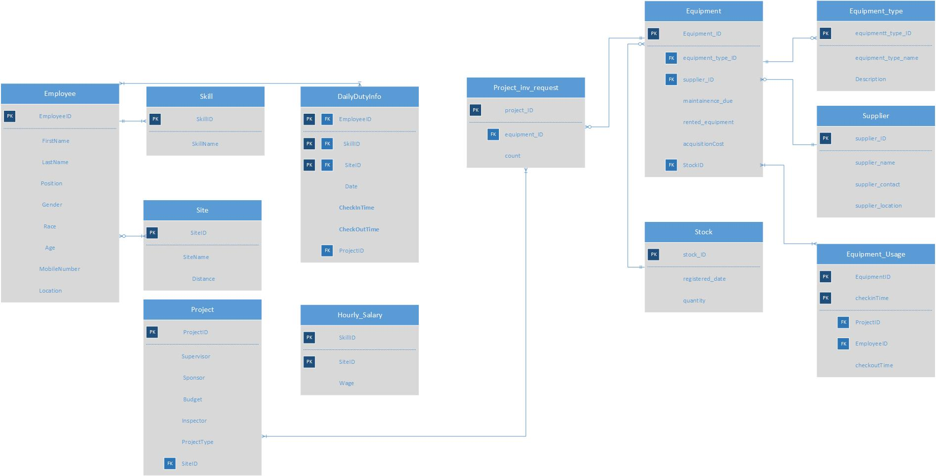
Old database model

Slide 6
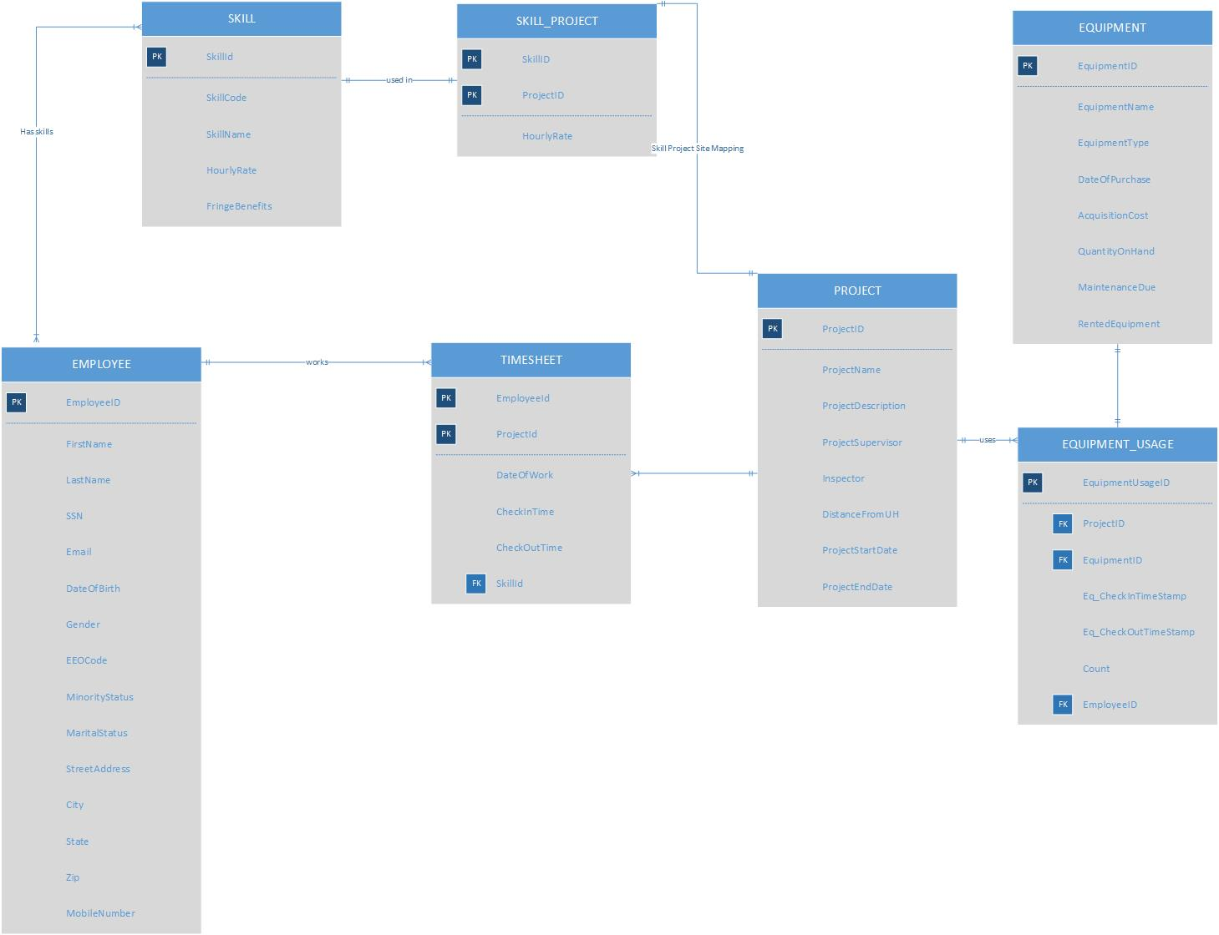
Proposed database design model

Slide 7
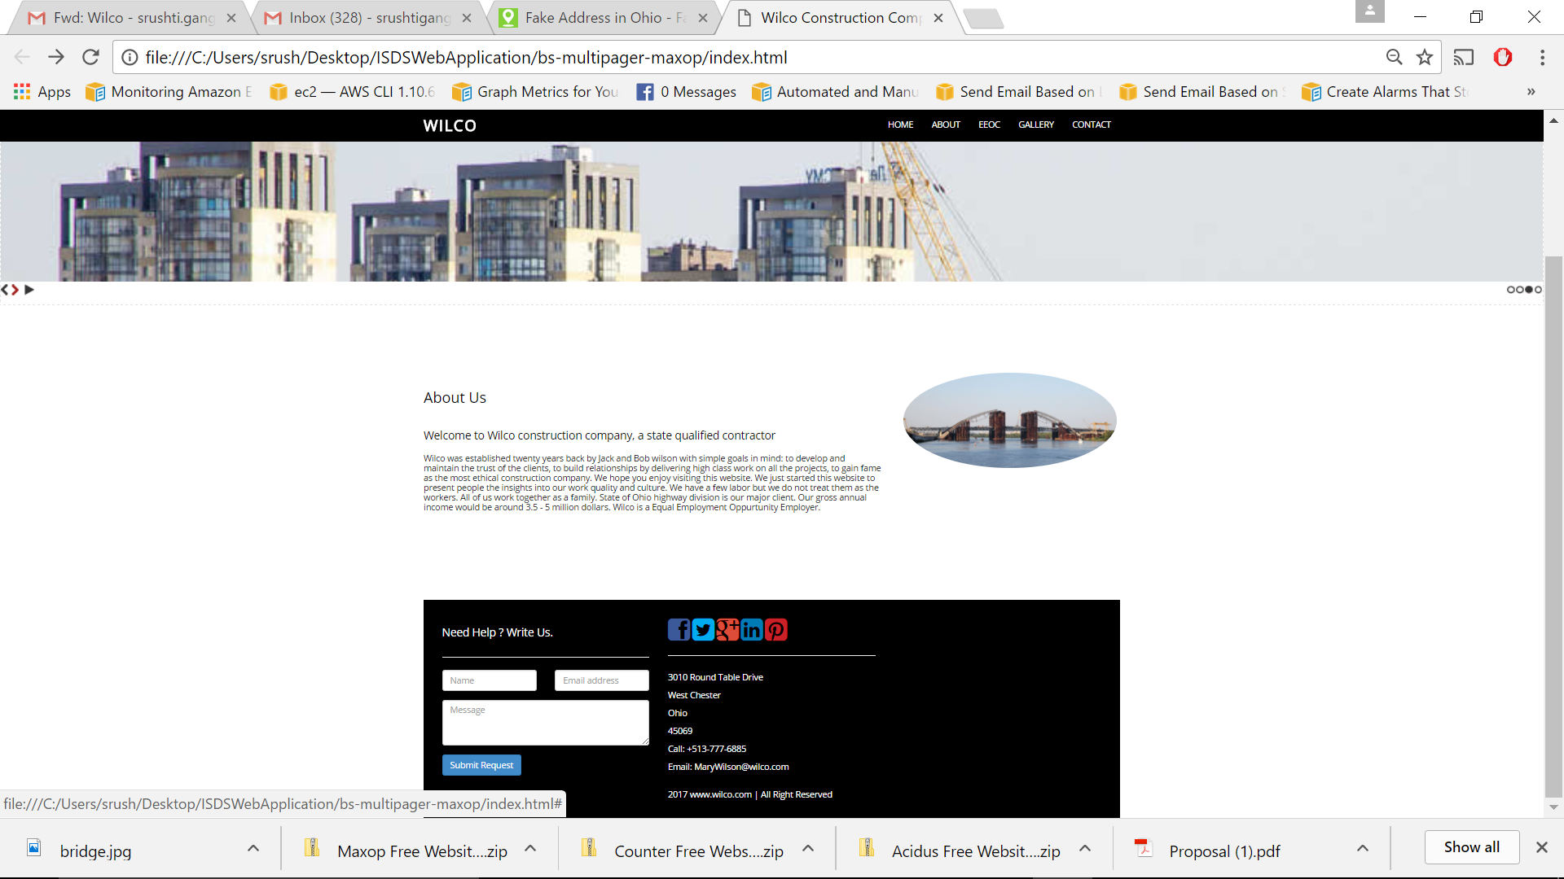
Web application prototypes

Slide 8
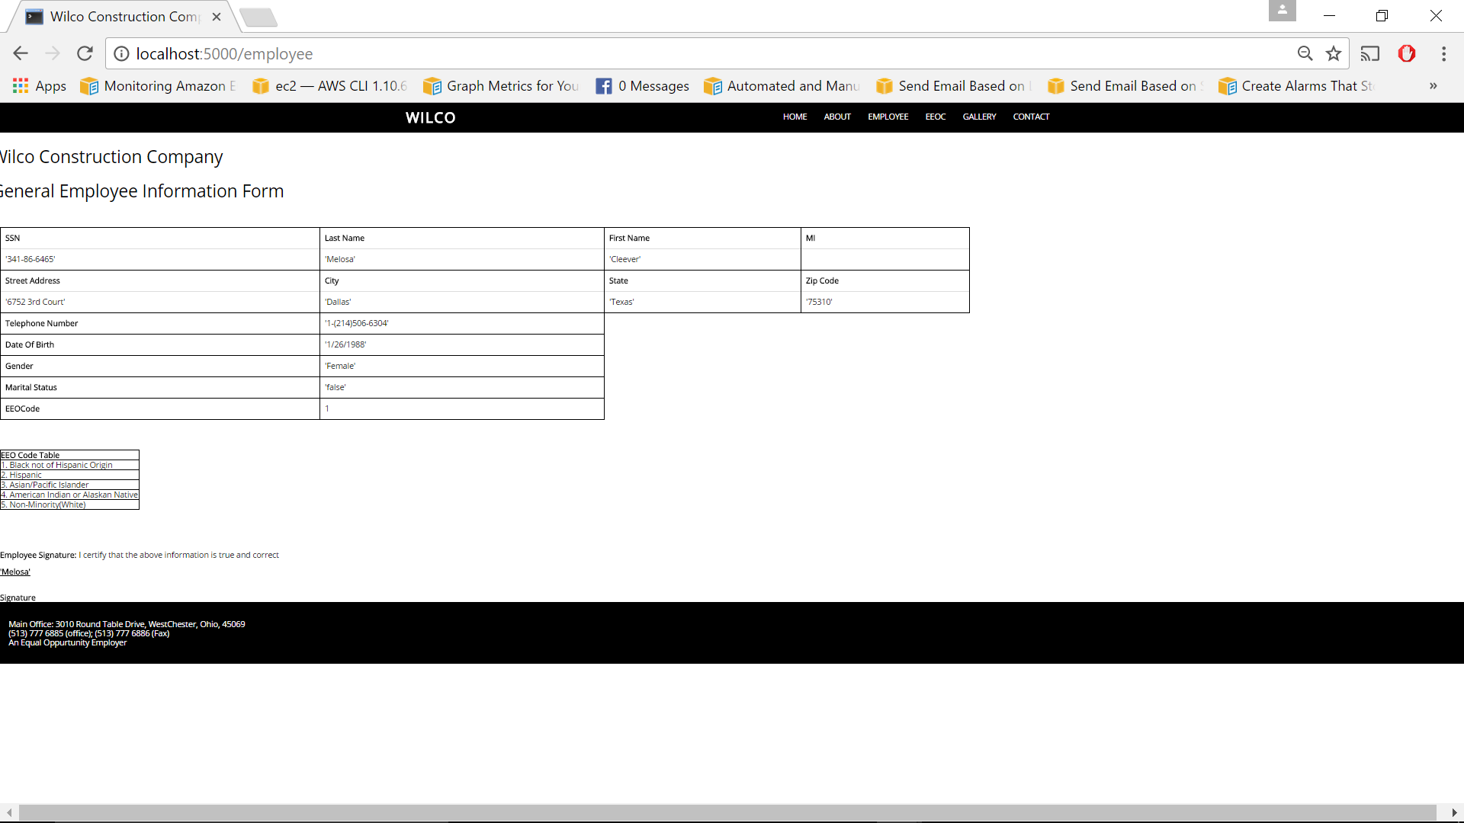
Web application prototypes (cont.)

Slide 9
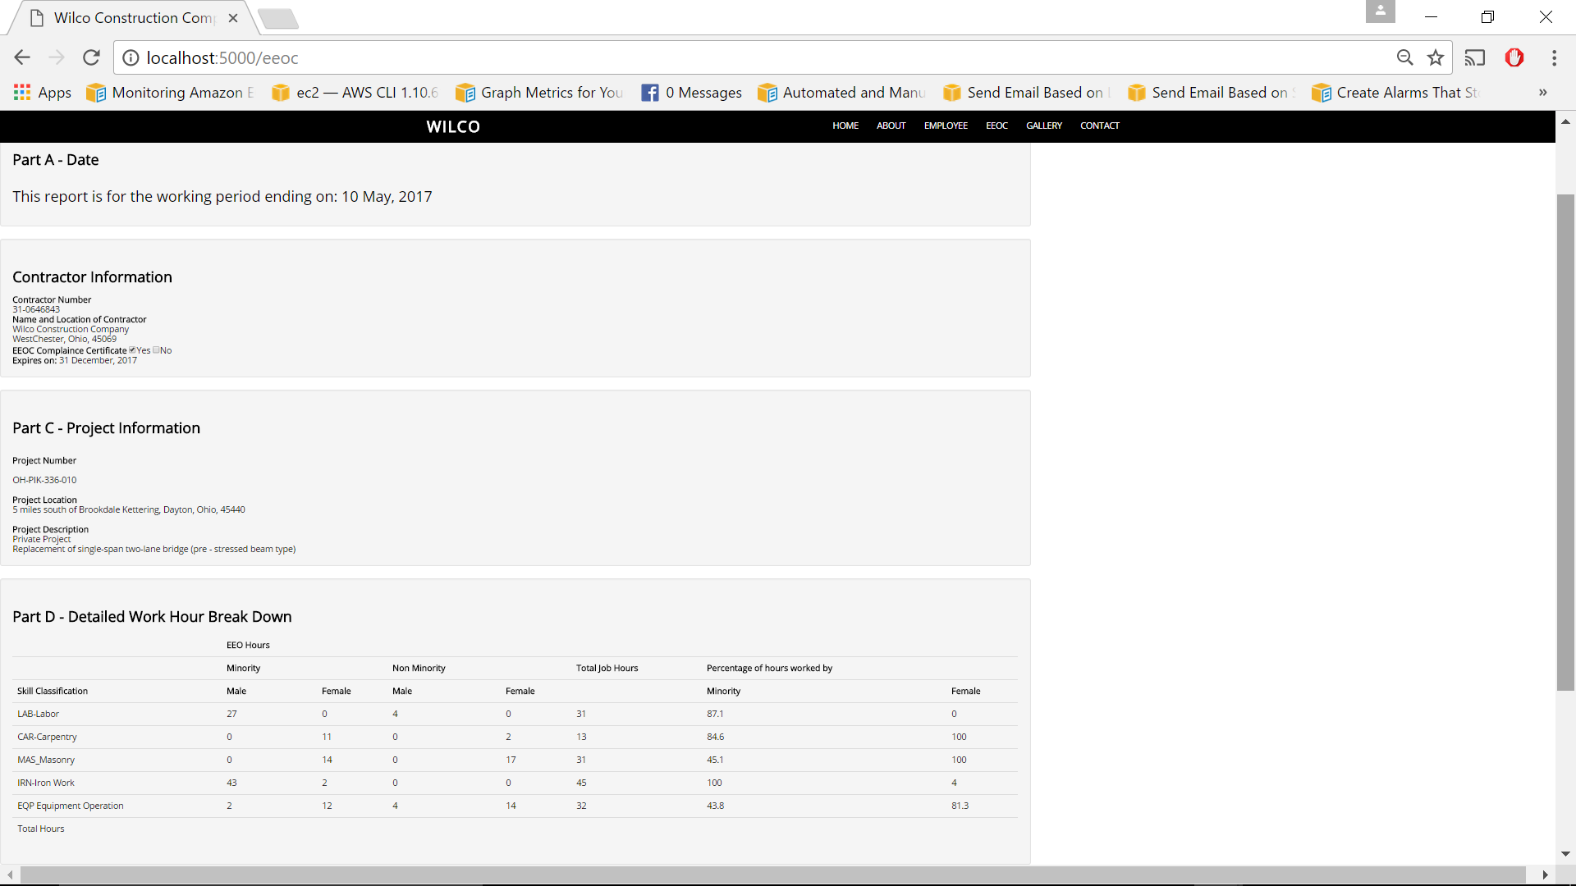
Web application prototypes(cont.)

Slide 10
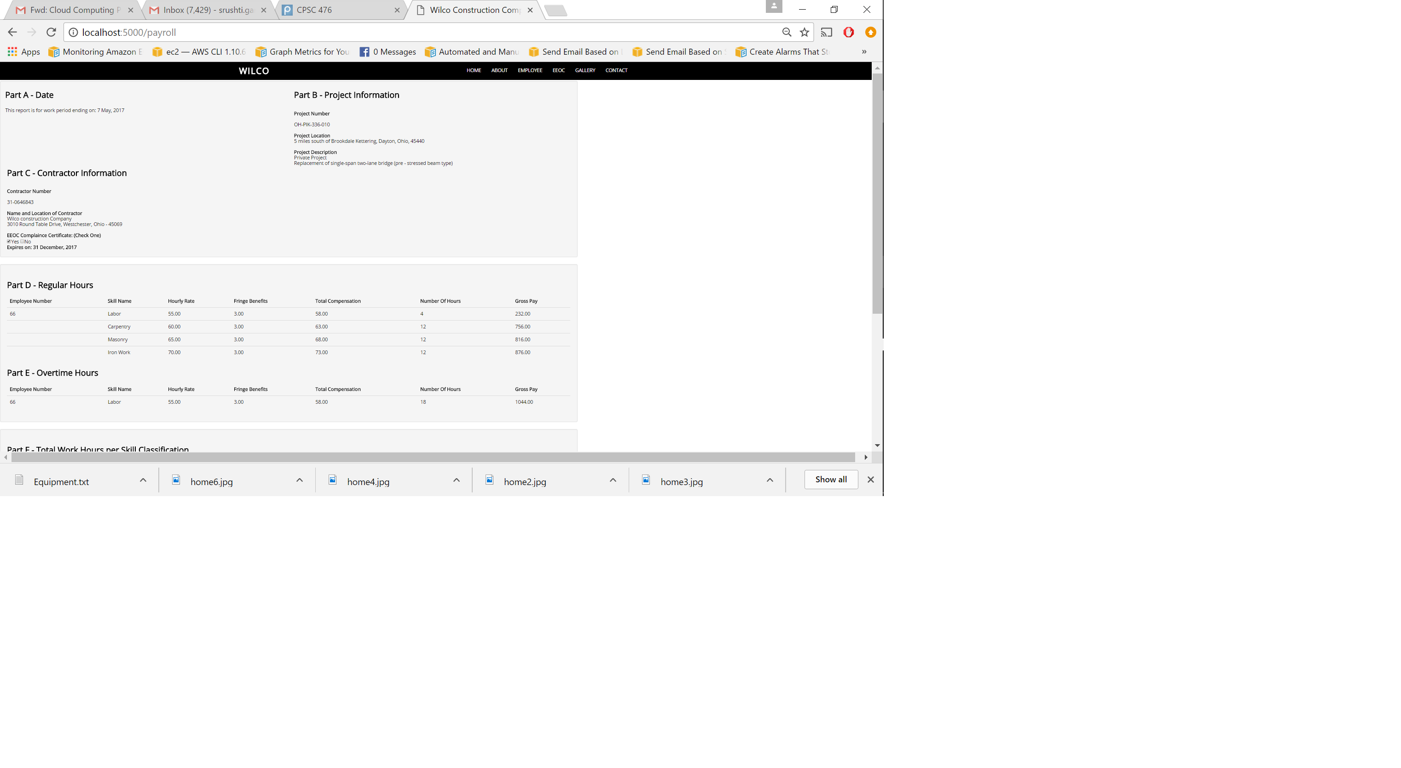
Web application prototypes(cont.)

Slide 11
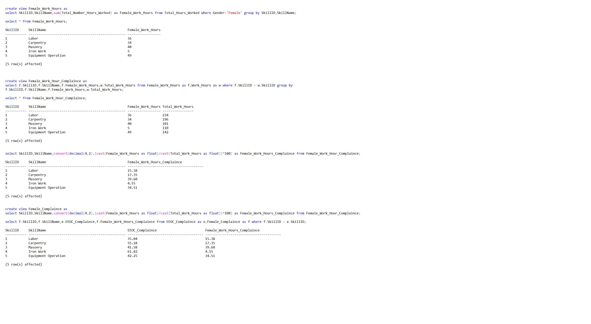
EEOC_CompliAnce

Slide 12
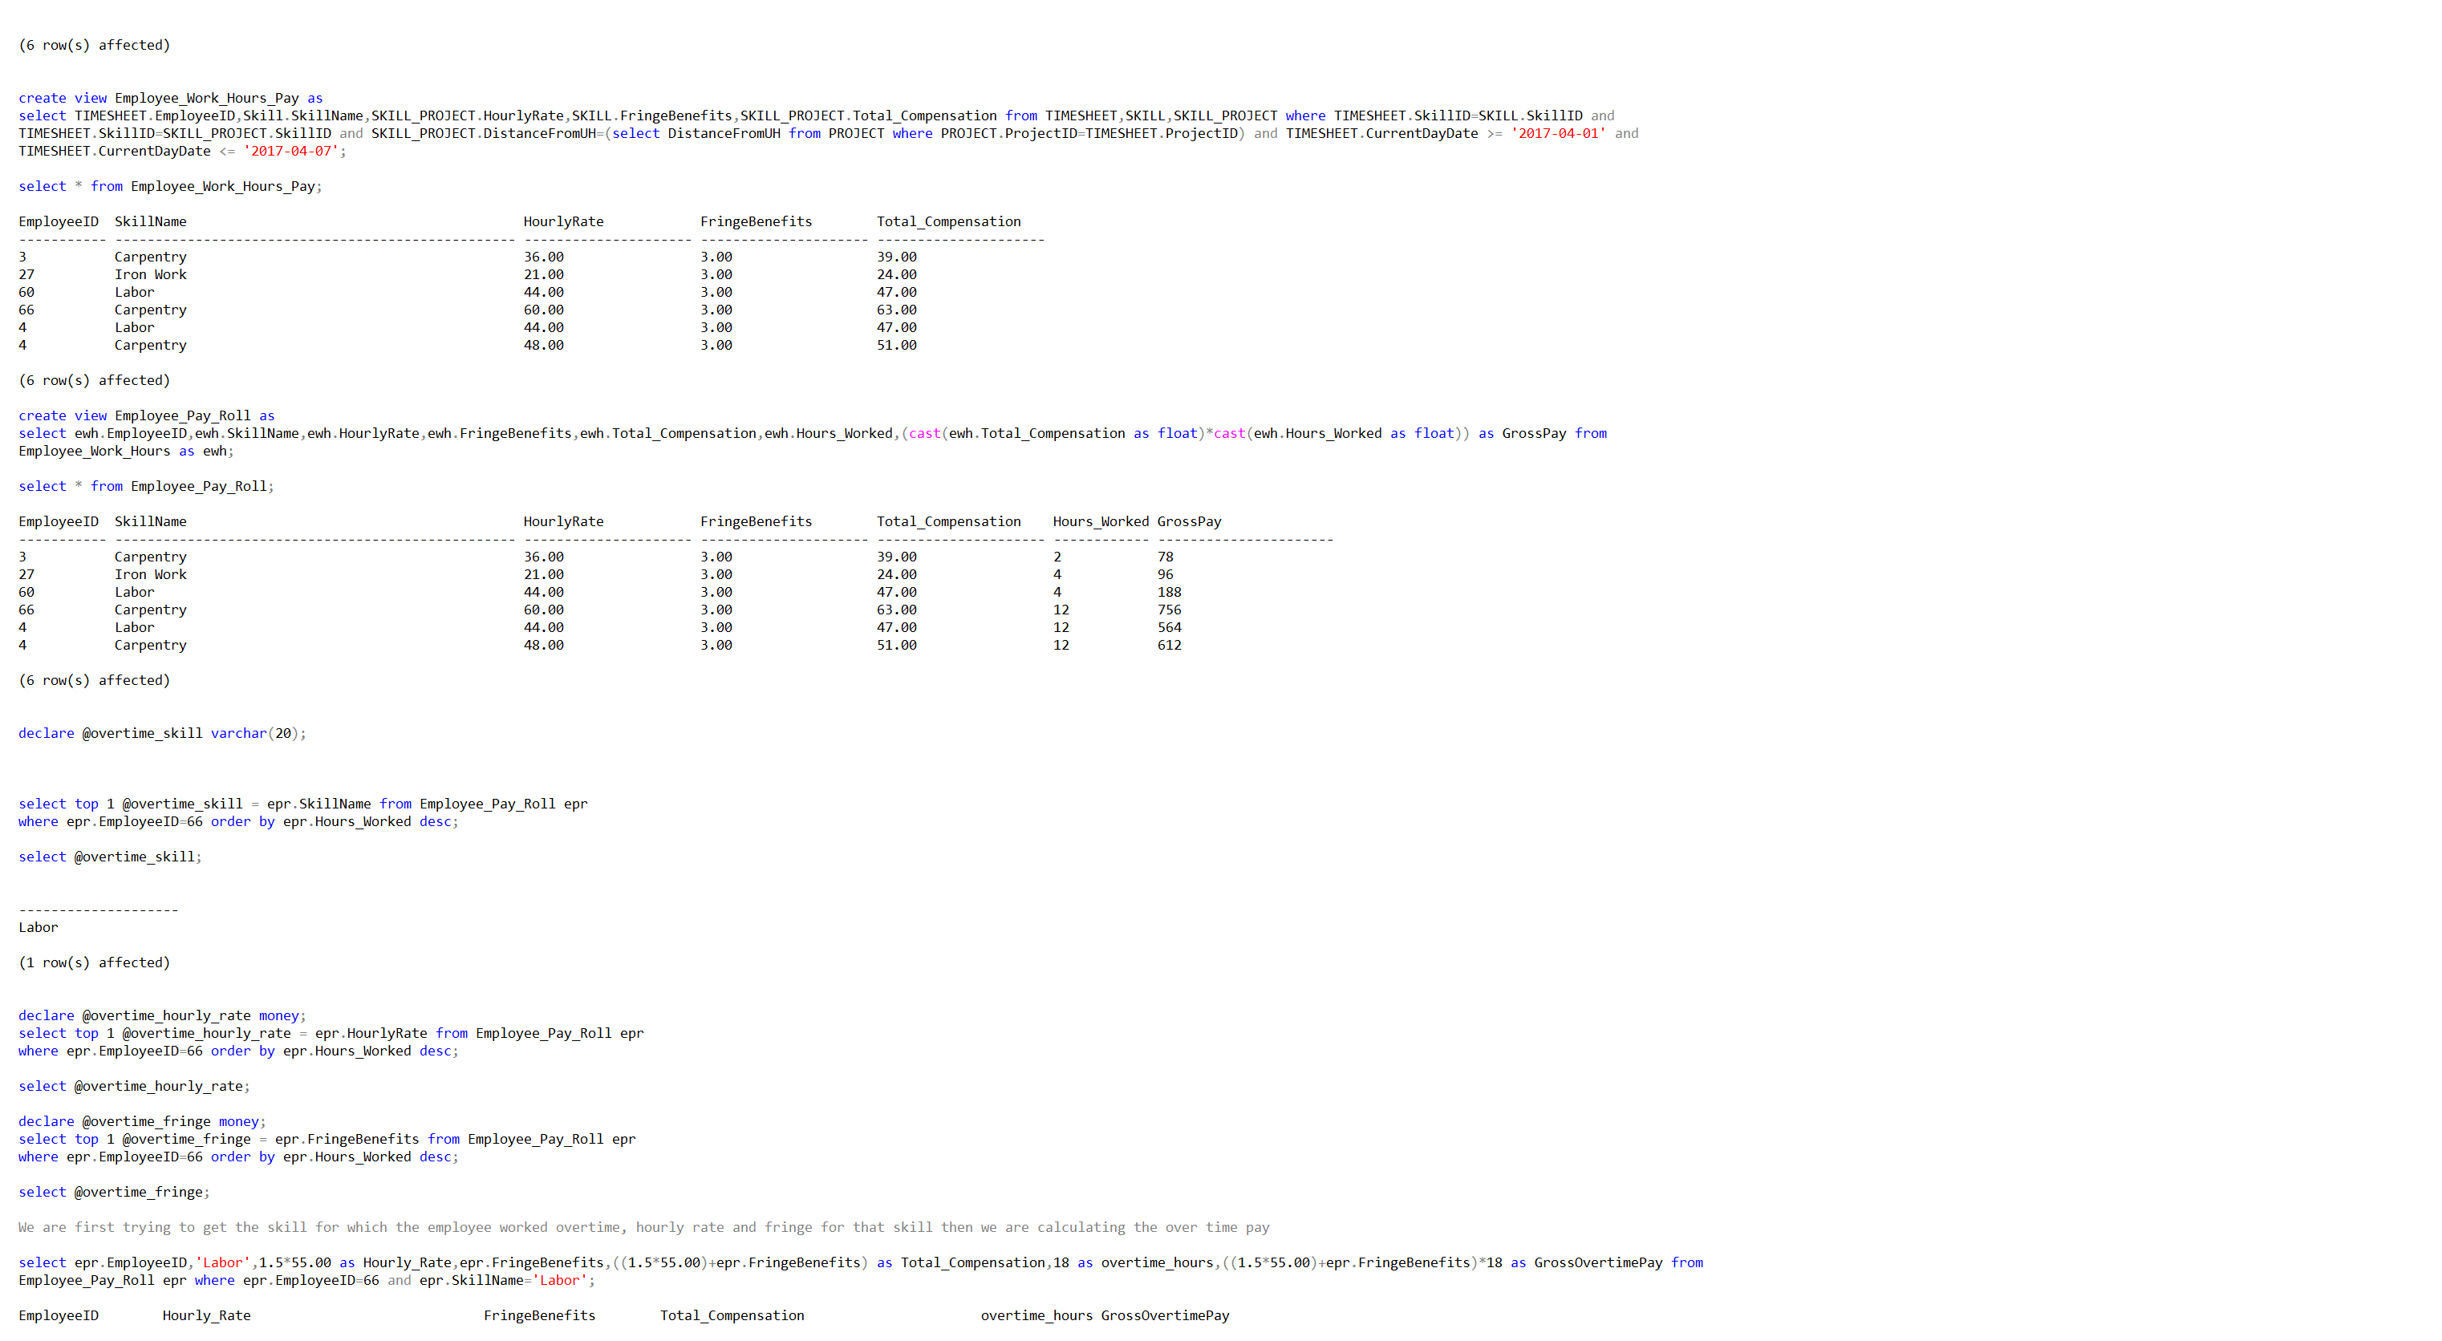
Payroll System

Slide 13
inventory System
Keep record of all the equipment using equipment ID
Use maintenance due date to schedule maintenance
Check out equipment using employee ID and project ID to track each equipment

Slide 14
FUTURE SCOPE
Online check in and check out by supervisor for each employee
Store detailed data for each project and vendor for future analysis
Keep financial data for tax purposes
Send low inventory alerts

Slide 15
conclusion
The proposed database model will address the problem of payroll generation.
Generates once in two weeks which can be sent to the EEOC.
Inventory maintenance process is easier.
Can be enhanced to automate majority of company’s operations.

Slide 16
Thank you

