Slide 1


Ministry/Organization Name:
Rajasthan Police Hackathon 1.0
Problem Statement Title :
POLICE FEEDBACK SYSTEM
Team Name :
THE INNOVENTURES
Team Members :
1) Akanksha Sawalikar
2)Srushti Kulkarni
3)Shruti Pagar
4)Shravani Deshmukh
Institute Name :
Pune Institute Of Computer Technology

Slide 2
IDEA APPROACH / DETAILS
User-Centric Design:
Create an intuitive, user-friendly web portal .
Women‘s safety :
We prioritize women's voices with a dedicated feedback form, ensuring their unique experiences shape a safer community-police relationship.
Tech Integration:
Assess and enhance the police department's tech infrastructure.
Iterative Improvement:
Continuously collect and implement user feedback.
Community Outreach:
Develop an outreach plan for education and awareness.
Transparency and Reporting:
Provide regular reports on actions taken in response to feedback.

Slide 3

Technology Stack :
Frontend: React
Backend: Node.js, Express
Database: MongoDB (with MongoDB Atlas for cloud hosting)

Slide 4
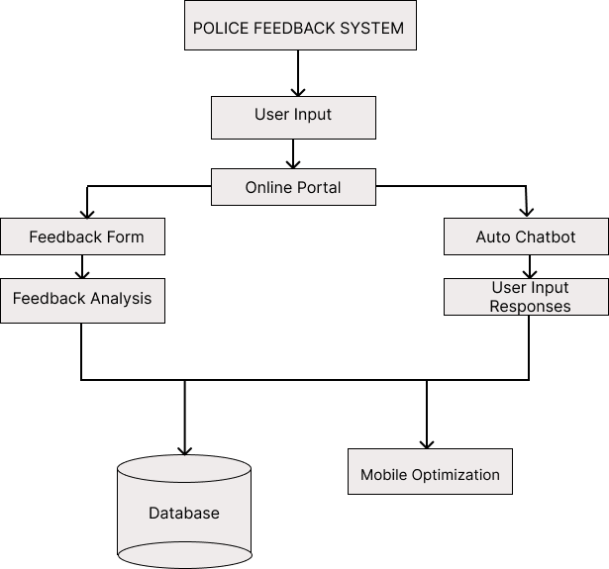
FlowChart :

Slide 5

Results :
Online Portal
Social Media-Like Platform
Bulk SMS Tool
Multilingual

Slide 6
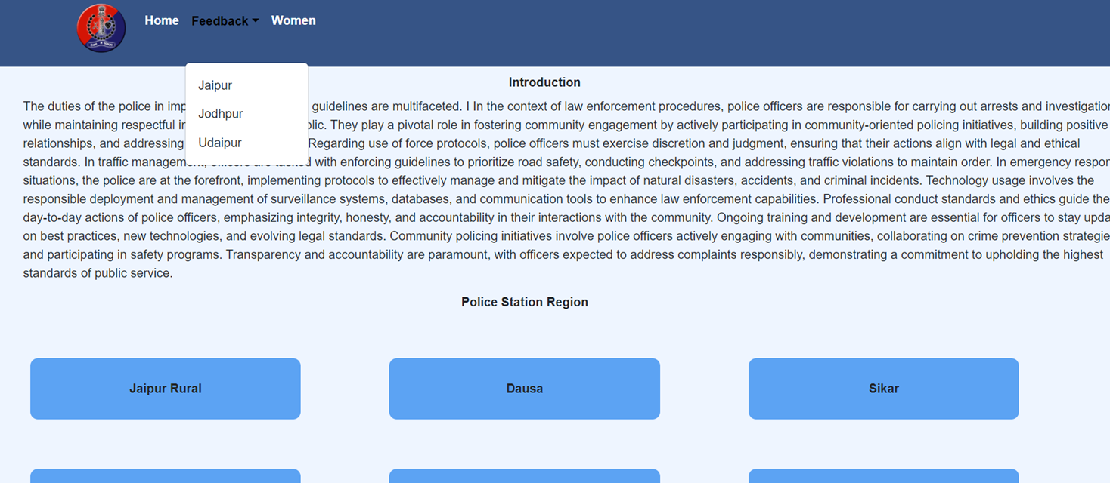
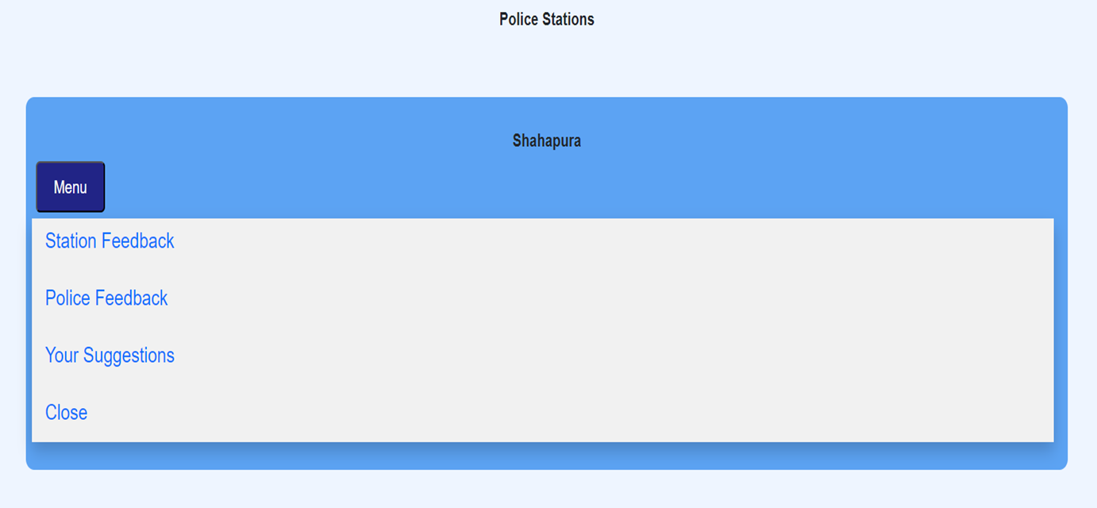

Slide 7
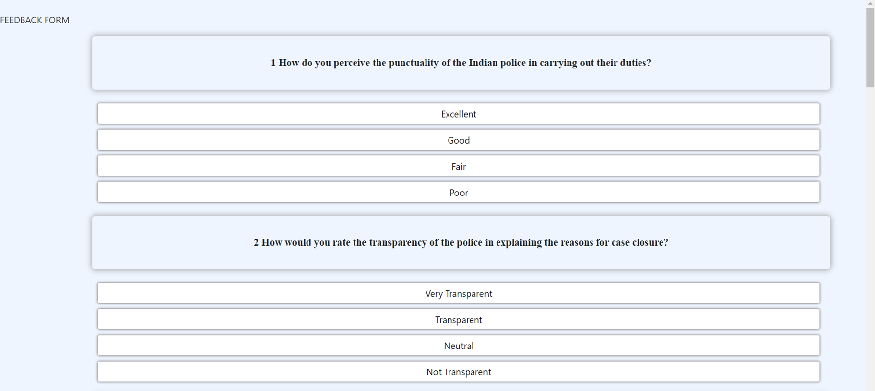
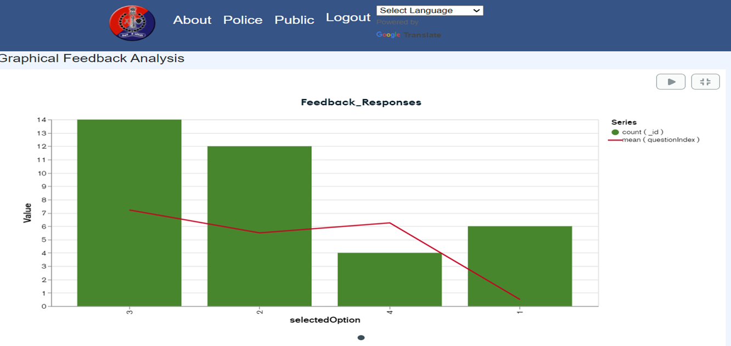

Slide 8
Future Scope :
To make it Scalable
To integrate in mobile application
To provide GPS location facility for users
Implementing JanSoochana api
Integration with ML model

Slide 9
References :
https://www.mongodb.com/cloud/atlas/lp/try4?utm_ad_campaign_id=14412646476&adgroup=131761130772&cq_cmp=14412646476&gad_source=1
https://jansoochna.rajasthan.gov.in/
https://nodemailer.com/

Slide 10
Conclusion :
Our proposed solution integrates a user-friendly feedback system utilizing React, Node.js, and MongoDB (hosted on MongoDB Atlas), ensuring accessibility and efficiency across all stations for a more responsive and inclusive community-police relationship.

