Slide 1

SignoSpeak: Bridging the Gap
For deaf and mute

Slide 2

Abstract
This aim of this project is to bridge the gap between people who know sign language and the people who are new for it .
Capturing the images as input and detecting them to display on our interface

Slide 3

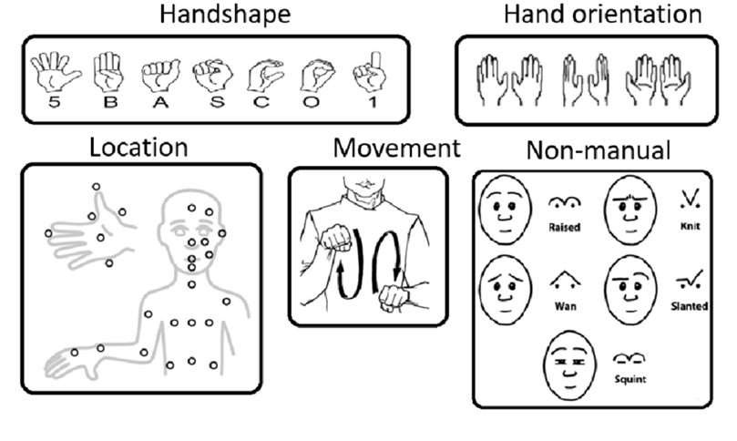
Various component of Sign Language:

Slide 4
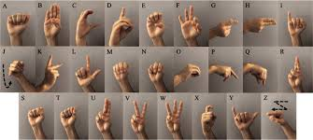
ASL (American Sign Language)
ASL is widely spoken sign language and many other sign languages are derived from it.
There are over half a million ASL speakers in US.

Slide 5
SignoSpeak
Project Timeline
1
2
3
4
Capturing Raw Image
Data Collection
Feature Extraction
Model Selection
5
6
7
Training and Testing
System Intergration
Result

Slide 6
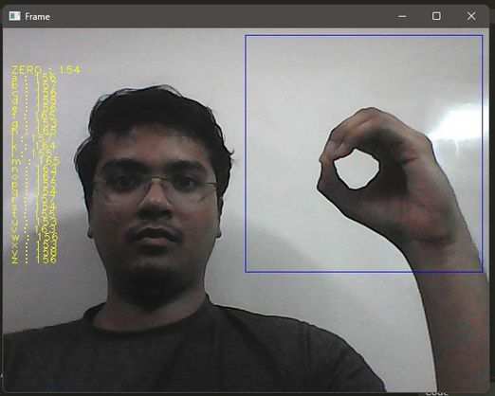
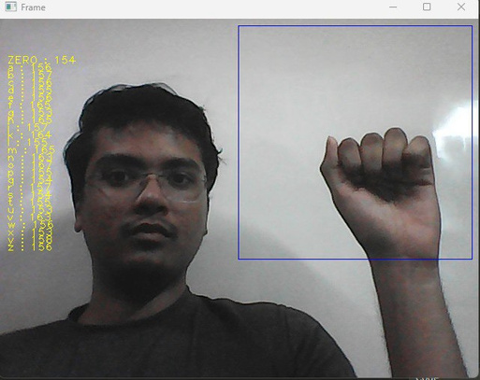
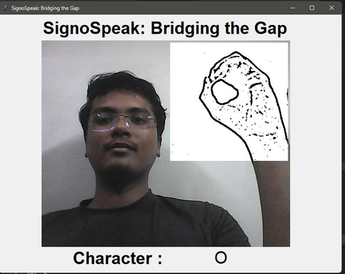
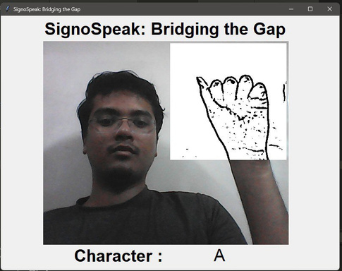
Capturing Raw Data
RGB Detection
Gray Scale Detection

Slide 7
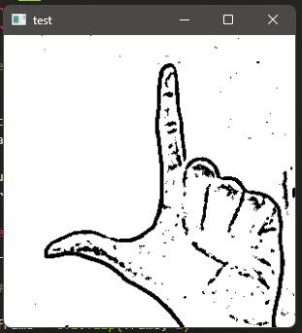
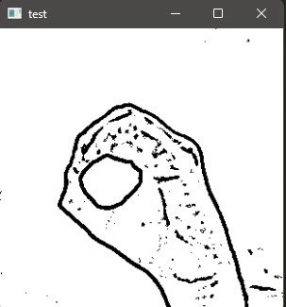
Data Collection
All Images are converted into Gray Scale and
an Individual folder will be created
for every single alphabet
and storing it in black and white images

Slide 8
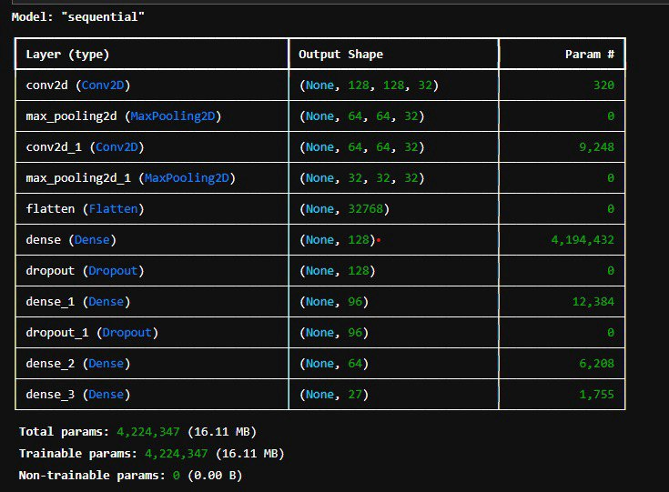
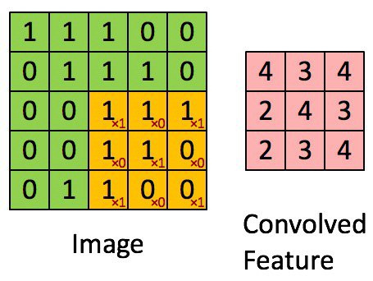
Feature Extraction
All the RBG values are
converted into Binary format
Which helps the model to detect and classify swiftly

Slide 9
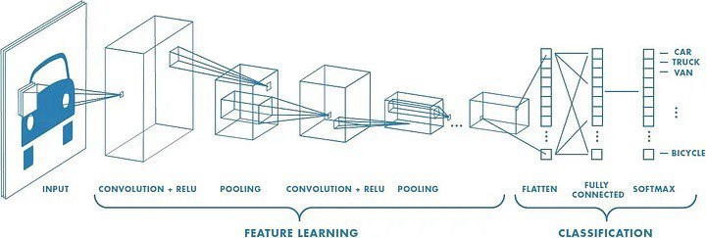
CNN (Convolutional Neural Network)
CNNs consist of multiple convolutional layers each layer containing numerous “filters” which perform feature extraction.
Initially these “filters” are random and by training, the feature extraction gets better by better.
It’s primarily used for image classification.

Slide 10
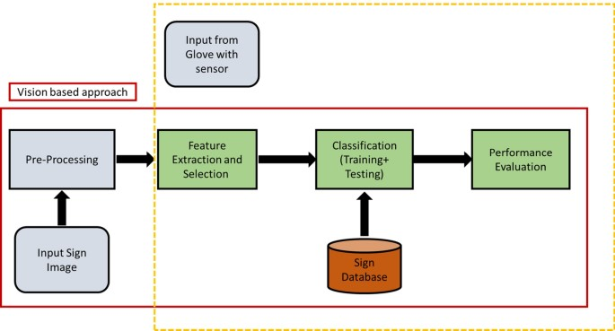
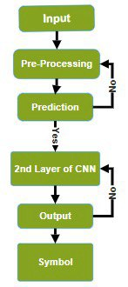
Model

Slide 11
Where it can be used
Education: In educational settings, sign-to-text conversion technology can assist deaf or hard of hearing students by providing
real-time captions during lectures, presentations, and classroom discussions. This helps ensure they have equal access to
educational content.
Video Content Accessibility: For online videos or video conferencing platforms, sign-to-text conversion technology can
automatically generate captions or subtitles from sign language present in the video, making the content accessible to a broader
audience.
Human-Computer Interaction: Sign-to-text conversion can enhance interactions with computers and mobile devices, enabling
users to input commands and communicate using sign language instead of traditional keyboard and mouse inputs.
Communication with Customer Support: Sign-to-text conversion can be integrated into customer support systems, allowing
deaf or hard of hearing customers to communicate with support agents using sign language while receiving written responses.
Public Events and Broadcasting: Sign-to-text conversion technology can be used in live events, public announcements, and
broadcasting to provide real-time sign language interpretation in the form of text overlays.
Healthcare and Medical Settings: In healthcare facilities, sign-to-text conversion technology can assist in communication
between medical staff and patients who use sign language, ensuring effective information exchange during medical
consultations.

Slide 12
Future Scope
Enhanced Accuracy
Multi-lingual and Multi-model support
Mobile and Wearable device integration

Slide 13
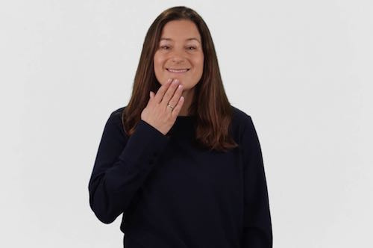
THANK YOU

