Slide 1
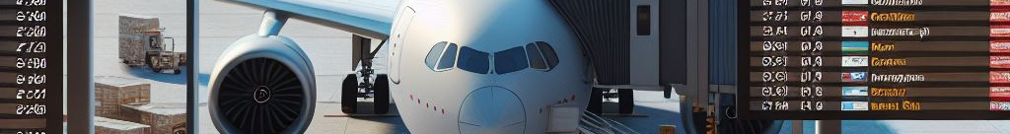
Voyage Analytics
Integrating MLOps in Travel – Production Deployment Journey
- Srushti Suthar
15/07/25 – 15/01/26

Slide 2
Description
- In the realm of travel and tourism, the intersection of data analytics and machine learning presents an opportunity to revolutionize the way travel experiences are curated and delivered.
- This capstone project revolves around a trio of datasets – users, flights, and hotels – each providing a unique perspective on travel patterns and preferences.
- The goal is to leverage these datasets to build and deploy sophisticated machine learning models, serving a dual purpose: enhancing predictive capabilities in travel-related decision-making and mastering the art of MLOps through hands-on application.

Slide 3
Objectives – Model Building
1. Regression Model Development:
Build a regression model to predict the price of a flight using the flights.csv dataset. Focus on feature selection, model training, and validation to ensure accuracy and reliability.
2. Gender Classification Model:
Deploy a classification model to categorize a user's gender.
3. Travel Recommendation Model:
Build a recommendation model to provide hotel suggestions based on user preferences and historical data. Develop a Streamlit web application to display insights and visualizations derived from the deployed travel recommendation model, offering an interactive and user-friendly interface for data exploration.

Slide 4
Objectives - MLOps
1. Model Tracking with MLFlow:
Utilize MLFlow for tracking and managing different versions of the travel price prediction model, ensuring a systematic approach to model iteration and deployment.
2. REST API for Regression Model:
Develop a REST API using Flask to serve the flight price prediction model, enabling real-time price predictions.
3. Containerization:
Package and deploy the flight price prediction model using Docker, ensuring portability and ease of deployment.
4. Kubernetes for Scalability:
Deploy the model using Kubernetes to manage scalability and handle varying loads efficiently.

Slide 5


Project Status
Model Building
Flight Price Prediction Model
Gender Classification Model
Travel Recommendation Model
MLOps
MLFlow Model Tracking
Streamlit UI + REST API (Flask)
Docker Containerization
Kubernetes Scalability

Slide 6
Project Architecture Overview
Layer | Language | Purpose
Frontend | Streamlit | Interactive UI
Backend | Python 3.10 | API + ML inference
ML Pipeline | Python 3.10 | Training + preprocessing
DevOps | YAML + Bash | Docker + orchestration
Container | Dockerfile | Packaging + deployment
Backend
Frontend
Python model building file
Streamlit UI
Flask API
Docker compose
Docker Container

Slide 7
Flight Price Prediction Model
- Data Handling and EDA
- Wrangling: Sanity checks for data, null values, duplicates, data types
- Preprocessing: Dates parsed, outliers removed, encoders (Ordinal and One-Hot Encoding), tranformation (PowerTransformer), scaler ( StandardScaler)
- Features: 25 columns exactly matching training schema
- Models: MLFlow tracking
- Pipeline: Streamlit → Flask /predict → 4-stage processing → JSON in <200ms
- Production: Dockerized, localhost:8501→5000
99.9% Accurate: Predicts exact flight prices (R² = 0.999)
Instant Results: Real-time predictions in under 200ms
Production Ready: Dockerized Flask API
Model | R² Score
Ridge | 0.740
Random Forest | 0.999
XGBoost | 0.997

Slide 8
Model Architecture Overview
Raw Input
Data wrangling
Data preprocessing
JSON payload
Clean DF
Scaled features
Model ready data
Streamlit UI
POST
Flask
/predict
Final Prediction

Slide 9
Project Structure
Voyage Analytics
api
app.py
app
Streamlit_app.py
src
data_handler
data_wrangling
data_preprocessing
models
prediction
training
Models
random_forest_flight.pkl
Docker-compose.yml
Dockerfile.api
Dockerfile.streamlit
Requirements.txt
data
raw
wrangled
processsed
features

Slide 10
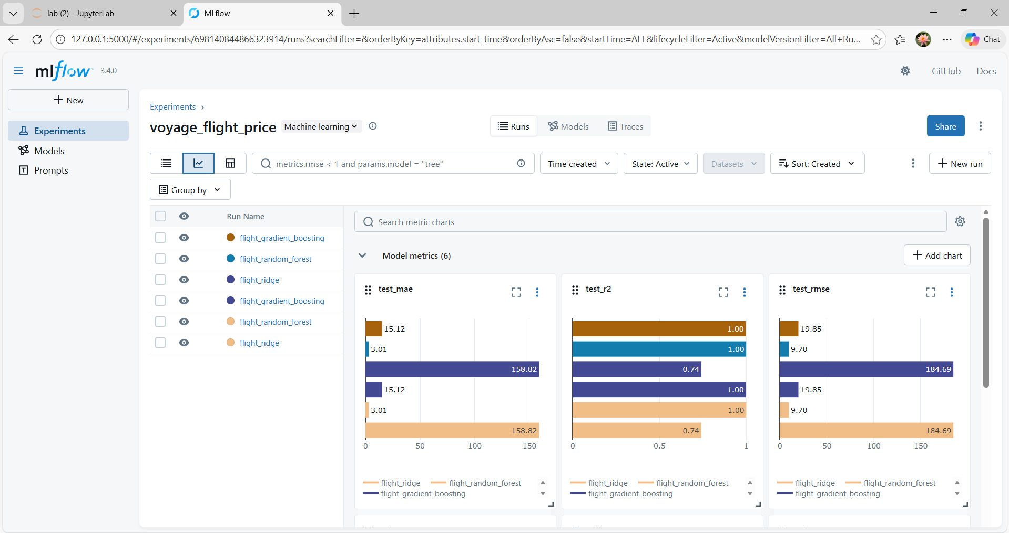
MLFlow UI – Models registered

Slide 11
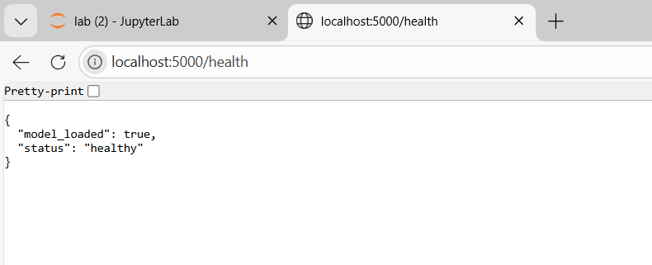
Flask API Health check

Slide 12
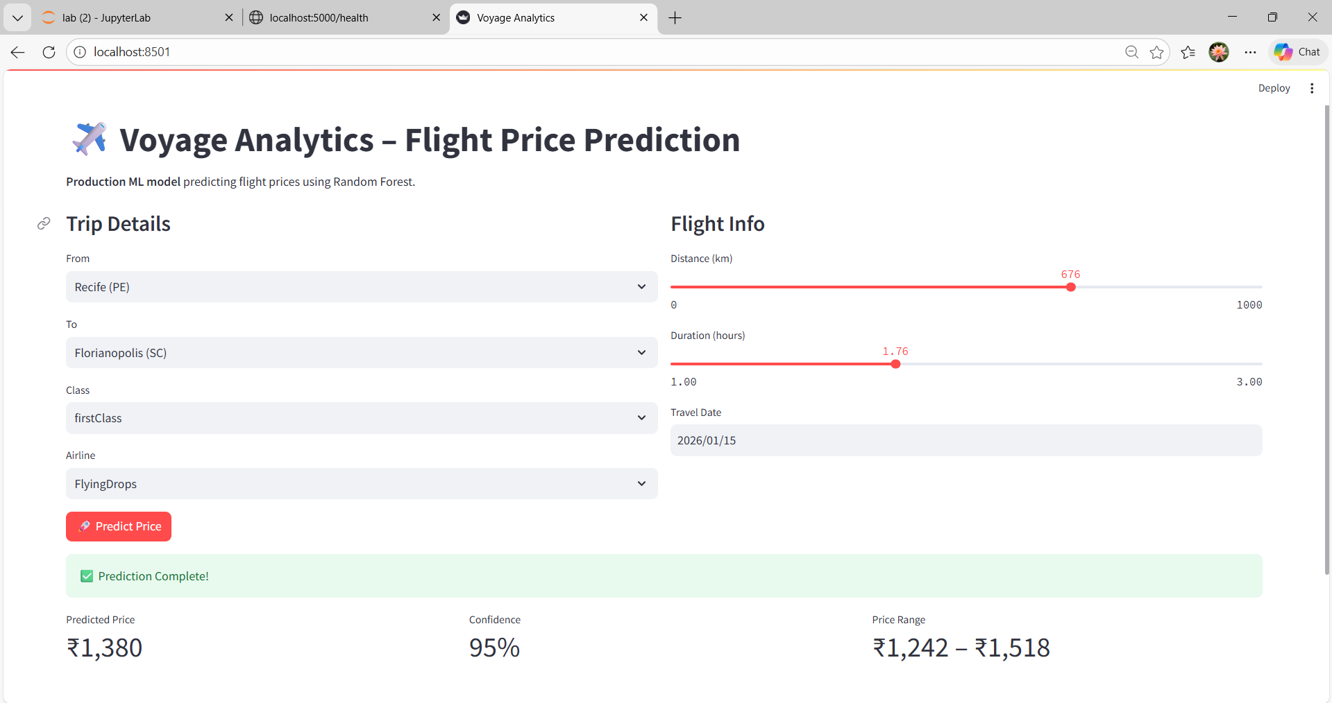
Streamlit Web Application

Slide 13
Future Aspects
- Flight Price Model: Automatic distance and time integration with destination
- Hotel Price Model: Hotel price prediction model using Hotels.csv
- Flights and Hotels data JOIN for a Travel Price Prediction Model per user joining the Users data
- CI/CD pipeline for a production grade application
- Kubernetes and Monitoring

Slide 14

Thank you
LinkedIn: https://www.linkedin.com/in/srushti-suthar/
GitHub: https://github.com/SrushtiSuthar
Email: srusht.suthar@gmail.com

